Slide 1
I-80 Robb Drive to Vista Boulevard
Design-Build Project
NDOT – Rick Bosch, P.E.
Granite – Matt Franz

Slide 2
Project Details
First Design-Build Project in Northern Nevada
I-80 is the Major Interstate Route for Moving Commerce in the West and Across the U.S.
Project Cost was $81,000,000
Design Builder was Granite Construction/Atkins
Notice to Proceed (NTP) was May 16, 2011 with Final Completion & Acceptance on February 14, 2013

Slide 3
Project Concepts
Project Consisted of 11 Different Concepts:
Pavement Reconstruction from Keystone Ave. to 4th Street
ITS Infrastructure (Intelligent Transportation System)
Signing ,Striping, & Landscaping Enhancements
Re-Stripe I-80 Eastbound to I-580 Southbound Ramp
Construct Sparks Blvd. Loop Ramp
Widen Virginia St. Westbound Off Ramp
Striping Realignment E. McCarran Blvd. Eastbound Off Ramp
Storm Drain Improvements at Robb Dr.
Auxiliary Lanes from E. McCarran Blvd. to Vista Blvd.
Reconstruction of Rock Blvd. Eastbound Off Ramp
Widen Robb Dr. Westbound Off Ramp

Slide 4
Project Challenges
Significant Traffic Volumes
Public Outreach & Coordination with Local Entities
Traffic Switches During Construction
Weather Conditions
Narrow Time Restrictions Allowed for Lane Closures & Ramp Closures
Long Term Ramp Closures
Impacts to Traffic and Special Events
-Hot August Nights
-Balloon Races
-Street Vibrations
-Rib Cook Off

Slide 5
Existing Pavement Conditions

Slide 6
Existing Pavement Conditions

Slide 7
Maintenance of Traffic
I-80 Average Daily Traffic is 110,000 vehicles per day
Keep Impacts to Traffic as Minimal as Possible
Several Traffic Control Phases Necessary
Consider Traffic Impacts Prior to Any Changes
Perform Traffic Control Phasing Changes at Night During Low Traffic Volumes
Installed Temporary Ramp Meters at Keystone Avenue, Center Street and Wells Ave. Eastbound

Slide 8
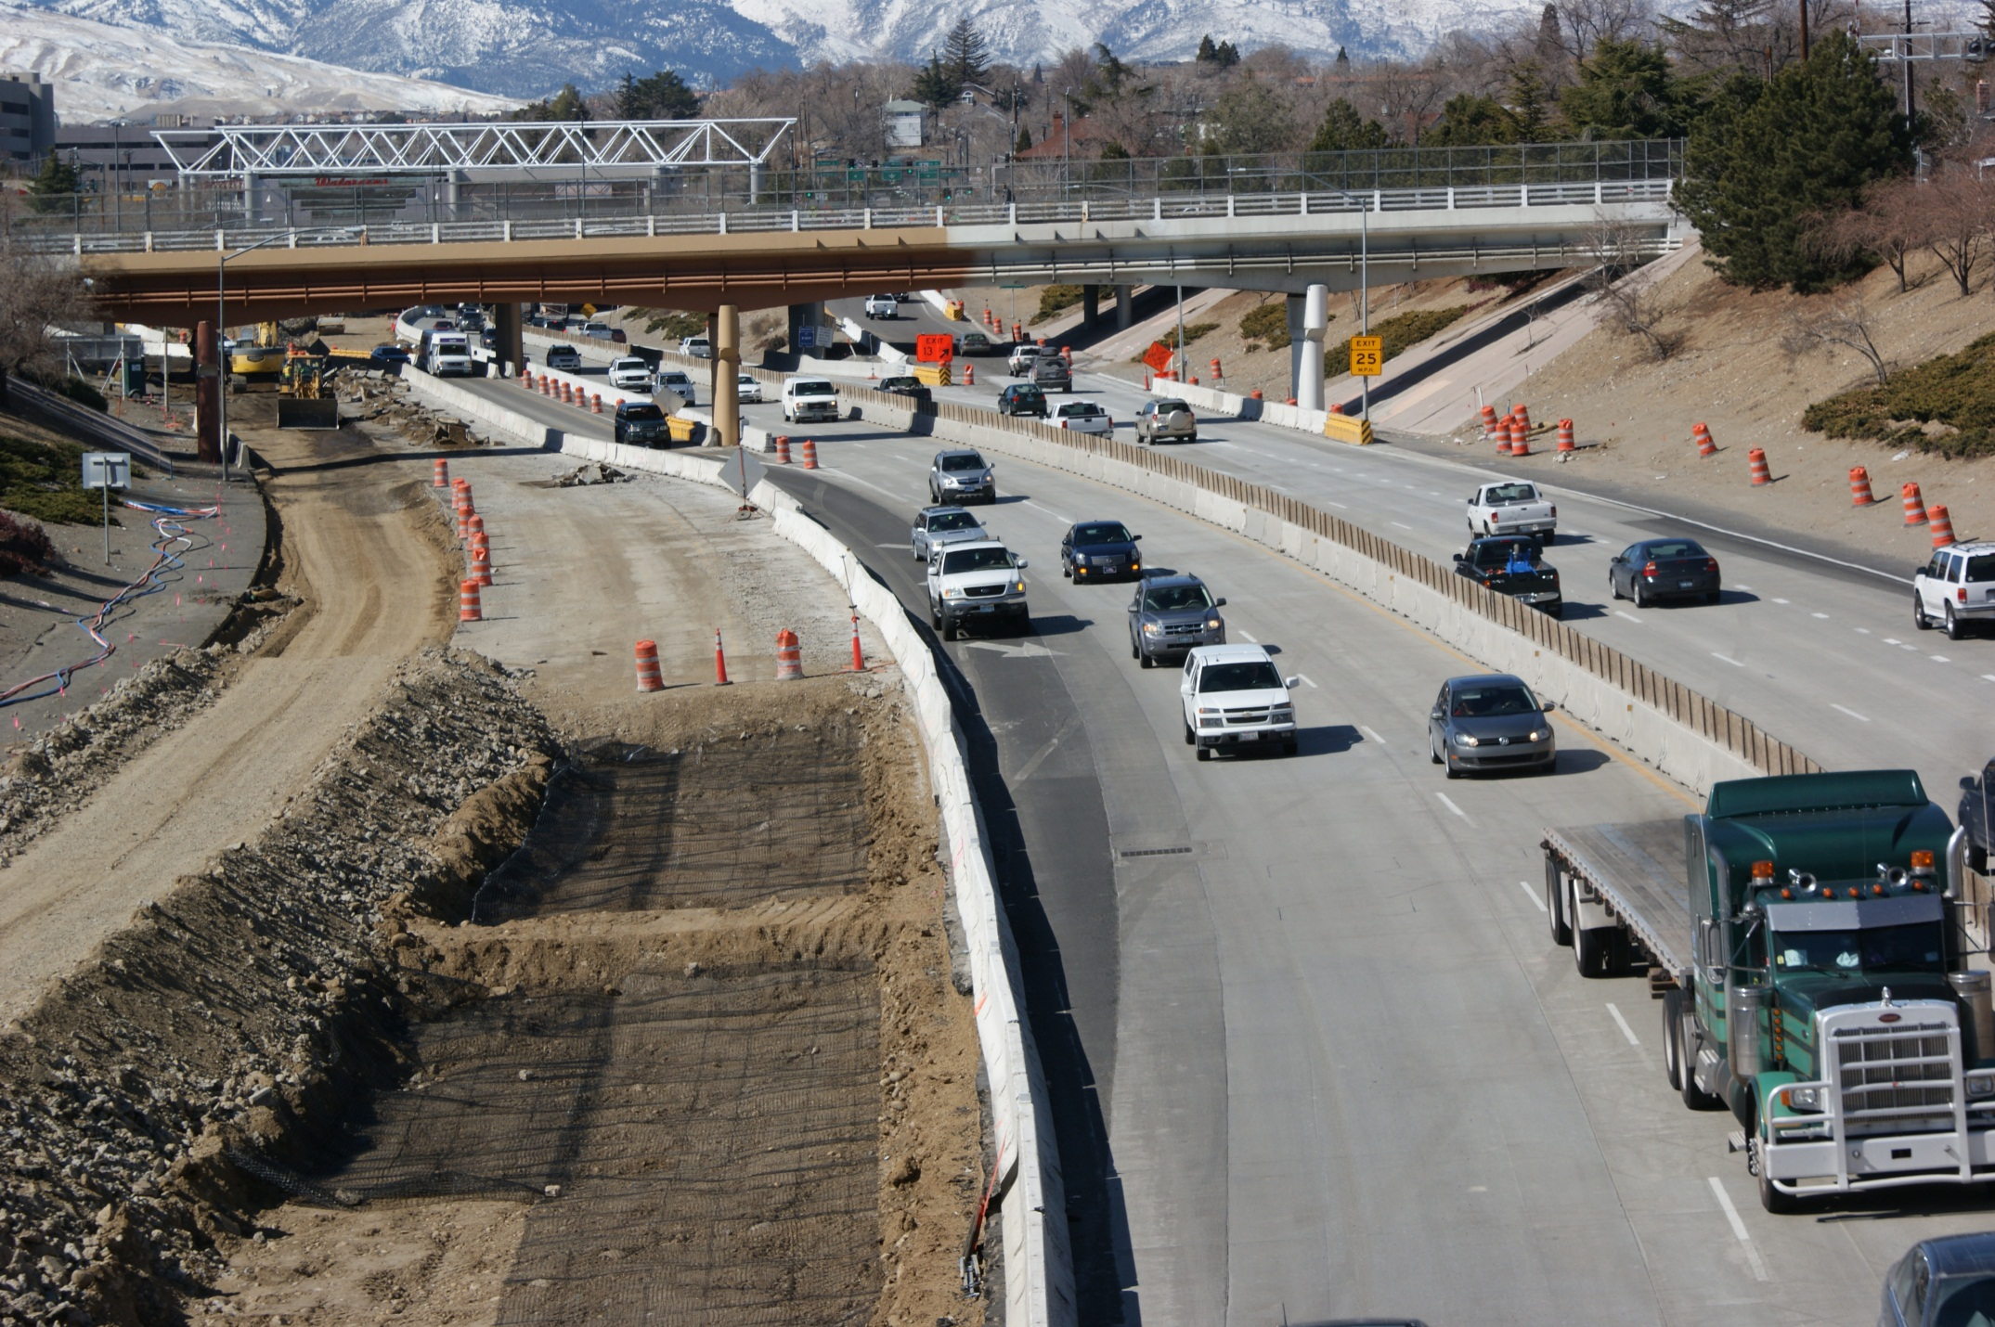
MOT Traffic Challenges

Slide 9
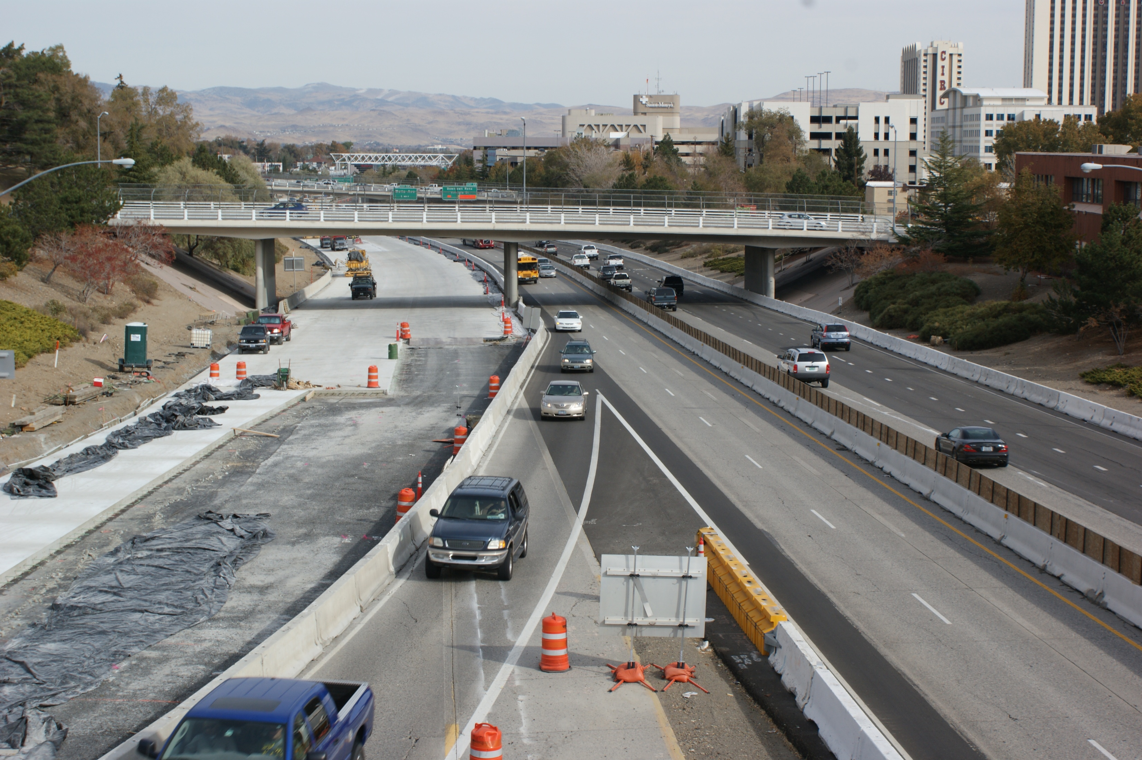
MOT Traffic Challenges

Slide 10
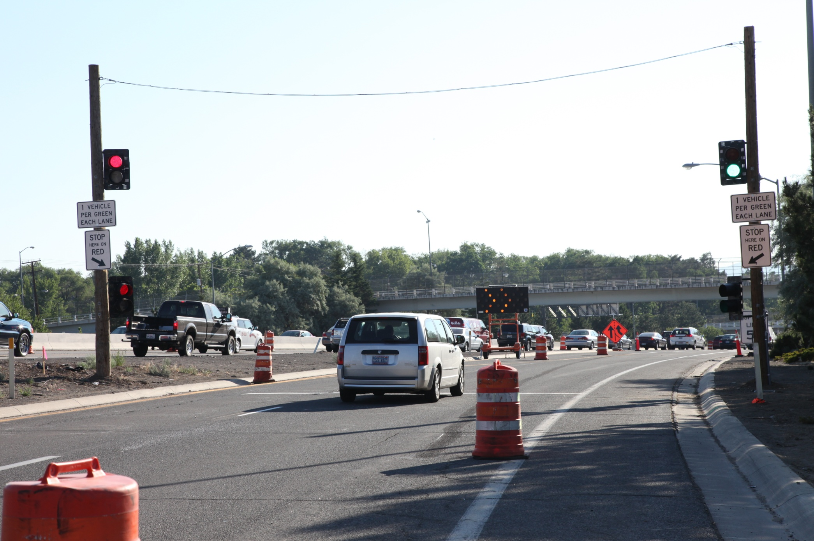
Temporary Ramp Meters

Slide 11
Breaking Existing PCCP

Slide 12
Concrete Removal I-80 WB

Slide 13
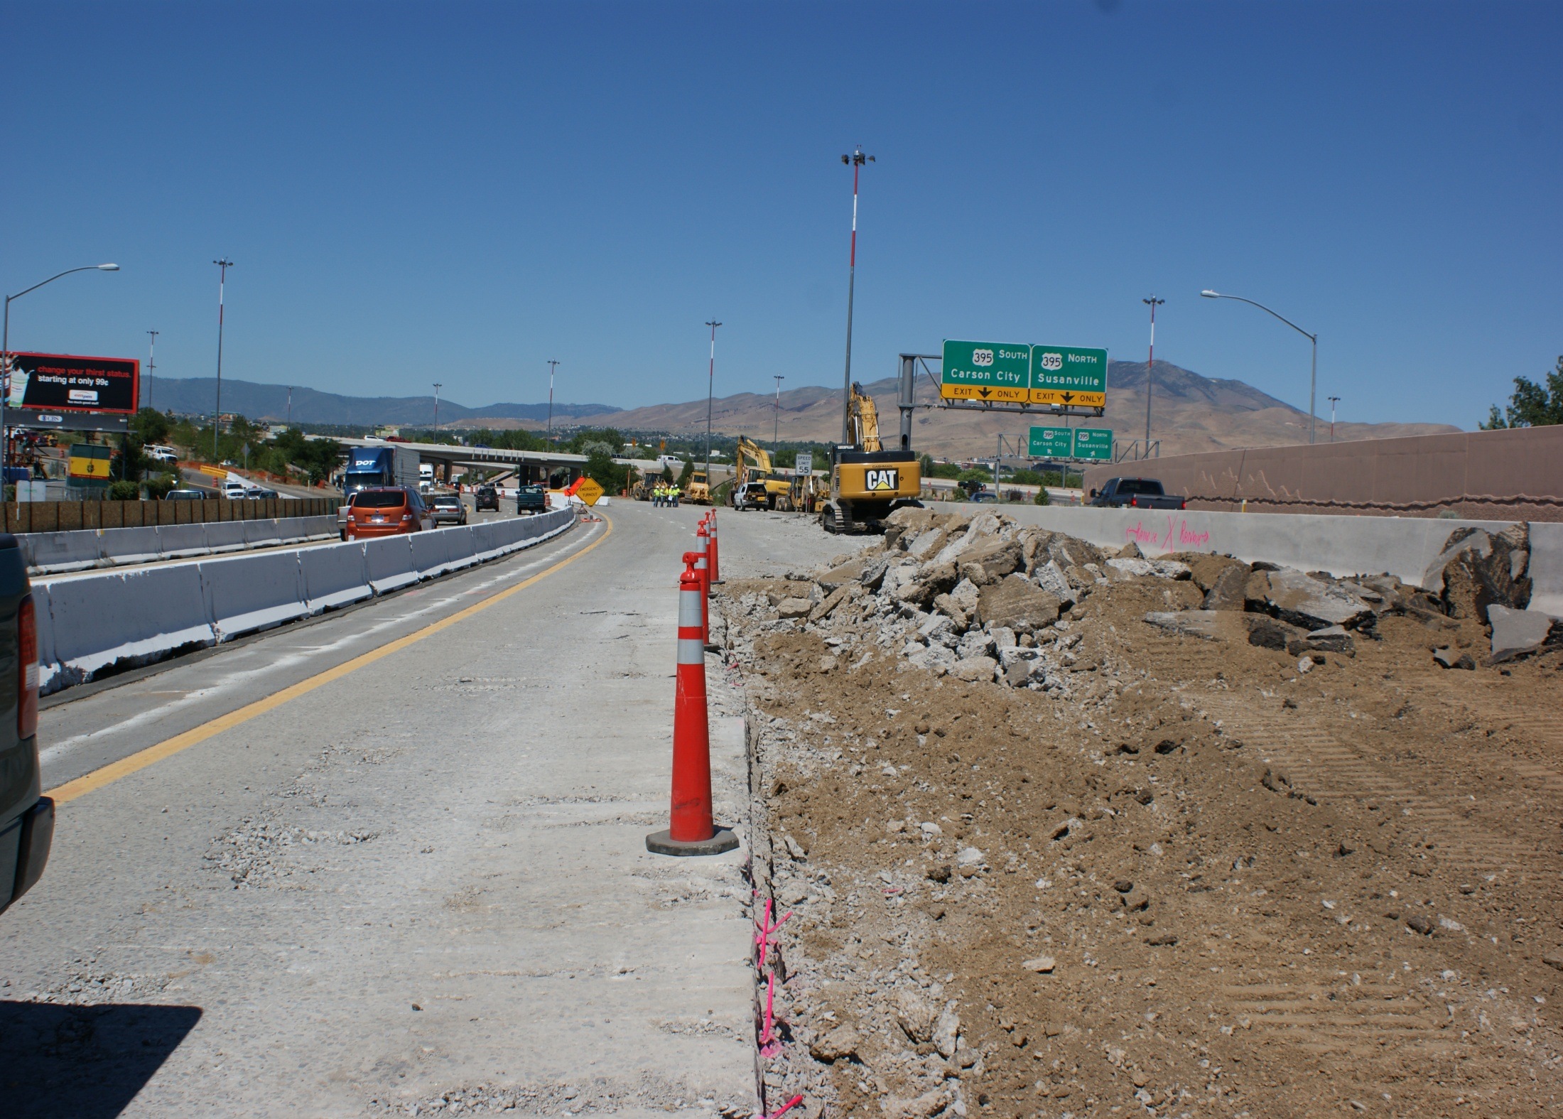
Concrete Removal I-80 WB

Slide 14
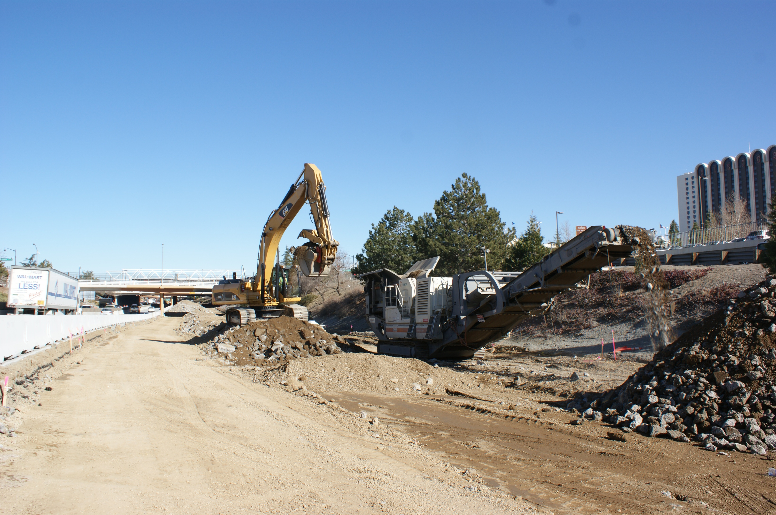
Innovation– Portable Crusher

Slide 15
Subsurface Challenges

Slide 16
Base Preparation

Slide 17
ATPB Placement

Slide 18
WB Virginia Street Off Ramp

Slide 19
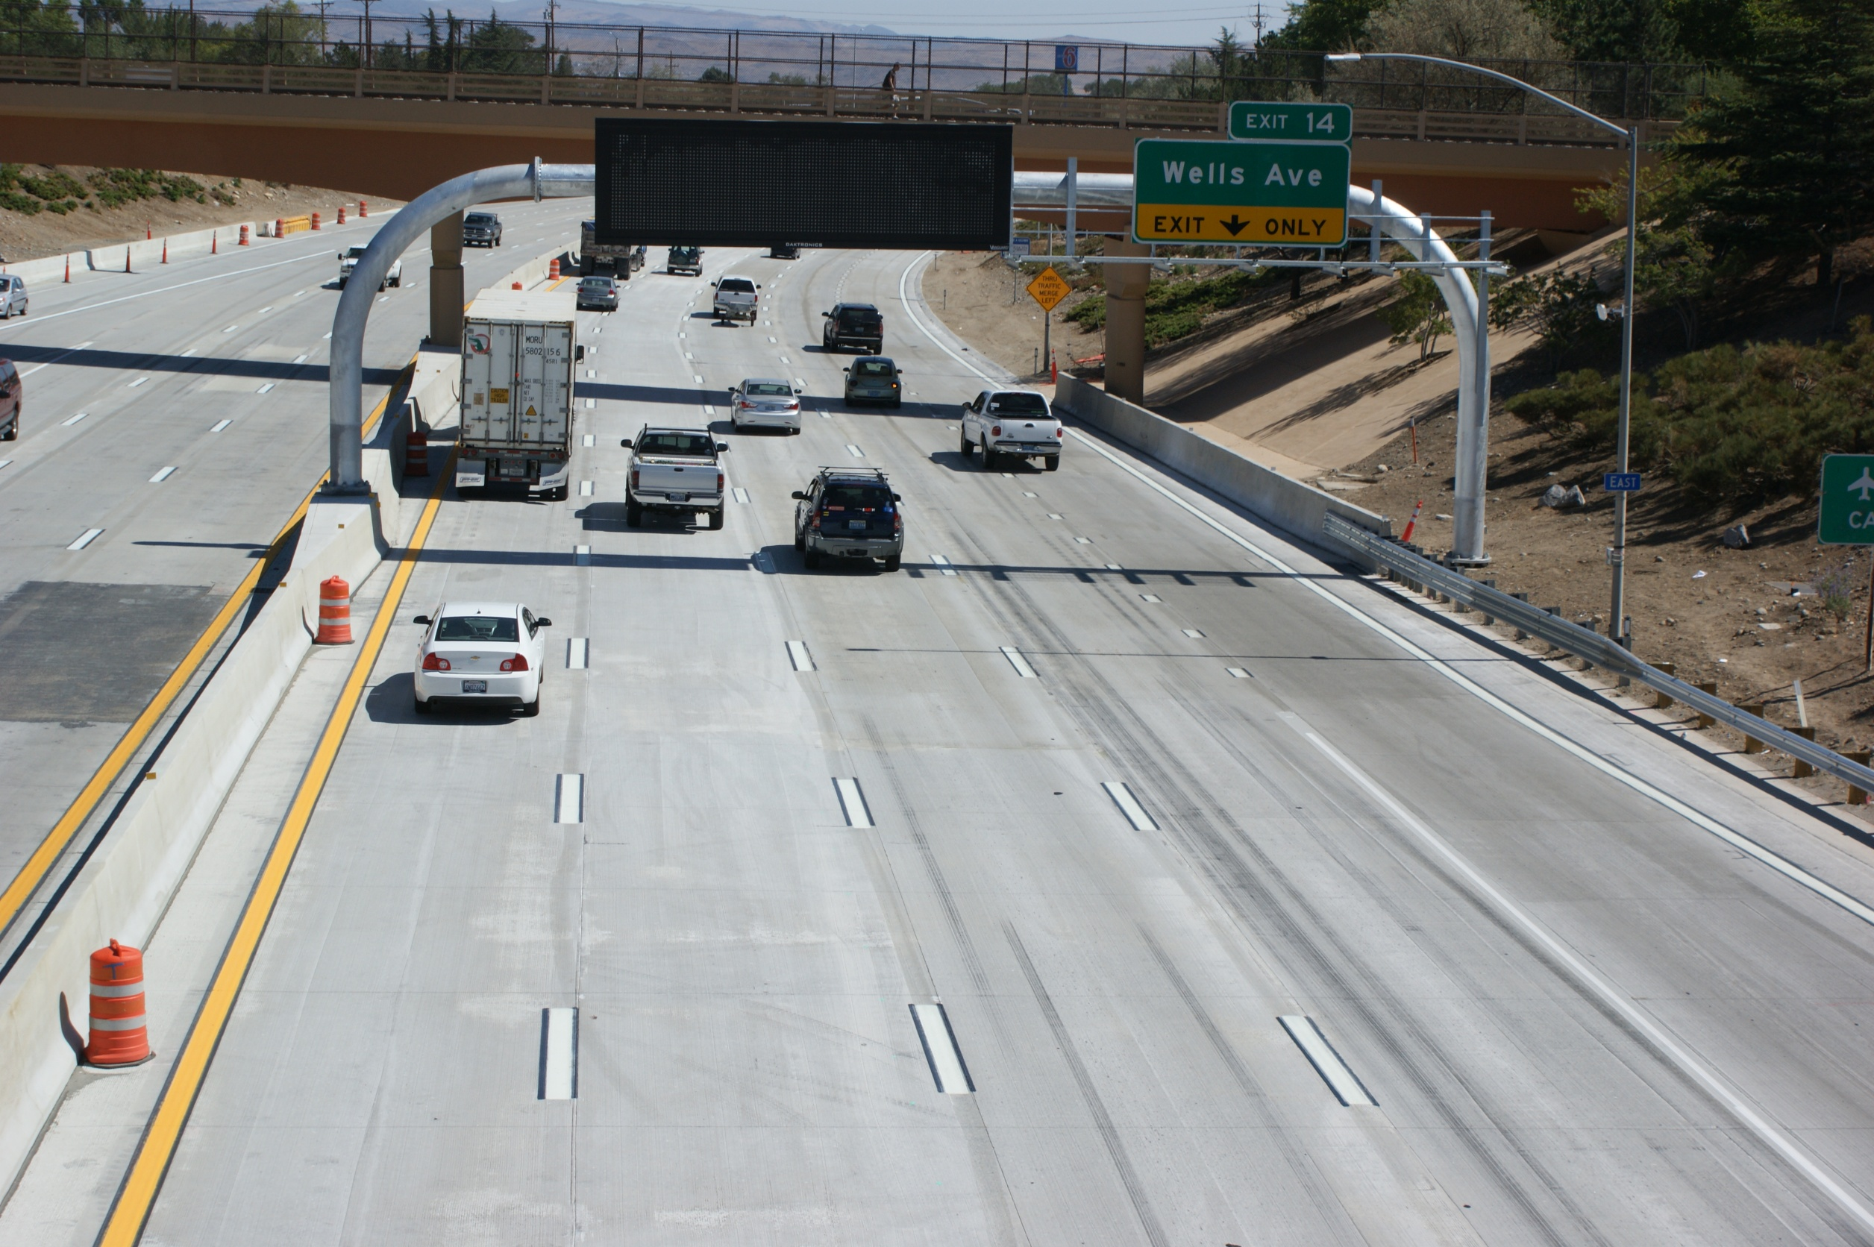
ATC Innovation - Auxiliary Lane

Slide 20
Fabric & Dowel Bar Placement

Slide 21
Night Time Paving

Slide 22
Night Time Paving

Slide 23
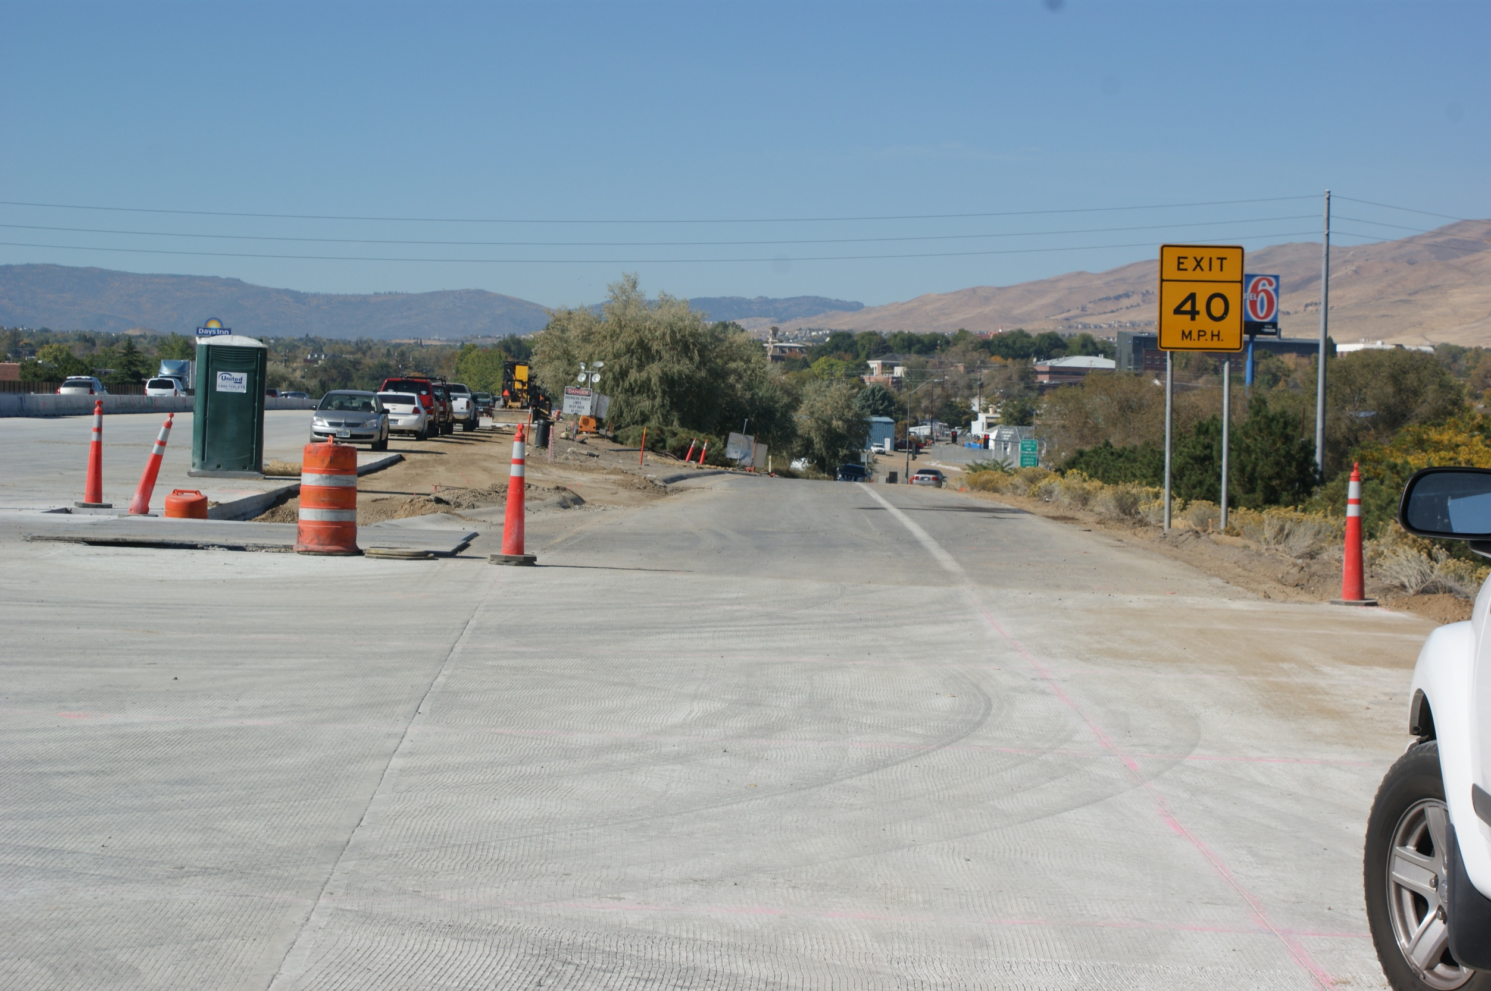
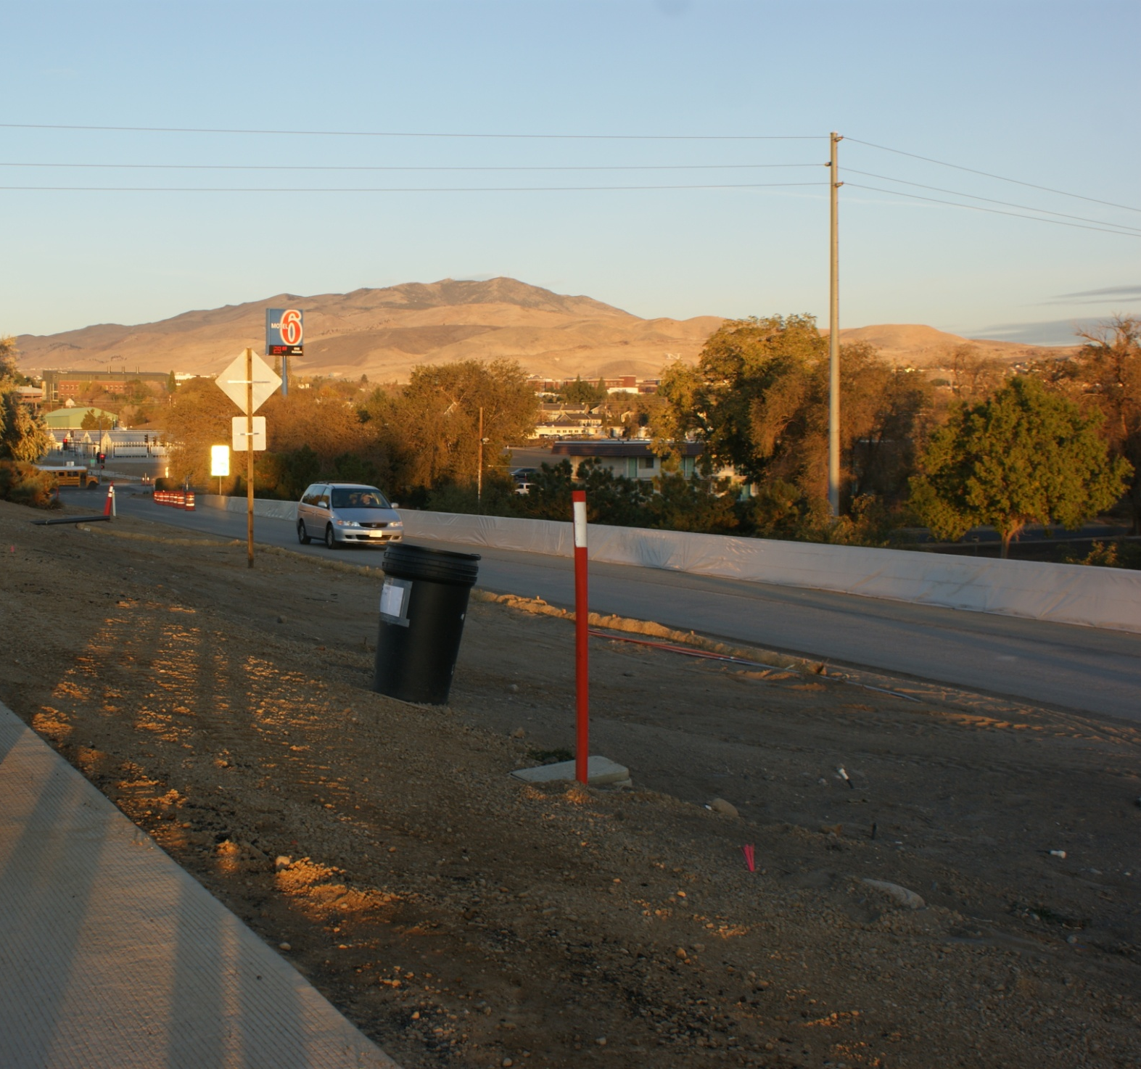
Innovation – Offramp Becomes Onramp

Slide 24
Complete 24’ PCCP Placement

Slide 25
Virginia Street Off Ramp

Slide 26
WB New Pavement

Slide 27
Overview from Ralston

Slide 28
New PCCP at Keystone Ave

Slide 29
Widening E. McCarran to Vista

Slide 30
Median FA Concrete Barrier

Slide 31
New Tubular Sign Structures

Slide 32
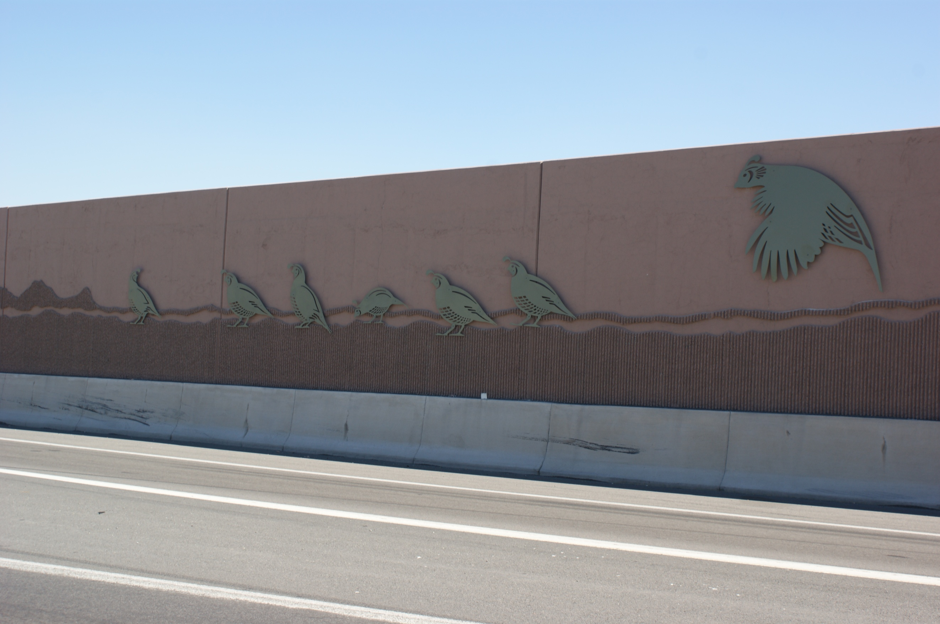
Steel Graphics

Slide 33
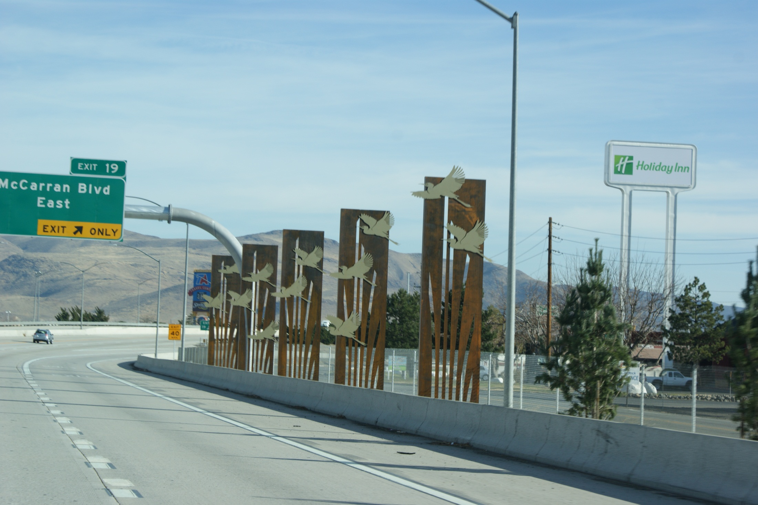
Steel Graphics

Slide 34
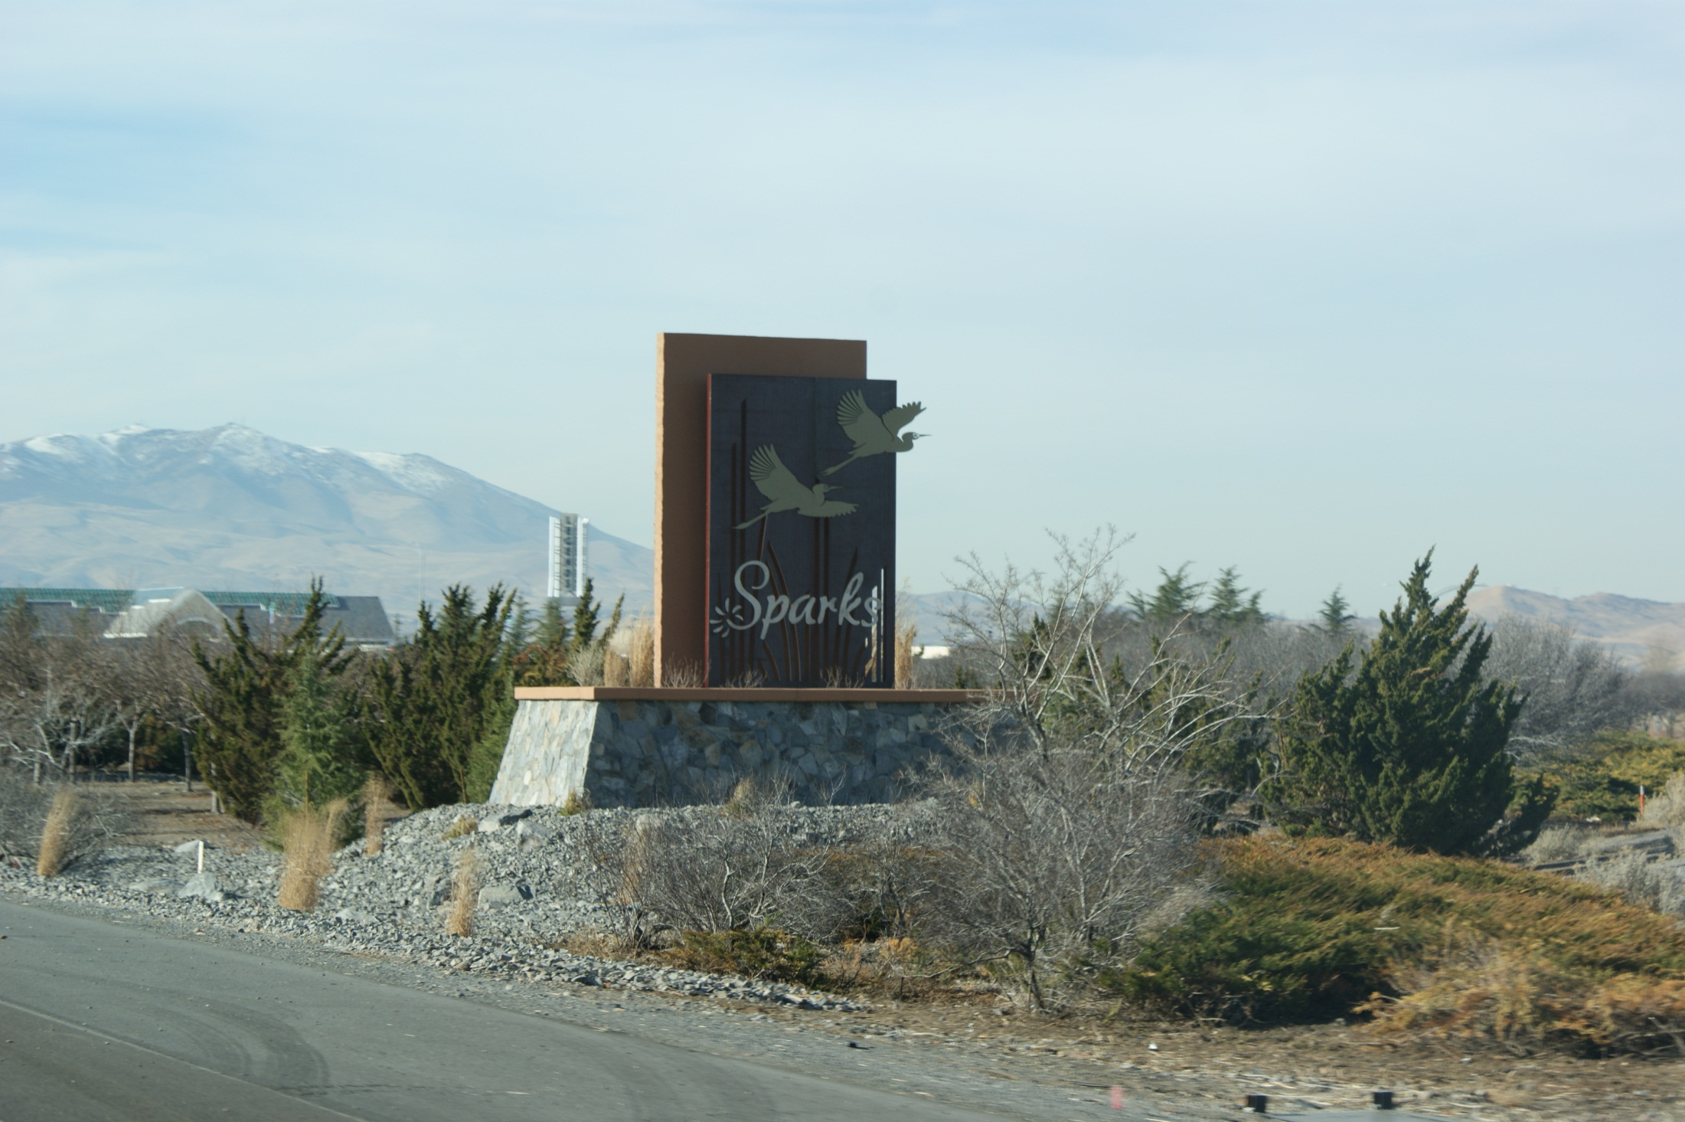
Monuments

Slide 35
Painting/Decorative Fencing

Slide 36
Bridge Painting Before

Slide 37
Bridge Painting After

Slide 38
Before…

Slide 39
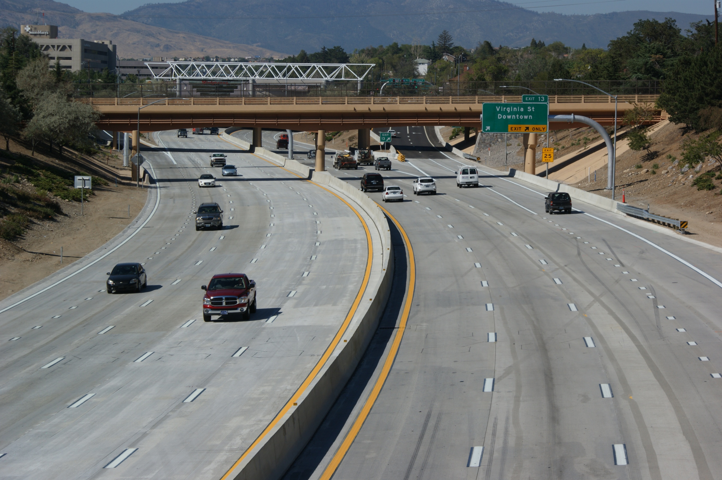
After…
QUESTIONS ?
Questions?

