Slide 1
2013 Nevada Transportation Conference
Paul Schneider
FHWA – Nevada Division
http://www.fhwa.dot.gov/everydaycounts/

Slide 2
Overview of Presentation
What is Every Day Counts?
EDC 1
Nevada Successes
EDC 2
Initiatives
The END!
Part 1:
Part
2:
Part
3:
Part
4:

Slide 3
WHAT IS Every Day counts?
Part
1:
EDC is Designed to Identify and Deploy Proven Innovation Aimed at Shortening Project Delivery, Enhancing the Safety of Our Roadways, and Protecting the Environment.

Slide 4
EDC 1 Nevada Successes
Part
2:
Planning and Environmental Linkages
Programmatic Agreements
Safety Edge
Construction Manager @ Risk (CMAR) Contracting
Design Build Contracting

Slide 5
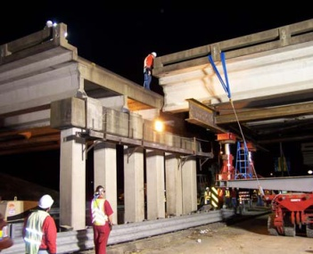
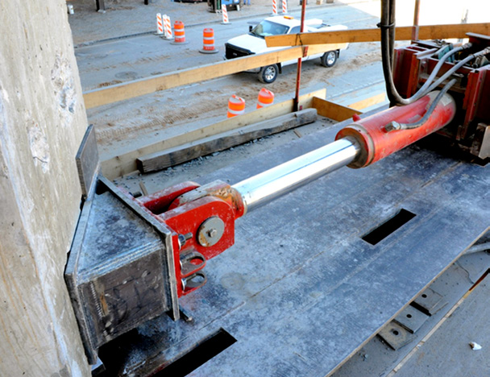
EDC 2 Initiatives
Part
3:
Accelerated Bridge Construction
Slide In Bridge Construction

Slide 6
3D Engineered Models for Construction

Slide 7
Intelligent Compaction

Slide 8
Geospatial Data Collaboration
FWS
EPA
USDOT
SHOP
SHPO
DNR
DOT
DOT
GIS Service Provider
Data, Maps, Reports
Planning
Safety
Design
Ops
Public
Utilities
Asset

Slide 9
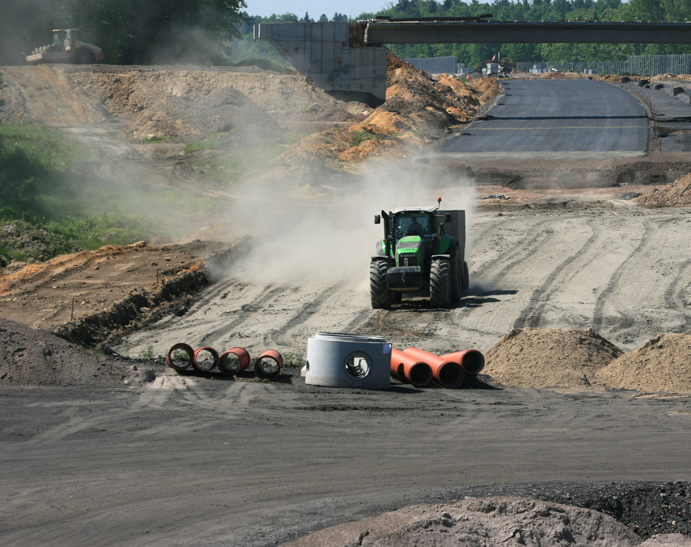
Locally Administered Projects
Certification / Qualifications Programs
Consultant Services Flexibilities

Slide 10
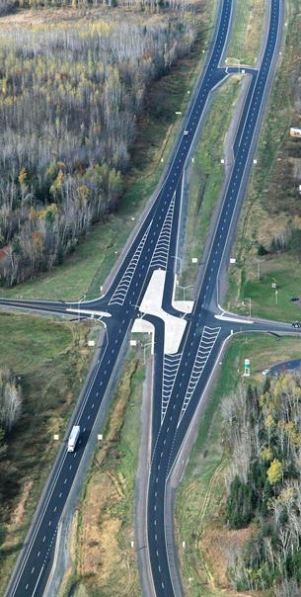
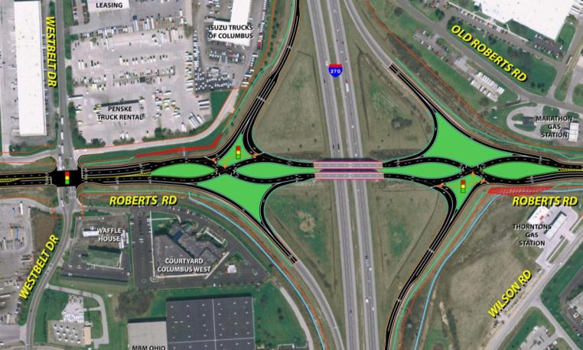
Intersection and Interchange Geometrics
Innovative Designs that Eliminate, Relocate, or Modify Conflict Points
Source: Wisconsin DOT

Slide 11
Alternative Technical Concepts
Innovative Tool Seeking Contractor Ideas
Team A Idea
Team B Idea
Team A Design
Team B Design
Selection

Slide 12
Construction Manager At Risk (CMAR)
Design
Design Consultant
General Contractor
Bid-Build Market
General Contractor

Slide 13
Other Initiatives
High Friction Surface Treatments
Implementing Quality Environmental Documentation
Traffic Incident Management Responder Training

Slide 14
Part
4:
http://www.fhwa.dot.gov/everydaycounts/

