Slide 1
Left Turn Crash Reduction Program: 50 Worst Intersections in CLV Limits
Mike Janssen, P.E., PTOE
City of Las Vegas
Assistant City Traffic Engineer

Slide 2
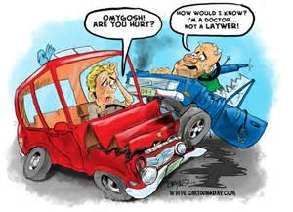
Why focus on left turn crash reductions?
Because left turns are a huge problem when reviewing all of the crashes that occur in LVMPD’s jurisdiction
In 2012 there were just under 4200 crashes involving a left turn maneuver (this represents 19% of all crashes)
About 50% of these left turn crashes resulted in an injury
4 resulted in a fatality
On the flip side, they can be relatively quick and easy to fix
And..they can be very low cost to fix

Slide 3
Our Program Specifics:
We have about 12,500 public street intersections in CLV limits. This program focused on 50 intersections that had the most left turn crashes in a 3 year period (2005-2007)
These intersections represent just 0.4% of all our intersections yet they produced about 15% of all left turn crashes on average for the years 2005-2007
Targeted goal was to achieve a 50% reduction in the total number of left turn crashes at these same intersections between 2009-2011

Slide 5
Common Causes of Left Turn Crashes: 1) Failure to yield at traffic signals
Occurs during permissive left turn phase
Improper judgment of gaps and speeds of oncoming cars in particular on multi-lane roads
Site line limitations

Slide 6
Solution: Changing Left Turn Phases
Adding a left turn phase where none previously existed
Converting Protected-Permissive Phases to FYA
Converting Protected-Permissive to Protected-Only
Very high cost/benefit

Slide 7
Common Causes of Left Turn Crashes: 2) Red Light Running
“Common” red light running often appears at intersections with long cycle lengths: 8 phase 140-180 second cycle length intersections are full of red-light running problems (whereas 2 phase 70 second cycle length intersections have no such problems)
“Situational” red light running often appears at intersections having operational or geometric limitations. Examples include inadequate left turn phase splits; use of “leading lefts” when left turn pockets are blocked by adjacent through lane queues; and inadequate capacity / cycle failures such as having a single left when the demand warrants dual lefts

Slide 8
Solution: Adjust/Improve Signal Timing
As low cost as it gets!
No free lunch – someone else “pays” for split time reallocation
Only so much you can do
Keep an eye on off-peak cycle lengths – if too long they can lead to a lot of red light running

Slide 9
Solution: Increasing Left Turn Storage

Slide 10
Solution: Adding Dual Lefts

Slide 11
Common Causes of Left Turn Crashes: 3) “Good” Samaritan Crash
These occur when a vehicle attempts to make a left turn across an opposing direction of multi-lane traffic that is backed up from a nearby traffic signal
Often a “good samaritan” waves the driver on, only to send them into a collision with traffic in an auxiliary lane
It is not uncommon for us to have Q lengths 600-800 feet in length at signals running 120-160 second cycle lengths and it is usually that first median opening that sees these types of crashes

Slide 12
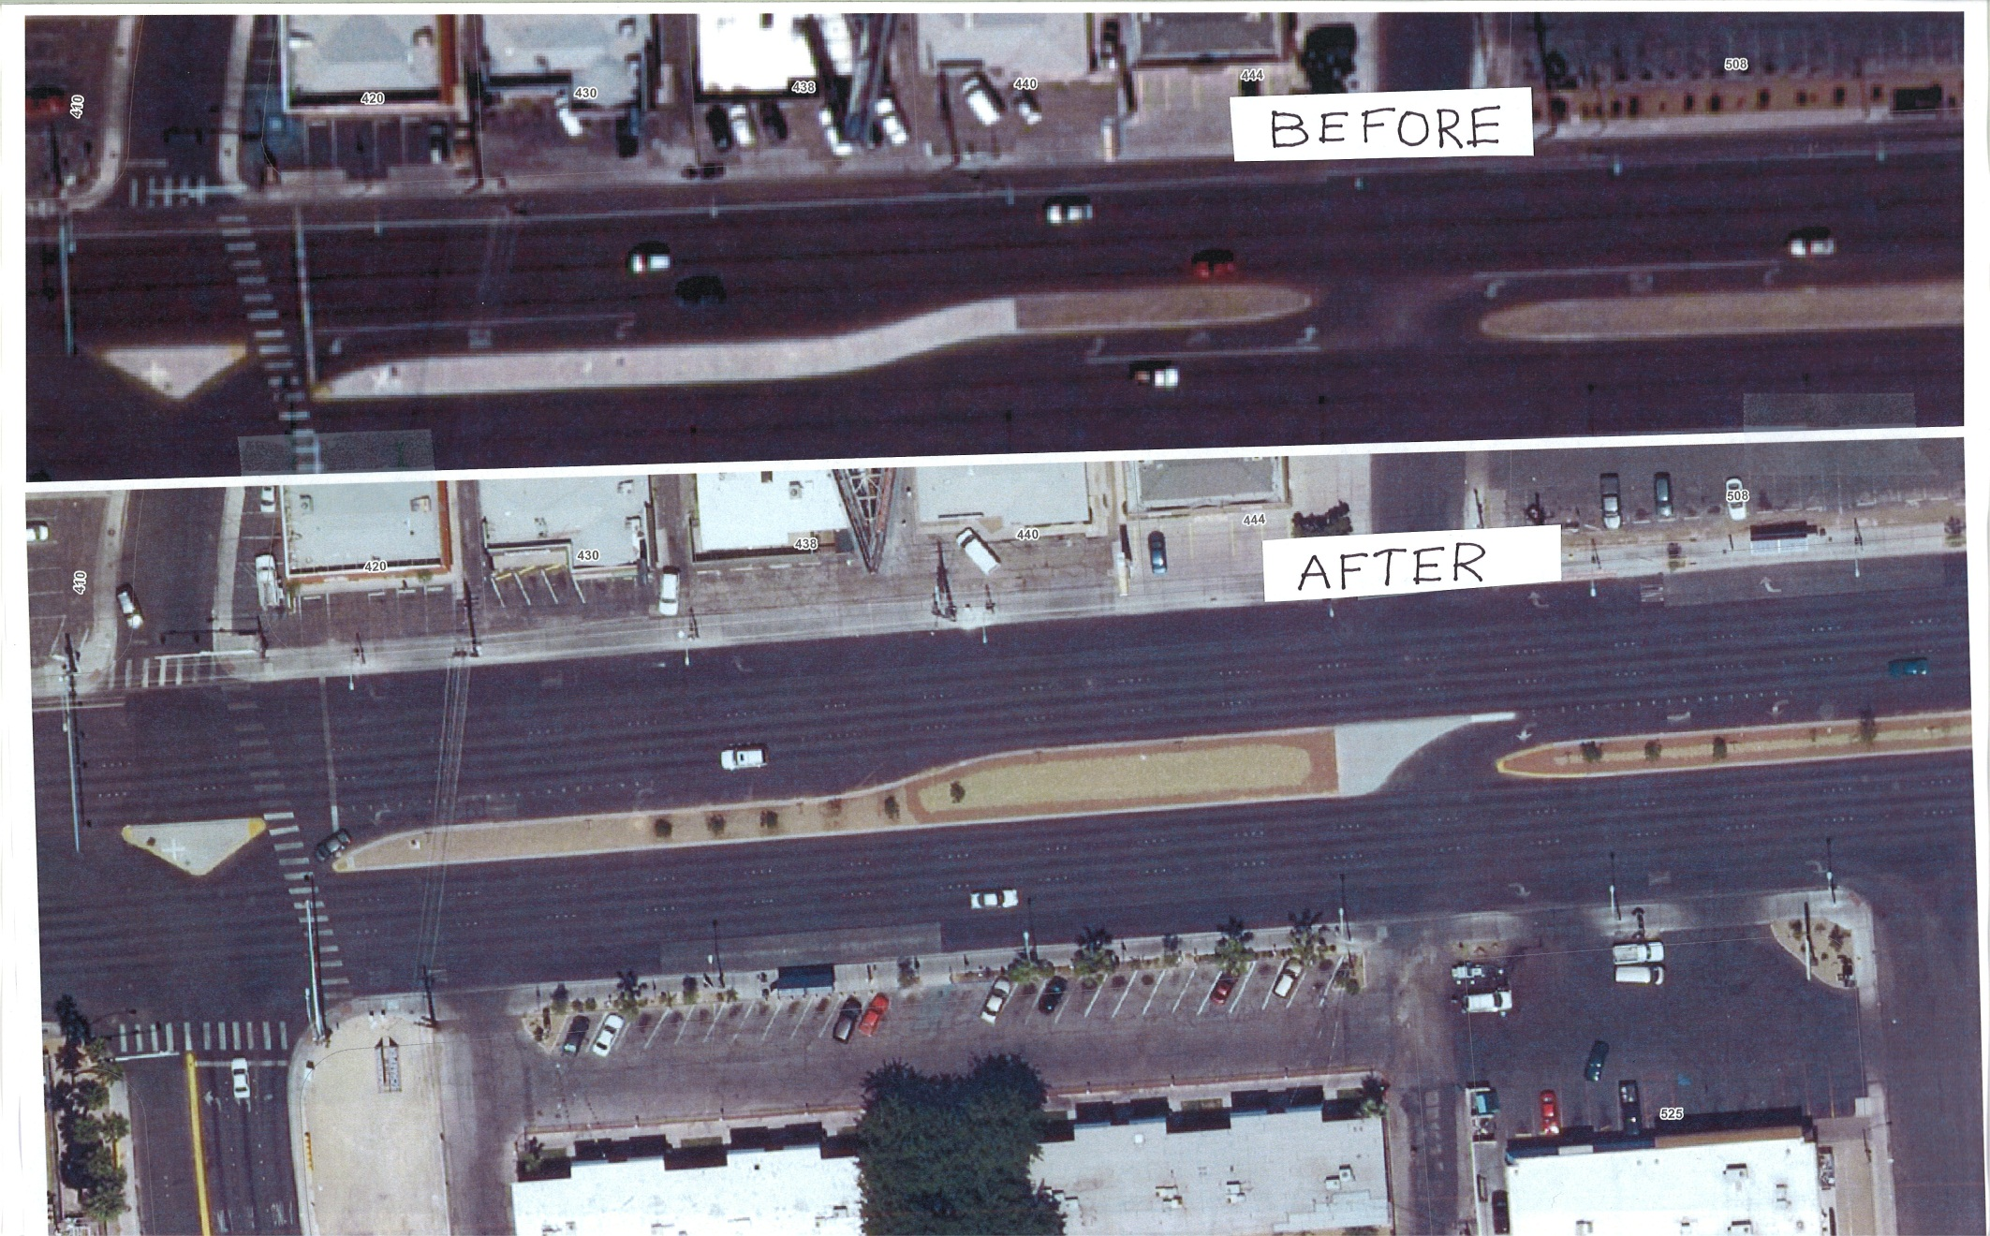
Solution: Relocating Left Turn Past “Q”

Slide 13
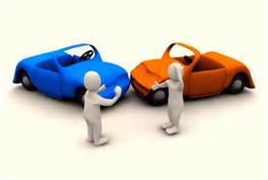
Common Causes of Left Turn Crashes: 4) Side street gap misjudgment
Many 6 lane corridors allow full movements (lefts in/out and thru) for side streets at median breaks “until operational problems develop”
As traffic volumes increase, side streets have more difficulty judging the gaps in opposing traffic most often when attempting to turn left onto the main street and this frequently results in a left turn crash

Slide 14
Solution: Adding “Worm” Median Islands

Slide 15
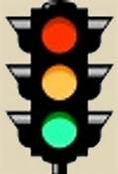
So How Did We Do????
Better than expected!
1794 crashes before (2005-2007)
700 crashes after (2009-2011)
61% reduction in left turn crashes (50% was our goal)
Most of the work done as part of scheduled street rehab projects resulting in very low cost
City staff performed most of the signal mods associated with left turn phase changes
RTC F.A.S.T. – Huge help adjusting signal phasing and timing plans !
Could not have done program without NDOT Safety

Slide 16
What’s Next?
New Programs
New Countermeasures
The work never ends! Focus on a new “top 50” worst intersections for left turn crashes list based on 2010-2012 data
Focus on left turn crashes at commercial driveways (i.e. use midblock crash data to find problem locations)
Currently considering the use of a DDI to retrofit an existing interchange and reduce left turn conflicts (and get rid of a phase!)
Just starting conversion of all P/P left turn phases to FYA (thank you NDOT!)
Convert some intersections to roundabouts ? Maybe…

Slide 17
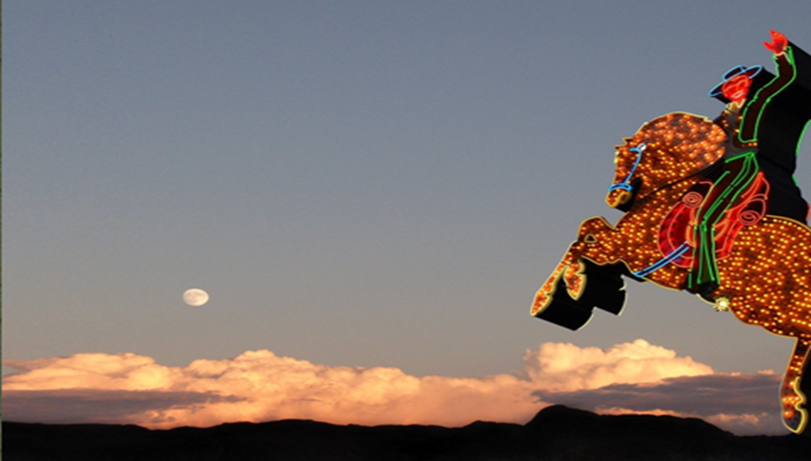
Thank you!

