Slide 1
Nevada Transportation
Conference
04/09/13

Slide 2
Agenda
Traffic Safety Background
Highway Safety Manual Overview
Highway Safety Manual Implementation in Nevada
HSM Tools
Questions

Slide 3
Highway Safety Manual (HSM) Contacts
NDOT Safety
Chuck Reider, NDOT Chief Safety Engineer – *Retired*
Ken Mammen, NDOT Acting Chief Safety Engineer
Jaime Tuddao, NDOT Safety Engineer
Peter Aiyuk, NDOT Safety (IHSDM Contact)
Task Force of NDOT Divisions and MPOs
Consultant Project Manager
Mike Colety, Kimley-Horn and Associates, Inc.

Slide 4
Traffic Safety Background
Far too many people are dying from traffic crashes
Traffic safety is an epidemic
Decade of Action for Road Safety launched by United Nations 5/12/11
Nevada Strategic Highway Safety Plan
Nevada has set a goal of Zero Fatalities
What is a good goal for your family?

Slide 5
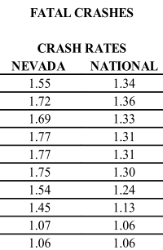
Nevada Crash Data

Slide 6
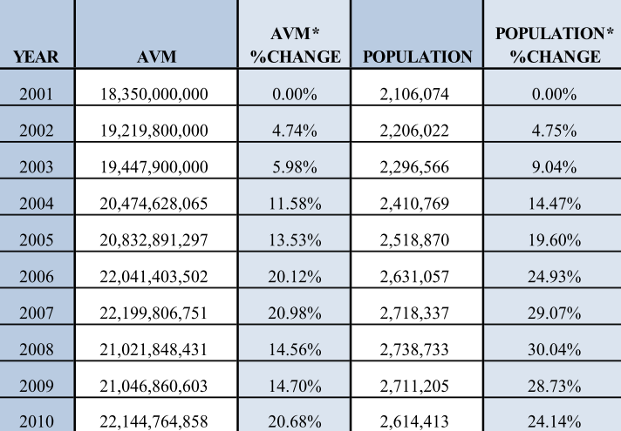
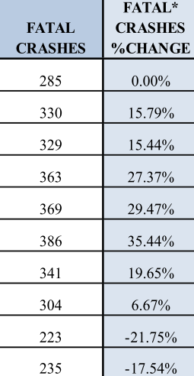
Nevada Crash Data

Slide 7
HSM Big Picture
Proven and science‐based approach
Characterizes the safety effects (i.e., crash frequency and severity) of decisions and actions
Highway Safety Manual V1 released 2010 by AASHTO
Based on Highway Capacity Manual
Not mandated by FHWA
States at various levels of implementation
NV in middle of 2 year plan
Year 1 develop plan, Year 2 implement plan

Slide 8
HSM = Substantive Safety
Nominal Safety
Substantive Safety
Standards Compliance
Expected or Actual
Crash Frequency and Severity
Notes:
Highway engineers are used to thinking of safety in terms of adherence to design criteria such as those published in the AASHTO Green Book. This is referred to as ‘nominal safety’. The performance of a highway as determined by crash frequency and severity, is referred to as ‘substantive’ or quantitative safety. The Highway Safety Manual provides the tools needed for highway designers to quantitatively asses safety.
(click)

Slide 9
HSM Primary Benefits
Better safety analysis tools to support decision making
Cost-effective investments in safety
More lives saved and serious injuries avoided

Slide 10
Where Does HSM Fit in Project Cycle
All transportation projects, although limitations on data
Applies to:
Planning
Pre-design and Scoping
Design
Construction
Operations

Slide 11
Applying the HSM in Planning
Incorporate HSM into Long-Range Plans
Access Management Policy
Roundabout First Policy
Incorporate HSM into Corridor Planning
Frequency of intersections
Frequency of driveways
Parking
Median types

Slide 12
Applying the HSM in Pre-design and Scoping
Project scoping
Safety of project design alternatives
Component of project prioritization
Environmental Analysis
Evaluate alternatives

Slide 13
Applying the HSM in Design & Construction
Design Alternatives
Geometric parameters such as lane or shoulder width, rumble strips
Design exceptions
Design criteria
Time duration of work zones

Slide 14
Applying the HSM in Operations
Performance measures
Safety performance evaluation
Operations
Before/after studies
Operational strategies such as signal timing, signal phasing, or roundabouts versus signals

Slide 15
PRELIMINARY Project Safety Process (PSP)
Quantified estimate of the safety impacts
Training required prior to analysis
Based on HSM to extent practicable
Analysis includes:
Annual reduction in crashes
Crash reduction factor
Benefit cost ration for safety improvements

Slide 16
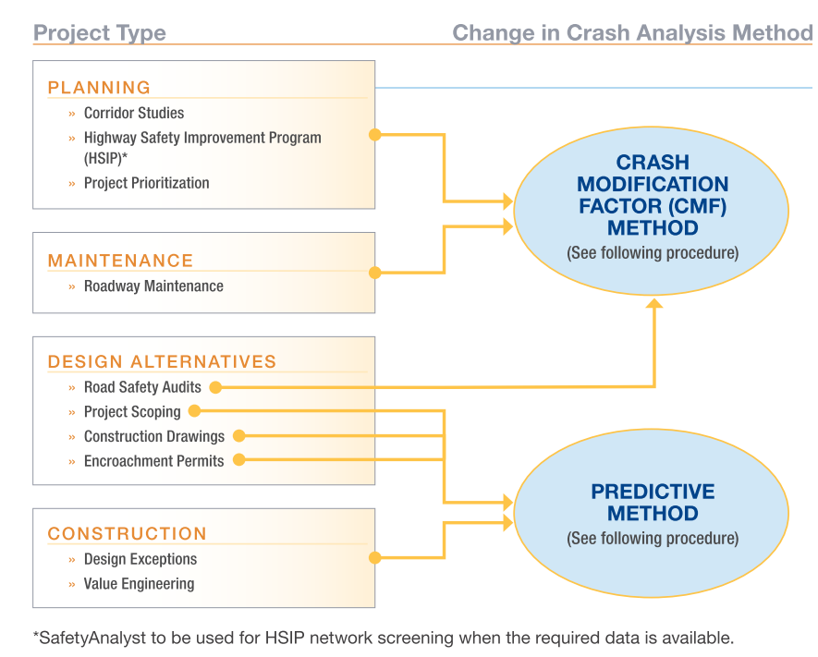
PRELIMINARY Project Safety Process (PSP)

Slide 17
Crash Modification Factor (CMF) Method

Slide 18
Crash Modification Factor (CMF) Method
CMFs from HSM Part D or FHWA CMF Clearinghouse (4 stars or above)
CMF selected must match project
Situational – area type, time of day
Geometrics – number of lanes, driveway density
Operational – ADT, crash history
Applying multiple CMFs must be used cautiously

Slide 19
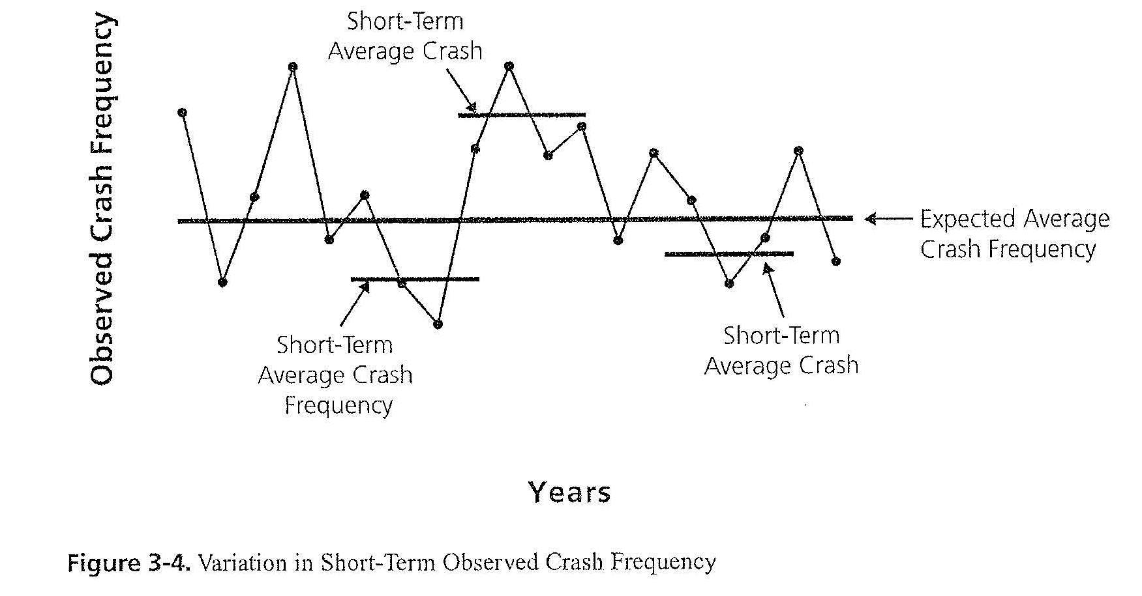
Why Not Use Just Historical Crash Data?
Variation in short term crash data

Slide 20
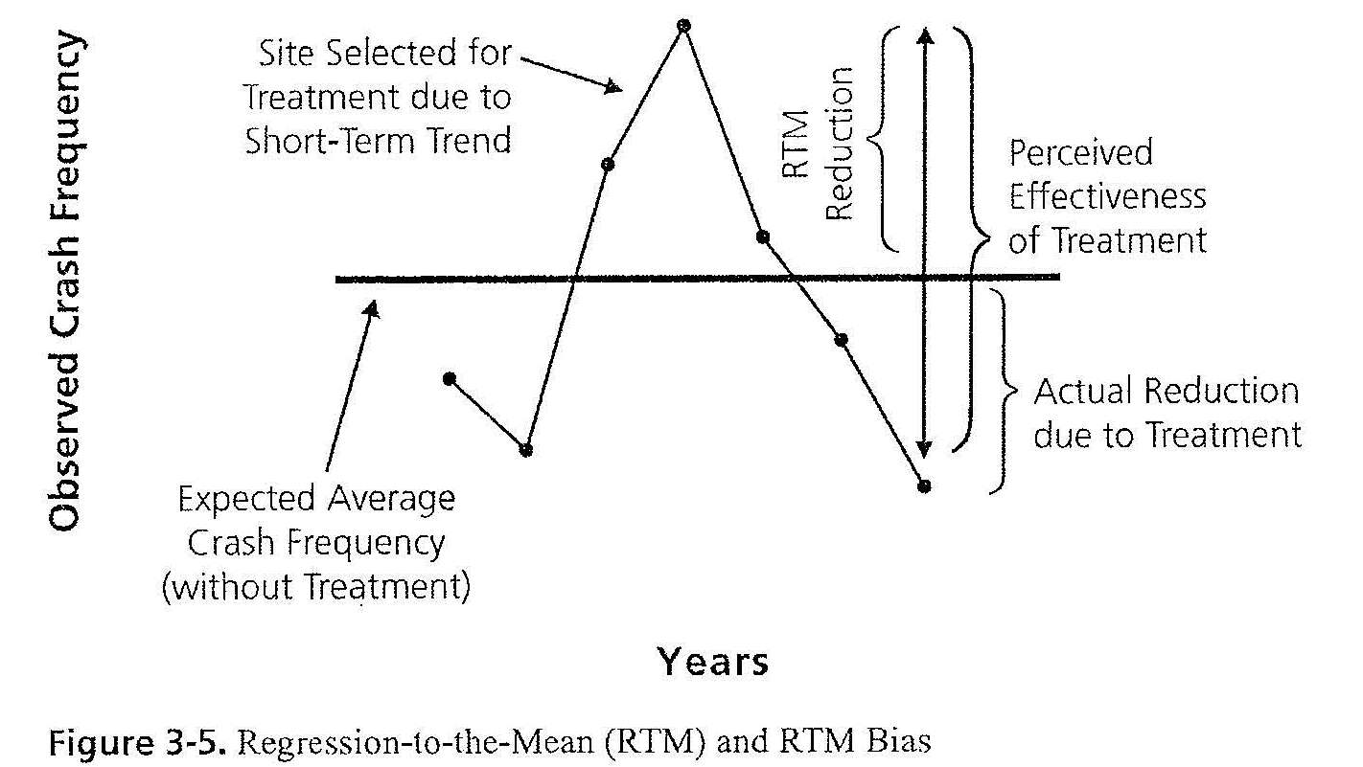
Why Not Use Just Historical Crash Data?
Regression-to-the-mean

Slide 21
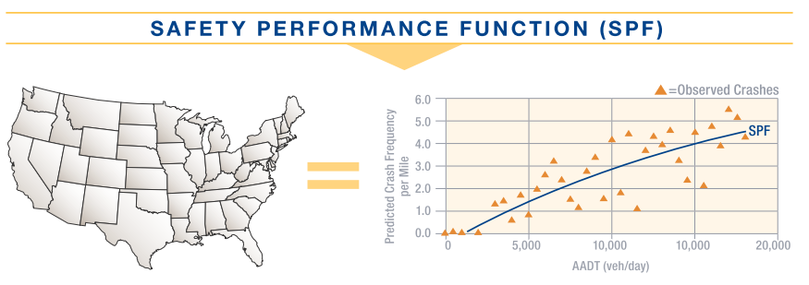
Predictive Method

Slide 22
Predictive Method

Slide 23
Predictive Method

Slide 24
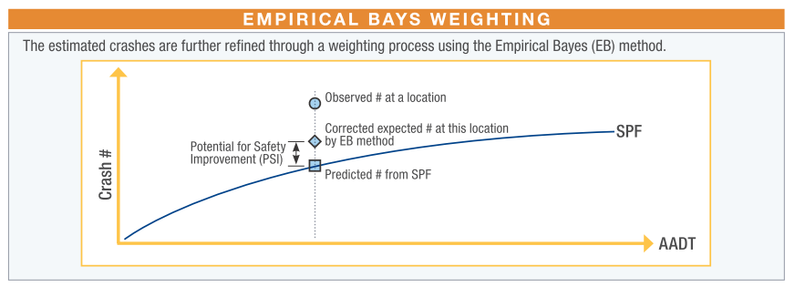
Predictive Method

Slide 25
Predictive Method

Slide 26
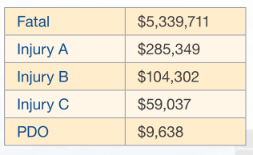
Benefit-Cost Ratio

Slide 27
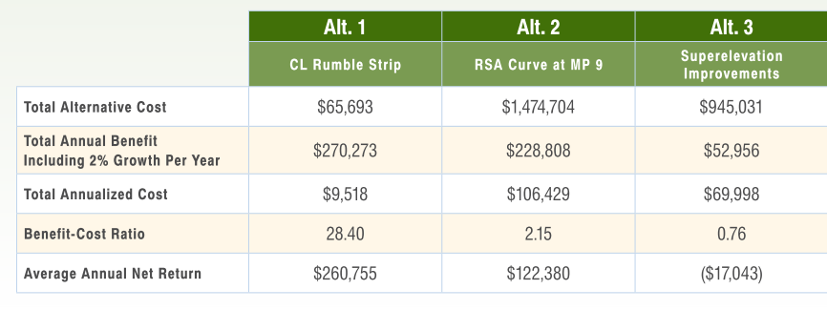
Benefit-Cost Ratio

Slide 28
HSM Tools
NCHRP 1738 Spreadsheets
Publicly available spreadsheets for Part C
HiSafe
Private software for Part C

Slide 29
Nevada Implementation Schedule
State and regional staff participating on task force to guide implementation
Training for task force this month
Application of HSM to pilot projects to follow
Additional training open to all anticipated this fall

Slide 30
Highway Safety Manual (HSM) Contacts
NDOT Safety
Chuck Reider, NDOT Chief Safety Engineer – *Retired*
Ken Mammen, NDOT Acting Chief Safety Engineer
Jaime Tuddao, NDOT Safety Engineer
Consultant Project Manager
Mike Colety, Kimley-Horn and Associates, Inc.

