Slide 1
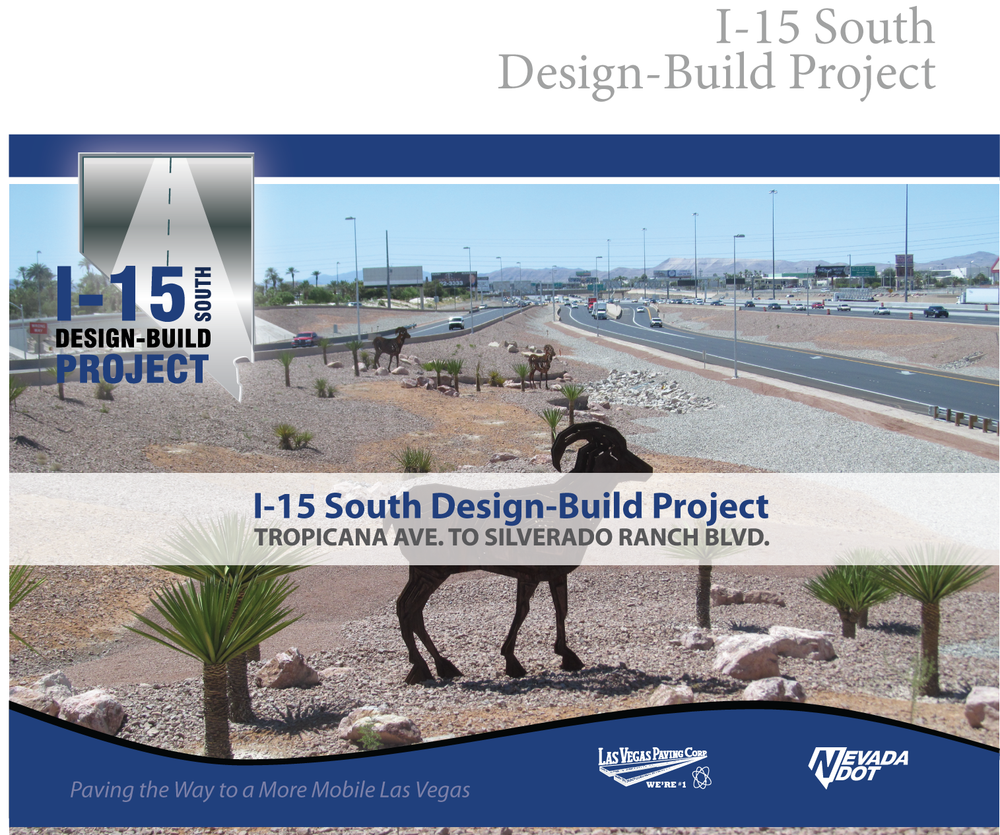
Transportation Conference
Jason Voigt, P.E., NDOT Resident Engineer
Corey Newcome, P.E., Las Vegas Paving Project Manager

Slide 2
Benefits of Using Design Build
Design and construction are completed by a single contractor
Minimize project risk and reduces overall completion schedule by overlapping the design and construction phases of a project
Faster delivery due to overlap of NEPA and procurement
Notes:
Jason

Slide 3
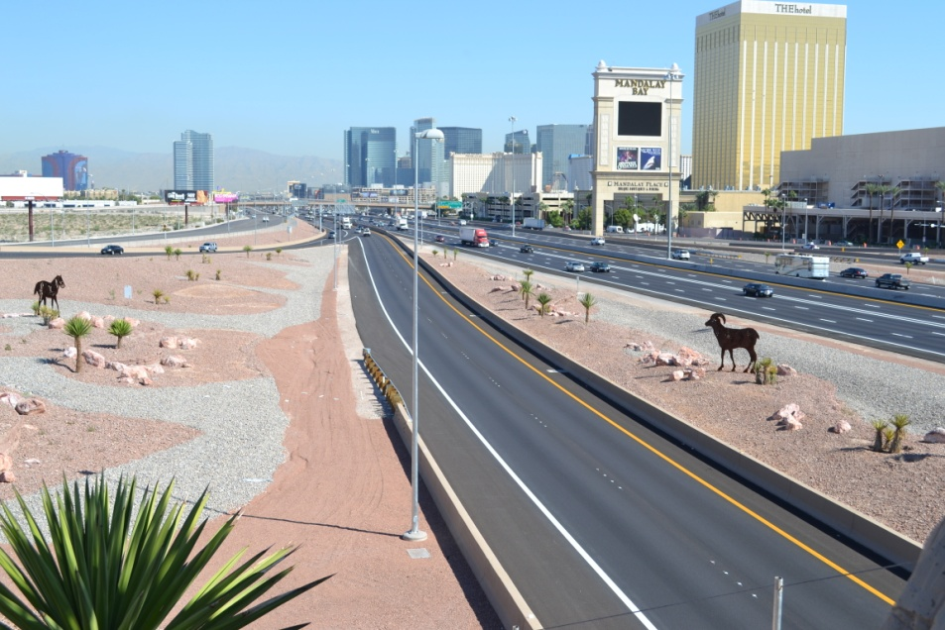
Project Features
Widening I-15
Addition of Collector Distributor Roads (Access Roads)
Improve Ramps at Interchanges
  Tropicana Avenue
  Russell Road
  I-215/CC-215
  Blue Diamond Road(SR 160)
  Silverado Ranch
Notes:
Jason

Slide 4
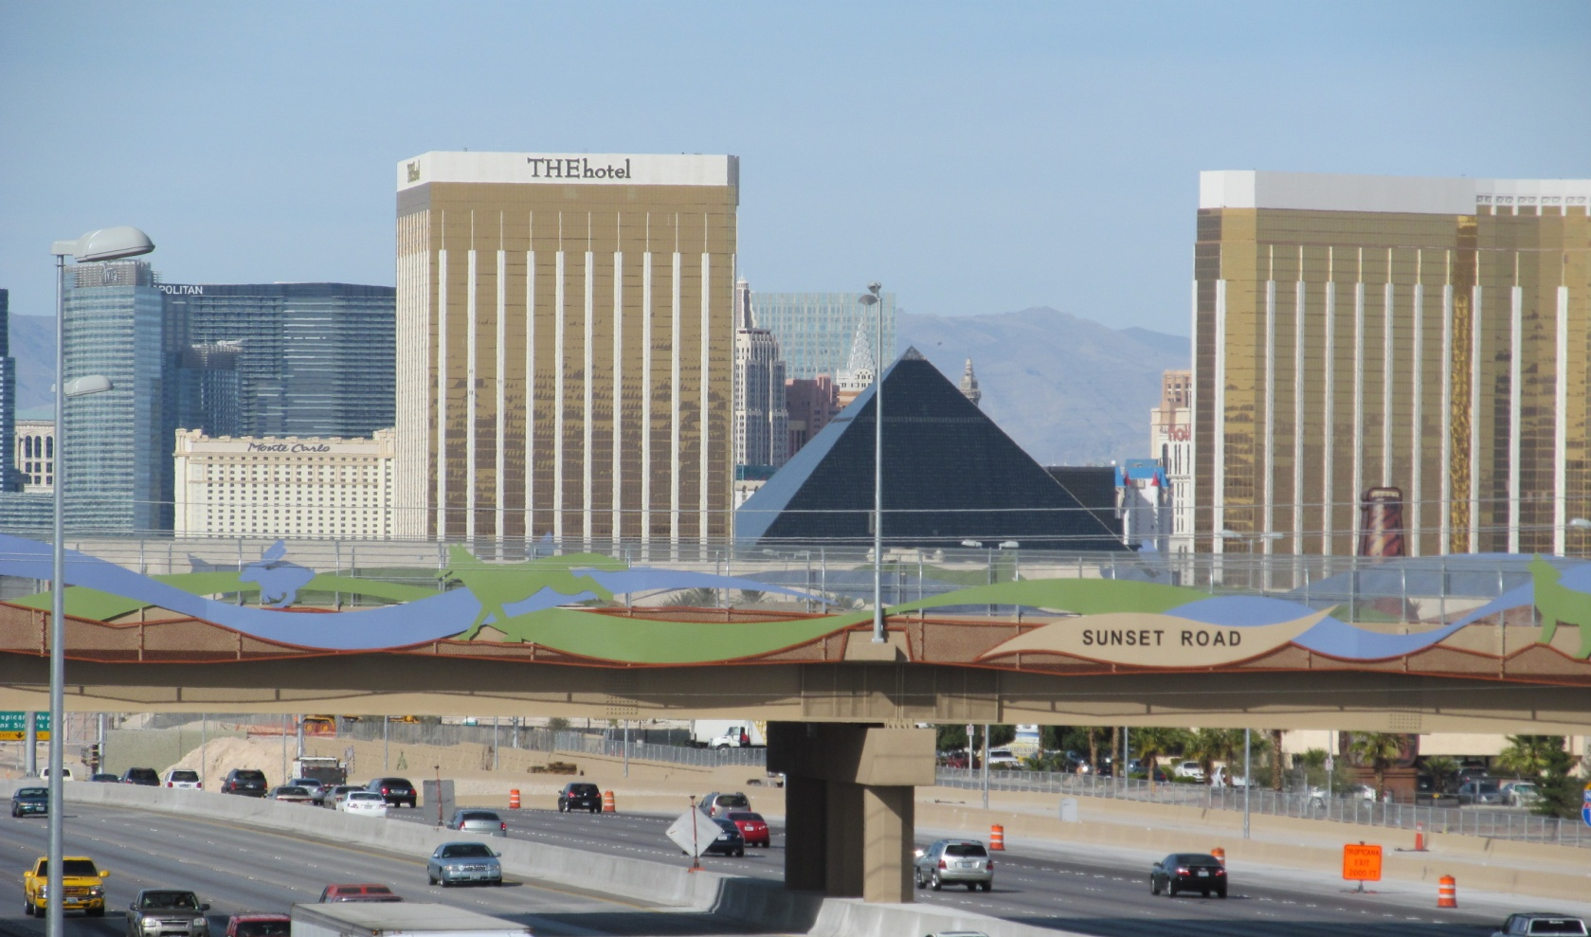
Project Features
26 Bridge Structures Including New Bridges Over I-15 at Warm Springs Road and Sunset Road
35 Retaining Walls
1.5 Miles of Sound Walls
Landscaping and Aesthetics
Intelligent Transportation System
  Ramp Meters
  Variable Message Signs
  Cameras
  Speed Radar Detectors
Notes:
Corey

Slide 5
Project Limits
Silverado Ranch Blvd.
CC-215
Russell Rd.
Blue Diamond Rd.
SR-160
Tropicana Ave.
I-215
Notes:
Project Limits - Jason

Slide 6
Project Goals
Early completion for a safe better-operating highway
Minimization of impacts to the traveling and adjacent public during construction
A high-quality, durable, maintainable, aesthetic, and safe project
Maximize forward compatibility for the ultimate configuration on I-15 and I-215
Construction of base scope of work
Notes:
Jason

Slide 7
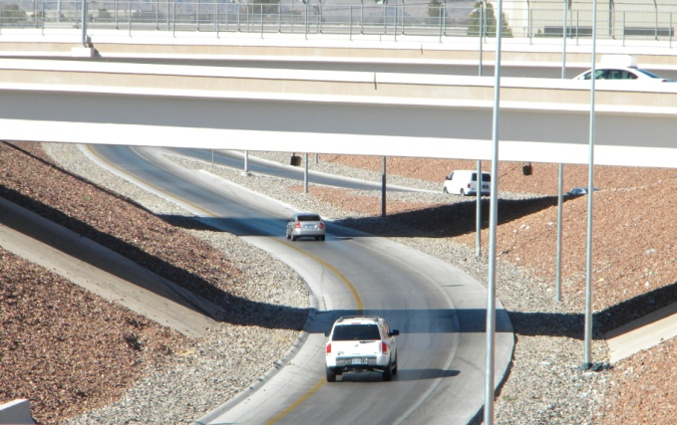
Project Goals
Construction of as much of the additive scope of work or other additional scope of work as possible within the fixed price range
Operation of level of service D, or better, for all elements of the system in design year 2020, within the project limits
Notes:
Jason

Slide 8
Complexity of Funding
Funding Sources
DESCRIPTION | FUNDING
Las Vegas Convention and Visitors Authority | $259M
Clark County | $23M
NDOT State Funds | $12M
TOTAL | $294M
Notes:
Jason

Slide 9
Complexity of Funding
Budget
DESCRIPTION | BUDGET
Contract Payments | $267M
NDOT Contract Administration | $22M
Right of Way | $5M
TOTAL | $294M
Notes:
Jason

Slide 10
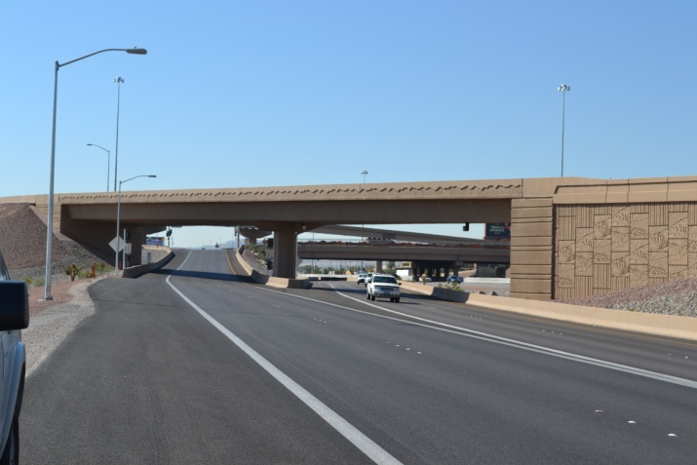
Service to the Public
Alleviates congestion
  250,000 vpd on I-15
  180,000 vpd on I-215
  LOS D for I-15 to 2020
Reduces accidents
  I-15 SB from Russell Road to I-215/CC-215 is one of the highest accident location in state
  Other weaving movements on I-15 eliminated which were causing accidents
Improves access to Las Vegas Strip and McCarran International Airport
  New grade separations at Sunset Road and Warm Springs Road
Notes:
Jason

Slide 11
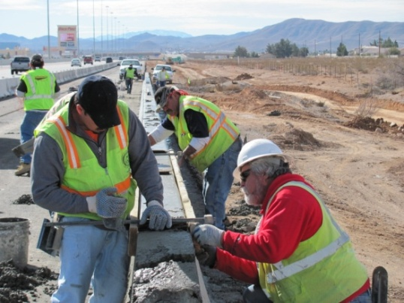
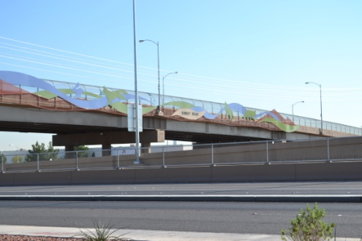
Community Need
Employment
  Peak employment at 400+/-
  Design hours – 100,000+
  Craft Labor hours – 1,250,000+
  Craft Labor 52% Minority Workers
Improved access to Las Vegas Strip
    Close coordination with LVCVA and resorts
    Economic driver of Southern Nevada Economy
Improve access to McCarran International Airport
Notes:
Corey

Slide 12
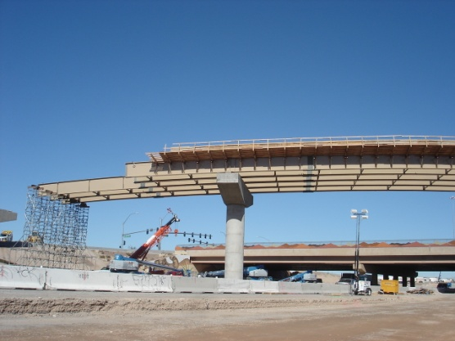
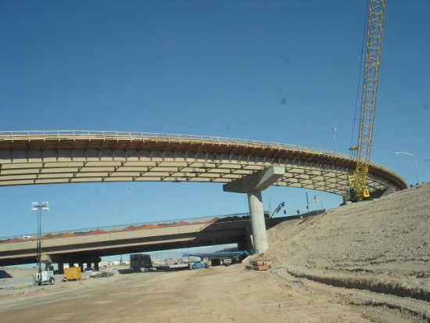
Intricacy of Design
Adding access roads within limited ROW
  Retaining walls
  Braided ramps
Bridges
  Flyovers
  Grade separations
  UPRR
U.S. Army Corp. of Engineer Channel
  Tropicana Wash
  Ramp and Access Road directly on concrete lid
Notes:
Corey

Slide 13
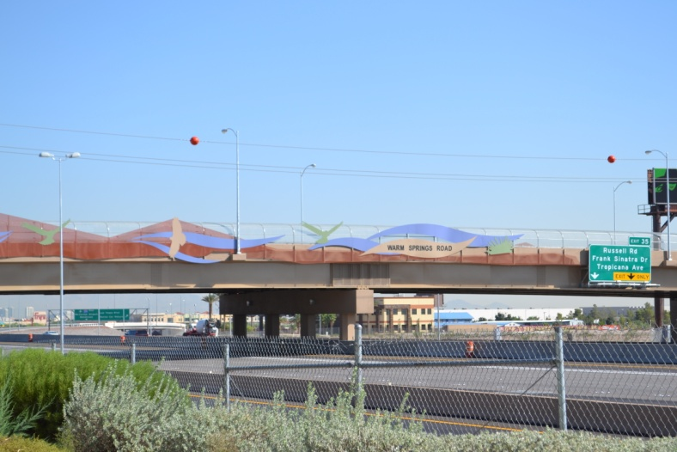
Intricacy of Design
Maintaining traffic flow on Nevada’s busiest freeway segment
  Traffic volumes
  Limited number of lane closures allowed in RFFP
Warm Springs Bridge
  Interim and Ultimate Configuration
  Utilities
    LVVWD
    NV Energy
    Cox Communications
    Century Link
  Acquisition of additional Right of Way and utility easements
Notes:
Jason

Slide 14
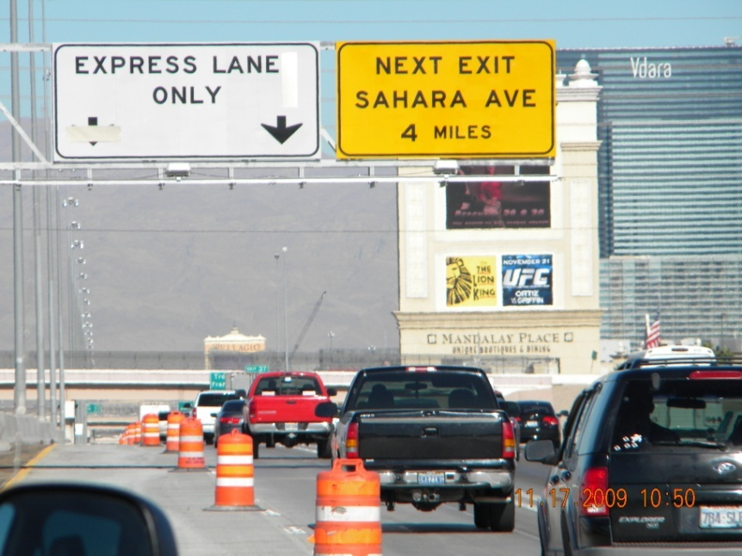
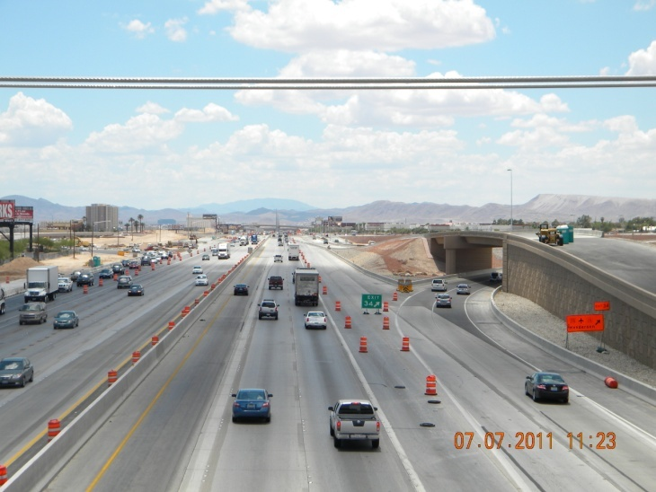
Difficulty of Construction
Maintenance of Traffic (MOT)
  Number of vehicles
  Various Phases
  Minimal closures per contract
Notes:
Jason

Slide 15
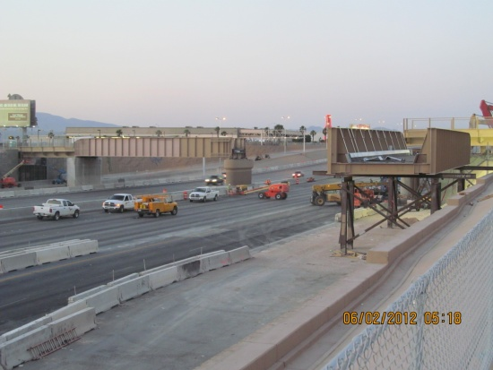
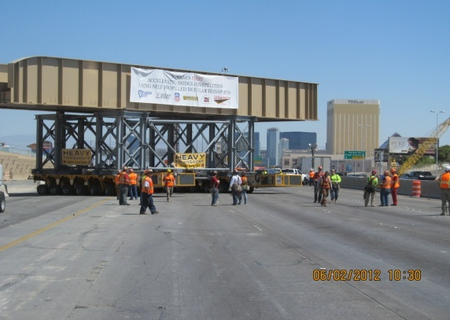
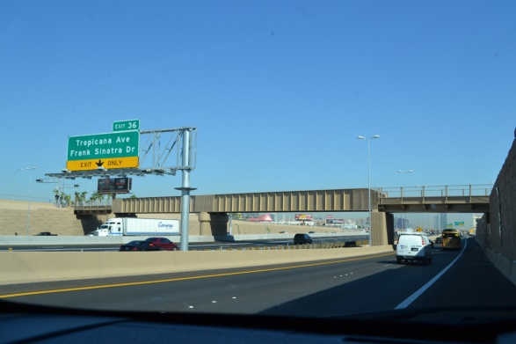
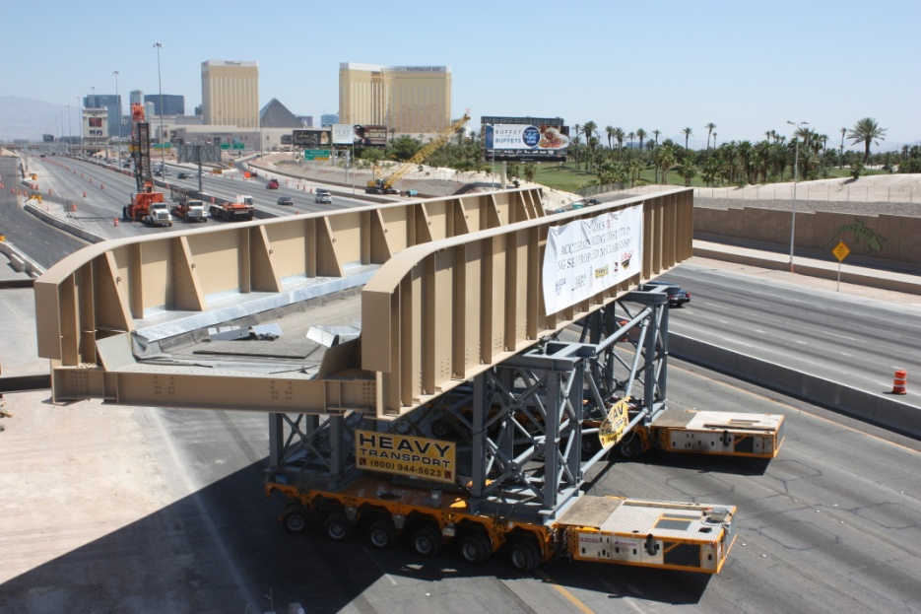
Difficulty of Construction
UPRR Bridge
  Maintain UPRR train traffic
  One I-15 weekend shutdown
  Convert abutment to pier
  Add new end spans over new Access Roads
  Girder Self Propelled Motor Transportation (SPMT) Rollout
Notes:
Corey

Slide 16
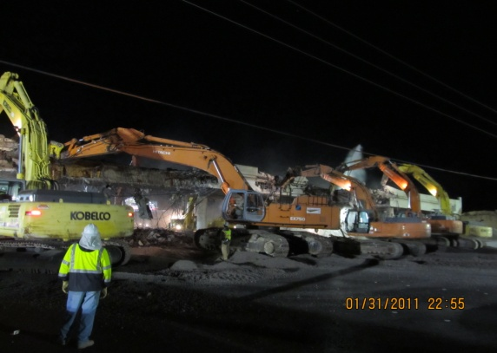
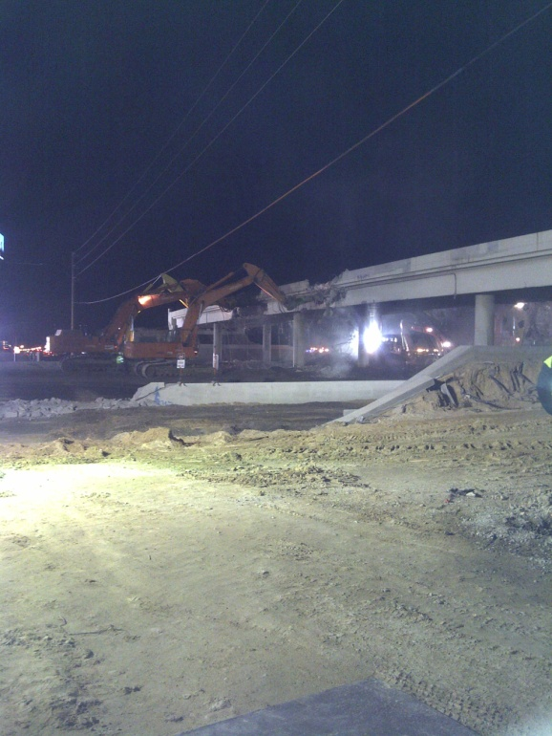
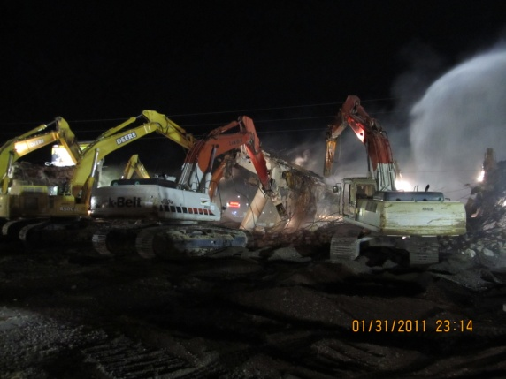
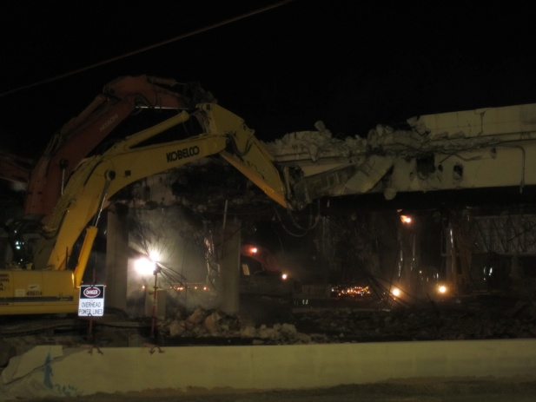
Difficulty of Construction
Warm Springs bridge demolition and debris cleaning in single shift
Notes:
Jason

Slide 17
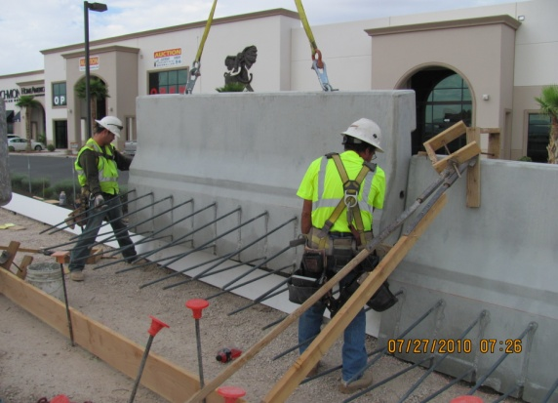
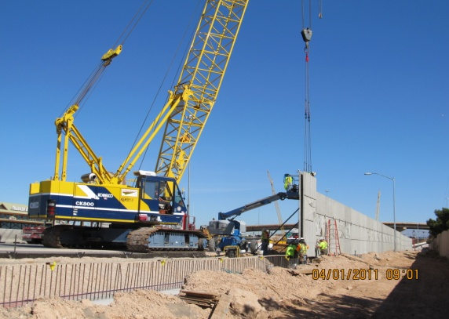
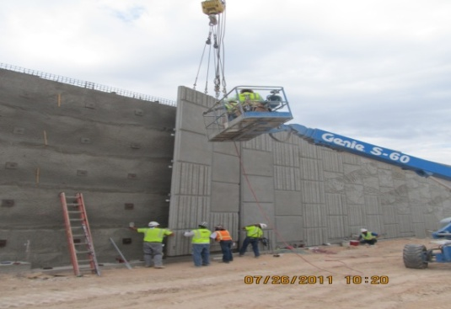
Innovations
Precast barrier rail
2. Precast veneer panels
3. Precast Soundwall Panels
Notes:
Corey

Slide 18
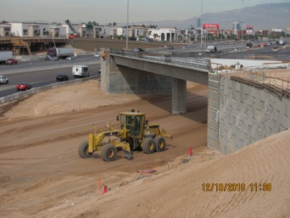
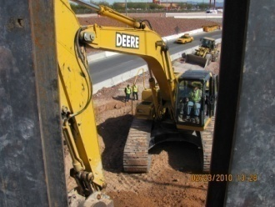
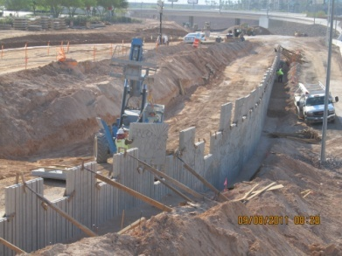
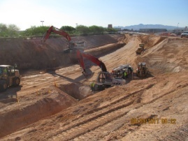
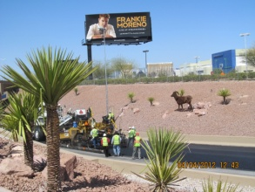
Schedule
Complete Construction of Warm Springs Bridge
All I-15 Lanes Completed and Open
NTP: Design Begins
Design Substantially Complete
Original Construction Completion of Warm Springs Bridge & UPRR Bridge
Complete Construction of UPRR
Construction Begins
Project Complete
Fall 2010
March 2012
September 2011
May 2012
September 2009
December 2009
June 2012
September 2012
Notes:
Corey

Slide 19
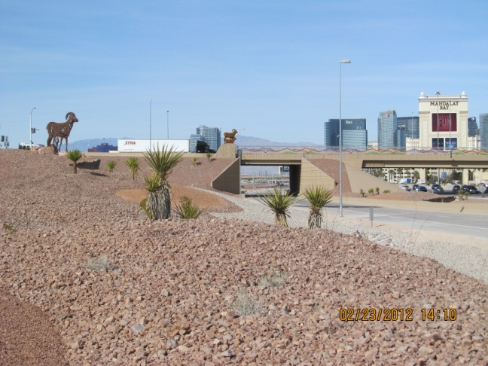
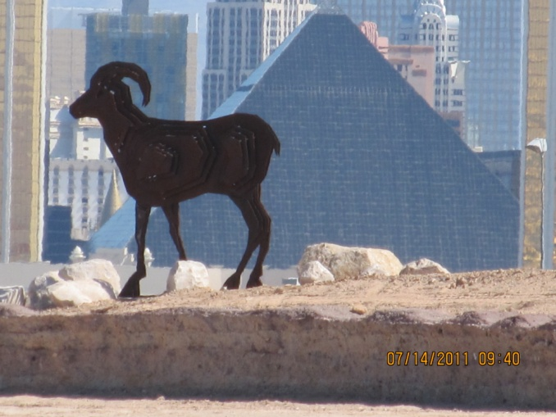
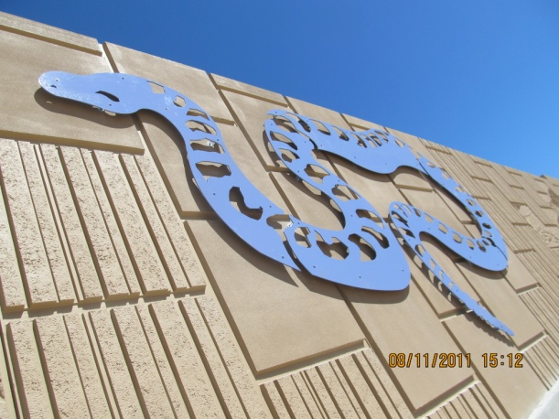
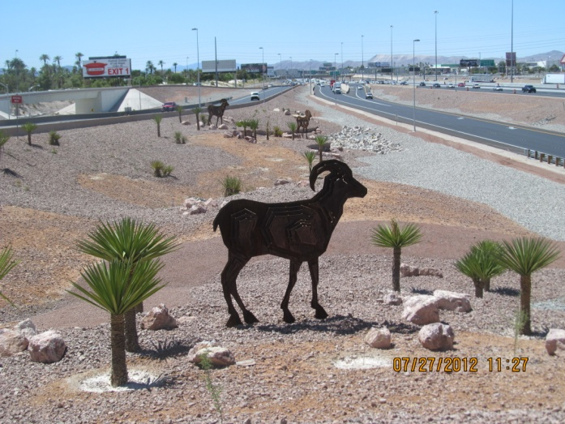
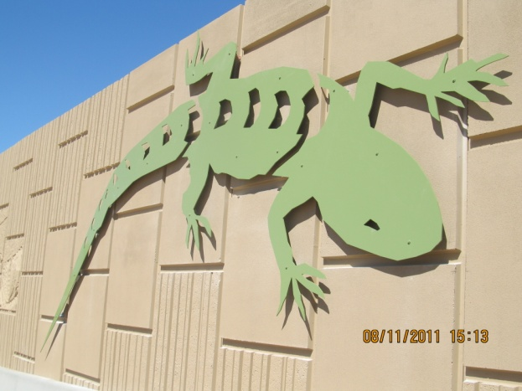
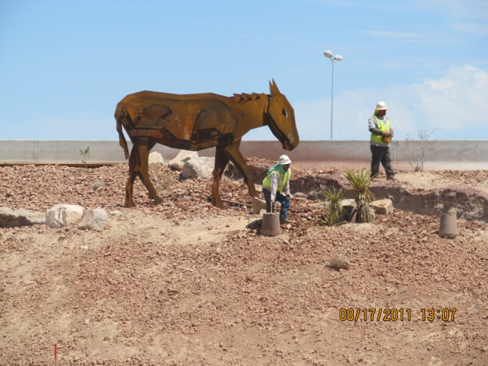
Aesthetic Value
$7.2M Allocated for aesthetics
NDOT Aesthetic Process
  Stakeholder Committee
  Three Alternatives
Notes:
Jason

Slide 20
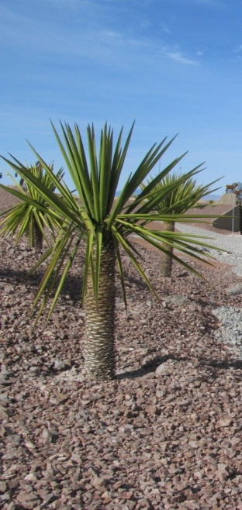
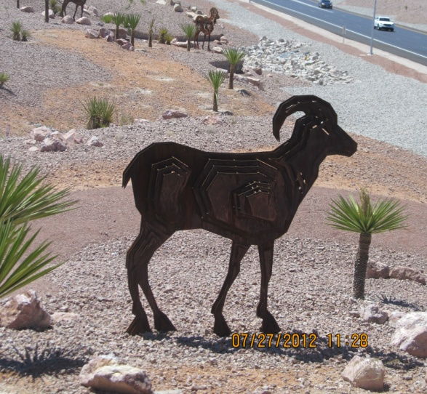
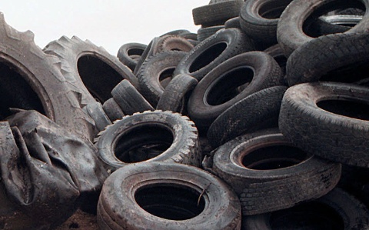
Sustainability
Aesthetics designed for minimal maintenance
  Low-water-use landscaping
  Natural rusting steel for sculptures
  Kept colors to a minimum
Crumb Rubber Overlay
  Approx. 266 tons of crumb rubber
  Approx. 21,000 of recycled passenger car tires used
  Extended service life of I-15 pavement
Use of Topein for Asphalt Oil
  2 parts water to 1 part tree sap emulsion
  Also used for erosion control as dust palliative
Notes:
Corey

Slide 21
Lessons Learned
What Worked Well
Estimate process
Hub Office
Using NDOT’s traditional construction QA/QC process
Document control process
Commitment to continued use of partnering
All parties approached dispute resolution with an open mind
Notes:
Jason

Slide 22
Lessons Learned
What Worked Well
NDOT was open to new, innovative ideas in construction methods
Design team being present in the Hub Office made design process easier to manage and made design staff more responsive and accountable
Change orders were created and managed by the construction team
Notes:
Corey

Slide 23
Lessons Learned
What Needed Improvement
Verify Design Criteria up front
Utility coordination in design build
NDOT should continue to focus on incorporating 3rd parties earlier in the design build process
Notes:
Jason

Slide 24
Questions??
THANK YOU

