Slide 1
District 2 ITS
April 10, 2013
Presented by:
Mike Fuess, PE, PTOE
Jae Pullen, PE

Slide 2
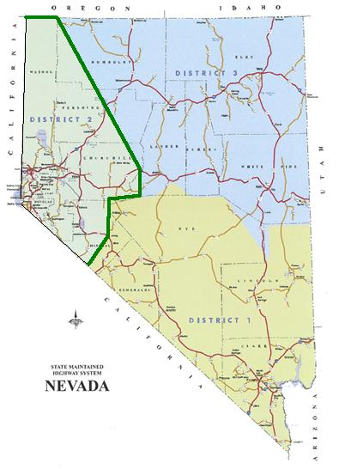
District 2
Northwest
Total 9 Counties
Maintained District Mileage

Slide 3
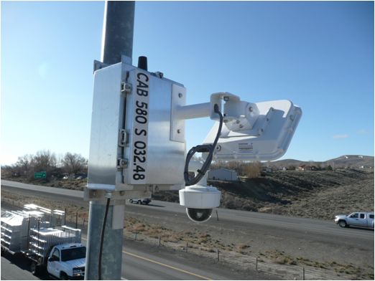
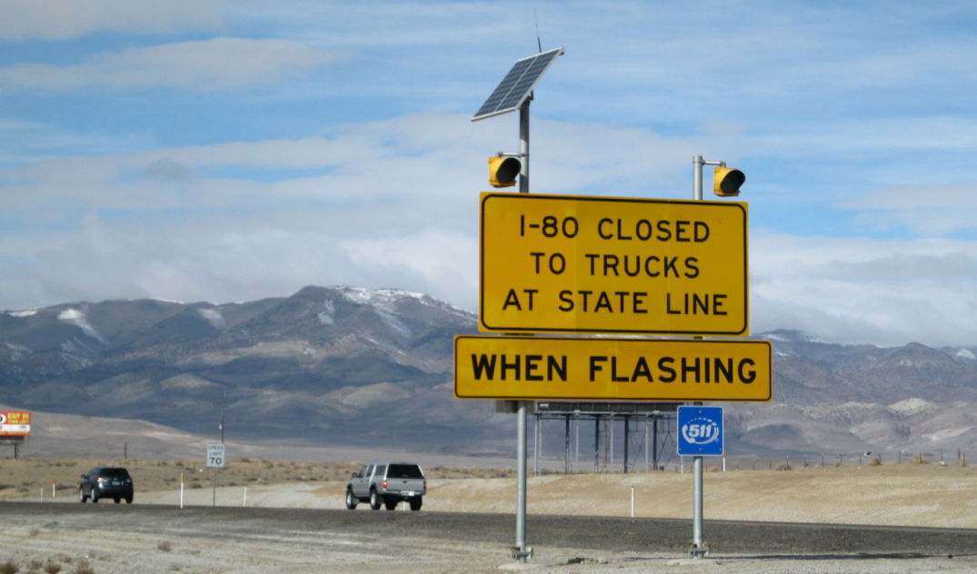
District 2 ITS
Overview
ITS Developments

Slide 4
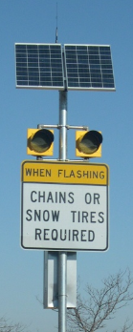
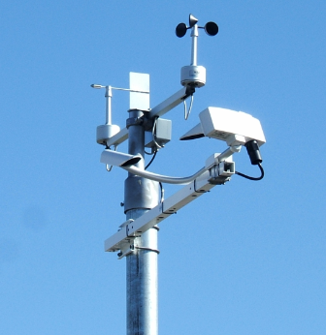
ITS Deployment Overview
1990s
RWIS (49)
CMS (DMS/portable CMS) (60)
Flashing beacon signs (120)
HAR
2004
C*Cure

Slide 5
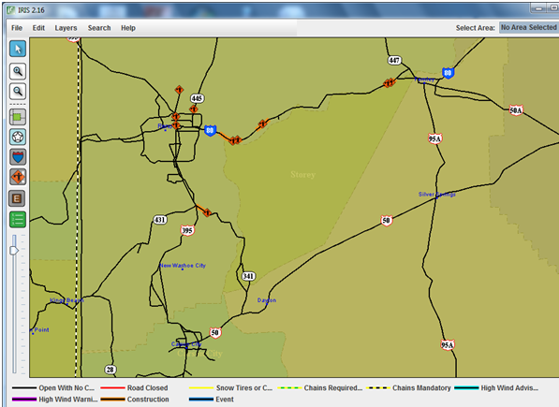
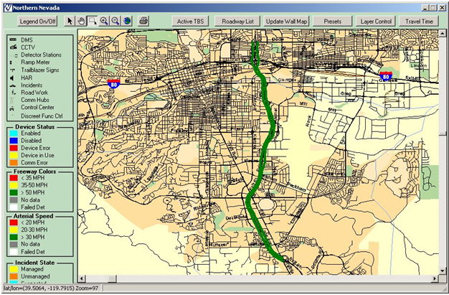
ITS Deployment Overview
Continued:
2006
511 program (Safe Travel)
2007
Central System Software (CSS)

Slide 6
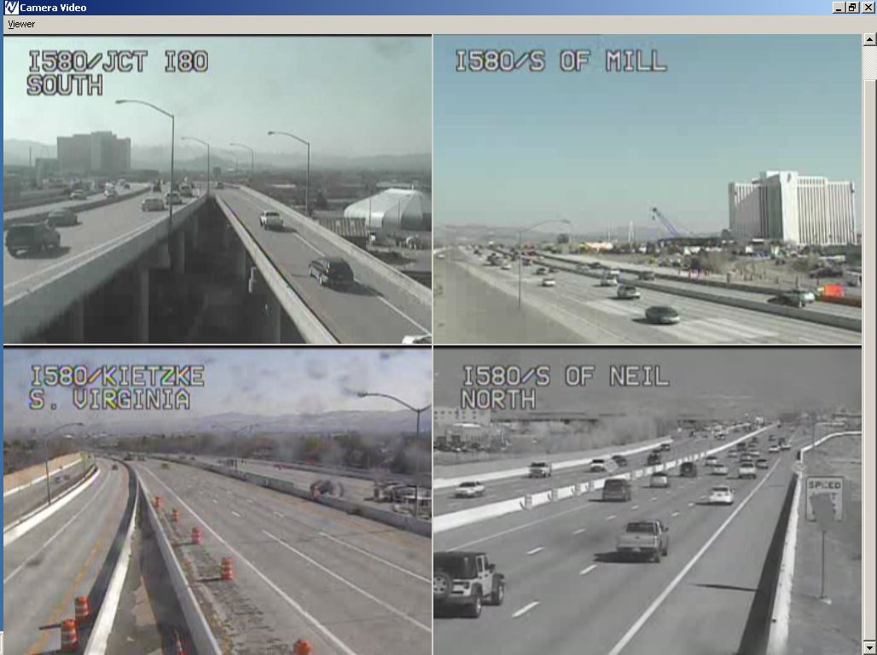
ITS Deployment Overview
Continued:
2010
Flow Detector (89)
CCTV (45)
2012
Ramp Meters (3)
Travel Time Signs (4)
Bridge Anti-icing System (4)

Slide 7
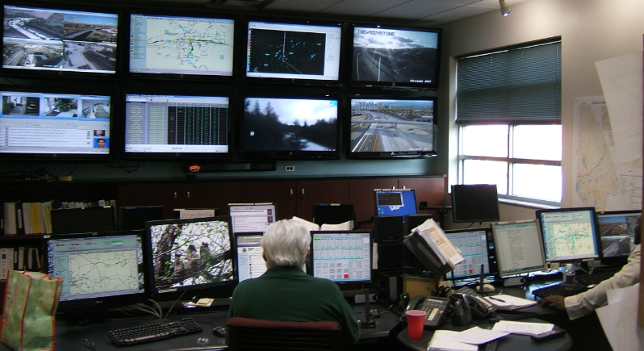
ITS Developments
Rural Hotspots
Calsense
Ramp Meters
Travel Time Signs
Boschung
Wind Warning System
Wind Generator

Slide 8
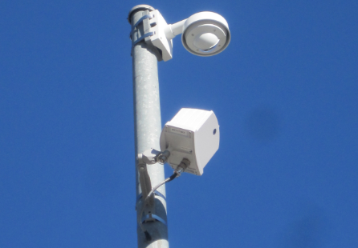
Rural Hotspots
Smart Pole
Instruments:
CCTV
Flow Detector
RWIS

Slide 9
Rural Hotspots
Communications
1) Dial-up
Cellular
Dial-tone
I.P.
Notes:
Slide 9: Rural Hotspots Communication 1
I’m going to quickly go over communication options.
Landline dial-up is very reliable. We have had great success with DMS and RWIS; cost is between $15-30 depending on the provider.
Cellular- In 2014, dial up cellular is no longer going to be supported by the telephone carriers. We still use this option on a few of our weather stations.
The data plan (internet protocol) is usually the best solution for rural applications if you can get an adequate signal. 70 dB is decent for a camera and 80 dB is good for RWIS. Also important to check for latency (time it between sending a packet and receiving a reply).
In the past we deployed Raven X- which only has one port/would need a switch. Juniper SSG5 (firewall) is an indoor unit we deployed in field cabinets. We have been experience problems with them. We recently moved to Proxicast, which is rugged- but the modem card isn’t.

Slide 10
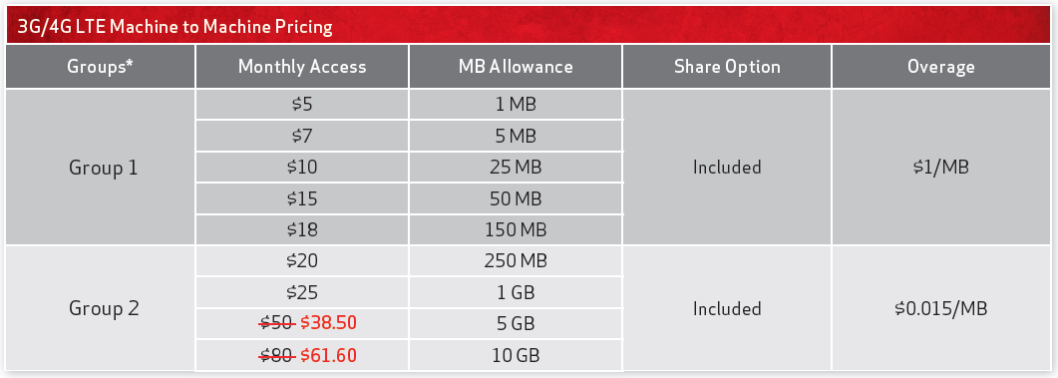
Rural Hotspots
Communications (continued)
Options
Notes:
Slide 10: Rural Hotspots Communication 2
Typical sites use between 2 to 7 GB per month. We would usually use Verizon’s unlimited plan for $39.99. There is a new plan offered where you group your sites in one plan. If you have 10 sites and you decide to use Group 2 with a 5 GB allowance plan (that’s 50 total), as long as the cumulative data used doesn’t exceed 50 GB, you are fine. This plan would save a few dollars/ per site/ a month.

Slide 11
Rural Hotspots
Communications (continued)
3) Radio
800 MHz Radio (EDACS)
Microwave
Notes:
Slide 11: Rural Hotspots Communication 3
The trunked radio system was designed as a voice system WITH data as a secondary application. For data, we would use RDI (Radio Data Interface). We used this for some RWIS, but have replaced with cellular.
Microwave is another option. Either using a public safety frequency (unlicensed)/ can have issues due to noise or an FCC licensed microwave that will more likely provide more reliability. It could be a single point (a handful of ITS hotspots) communicating to a multipoint (hub). The radios are about 5-6K per site.

Slide 12
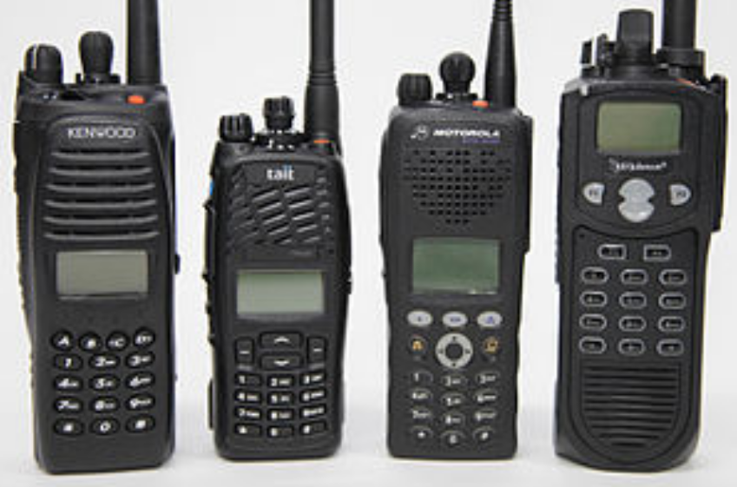
Rural Hotspots
Communications (continued)
Future (analog to digital)
Harris – OpenSky
VoIP
Project 25 (P25)
Notes:
Slide 12: Rural Hotspots Communication 4
Our current system will no longer be supported in the future. We will need to move from the analog system to a digital one. The two primary technologies available are Harris (proprietary) and Project 25 (open source standard).

Slide 13
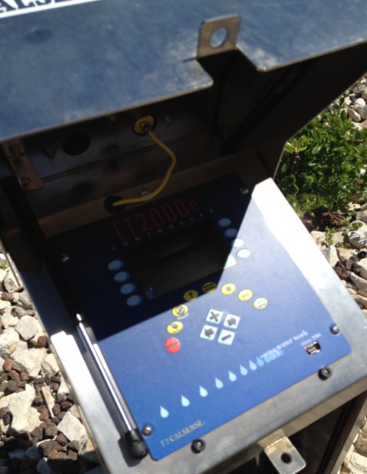
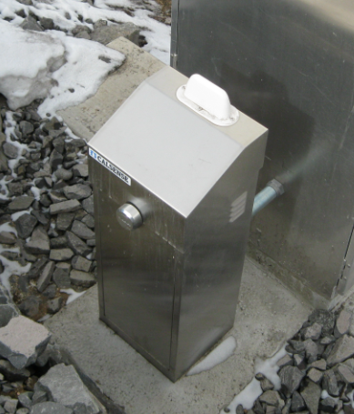
Water Management System
I-80 & I-580
ITS Network

Slide 14
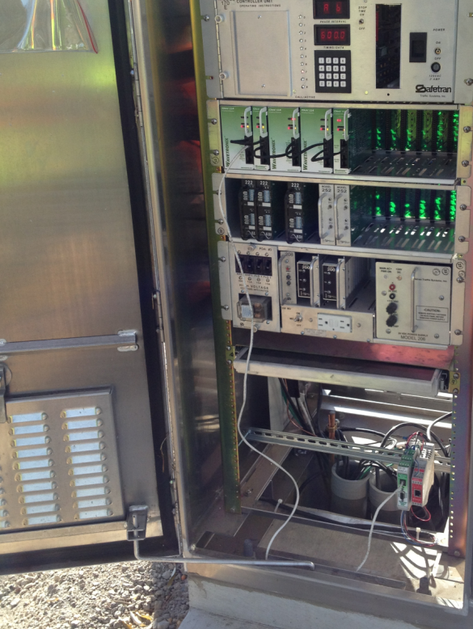
Ramp Meters
Locations on I-80
Keystone WB
Center Street WB
Wells WB

Slide 15
I-80 Locations
Robb Dr. (EB)
E. of Evans Ave (EB)
Rock Blvd (WB)
Sparks (WB)

Slide 16
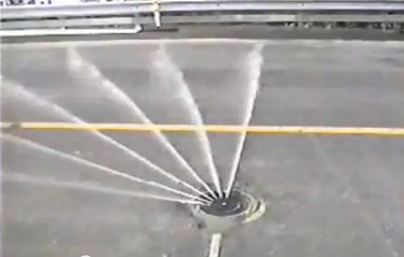
Boschung
Fixed Automated Spray Technology (F.A.S.T.)
Locations on I-580/US-395:
1) Galena Forest Bridge
2) Steamboat Hills Bridge
3) Galena Creek Bridge
4) Browns Creek Bridge
Notes:
Slide 16: Boschung FAST
The anti-icing system is connected to our ITS network and is monitored by maintenance and Reno Roads using the Borma software (checking tank levels and alarms).
Galena Forest/Creek have 4,500 gal tanks & Browns/Steamboat have 2,500 gal tanks.
The system strays potassium acetate and the duration of spray depends on the program.
The product is purchased from a vendor in Iowa and one truck holds 4400 gallons (take up to 4 days for delivery). The cost is somewhere around $8.00/gal.
---during off-season, nozzles are cleaned by running the system with water.

Slide 17
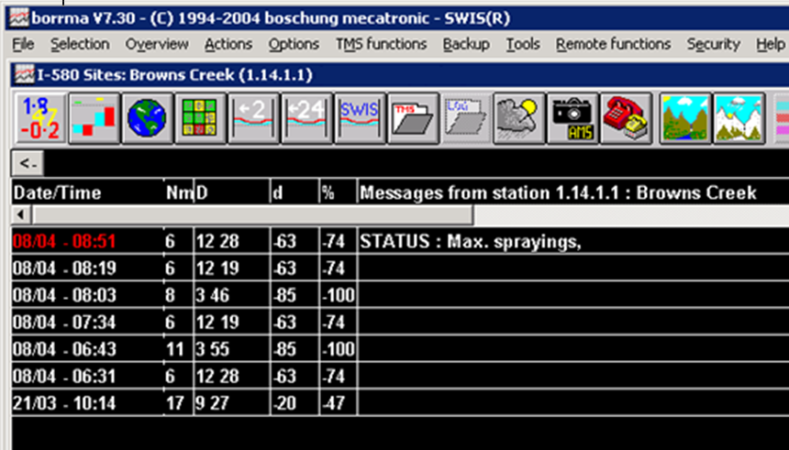
April 8, 2013
Notes:
Slide 17: Boschung part 2
Is a log from Brown’s Creek’s system and you can see the system sprayed 3 times from 8am to 9am. The system can spray up to 3 times as it did during this time period. There is a difference in spraying times (3 seconds and 12 seconds).

Slide 18
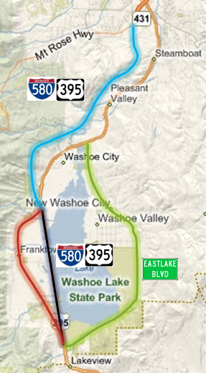
Washoe Valley Wind System
3 routes
Wind Thresholds (2 controls)
RWIS
Automated DMS/portable CMS
Sign Message
HAR
Permanent system
Notes:
Slide 18: Washoe and Pleasant Valley Wind System.
This system is automated and uses RWIS (5) to trigger prohibition of HPVs over 9 feet. The system consists of three sections of roadway (color coded). Each route acts independently which means there are 8 different combinations of wind controls.
There are two wind controls: A wind alert- HPVs are not advised and High Winds- HPVs are prohibited.
We are currently working on activating a wind HAR- AM 580. There is a permanent system that will consist of flashing beacon signs and a full-color matrix digital board/very similar to a travel time sign/ to show route shield and direction of prohibition. This system is a year out.
12 DMS/10 pCMS

Slide 19
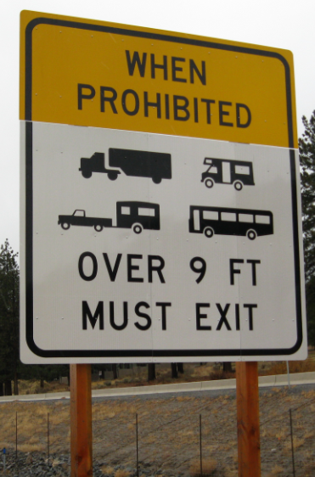
Max Wind Gust 3/20/2013 (3pm – 4pm)
I-580 Washoe, 77 MPH
US395A No., 69 MPH
US395A So., 92 MPH
I-580 Galena, 81 MPH
I-580 Browns, 77 MPH

Slide 20
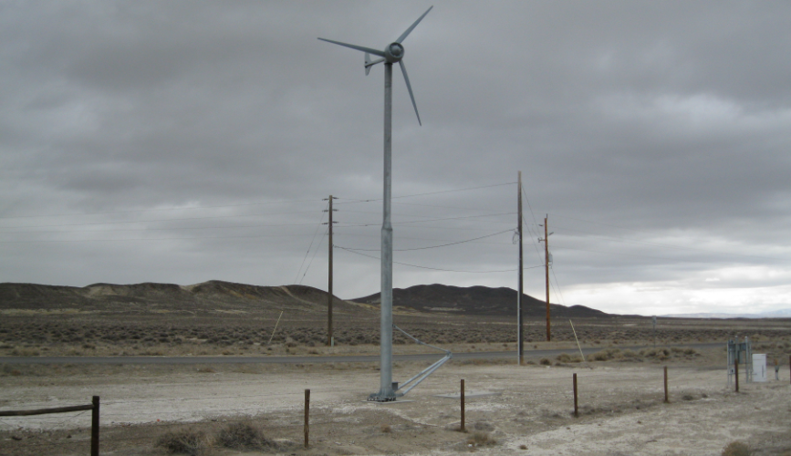
Wind Turbine
I-80
Evance R9000

Slide 21
Contact Information
Mike Fuess, PE, PTOE
mfuess@dot.state.nv.us
Jae Pullen, PE
jpullen@dot.state.nv.us
(775) 834-8300

