Slide 1
Sustainable Infrastructure Rating Systems
Geoff Boraston, P.E.│VP of Environmental Affairs

Slide 2
WHY
Notes:
Over the last decade, the notion that society’s approach to economic development is not sustainable has moved from extremist thinking to mainstream opinion. In an increasingly connected world, economic imperatives and sustainability imperatives are converging: sustainable growth is the only way to prosperity.
According to the most recent ASCE 2013 report card, US infrastructure has been given a D+ and needs to spend $3.6 trillion to rebuild our deteriorating infrastructure and help our economy remain competitive with other nations. Infrastructure serves as one of the most important foundations of civil society and has a huge impact on environmental sustainability and the competitiveness of national economies. Therefore, a new way of thinking about infrastructure development (and redevelopment) is needed, one that incorporates a deeper understanding of complex systems, large scale innovation and change management, the economic advantages of infrastructure investment, sustainability principles, new technologies and business process innovations and the new collaboration models and financing strategies that they enable.
Infrastructure is long lived. The highways, bridges, power stations and wastewater treatment plants we build today have design lives ranging from 20 to over 75 years. This means that the infrastructure we are building today will establish the energy, water and materials efficiencies, and ecosystem impacts for decades to come. Therefore, whatever we build today, we better get it right. We must do the best we can with existing technologies, designing and delivering the most resource and energy conserving infrastructure within the limits of budgets and priorities. In addition, the efficiency and effectiveness of infrastructure depends not only on its intrinsic design, but on how that design integrates and functions for the community in which it resides.
It is no longer enough that infrastructure work, that it be constructed on time and within budget, or even that it last.
It now must be sustainable, which means we need a measure of sustainability at the project level.

Slide 3
Notes:
This is where the Envision rating system comes in…(This is mainstream engineering.)
The Envision™ sustainable infrastructure rating system is an objective framework of criteria and performance achievements. It is designed to help users identify ways in which sustainable approaches can be used to plan, design, construct and operate infrastructure projects. It is similar to LEED by the US Green Building Council; however, it applies to infrastructure, not buildings.
The goal is to improve the sustainable performance of infrastructure projects in terms of not only the technical performance but also from a social, environmental and economic perspective.
Envision™ provides an opportunity for infrastructure owners and designers to provide higher performing solutions by using a lifecycle approach, by working with communities, and by using a restorative approach to infrastructure projects.
EnvisionTM was developed in joint collaboration between the Institute for Sustainable Infrastructure (ISI) and the Zofnass Program for Sustainable Infrastructure at the Harvard Graduate School of Design.
The Institute for Sustainable Infrastructure, ISI, it is a not-for-profit education and research organization, dedicated to developing and maintaining a civil infrastructure rating system
ISI was founded by the American Council of Engineering Companies (ACEC), the American Public Works Association (APWA), and the American Society of Civil Engineers (ASCE).

Slide 4
Collaboration
ISI Founders (2010)
Notes:
EnvisionTM was developed in joint collaboration between the Institute for Sustainable Infrastructure (ISI) and the Zofnass Program for Sustainable Infrastructure at the Harvard Graduate School of Design.
The Institute for Sustainable Infrastructure, ISI, it is a not-for-profit education and research organization, dedicated to developing and maintaining a civil infrastructure rating system
ISI was founded by the American Council of Engineering Companies (ACEC), the American Public Works Association (APWA), and the American Society of Civil Engineers (ASCE).
Each of ISI’s founding organizations was developing a sustainable infrastructure program and saw the need for a standardized framework for classification of sustainability practices. The organizations decided to work together to form ISI to produce and administer a sustainable infrastructure rating system.

Slide 5
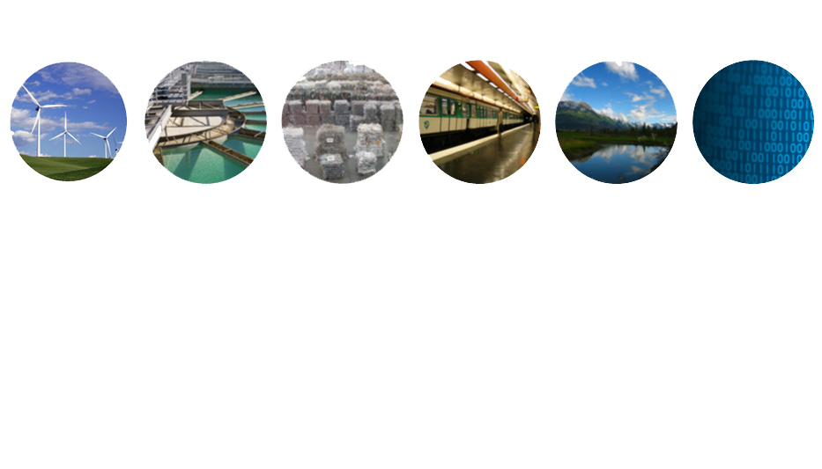
What Types Of Infrastructure Will EnvisionTM Rate?
ENERGY
Geothermal
Hydroelectric
Nuclear
Coal
Natural Gas
Oil/Refinery
Wind
Solar
Biomass
WATER
Potable water distribution
Capture/Storage
Water Reuse
Storm Water Management
Flood Control
WASTE
Solid waste
Recycling
Hazardous
Waste
Collection &
Transfer
TRANSPORT
Airports
Roads
Highways
Bikes
Pedestrians
Railways
Public Transit
Ports
Waterways
LANDSCAPE
Public Realm
Parks
Ecosystem
Services
INFORMATION
Telecommunications
Internet
Phones
Satellites
Data Centers
Sensors
Notes:
First Point:
Most available sustainability rating systems for infrastructure are sector specific or regionally based. For example, there are rating systems specific to buildings, roads, airports, etc. And there are rating systems in use by a city or state. There is no comprehensive U.S. system that covers all aspects of infrastructure.
EnvisionTM is designed to fill this need. Over 900 rating systems were evaluated to identify gaps, develop goals, refine approach. There was collaboration with federal agencies, universities, consultants, professional societies, and municipalities. This tool was vetted by industry experts.
Envision™ is not intended to supplant existing, sector-specific infrastructure rating systems. It is intended to provide the essential context for their rating results. EnvisionTM measures outcomes, not intentions
Second Point:
The rating system for buildings are gaining popularity, but these aren’t applicable or transferrable for infrastructure projects. Much of the focus of these systems is on the comfort and health of the building occupants, but most infrastructure does not have occupants.
Infrastructure has different challenges than buildings . Buildings are under the control of a single owner or entity. You can readily optimize building systems.
For infrastructure, there is no single responsible entity. There are multiple departments with different issues, agendas, schedules, budgets, customers and integration needed at the city/community and regional levels.

Slide 6
60 Credits in 5 Categories
Purpose, Community, Wellbeing
Collaboration, Management, Planning
Notes:
60 Credits in 5 Categories
Quality of Life specifically addresses a projects impact on communities from the health and wellbeing of individuals of the wellbeing of the larger social fabric as a whole.
Leadership is comprised of the tasks that demonstrate effective leadership and commitment by all parties involved in a project. The meaningful commitment from the owner, team leaders, & constructors.
Resource Allocation measures the use of renewable and non-renewable resources for the project. Benefits of managing resources needed will allow a longer life as we know it.

Slide 7
Materials, Energy, Water
Siting, Land & Water, Biodiversity
Emission, Resilience
Notes:
Resource Allocation measures the use of renewable and non-renewable resources for the project. Benefits of managing resources needed will allow a longer life as we know it.
Natural World allows project teams to assesses the effect of the project on the preservation and renewal of ecosystem functions. This section addresses how to understand and minimize negative impacts while considering ways in which the infrastructure can interact with natural systems in a synergistic and positive way.
Climate And Risk looks at two main concepts: minimizing emissions that may contribute to increased short- and long-term risks and ensuring that infrastructure projects are resilient to short-term hazards or altered long-term future conditions.
Innovation Points are assigned in each of the 5 categories for both exceptional performance beyond the expectations of the system and the application of methods that push innovation in sustainable infrastructure. Innovation credits act as bonus points that are added to the project score. For example, a project where job development and training far exceed the restorative level and fundamentally revitalize a community’s economy, or a project where the stormwater management system is a community-wide resource for capturing stormwater, preventing erosion, and treating stormwater prior to release back into natural hydrologic systems.

Slide 8
Recognition Level | Minimum Applicable Points | Minimum in Each Category
Acknowledgement of Merit |  | 5%
Silver Award |  | 8%
Gold Award |  | 15%
Platinum Award |  | 20%
25%
50%
60%
80%
Notes:
Award Levels
It’s almost impossible to get all the points (845)! There are so many ways to be sustainable, no project could incorporate them all.
Do not expect your project to achieve a score of 90% to 100% that is typically considered an “A” in academia. Many projects that were designed with environmental and social considerations in mind achieve 40 to 45% of the applicable points in EnvisionTM.
Note that there is a required minimum level of points required in each category as well as the minimum overall.
When the project team and ENV PV have complete the project and evaluation, they can submit the project to ISI for verification, but it is not a requirement. ISI assigns a Verifier to review and confirm the points achieved. The Verifier will make a recommendation for award based on the points achieved.

Slide 9
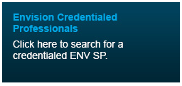
EnvisionTM Sustainability Professional
Envision Sustainability Professional (ENV SP)
ISI Credentialed Practitioner Trained to Use the Envision Rating System
Available now
Role
Guide the project team in
using Envision
Notes:
At least one person on the project team must be trained and credentialed to use the EnvisionTM web portal. That person guides the project team in applying the EnvisionTM rating system to their project. These credentialed project guides are called EnvisionTM Sustainability Professionals, or ENV SPs. Online training and testing is available to credential the project guide on their knowledge of the rating system and rating process.
A searchable list of ENV SPs is available on the ISI website.

Slide 10
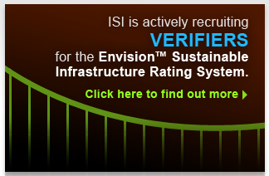
EnvisionTM Verifiers
Independent, Third-party Verification of Project Certification Applications
Role
Mentor ENV SP in
Application Process
Verify Documentation,
Levels of Achievement,
and Overall Score
Notes:
ISI Verifiers provide independent, third-party verification of an EnvisionTM assessment.
Professionals trained by ISI in the verification process will work under direct contract with ISI to assure an absence of a conflict of interest, overall uniformity, and quality in the conduct of evaluations and verifications.
Verifiers work with ENV SPs during the rating process and verify the documentation, levels of achievement for individual credits, and the overall rating score of the final project assessment submitted to ISI.
They ensure EnvisionTM project assessments are accurate and that the same standards are applied from one project to the next.
To become an ISI Verifier, you must
- Be credentialed as an ISI Sustainability Professional (ENV SP) before ISI Verifier training begins.
Have at least 10 years of professional experience.
Current licensure, certification, or credentialing if applicable to your professional field. And must be active in this profession.

Slide 11
© 2011 University of Washington
& Greenroads Foundation
Notes:
I would now like to introduce you to the Greenroads rating system which is specific to roads and provides criteria that are more detailed than Envision is as they apply to road construction.

Slide 12
What is the Greenroads rating system?
A rating system for roadway design and construction that awards points for more sustainable practices. Greenroads helps quantify the sustainable attributes of a roadway project.
Notes:
This system helps you answer the question, “what can I do on my project tomorrow to be more sustainable?”

Slide 13
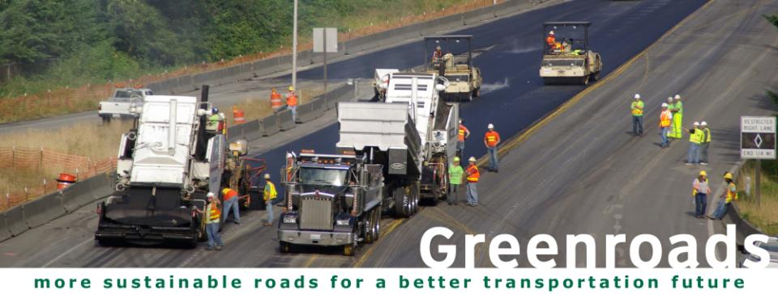
Greenroads is a project-oriented system
It focuses on design and construction.
TM
Planning
Design & Construction
Operation
Notes:
Greenroads is focused on design and construction.

Slide 14
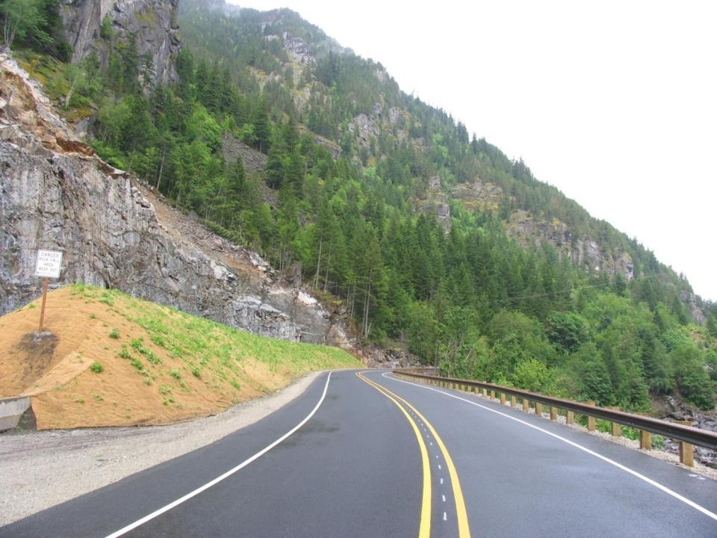
natural cut slope
warm mix asphalt
life cycle cost analysis
env. mgmt. sys.
long-lasting pavement
scenic views
local material
recycled materials
LID stormwater
quality construction
Notes:
(Show this as a the full screen)
Greenroads considers various aspects of road design and construction.

Slide 15
ped./bicycle access
art
bus rapid transit
fewer emissions
recycled materials
CSS
LID stormwater
regional material
quality construction
native vegetation
Notes:
(show as full screen)
Often in urban areas we see lots of people-centered features. Greenroads is context senistive.

Slide 16
Category | Points
Project Requirements | Req.
Voluntary Credits
Environment & Water | 21
Access & Equity | 30
Construction Activities | 14
Materials & Resources | 23
Pavement Technology | 20
Total Voluntary Credit Points | 108
Custom Credits | 10
Total Points | 118
Notes:
This summarizes the Greenroads rating system by category. Point out that there are 3 major sections:
Project Requirements – things you MUST do to be certified
Voluntary Credits – get points for achieving them, not required
Custom Credits – can propose and Greenroads Foundation can adopt these for use on your project and any other project for anyone
Generally, the categories are organized around professionals who may be doing these activities on a project – though there is definitely crossover between categories for many features.

Slide 17
Certification Levels
Notes:
It’s important to know that we may be bidding on a project where we could get an advantage by including sustainability features in the project that would allow the owner to get certified…could be a competitive advantage for Granite.
Stay tuned, we are updating these logos in 2011 with our first certified projects scheduled to complete.

Slide 18
Sustainable Transportation Professional (STP) Credentials

Slide 19
Project Procurement
Sustainability is becoming increasingly more prominent

Slide 20
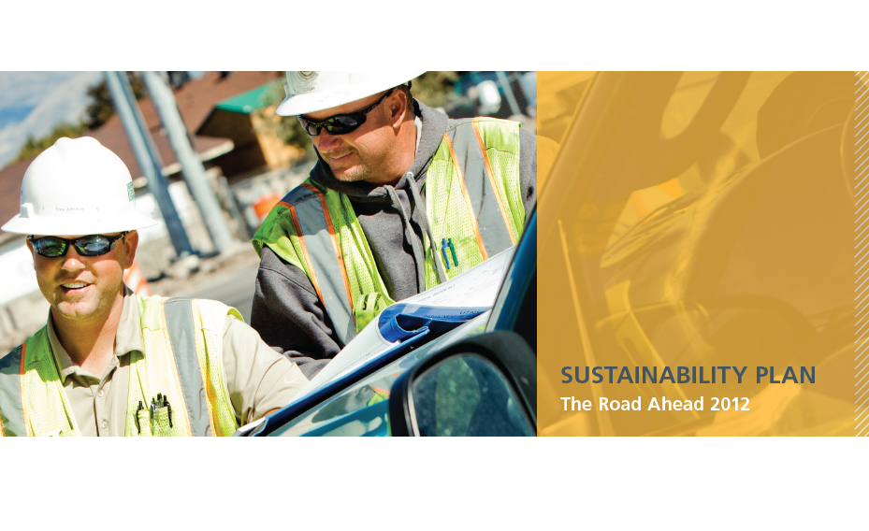
Notes:
Wrap up.

Slide 21
Additional Information & Questions
Envision
www.sustainableinfrastructure.org
Greenroads
www.greenroads.us
Notes:
Add as resources.

