Slide 1
INVEST 1.0: FHWA’s Sustainability Self-Evaluation Tool
Nevada Transportation Conference
April 10, 2013

Slide 2
What is Sustainability?
Economic
Social
Environmental
Notes:
Sustainability is the satisfaction of basic social and economic needs, both present and future, and the responsible use of natural resources, all while maintaining or improving the well-being of the environment on which life depends
Sustainability means addressing environmental, economic, and social equity dimensions – the triple bottom line.
Sustainability seeks to achieve balance among these three elements, so that it goes beyond just being “green”.

Slide 3
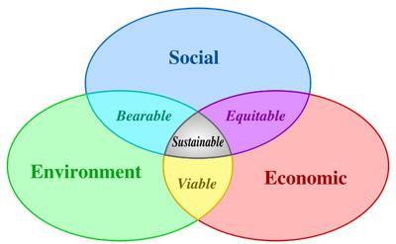
One Definition of Sustainability
The satisfaction of basic social and economic needs, both present and future, and the responsible use of natural resources, all while maintaining or improving the well-being of the environment on which life depends
Notes:
Sustainability means addressing environmental, economic, and social equity dimensions – the triple bottom line.
Sustainability seeks to achieve balance among these three elements, so that it goes beyond just being “green”.
3

Slide 4
What is INVEST?
INVEST - Infrastructure Voluntary Evaluation Sustainability Tool
A web-based self-evaluation tool for assessing sustainability over the life cycle of a transportation project or program — from system and project planning through design and construction, to operations and maintenance
Notes:
Voluntary Web-based Tool

Slide 5
Why INVEST?
Fulfills a need in the profession
Connects sustainability principles with action
Measures sustainability specifically for transportation
Challenges us all to go above and beyond
Notes:
When we first got the idea for the tool several years ago, there really was nothing like it out there
We saw the need to create something that translates those broad sustainability principles I just mentioned from words into specific actions.
And we wanted to develop a tool with a unique view of measuring sustainability.
One that focuses on our world: the transportation profession
One that doesn’t just measure compliance, but measures stewardship
So, INVEST challenges us all to go above and beyond what is required.

Slide 6
Built for the Real World
Voluntary - use it how and where you want
Private - data belongs to you
Free - no licenses, no limits
Tangible & Practical - relates to things you do everyday
Notes:
We didn’t want this effort to be a theoretical exercise, we built INVEST to be used in the real world.
INVEST is not something we wanted to force on anyone
It is completely voluntary – use where and how you think it will do the most good.
And, considering that projects and programs can involve many people and disciplines, INVEST allows you to collaborate and share results with whoever you need to make your assessment a success
But the data that you provide belongs to you – you choose how and whether or not to share it
One more thing.
We built INVEST using your input and advice and with your needs in mind.
And as a result of your help, the information in INVEST is practical and tangible: it relates to things you do every day.

Slide 7
Supporting the Entire Lifecycle
Project Development
System Planning & Processes
Operations & Maintenance
Notes:
Project Development (PD) Criteria
Focus is on the development of a specific project once the general need and proposal for a solution to a transportation problem have been programmed
System Planning (SP) Criteria
Focus is on agency-wide management and planning of highway networks
Operations & Maintenance (OM) Criteria
Focus is on agency-wide practices, policies and procedures required for the overall functionality and efficiency of a highway network

Slide 8
INVEST Goals
Encourage implementation of sustainable practices
Help agencies assess their level of sustainability implementation and identify areas for internal improvement
  Assess single or multiple projects
  Prospective vs. retrospective
  Planning or O&M programs and processes
Provide a framework for communicating with stakeholders and decision makers about sustainability
Establish a method for identifying sustainable best practices in highway systems, projects, programs
Notes:
The FHWA Sustainable Highways Tool establishes measures for sustainability that will enable agencies to set sustainability goals, track progress, and apply management strategies.
8

Slide 9
Evolution of INVEST
Beta Test Version
Released Fall 2010
Pilot Test Version
Released Fall 2011
Version 1.0
Released October 2012
Over 700 comments from AASHTO, EPA, SMEs, others
Over 1200 comments from pilot test participants, SMEs, FTA, others
Notes:
First version of INVEST – Beta Test Version – released in the Fall of 2010
The second version – Pilot Test Version – incorporated many of the comments received on the beta version and was released for testing in Fall 2011
Version 1.0 includes changes made as a result of the pilot testing process
Emphasize how much we appreciate all of the comments we’ve received on all of the earlier versions of INVEST

Slide 10
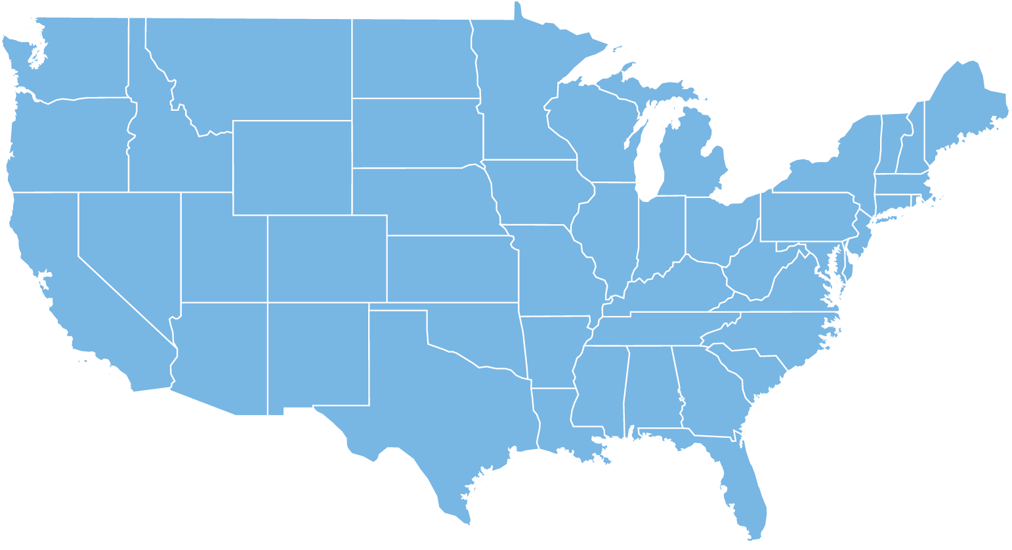
INVEST Pilot Sites
Puget Sound Regional Council
Western Federal Lands
Montana DOT
(4 projects)
Oregon DOT
Ohio DOT
Western Federal Lands
Pioneer Valley
Planning Commission
Washoe County, NV
Central Federal Lands
Maryland DOT
Monterey County, CA
D.C. DOT
North Carolina DOT
Nevada DOT
Nashville Area MPO
Utah DOT
Georgia DOT
Arizona DOT
North Central Texas Council of Governments
City of Peoria, AZ
Notes:
Testing done on the Project Development (PD), System Planning (SP) and Operations & Maintenance (OM) criteria from July 2011 – February 2012
Objectives were to obtain input on:
further refinements to the criteria
scoring and achievement levels
making the tool easier to use
Process varied across pilot test agencies
Nevada tested all three modules and was only State to do so
Nevada DOT tested OM and SP
Washoe County tested PD
Significant changes to the criteria in all three modules
More flexibility in selecting relevant PD criteria to address project concerns/context
urban vs. rural
large vs. small
More opportunities for partial credit (i.e., gradation in point scale within criteria)
Putting more emphasis on the process of using the tool and learning (not the score!)

Slide 11
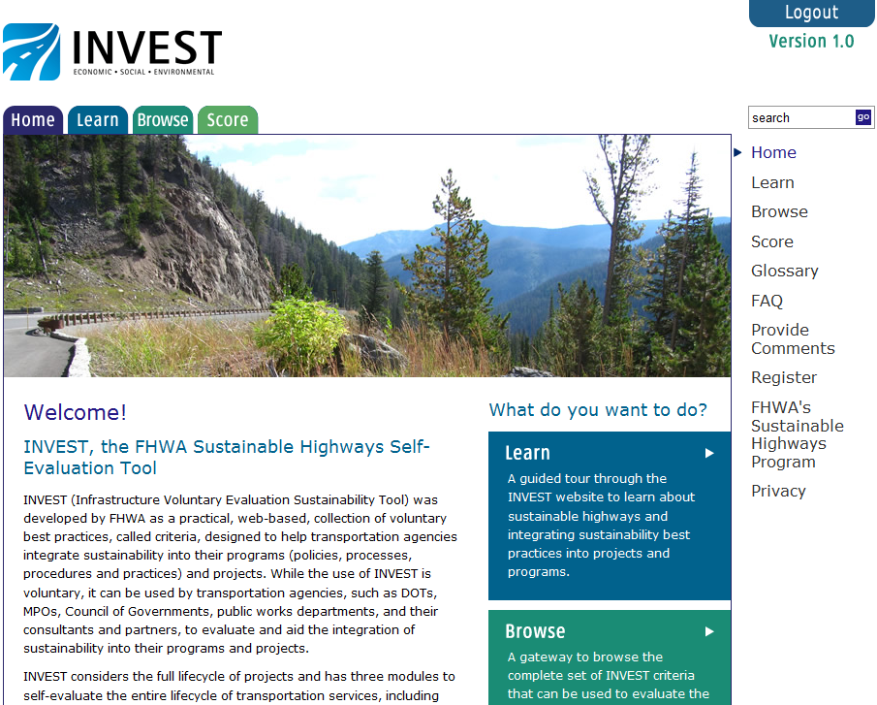
About INVEST 1.0
Notes:
If you were to visit the website, this is a screenshot of what you would see.
From here the tabs at the top allow you to learn about sustainability, browse through the tool, and actually score a project or program.
There’s also a glossary section and a section for Frequently Asked Questions.
Again, there’s a lot of great information here allowing you to learn about sustainability and what it can mean for the three phases of the transportation infrastructure lifecycle

Slide 12
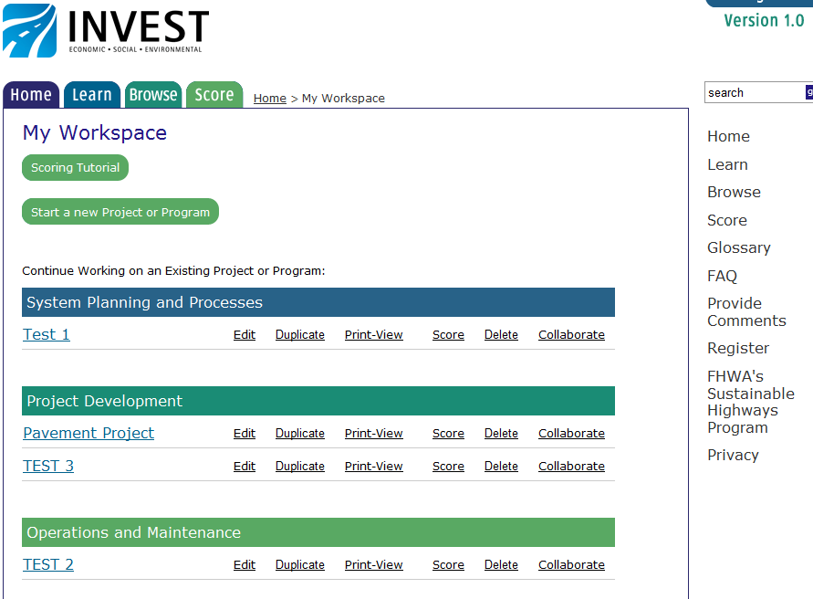
INVEST User Workspace
Notes:
When you are ready to start your evaluation, you begin by entering some basic information into your workspace
In the workspace, you can work on an evaluation in the System Planning, Project Development, or Operations and Maintenance modules
This workspace gives you a place to organize your evaluations, make changes, and even collaborate with others in your organization
This is actually a new feature for Version 1.0 of INVEST
So let’s say you want to evaluate your transportation planning process…you would start your evaluation using the System Planning and Processes module

Slide 13
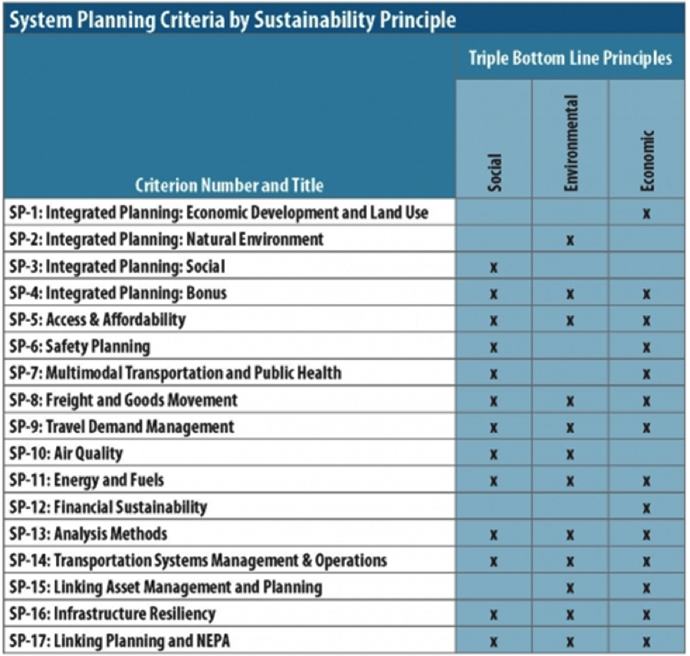
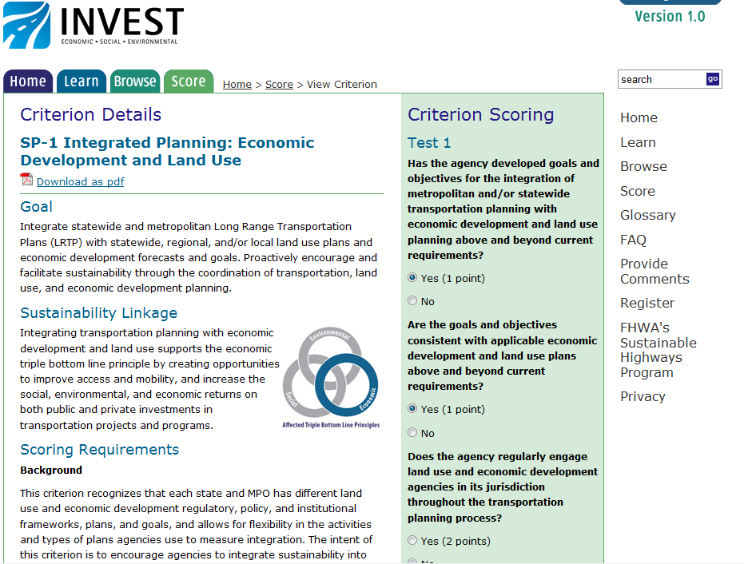
Scoring in System Planning
Notes:
You can browse the criteria and any of the information about sustainability without logging in or registering on the website.
However, if you wish to score a project or program, you will need to login to obtain a password that will be needed to register as a user and to evaluate a project. Taking this step will allow you to access your workspace where you can then conduct an evaluation.
From your workspace INVEST then takes you to a scoring section to evaluate your planning process against specific issues relevant to system planning – these are called criteria
For the System Planning module there are 17 criteria ranging from Integrated Planning, to Freight and Goods Movement, to Linking Planning and NEPA – these are listed on the left side of the screen
For the other two modules – Project Development and Operations & Maintenance – there are separate sets of criteria specific to those phases of the transportation lifecycle
Within each criteria, scoring involves answering a series of questions that relate to specific practices
You can see the scoring page for integrated planning shown here on the slide.

Slide 14
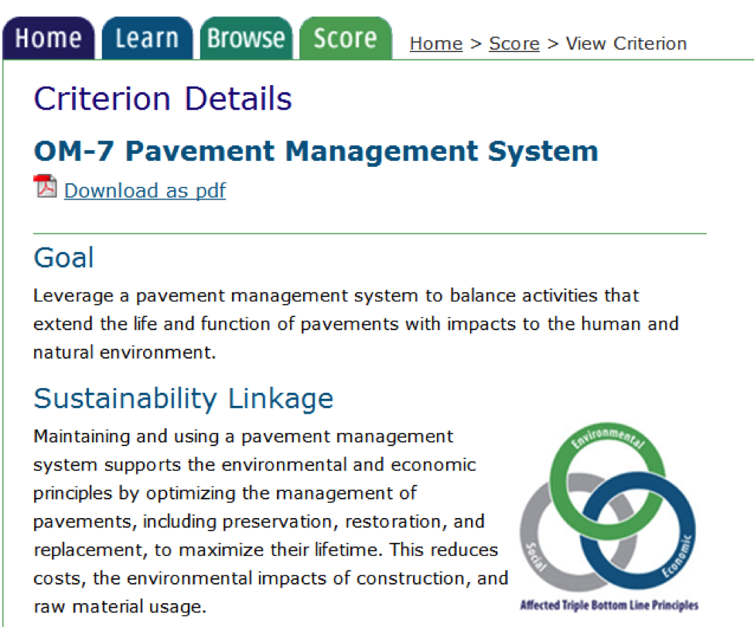
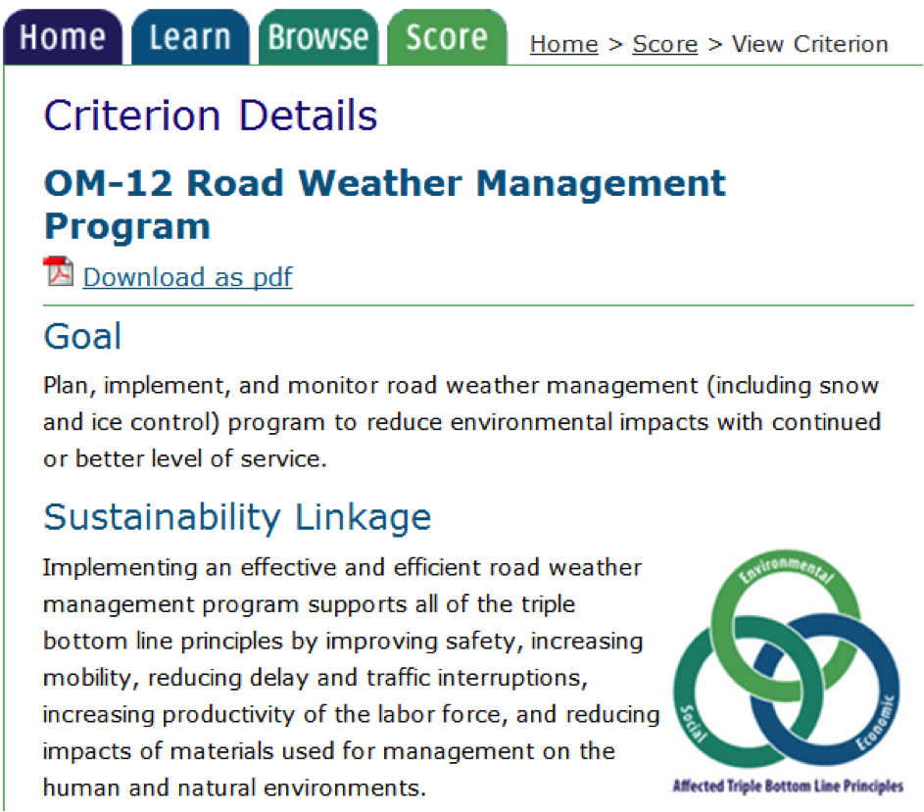
Criteria – Examples from Operations & Maintenance (OM)
Utah

Slide 15
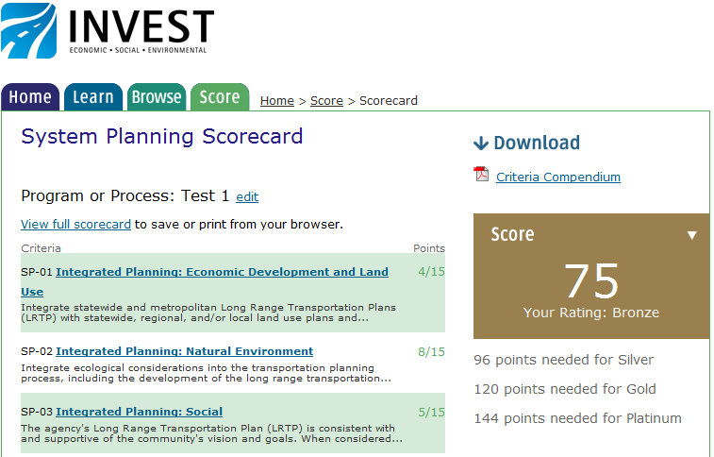
How INVEST Measures Sustainability
Notes:
As you answer the questions in each criteria you get points, which are then added to your overall score
In this case, for the Integrated Planning Criteria, 4 points out of a possible 15 were awarded
The scoring process involves a numbering system that is easy to understand and use
Here in this example, the total score for this program is 75, which achieves a Bronze level
The achievement levels represent how well you are implementing best practices related to sustainability.
And the results of the evaluation can be used to develop sustainability goals, and measure and communicate progress to others

Slide 16
Version 1 System Planning Criteria
SP-1 | Integrated Planning: Economic Development and Land Use
SP-2 | Integrated Planning: Natural Environment
SP-3 | Integrated Planning: Social
SP-4 | Integrated Planning: Bonus
SP-5 | Access & Affordability
SP-6 | Safety Planning
SP-7 | Multimodal Transportation and Public Health
SP-8 | Freight and Goods Movement
SP-9 | Travel Demand Management
SP-10 | Air Quality
SP-11 | Energy and Fuels
SP-12 | Financial Sustainability
SP-13 | Analysis Methods
SP-14 | Transportation Systems Management & Operations
SP-15 | Linking Asset Management and Planning
SP-16 | Infrastructure Resiliency
SP-17 | Linking Planning and NEPA

Slide 17
Version 1 Project Development Criteria
PD-1 | Economic Analyses
PD-2 | Lifecycle Cost Analysis
PD-3 | Context Sensitive Project Development
PD-4 | Highway and Traffic Safety
PD-5 | Educational Outreach
PD-6 | Tracking Environmental Commitments
PD-7 | Habitat Restoration
PD-8 | Stormwater
PD-9 | Ecological Connectivity
PD-10 | Pedestrian Access
PD-11 | Bicycle Access
PD-12 | Transit & HOV Access
PD-13 | Freight Mobility
PD-14 | ITS for System Operations
PD-15 | Historical, Archaeological, and Cultural Preservation
PD-16 | Scenic, Natural, or Recreational Qualities
PD-17 | Energy Efficiency
PD-18 | Site Vegetation
Notes:
List of the Project development criteria – the first 18

Slide 18
Version 1 Project Development Criteria
PD-19 | Reduce and Reuse Materials
PD-20 | Recycle Materials
PD-21 | Earthwork Balance
PD-22 | Long-Life Pavement Design
PD-23 | Reduced Energy and Emissions in Pavement Materials
PD-24 | Contractor Warranty
PD-25 | Construction Environmental Training
PD-26 | Construction Equipment Emission Reduction
PD-27 | Construction Noise Mitigation
PD-28 | Construction Quality Control Plan
PD-29 | Construction Waste Management
Notes:
List of the other PD criteria – total of 29

Slide 19
Multiple Scorecards to Fit Your Project
Larger Project
Rural/
Extended
Urban/
Extended
Paving
Rural/
Basic
Urban/
Basic
Custom
Smaller Project
Rural
Urban

Slide 20
Version 1 Operations & Maintenance Criteria
OM-1 | Internal Sustainability Plan
OM-2 | Electrical Energy Efficiency and Use
OM-3 | Vehicle Fuel Efficiency and Use
OM-4 | Reuse and Recycle
OM-5 | Safety Management
OM-6 | Environmental Commitments Tracking System
OM-7 | Pavement Management System
OM-8 | Bridge Management System
OM-9 | Maintenance Management System
OM-10 | Highway Infrastructure Preservation and Maintenance
OM-11 | Traffic Control Infrastructure Maintenance
OM-12 | Road Weather Management Program
OM-13 | Transportation Management and Operations
OM-14 | Work Zone Traffic Control

Slide 21
Highlighted Implementations
Ohio Cleveland Innerbelt Bridge Project
Montana Going to the Sun Road Project
Utah Ops and Maintenance Program
Dallas-Fort Worth Long Range Transportation Plan
Check out the videos at:
www.sustainablehighways.org
Under “Case Studies”

Slide 22
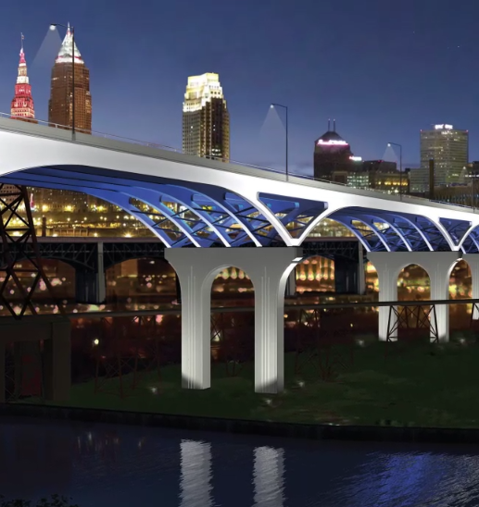

Ohio Department of Transportation (ODOT)
Cleveland Innerbelt Bridge
Ohio

Slide 23
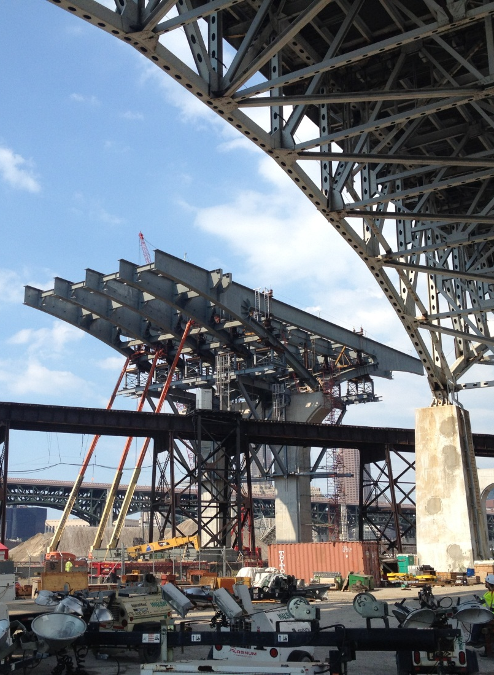
Ohio Department of Transportation (ODOT)
Complex, Urban Project
INVEST Role: Project Development
Largest project in ODOT history – replace bridge spans / expand lanes
Involves coast-to-coast Interstate
Affects historic district and high-traffic sports complex
Targeted major savings in diesel fuel, steel, water and landfill
Used INVEST to validate those savings assumptions

Slide 24
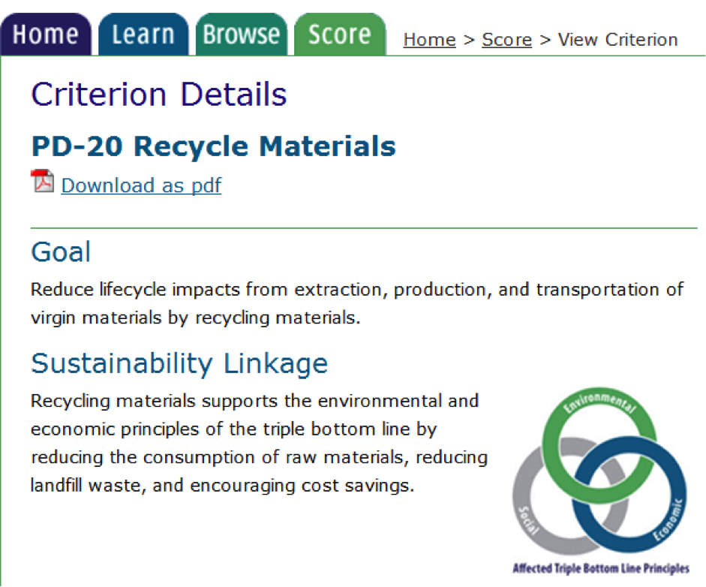
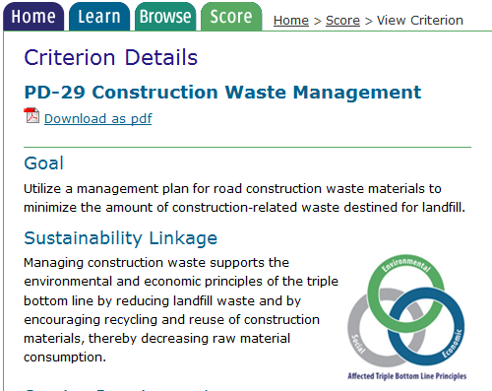
Ohio Department of Transportation (ODOT) Project Development (PD) Module

Slide 25
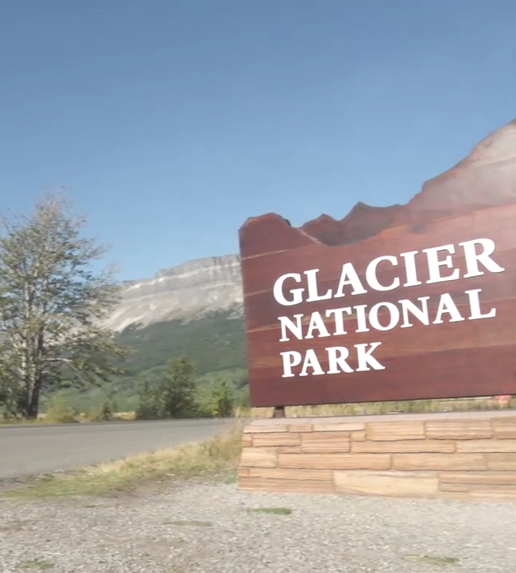

Western Federal Lands
Going to the Sun Road
Montana

Slide 26
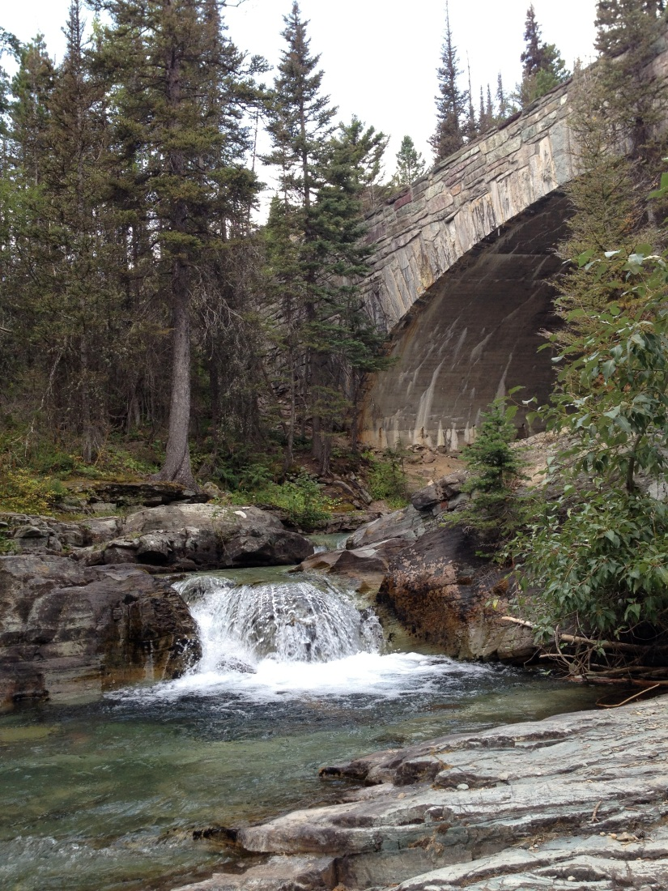
Western Federal Lands
National Scenic Parkway
INVEST Role: Project Development
70 years of traffic, weather, avalanches & rockslides
Aggressive 20-year seasonal rehab program keeps road open but work moving ahead
Reusing all existing stonework, re-seeding disturbed roadsides
INVEST helped validate context sensitivity but also improve their documentation & communications

Slide 27
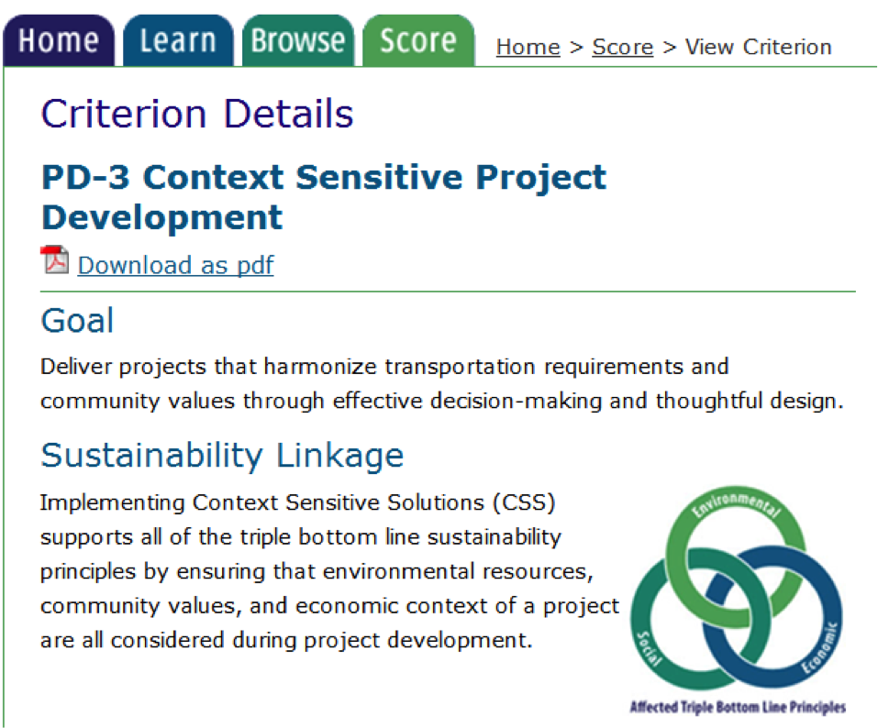
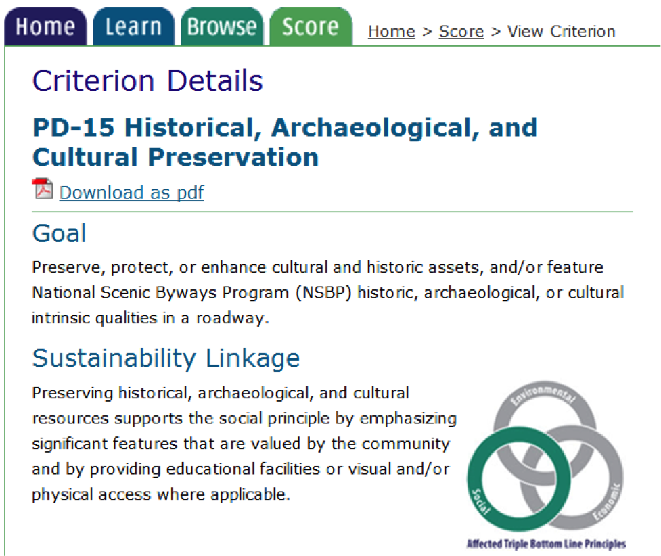
Western Federal Lands –
Project Development (PD)

Slide 28
Evaluate – Score – Improve
Evaluate – collaborative process can be the most important outcome
Score – provides recognition for implementing sustainability best practices and helps identify gaps
Improve – process can lead to improvements in practice and identification of cost effective measures

Slide 29
Next Steps
Encouraging transportation agencies across the US to use INVEST
Implementation Program
INVEST Toolkits for Users and FHWA Field Offices
Monitor performance/impact of INVEST 1.0
INVEST 1.X, 2.0…beyond

Slide 30
Next Steps – Implementation Opportunity
Purpose:
  Gather success stories, examples, feedback for improving tool.
  Encourage use of INVEST to improve practices
  Impact decision-making
  Lead to implementation of sustainable practices.
Eligible activities: use INVEST to assess and improve:
  Projects or a set of projects
  Transportation plans
  Business practices
  Programs
  Operations and maintenance practices
Eligible entities: State DOTs, MPOs, Federal lands
Notes:
FHWA’s ultimate goal is to improve the sustainability triple bottom line – social, economic, and environmental outcomes – of highway programs and projects. To further this goal, FHWA is seeking implementation of INVEST 1.0 at DOTs, MPOs, Federal lands, and local governments to assess and improve sustainability outcomes. FHWA seeks to establish a broader collection of case studies and best practices in evaluating and improving highway sustainability. These examples can be shared with other agencies interested in how sustainability can be integrated into their projects and programs. Finally, FHWA seeks the continuous improvement of the INVEST tool and requests feedback on further enhancement of the tool. Assessing the sustainability of current action is only the first step of the process. Making changes to improve sustainability is the desired result. As such, FHWA is interested in projects that utilize INVEST to assess the sustainability of current practice, identify opportunities for improvement, and implement improvements. Projects should also quantify as best as possible costs and cost savings as well as benefits to environmental, economic, and social outcomes.

Slide 31
Next Steps – Funding Opportunity
Multiple awards of $25,000 to $150,000 FHWA share
100% non-federal match required (in-kind such as staff time ok)
Funding can be used for staff or consultant time to use INVEST and conduct analyses
Submit letter of interest to FHWA Division Office
Consult INVEST website for more info on implementation program
Notes:
FHWA’s ultimate goal is to improve the sustainability triple bottom line – social, economic, and environmental outcomes – of highway programs and projects. To further this goal, FHWA is seeking implementation of INVEST 1.0 at DOTs, MPOs, Federal lands, and local governments to assess and improve sustainability outcomes. FHWA seeks to establish a broader collection of case studies and best practices in evaluating and improving highway sustainability. These examples can be shared with other agencies interested in how sustainability can be integrated into their projects and programs. Finally, FHWA seeks the continuous improvement of the INVEST tool and requests feedback on further enhancement of the tool. Assessing the sustainability of current action is only the first step of the process. Making changes to improve sustainability is the desired result. As such, FHWA is interested in projects that utilize INVEST to assess the sustainability of current practice, identify opportunities for improvement, and implement improvements. Projects should also quantify as best as possible costs and cost savings as well as benefits to environmental, economic, and social outcomes.

Slide 32
INVEST: Sustainability throughout the Project Lifecycle
Social
Economic
Environmental
Project Development
System Planning & Processes
Operations & Maintenance
Voluntary • Private • Free • Flexible • Practical

Slide 33
Try INVEST at www.sustainablehighways.org
Contact:
Mike Culp (michael.culp @dot.gov)
Connie Hill (connie.hill@dot.gov)
Tina Hodges (tina.hodges@dot.gov)
Heather Holsinger (heather.holsinger@dot.gov)
Rob Hyman (robert.hyman@dot.gov)

