Slide 1
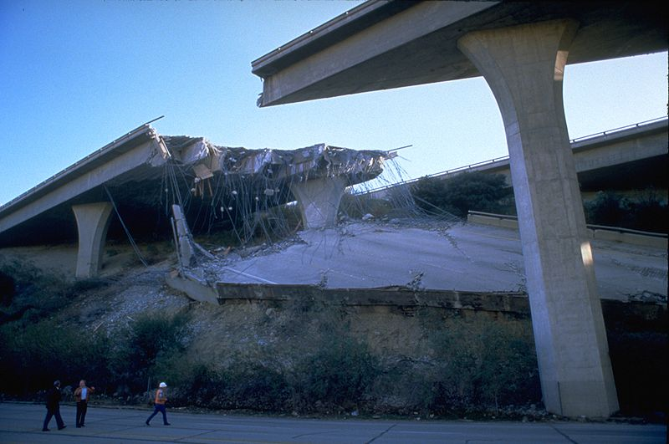
Chris Joncas
Emergency Operations Project Manager
Maintenance & Asset Management Division

Slide 2
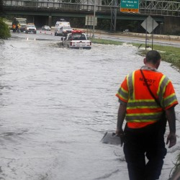
Hurricane Katrina in 2005 was the Watershed Moment for changing the way things work!
Fire , Law Enforcement and FEMA figured out what we (the DOT) already knew!
DOT’s play an absolute key role in response and recover efforts.
DOT’s have a statewide footprint
DOT’s have very large inventories of equipment (NDOT has over 8,000)
DOT personnel have years of experience and knowledge,
expertise on terrain and equipment

Slide 3
Who we are and What we do!
Three of us! (We are not First Responders) (District Personnel are)
Chris Joncas – NDOT Project Manager-EM/HS
James Walker – NDOT Emergency Manager
Victoria Thompson – Engineering Tech EM/HS
In 2007 we created the NDOT Emergency Management & Homeland Security Section
Our only function is Emergency Management/Homeland Security
Day one we began to establish policies, procedures and guidelines
We continually provide scenario based training to NDOT Executive Management, Senior Management, Division Heads, District Heads and other management staff.

Slide 4
Who we are and What we do!
We continually update our written plans for necessary changes
Created the NDOT Headquarters Emergency Operations Center (EOC)
Are working to get an Alternate EOC at the new Roop Street annex.
We work hand in hand with the Nevada Division of Emergency Management (NDEM) (Fairview Drive - Carson City – National Guard Facility)
Work with the three Fusion Centers (Carson, Reno, LV)
To coordinate the exchange of intelligence information on a national, statewide and regional basis. “Fusion” of information, sharing and analysis center
(FBI, DHS, Local)

Slide 5
“Every state DOT must consider all hazards emergency management
and security as an integral part of its operational agenda"
(SCOTSEM)
SCOTSEM
Irvine, CA
August 2012

Slide 6
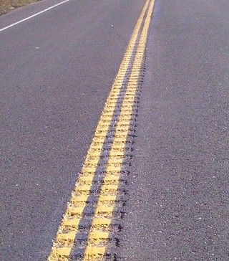
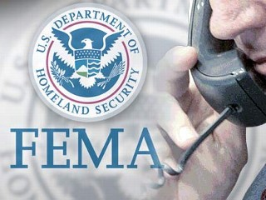
NDOT is primary agency responsible for:
Infrastructure issues
Airports
Rail
Public transportation We provide statewide support by supplying personnel in the SEOC to manage transportation related issues
State Emergency Operation Center
(SEOC) ESF-1
Operation Rumble Strip
February 27, 2013
Large Scale “Functional” exercise
150 participants
Districts I, II, III

Slide 7
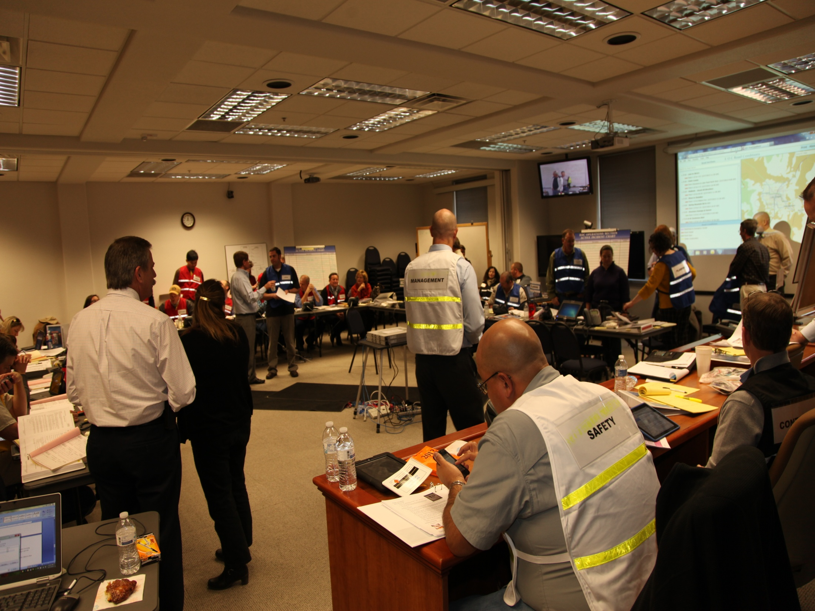
NDOT HQ
Emergency Operations Center (EOC)

Slide 8
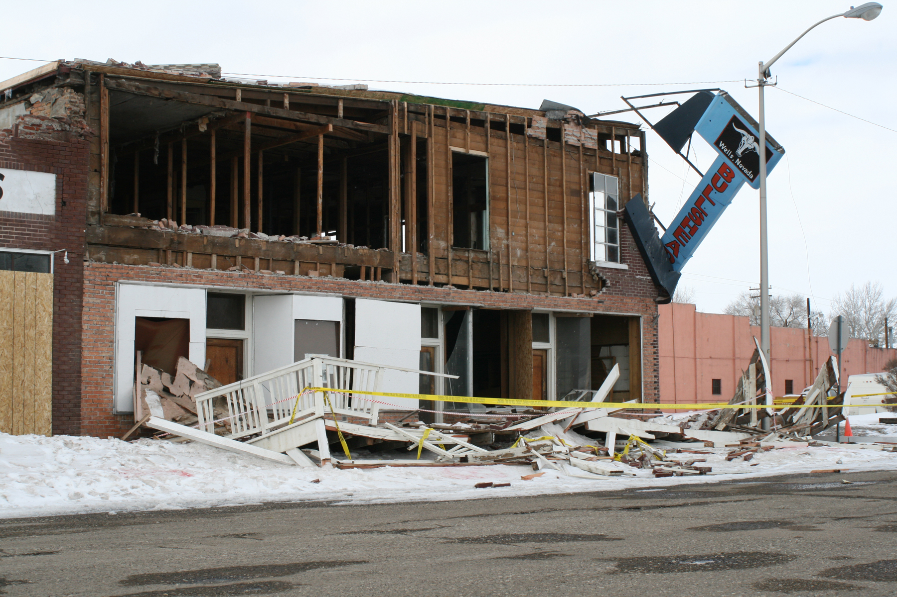
Wells Nevada Earthquake
February 21, 2008

Slide 9
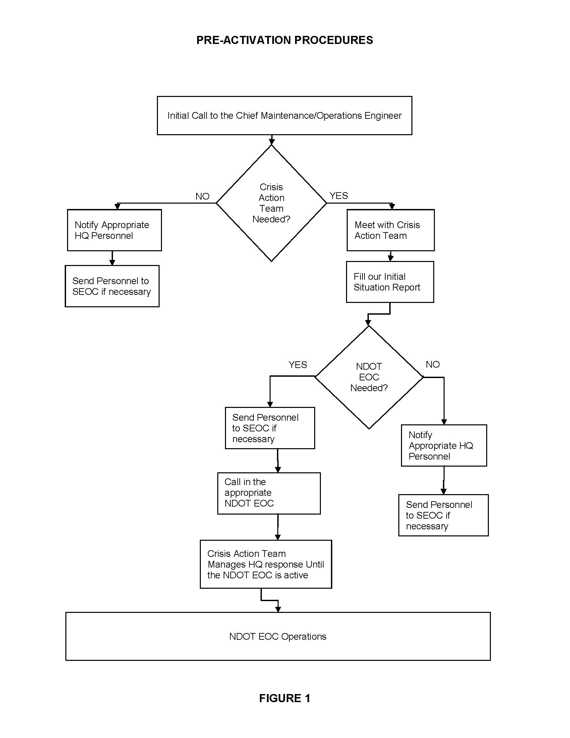
Crisis Action Team (CAT)
NDOT Executive Management
Chief Maintenance & Asset Management Engineer
The CAT will initiate NDOT’s response efforts.
During an event my group will act as advisors to NDOT Executive Management.

Slide 10
SEOC and NDOT EOC Activation ?
Emergency/Disaster occurs
NDOT Duty Officer (Emergency Management Section) is notified
Duty Officer Notifies the Chief Maintenance and Asset Management Engineer
Crisis Action Team (CAT) Convenes (Phone, in person, video conference)
Decision: Duty Officer can provide necessary support to the District (No Activation)
or ESF-01 personnel only (If NDEM Activates the SEOC)
We would send four NDOT staff to the SEOC, as this would be sufficient to support the District. or More than four people are necessary to provide proper support to the District
NDOT EOC is activated (ICS-Expands and contracts as necessary)

Slide 11
Performance Measures
“Emergency Management Security and Continuity of Operations”
AB595 - Performance Measures (#11)
Emergency Plans have been:
Trained
Education Provided
Exercised
Updated
Within a two year cycle.

Slide 12
7 Original Emergency Management and Homeland Security Plans
State Level Emergency Operations Plan
Continuity of Operations Plan
District Level Emergency Operations Plan
Southern Nevada Evacuation Plan
Mobile Fleet Security Plan
Infrastructure Security Plan
Department Access Management Plan

Slide 13
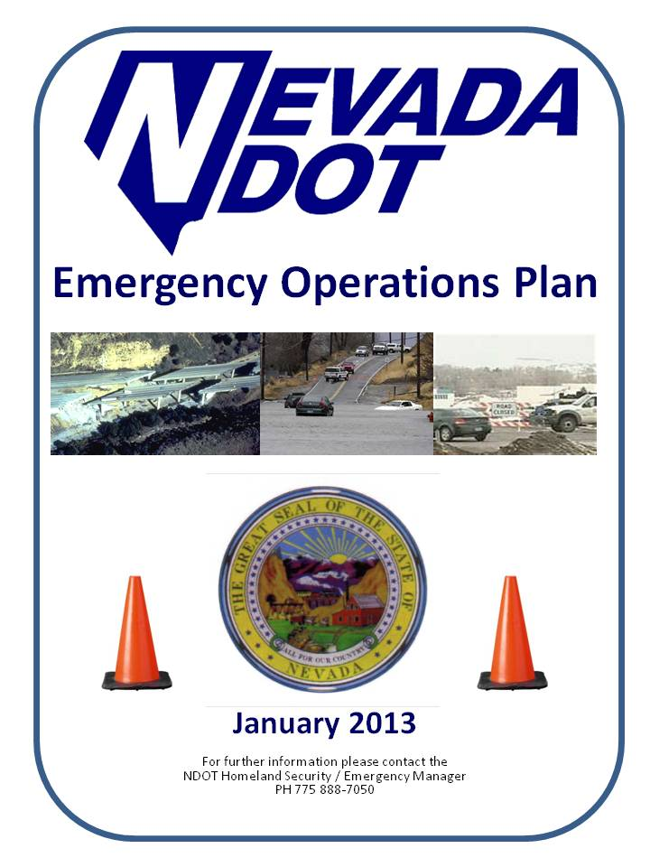
Seven overall plans combined into two
Department Access Management Plan
Became a Transportation Policy (TP)

Slide 14
Continuity of Operations (COOP) Planning
HQ Mission Essential Functions Indentified
District Mission Essential Functions Indentified
Provide direction to keep NDOT operational during an event.
Ensures the preservation, maintenance and reconstitution of NDOT’s essential functions
COOP was embedded into NDOT’s EOP.
Governor is mandating a COOP planning for all state departments. NDOT is way ahead of the curve, we are done with ours.

Slide 15
State and Federal Guidelines
HSEEP (Homeland Security Exercise & Evaluation Program
Standardized methodology and terminology for exercise design, development
(NIMS) National Incident Management System Protocol
Structured framework used nationwide for both governmental and nongovernmental agencies to respond to natural disasters and or terrorist attacks
44 CFR § 206.4
States - prepare for and respond to major disasters and emergencies
Homeland Security Presidential Directive – 5 (Post 9/11)
Government shall establish a single, comprehensive approach to domestic incident management
Homeland Security Presidential Directive – 8 (Post 9/11)
Mechanisms for improved delivery of Federal preparedness assistance to State and local governments
AB595 Performance Measures (#11)
Maintain NDOT’s seven emergency plans (updated, tested and exercised)
(SCEMP) State Comprehensive Emergency Management Plan
State agencies are directed to prepare a plan to protect government resources, facilities and personnel.

Slide 16
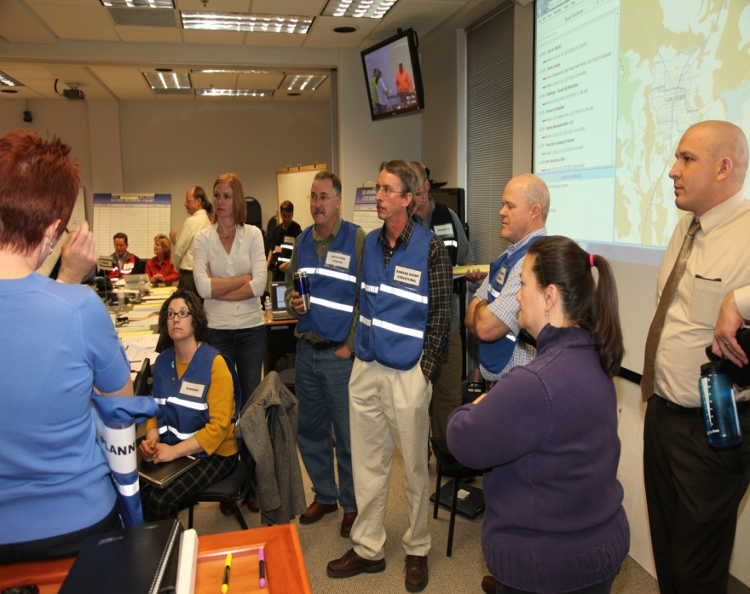
Training, Training, Training!
You can have all the written plans you want!
But if you don’t conduct exercises to test the plans or provide hands on training, then all those written plans mean nothing!
The training never stops!
Procedural Changes
Retirements of personnel
Transfers of personnel
Job description changes
State and federal guideline changes

Slide 17
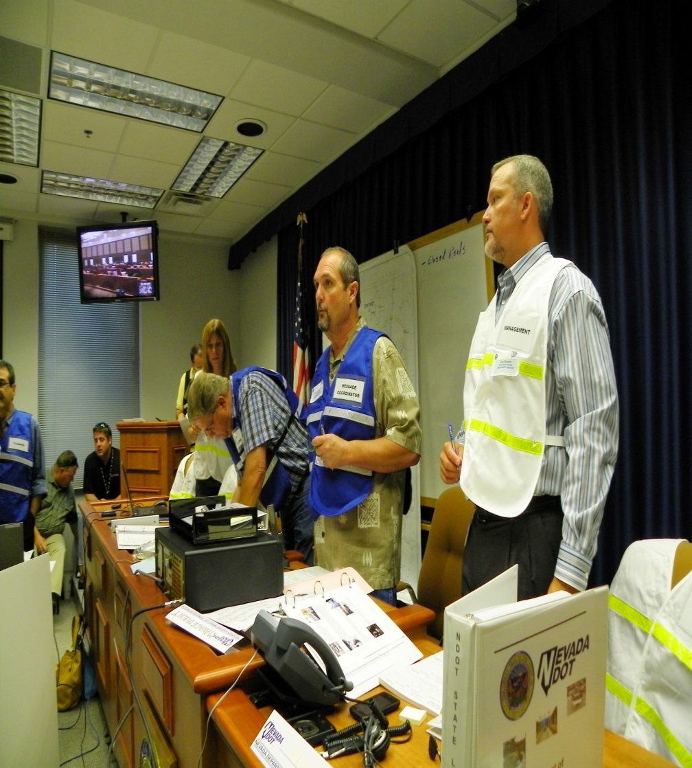
How we do it!
FEMA defines exercises into two categories:
Discussion based
Tabletop
Workshops
Drills
Operation based
Functional
Full-scale
Tabletop
Functional

Slide 18
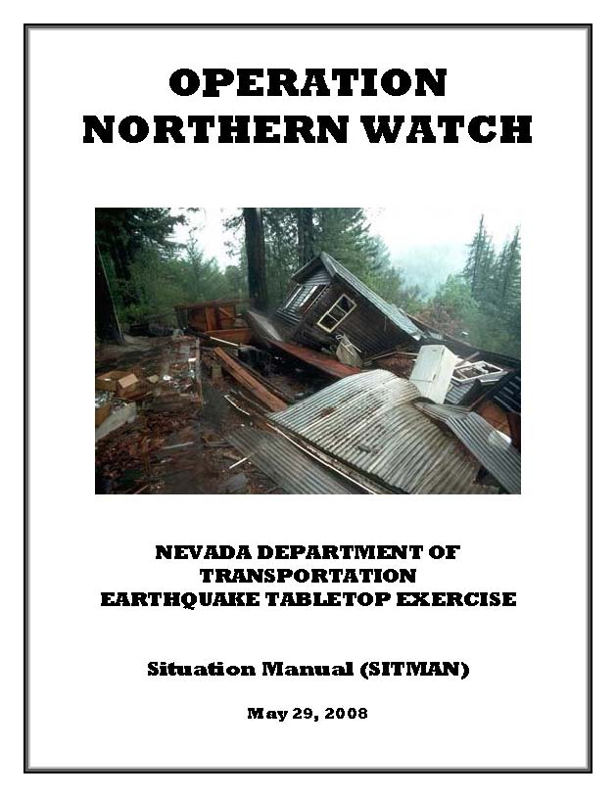
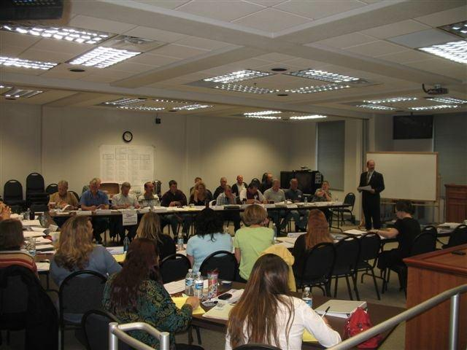
Operation “Northern Watch” May of 2008
Scenario: Earthquake (Reno/Carson)
Classification: Tabletop Exercise

Slide 19
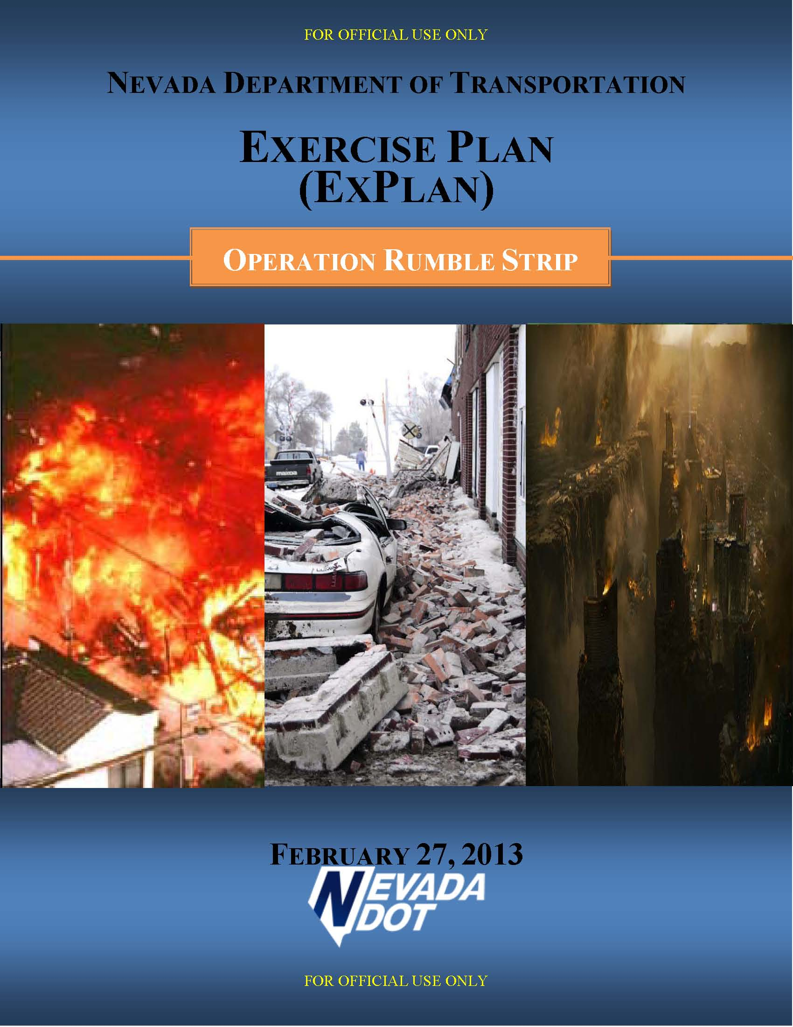
Operation “Rumble Strip”
Scenario: Earthquake (Las Vegas)
Classification: Functional Exercise

Slide 20
Operation Rumble Strip
(February 27, 2013)
Operation Northern Watch
Functional Exercise over 100 participants
Incorporated a “Shift Change”
Coordination with outside agencies
One year to develop this exercise
Tested the EOP revisions

Slide 21
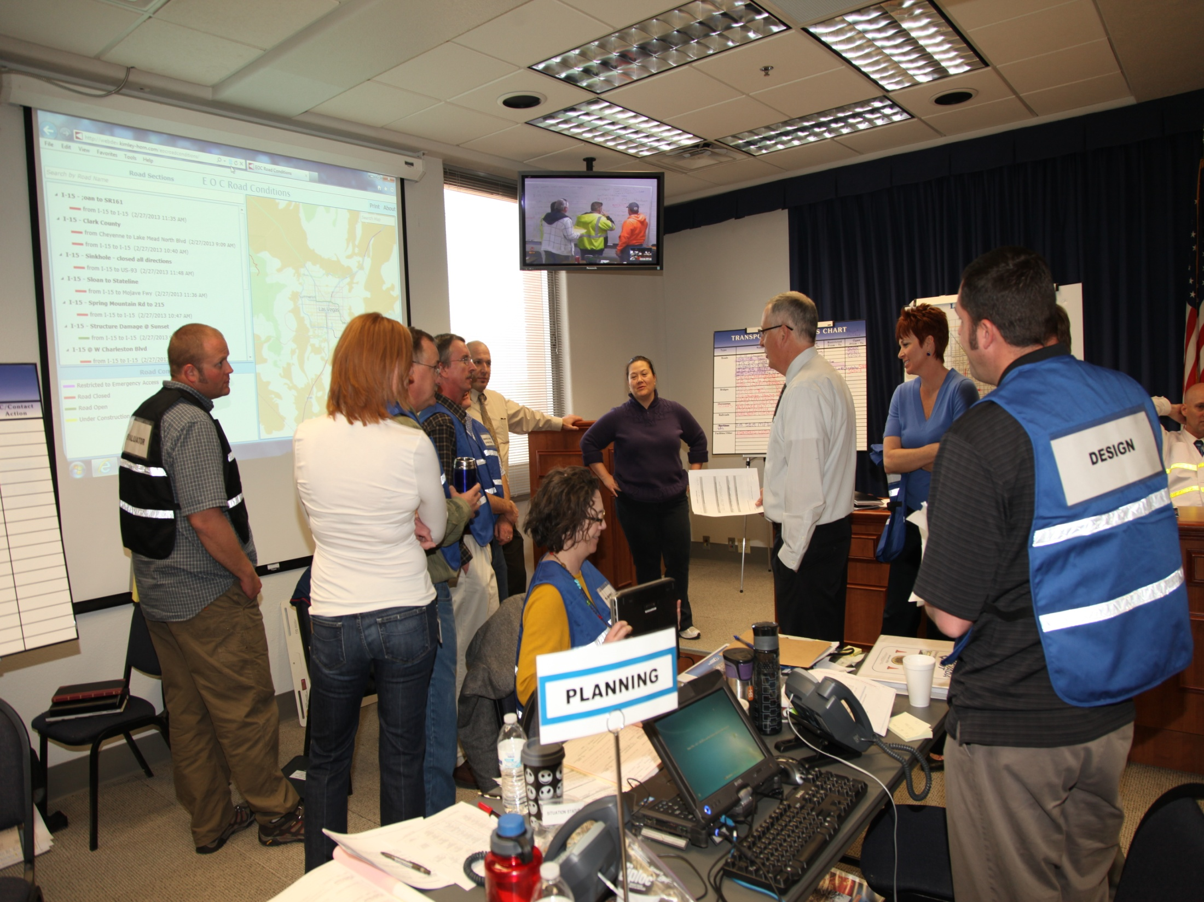
Operation Rumble Strip (February 27, 2013)
Reality based exercises

Slide 22
“Operation Rumble Strip”
(February 27, 2013)

Slide 23
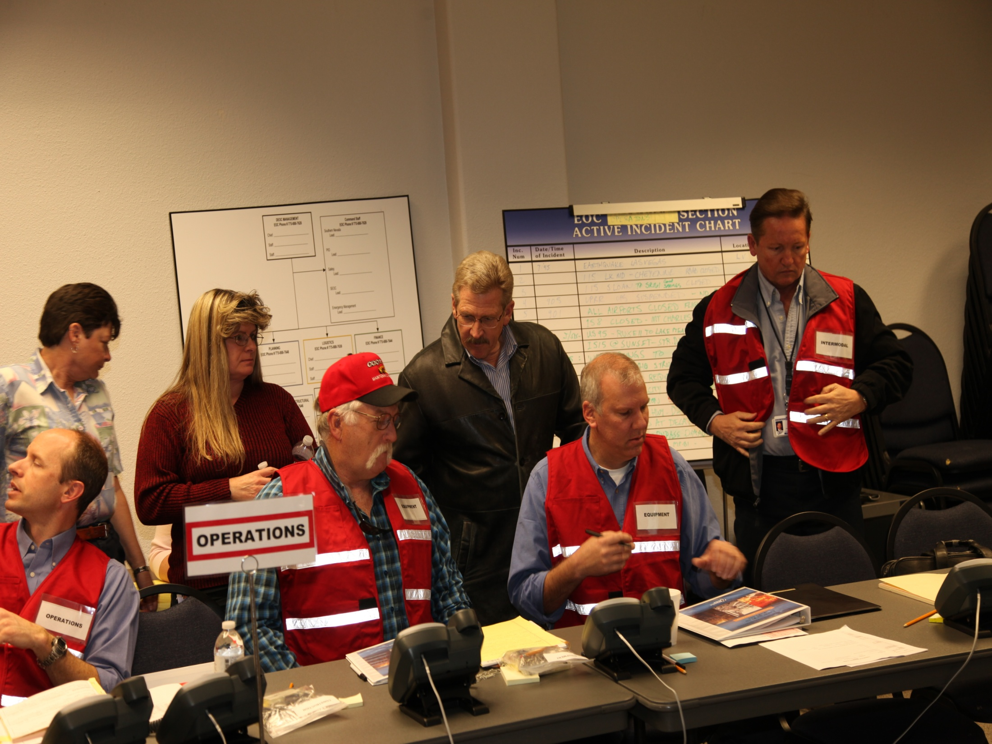
“Operation Rumble Strip”
(February 27, 2013)

Slide 24
“Operation White Tiger”
After Action Report (AAR/IP)
Operation Northern Watch
Absolutely necessary!
Actually, its mandated! (HSEEP)
Positives
Negatives
Areas for Improvement
Schedule for Improvements

Slide 25
NDOT HQ EOC will provide support to the impacted District (s). However, we will not manage the event. The people best qualified to manage an event are the local personnel on scene, the districts . We are here to assist them with resources.

Slide 26
The perception of Fire and Police as the Only “First Responders” is changing.
DOT’s and Public Works agencies are doing more and more everyday.
A Firefighter asked what good an
Equipment operator (such as a backhoe) in Self-contained breathing apparatus would
be on a fire scene. The answer was “a lot more effective than a firefighter with a shovel”.

Slide 27
Exercises we have conducted
Operation “Alpha Shield” - (Security) Table Top Exercise January 2008
Operation “Northern Watch” - (Earthquake) Table Top Exercise May 2008
Operation “Eagle Eye” - (Flood) Functional Exercise July 2009
Operation “Solid Shield” - (Earthquake) Table Top Exercise March 2010
Operation “Safe Route” - (Terrorist) Table Top Exercise April 2011
Operation “Watchful Eye” - (Terrorist) Table Top Exercise January 2012
Operation “Rumble Strip” - (Earthquake) Functional Exercise February 2013

Slide 28
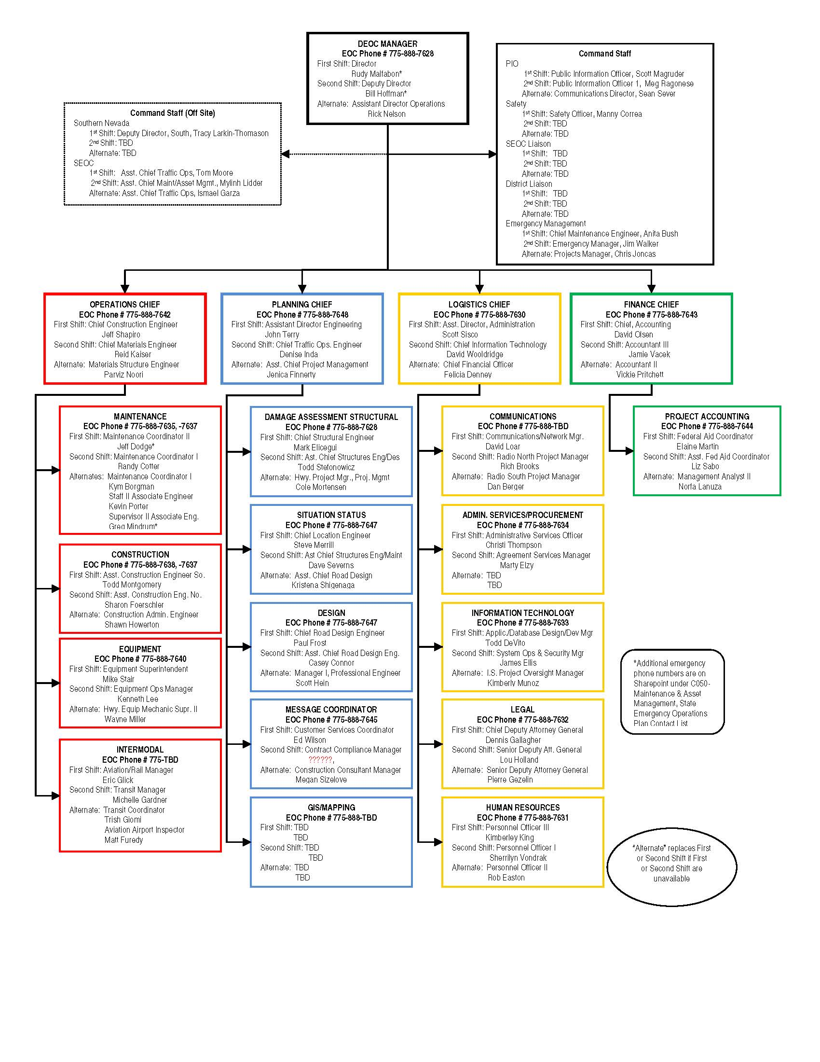
Incident Command System
Is the national standard
For emergency response, NDOT employs this system
Re-write
Easier to read/use
4 EM Plans into 1

Slide 29
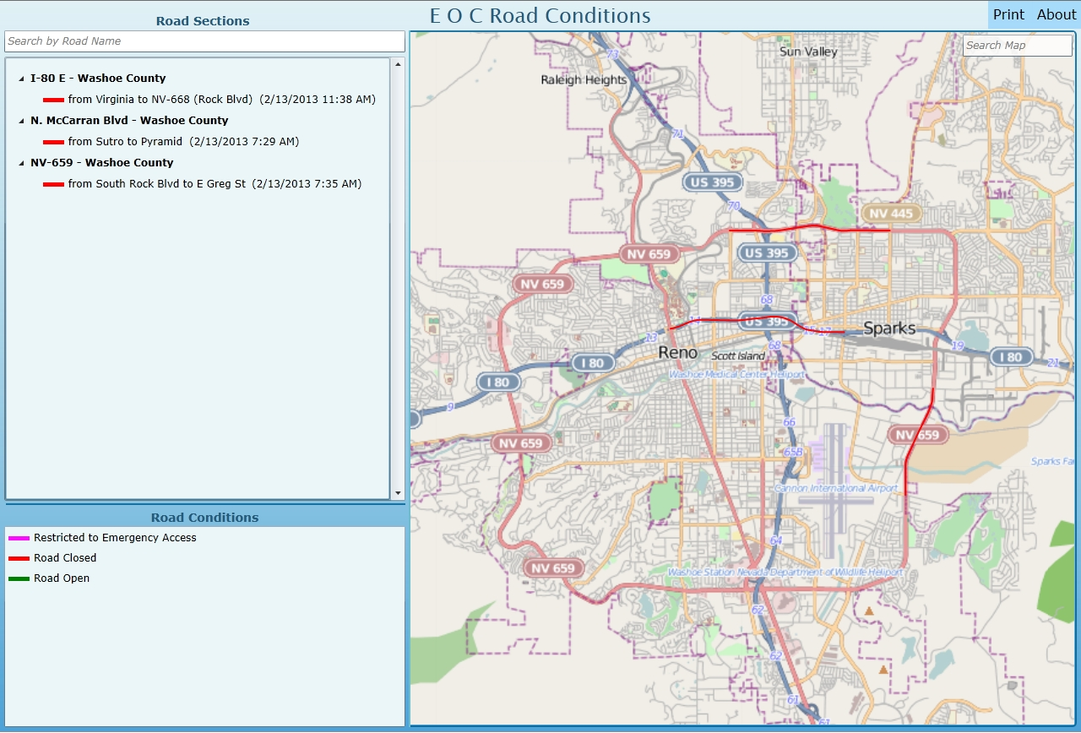
Technology!
Emergency Operations Center (EOC) - Mapping Program
Web-based, intuitive, scope called for operational on network or standalone.

Slide 30
New Phones and Vests
Technology improvements
in NDOT EOC

Slide 31
New Phones and Vests
Conclusion
The key to effective
Emergency Management & Homeland Security is communication and coordination!
To achieve this:
We continually train, exercise and update our plans.
We apply the lessons learned from our exercises to our written plans and procedures.
We include outside agencies in our planning and exercises.
If an event were to occur NDOT will be ready!

Slide 32
New Phones and Vests
Thank you!
Questions?
Chris Joncas – Project Manager Emergency Mgmt/Homeland Security
cjoncas@dot.state.nv.us
(775) 888-7837
James Walker – NDOT Emergency Manager
jwalker2@dot.state.nv.us
(775) 888-7862

