Slide 1


Warm-mix Asphalt Experience in Nevada: Case Studies
Presented at Nevada Transportation Conference
March 22, 2011
Presented by:
Elie Y. Hajj, Ph.D.
University of Nevada Reno – UNR
Western Regional Superpave Center – WRSC

Slide 2
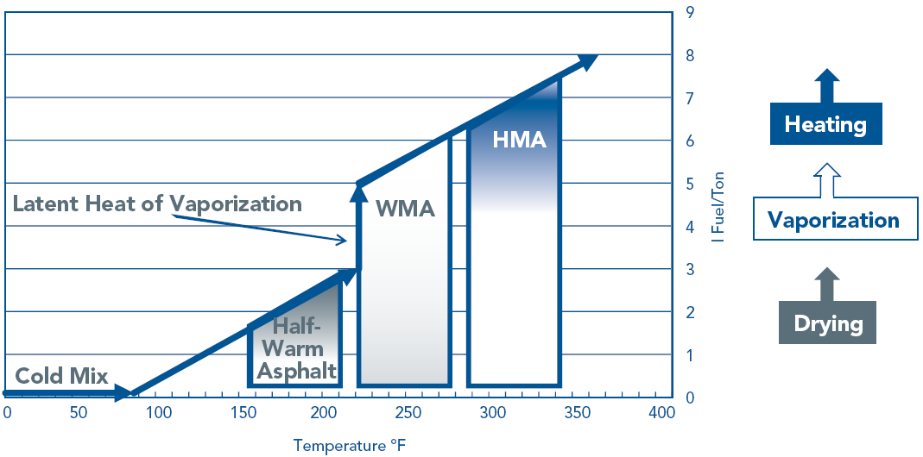
Warm-Mix Asphalt
Temperature Range
After FHWA Report FHWA-PL-08-007
Ambient
Below water vaporization
290°F – 345°F
220°F-280°F

Slide 3
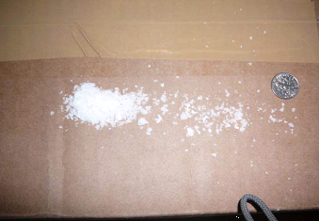
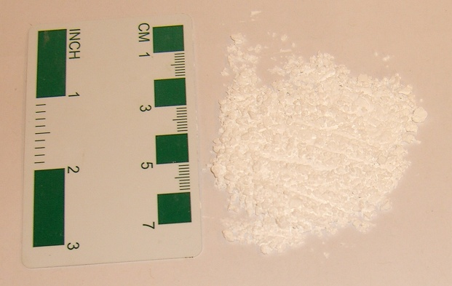
WMA Technologies
WMA Technologies
Organic
Additives
Water-Bearing
Water-Based
Chemical Additives
EvothermTM, RedisetTM & RevixTM
Double-Barrel® Green, WAM-Foam, LEA & Ultrafoam GXTM
Zeolites
e.g. Aspha-Min® & Advera®
Waxes
e.g. Sasobit®
Notes:
When making foamed asphalt, a small percentage of water is injected into the center of the asphalt flow. It is usually about 1 to 2% by weight of binder.

Slide 4
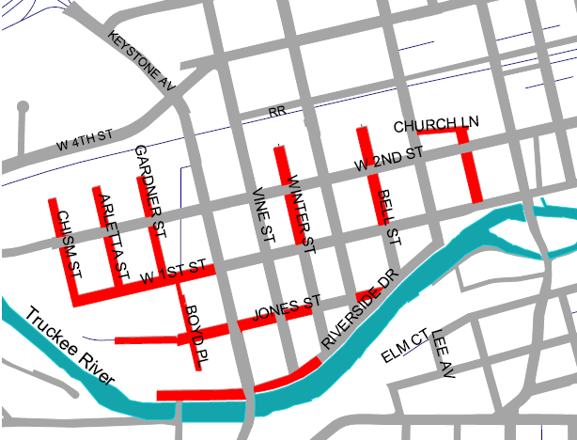
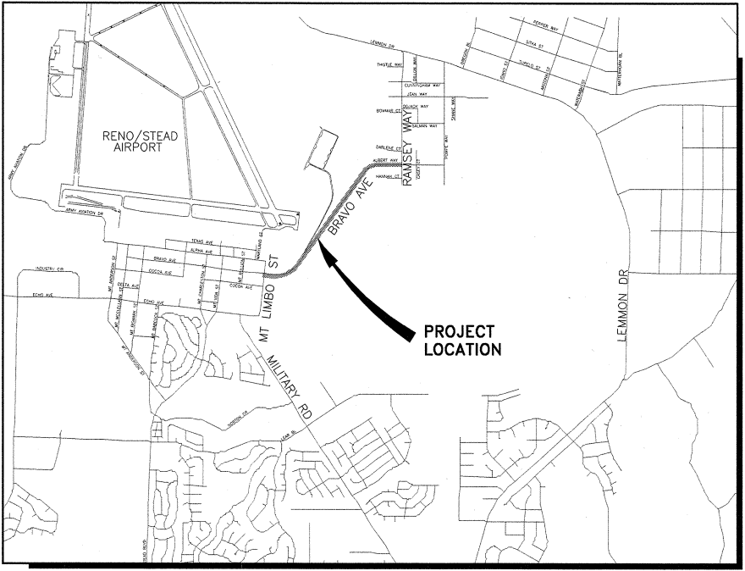



Field Projects: Case Studies
Chism Str. (2009) Bravo Av. (2011)

Slide 5

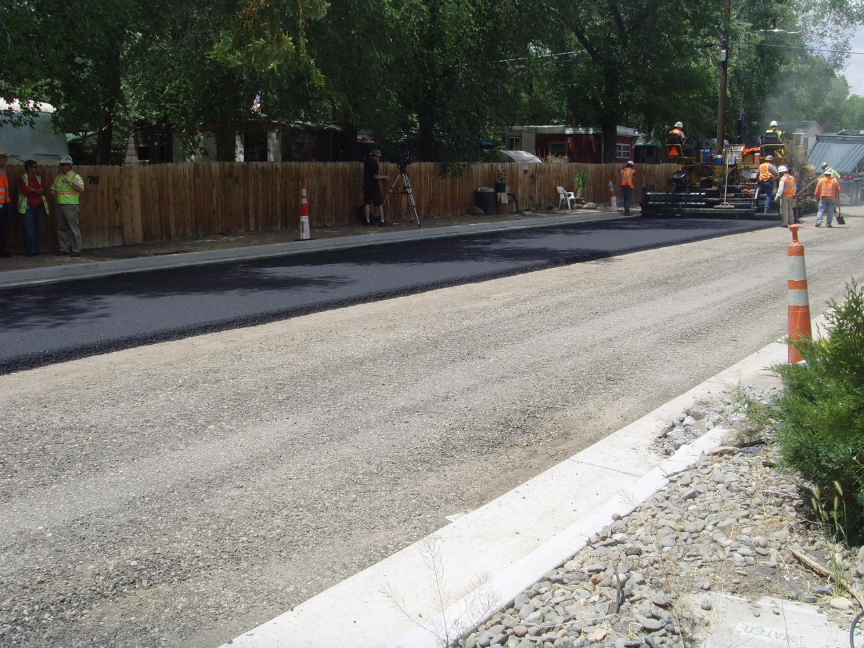
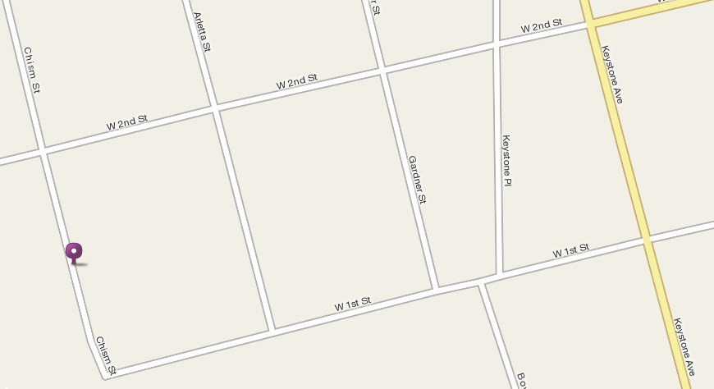
CHISM STREET
Placed on June 11, 2009 on a test trip along Chism Str. – Reno, NV

Slide 6
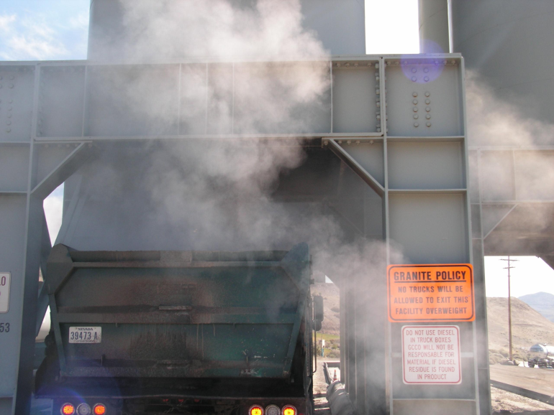
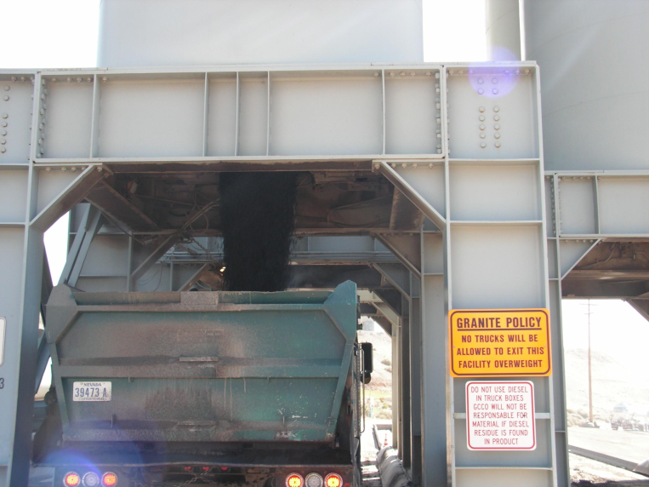
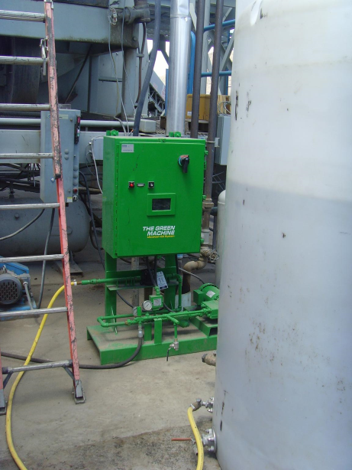
CHISM STREET
Granite Constr. plant (Lockwood, NV): Ultrafoam® GX
Water addition rate: 1.25% by weight of binder
PG64-22 , Type 2, 50 blows, 4% AV, Marshall Mix design
15% RAP
1.5% lime on the fly
HMA
WMA

Slide 7
CHISM STREET
WMA temperature:
  recorded at both plant & in the field during lay-down & compaction using an infrared heat gun.
Temp. of WMA as it came out the plant: 260-270°F
Average lay-down temp. = 250°F → used in all the lab experiment.

Slide 8
Overall Objective
Evaluate rheological properties of recovered asphalt binder from the WMA mix.
Evaluate impact of curing time on volumetric properties of WMA mix.
Evaluate mechanical properties of WMA mix.

Slide 9
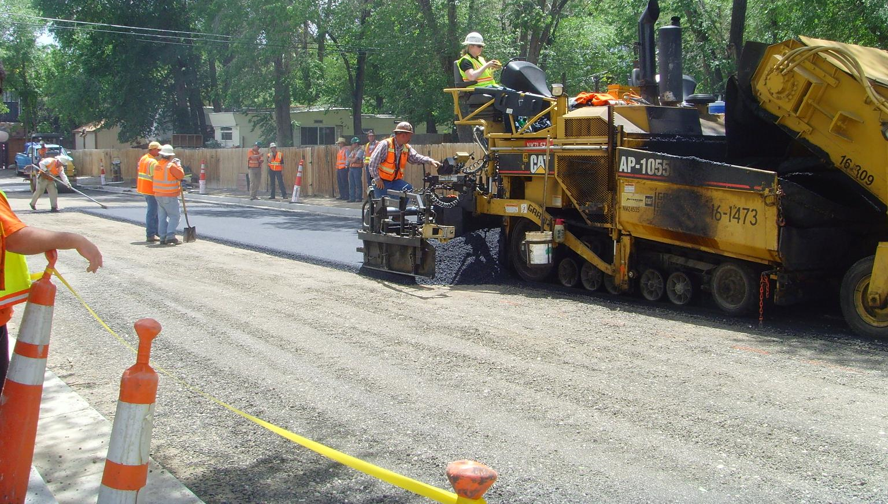
Materials
Two set of WMA mixes were sampled during production at the Granite asphalt plant.
  1st set was brought to UNR laboratory
  2nd set of samples was transferred to the on-site laboratory for Granite construction.
  Cold feed, RAP & asphalt binder were sampled during production & shipped to UNR.
  produce lab HMA mix to serve as a control mix.
Notes:
Mixture was sampled into tightly-sealed buckets.
haul time between plant & UNR ~ 20-30 mins ≡ haul time between plant & paving site.

Slide 10
Laboratory Evaluation
Granite
Volumetric Properties
UNR
Volumetric Properties
Mechanical Properties
Binder Properties
Curing at 250°F for:
0, 2, 4 & 15 hrs
- Gmm
- Marshal Air-Voids
- Marshal Stability & Flow
Curing at 250°F for:
4, 6, 8 & 24 hrs
Gyrations to 92% & 98% Air-Voids @ 300 kPa (N92 & N98)
-Samples compacted right-away
-Reheated Samples
- |E*| @ 0, 1 & 6 F-T
- FN
- TSRST
Experimental Program (WMA, HMA-Lab)
Extracting/ Recovering binder
DSR, G*/sinδ
2D Image Processing
-Aggregate Contact points
-Gradation

Slide 11
Evaluated Mixes
WMA-no reheat:
  Compacted right away (at delivery) or after curing in a sealed container at 250°F.
WMA-reheat:
  Reheated loose mix for 4 hrs at 275°F & then conditioned at 250°F before compaction.
HMA:
  Lab manufactured.
  15% RAP & 1.5% lime w/o marination.
  Mixing temp = 310°F
  Compaction temp = 290°F

Slide 12
G*/sinδ of Recovered Binders

Slide 13
Marshall Air-Voids at Different Curing Periods (compacted at 250°F)

Slide 14
Marshall Stability & Flow at Different Curing Periods (compacted at 250°F)

Slide 15
Superpave Air-Voids at Different Curing Periods (compacted at 250°F)

Slide 16
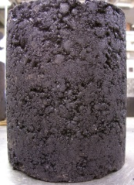
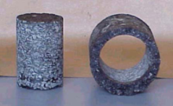
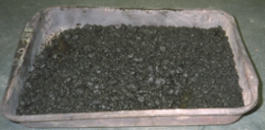
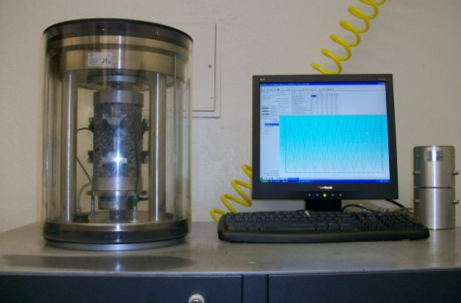
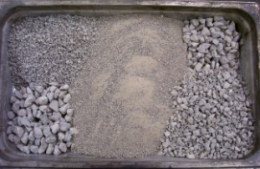
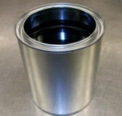
Stiffness – Dynamic Modulus
Samples Preparation & Testing
  0 F-T Cycle
  1 F-T Cycle
Field WMA
No Reheat
  6 F-T Cycles
WMA-No Reheat
  0 F-T Cycle
Reheat
  1 F-T Cycle
Lab HMA
  6 F-T Cycles
WMA-Reheat
4 hrs @ 275F
  0 F-T Cycle
  1 F-T Cycle
  6 F-T Cycles
HMA-Lab Produced

Slide 17
Dynamic Modulus
Mix | |E*| at 70⁰F (ksi) |  |  | |E*| at 100⁰F (ksi)
 | 0 F-T | 1 F-T | 6 F-T | 0 F-T | 1 F-T | 6 F-T
WMA-no reheat | 743 -- | 576 (77%) | 600 (81%) | 212 -- | 162 (76%) | 161 (76%)
WMA-reheat | 979 -- | 643 (66%) | 638 (65%) | 289 -- | 201 (69%) | 187 (65%)
HMA-lab produced | 979 -- | 620 (63%) | 714 (73%) | 273 -- | 192 (71%) | 187 (68%)

Slide 18
Rutting Resistance
Flow Number at 52°C
Notes:
78 psi deviator stress and 35 psi confining stress.

Slide 19
Low-Temperature Cracking Resistance
Mix | 0 F-T
 | Fracture stress (psi) | Fracture temperature (°C)
WMA-no reheat | 235 | -23
WMA-reheat | 177 | -23
HMA-lab produced | 180 | -19

Slide 20
Chism Street
Conclusions & Findings
Air voids requirement was still met after 4 hrs of curing in a sealed container at lay-down/compaction temperature.
Data from SGC show the loss of the foaming effect within 8 hours of curing.
Production testing for volumetric properties should be conducted within 4 hours of manufacturing the foamed WMA at the plant.

Slide 21
Chism Street
Conclusions & Findings
Mixes | HMA-Lab Produced
 | Moisture Damage Resistance | Rutting Resistance | Thermal Cracking Resistance
WMA-No Reheat | Similar | Lower* | Higher
WMA-Reheat | Similar | Lower* | Higher
* But the FN was still considered acceptable for the anticipated traffic level on Chism Street (< 0.3 million ESALs)

Slide 22
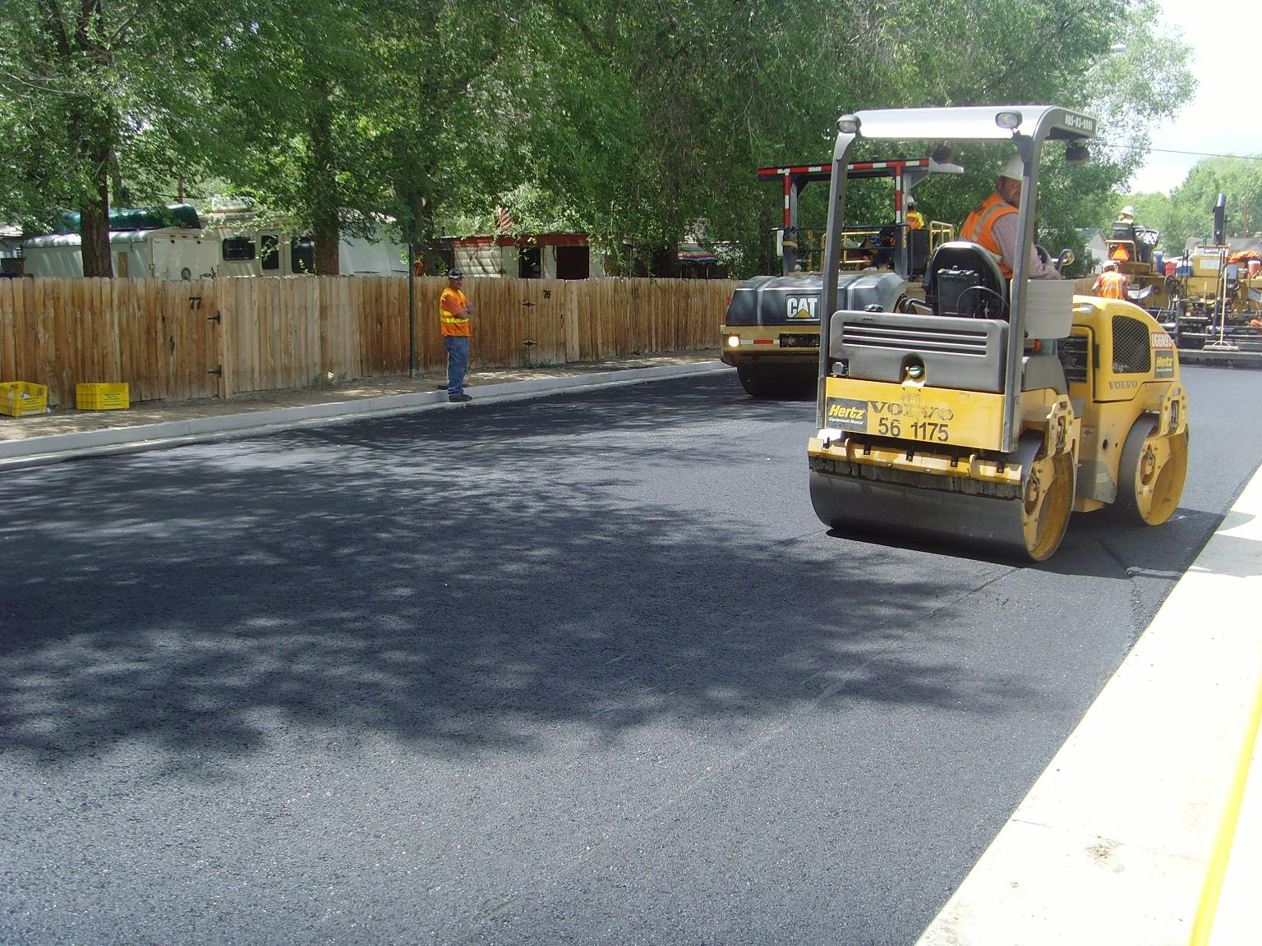
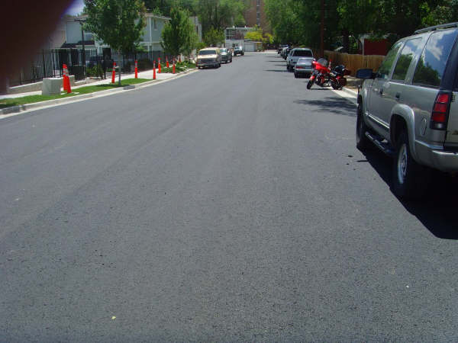
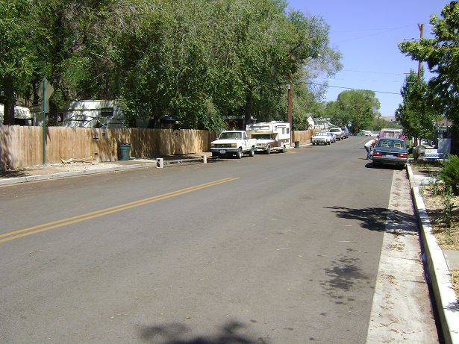
Chism Street
Field Performance
No Distresses observed in the WMA pavement after 21 months of service
→ The relatively low FN obtained in lab was sufficient on this project
06/11/09
06/14/09
07/27/10

Slide 23
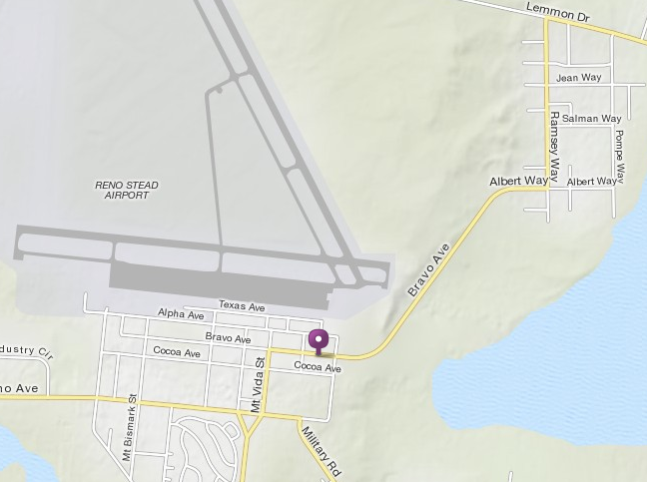
BRAVO AVENUE (August 2011)
Granite Constr. plant (Lockwood, NV): Ultrafoam® GX
Water addition rate: 1.25% by weight of binder
Type 2, 50 blows, 4% AV, Marshall Mix design
PG64-28NV
15% RAP
1.5% lime on the fly

Slide 24
Laboratory Evaluation
Experimental Program (WMA and HMA)
UNR
Asphalt Binder
Mechanical Properties
Granite
Volumetric Properties
Wood Rodgers
Volumetric Properties
Exposed to Air Curing at Laydown/ Compaction Temperature for 2 hours
-Gmm
-Marshall Air-Voids
-Marhall Stability & Flow
-Sealed Container Curing at Laydown / Comp Temp for: 0, 2, 4, & 15 hrs
-Exposed to Air Curing at Laydown / CompTemp for: 2 & 4 hrs
-Exposed to Air Cool to 100°C then Reheat for 2 and 4 hrs at: a) WMA laydown / comp temp & b) HMA laydown / comp temp
-Gmm
-Marhall Air-Voids
-Marhall Stability & Flow
Volumetric Properties
Compacted on Delivery And Reheated
- Lottman Test @ 0, 1, & 6 F-T
-|E*| @ 0, 1 & 6 F-T
-FN Test
-TSRST
-Sealed Container Curing at Laydown / Comp Temp for: 4, 6, 8, & 24 hrs
-Exposed to Air Curing at Laydown / CompTemp for: 2 & 4 hrs
-Exposed to Air Cool to 100°C then Reheat for 2 and 4 hrs at: a) WMA laydown / comp temp & b) HMA laydown / comp temp
N92 & N98 @ 300 kPa in SGC
Extraction/ Recovery
DSR (G*/sinδ)

Slide 25
Evaluated Field Mixes
HMA-no reheat:
  Compacted right away (at delivery) or after curing in a sealed container at 305°F.
WMA-no reheat:
  Compacted right away (at delivery) or after curing in a sealed container at 255°F
HMA-reheat:
  Reheated loose mix for 2-4 hrs at 275°F & then conditioned at 305°F before compaction
WMA-reheat:
  Reheated loose mix for 2-4 hrs at 275°F & then conditioned at 255°F before compaction

Slide 26
Number of SP Gyrations for
Different Curing Periods – Field Mixes

Slide 27
Dynamic Modulus – Field Mixes
Mix | |E*|, (ksi) at 70⁰F
 | 0 F-T | 1 F-T | 6 F-T
HMA-no reheat | 428 -- | 388 (91%) | 352 (82%)
HMA-reheat | 559 -- | 458 (82%) | 460 (82%)
WMA-no reheat | 392 -- | 377 (96%) | 339 (86%)
WMA-reheat | 443 -- | 393 (89%) | 412 (93%)

Slide 28
Rutting Resistance – Field Mixes
Flow Number at 58°C
Notes:
80 psi deviator stress and 30 psi confining stress.

Slide 29
Work in Progress
Complete Experimental Program Testing (including lab mixes)
Complete Data Analysis
Summarize findings

Slide 30
On-going/Future Nevada Studies at UNR
NDOT sponsored research:
      Lab Evaluation of Mixes Containing RAP & Warm-Mix Additives
    Northern and Southern NV aggregate sources
    Multiple WMA technologies
    0 and 15% RAP
    RTC sponsored research:
      Monitor field performance of HMA mixes with RAP
      Monitor field performance of WMA mixes
    Paramount Petroleum Co. sponsored research:
      Evaluate the use of WMA additives/technologies with modified asphalt mixtures (i.e. NV, PM, NVTR, TR binders) in NV & CA.

Slide 31
Acknowledgment
RTC and COR Support gratefully acknowledged.
Thanks to Granite Construction Inc. for their partnership in successfully conducting this study.
Thanks to UNR Graduate Students for their help in sampling and testing.

Slide 32
THANK YOU FOR YOU ATTENDANCE
Visit our websites at:
www.wrsc.unr.edu
www.arc.unr.edu

