Slide 1
State of Nevada
Department of Transportation
Nevada Transportation Conference
Susan Martinovich, P.E.
March 22, 2011
Notes:
Good Morning… Chair and Committee Members
I am Susan Martinovich – Director
Introduce Staff at table…. Scott Rawlins….. Robert Chisel…
Also introduce FHWA if they are present….

Slide 2
The Nevada Department of Transportation
Summary of Agency Operations:
The Nevada Department of Transportation (NDOT) is responsible for the planning, construction, operation and maintenance of the 5,400 miles of highway and over 1,000 bridges which make up the state highway system. This system carries 60% of total vehicle miles traveled in Nevada.
The department is also responsible for an integrated transportation system which supports travel by pedestrians, rail, bike, air, and bus, including providing the majority of federal funding for Nevada’s rural transit needs.
Highway Fund Agency:
Article 9, Section 5 of the Nevada constitution created the State Highway Fund with proceeds from licensing, registration, and other charges with respect to the operation of any motor vehicle upon any public highway in this state plus excise taxes on fuel (less administrative costs); and this fund is reserved exclusively for the construction, maintenance, and repair of public highways in Nevada. The Nevada Department of Transportation (NDOT) is funded with state highway funds and federal funds and does not utilize any general funds.
Notes:
I would like to provide a brief overview of the Department’s operations. NDOT is responsible for all the oversight of 5,400 miles of highway and over 1000 bridges that make up the state system.
These highways and bridges carry over 60% of the total vehicle miles traveled in Nevada.
We are also responsible for the oversight of many federal grant programs that provide funding for other transportation modes, including rural airports and rural transit, as well as funding for rail, bikes, and pedestrians.
We are funding through the State Highway fund, and work closely with the other highway funded agencies (DMV and DPS) and the Department of Administration to project and track highway fund balances.

Slide 3
Projected Overall Highway Fund Revenues and Expenditures
(Dollars in millions)
2011 – 2013 Biennium:
Revenue $1,578
Expenditures:
- NDOT $1,219
- Bond Repayment 161
- DMV 192
- DPS 136
- Other Agencies 8
(TSA, LCB, & other Public Safety)
Total Expenditures $1,716
Projected Ending Balance:
FY 2013 – June 30, 2013 $ 100
Notes:
This is a high level view of the Projected Overall Highway Fund Revenues and Expenditures.
NDOT is not the only agency that relies on the highway fund.
Our budget is developed and based upon having an ending balance in the highway fund of approximately $100 million.
Notes… not to say…. But if asked about why revenue less then expenditures..
Because of the large projects obligated over the last couple years, and through reimbursement by federal Highways, we have had more funding back into the highway fund.
Also projects get delayed for a variety of reasons…. Delays in Right of Way acquisitions, delays in approvals of the environmental documents, delays in having all the funding in place…. IE Federal CR’s…

Slide 4
State Highway Fund Projected Revenue
2011 - 2013 Biennium
Dollars in Millions
State Revenue
Miscellaneous Receipts
Federal Revenue
$
Highway Fund
Projected Revenue $1,578
Notes:
This is a pictorial view of what makes up the Highway Fund Revenue.
I would also like to point out the Federal Aid revenue. This revenue source is Authorized through a multi-year national highway bill. The current bill… SAFETEA-LU, expired on Sept 30, 2009. We have seen 6 continuing resolutions, with the latest that extend the funding to March 18 from March 4. The highway bill gets caught up with all the government bills, and we are awaiting to see what will happen.
In addition to a funding bill, Congress also must Appropriate each year, how much money from the Authorization bill that states will be allowed to spend.
The federal allocations are uncertain and therefore we have been conservative in our budgeting, but this uncertainty does effect timing of projects, as I do not know when, how much and under what criteria that our program must follow.
Also a note on federal money is we MUST spend it to get it.
Not Say… Unless asked….
You can see the LVCVA contribution. This was established through AB 595 during the 2007 Legislative Session that in counties that exceeded 400k, the convention authorities would contribute up to $300m for projects in those counties. This revenue has funded the Express Lanes on I-15 and is currently funding the I-15 Design Build South Project under construction that will add more capacity on I-15 from Blue Diamond to Tropicana.
Also as part of AB 595 a portion of the local property tax was diverted from the Counties to the Highway fund for use on projects in the specific county of origin. Our bi-ennium budget reflects this money to the General Fund and will not affect our project delivery.

Slide 5
American Recovery and Reinvestment Act
ARRA
ARRA provided approximately $201 million in highway funding. This funding required no state match.
71 highway projects (all contracts awarded)
Projects in every Nevada county
Expended Approximately $142 million
NDOT and other partners hosted workshops in Las Vegas and Reno to provide additional information for parties interested in bidding on recovery act projects.
These workshops were part of NDOT's Disadvantaged Business Enterprise program.
NDOT’s 2011 – 2013 budget does not include ARRA funding.

Slide 6
State Highway Fund Projected Expenditures
2011 – 2013 Biennium
Dollars in Millions
$
Highway Fund
Expenditures $1,716
Notes:
This is a pictorial view of the overall expenditures. NDOT’s budget that I will now get into is proposed at $1.2 million.

Slide 7
FY 2011 – 2013 Adjusted Base Budget
Notes:
This is NDOT’s base budget and the items that make up that budget.
The largest expenditure is our Capital Outlay… Money towards projects.
There are also some general maintenance projects that are included in the operating expenses as well.

Slide 8
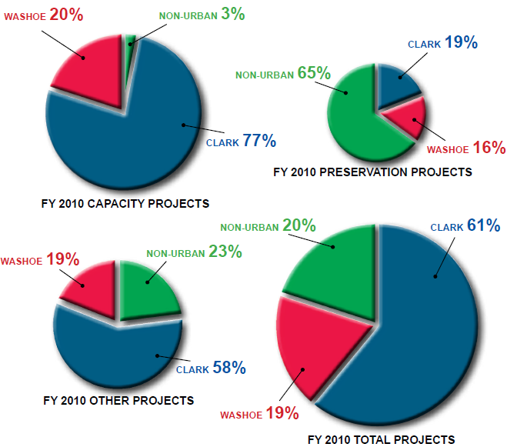
FY 2010 - NDOT PROJECT EXPENDITURES IN URBAN AND RURAL AREAS
FY 2010 - NDOT Expenditures in Urban and Rural Areas

Slide 9
FY 2011 – 2013
BUDGET SUMMARY
The department's budget request for the fiscal year 2011-2013 biennium was prepared with an emphasis on economy, efficiency, and safety.

Slide 10
State Highway Fund Projected Revenue
2011 - 2013 Biennium
Dollars in Millions
State Revenue
Miscellaneous Receipts
Federal Revenue
$
Highway Fund
Projected Revenue $1,578
Notes:
This is a pictorial view of what makes up the Highway Fund Revenue.
I would also like to point out the Federal Aid revenue. This revenue source is Authorized through a multi-year national highway bill. The current bill… SAFETEA-LU, expired on Sept 30, 2009. We have seen 6 continuing resolutions, with the latest that extend the funding to March 18 from March 4. The highway bill gets caught up with all the government bills, and we are awaiting to see what will happen.
In addition to a funding bill, Congress also must Appropriate each year, how much money from the Authorization bill that states will be allowed to spend.
The federal allocations are uncertain and therefore we have been conservative in our budgeting, but this uncertainty does effect timing of projects, as I do not know when, how much and under what criteria that our program must follow.
Also a note on federal money is we MUST spend it to get it.
Not Say… Unless asked….
You can see the LVCVA contribution. This was established through AB 595 during the 2007 Legislative Session that in counties that exceeded 400k, the convention authorities would contribute up to $300m for projects in those counties. This revenue has funded the Express Lanes on I-15 and is currently funding the I-15 Design Build South Project under construction that will add more capacity on I-15 from Blue Diamond to Tropicana.
Also as part of AB 595 a portion of the local property tax was diverted from the Counties to the Highway fund for use on projects in the specific county of origin. Our bi-ennium budget reflects this money to the General Fund and will not affect our project delivery.

Slide 11
National Issues – States View
Previous AUTHORIZATION bill SAFETEA-LU expired September 30, 2009
Multiple Continuing resolutions for funding – 6
Current programs are AUTHORIZED through September 30, 2011
APPROPRIATIONS only approved to ??? (was March 18 at time of this creation)

Slide 12
Proposals for New Authorization
Administration
Six-year $550 billion surface transportation program
Funding source not identified
Consolidates 55 highway programs into six
Safety $ 17b
National Highway $257b
Livable communities $ 28b
Research, Technology, and Education $ 4b
Federal Allocation (e.g. Federal Lands) $ 10b
Transportation Leadership Awards $ 17b

Slide 13
Adminstration cont.
High speed rail
National Infrastructure Bank
Transit Grants
House and Senate authorizing committees signaled they intend to introduce bills later this spring and summer
House T&I Committee Chairman John Mica – bill will be scaled to fit within the current revenue stream

Slide 14
Both the House and Senate have indicated that more fuel tax increases are off the table.
Current revenue stream will only support current program to 2013.
Susan’s view…. If no Authorization bill by September 30, then think.. HOPE.. For CR until after President Election then ?????

Slide 15
NDOT’s Plan of Action
Continue to work on MANY projects. Need to be ready at anytime with projects that qualify for unknown categories.
Work Nationally to ensure State’s have the flexibility…
Our Goal: Be at the right place, at the right time, with the right equipment.

