Slide 1
2011 Transportation Conference
Bill Hoffman, P.E.
Assistant Director – Engineering
March 22nd, 2011

Slide 2
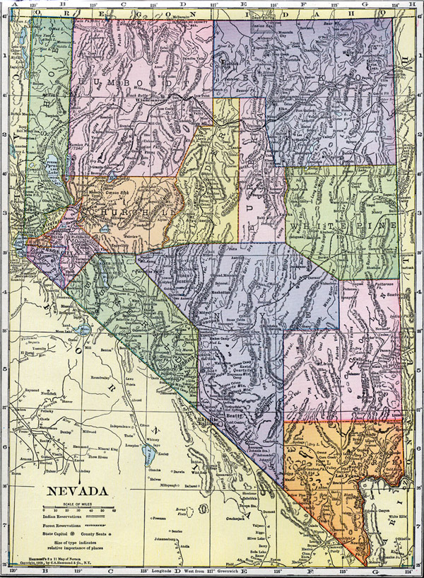
Presentation Roadmap
Major Projects - Defined
Major Projects Reporting Requirements
NDOT’s Efforts in Meeting Requirements
NDOT Report & Status of Projects
Notes:
Based on the Safe, Accountable, Flexible, Efficient Transportation Equity Act: A Legacy for Users (SAFETEA-LU), signed into law on August 10, 2005, a Major Project is defined as "a project with a total estimated cost of $500 million or more that is receiving financial assistance." Generally the Project Owner is the Transportation Agency (STA), but major projects can also be developed by other State Agencies (Toll Agencies), Local Public Agencies, and/or Private Ventures (e.g. Public Private Partnerships.)

Slide 3
Major Projects - Definition
SAFETEA-LU
"a project with a total estimated cost of $500 million or more that is receiving Federal assistance."
Project owner could be:
State Transportation Departments
Local agencies
Toll Authorities
Public Private Partnerships
Notes:
Based on the Safe, Accountable, Flexible, Efficient Transportation Equity Act: A Legacy for Users (SAFETEA-LU), signed into law on August 10, 2005, a Major Project is defined as "a project with a total estimated cost of $500 million or more that is receiving financial assistance." Generally the Project Owner is the Transportation Agency (STA), but major projects can also be developed by other State Agencies (Toll Agencies), Local Public Agencies, and/or Private Ventures (e.g. Public Private Partnerships.)

Slide 4
Major Projects – Definition (Cont.)
Projects < $500 million:
FHWA has the discretion to designate federal aid projects as a Major Project when:
Requires substantial agency time & resources
There is a high level of public or congressional interest
Unusually complex
Implications to the national transportation system
Exceeds $500 million over the life of the project
Notes:
the FHWA has the discretion to designate a project that has a total cost of less than $500 million and is receiving Federal financial assistance as a Major Project. The FHWA may choose to do so in situations that include, but are not limited to, those where the project: requires a substantial portion of State Transportation Agency (STA)'s program resources; has a high level of public or congressional interest; is unusually complex; has extraordinary implications for the national transportation system; or is likely to exceed $500 million in total cost during the life of the project.

Slide 5
Why all this Oversight?
FHWA’s role has shifted:
FROM project level engineering and construction oversight
TO a broader process and performance management approach…. Major Impact / Urban Corridor Focus
Avoid “alarming lapses in oversight”
Prevent “embarrassing fiscal debacles”

Slide 6
Why All This Extra Work?

Slide 7
FHWA List of NDOT’s Major Projects
Boulder City Bypass
NEON
US 95 North-West
I-15 North
I-15 South
Notes:
Doesn’t matter how many phases, packages or bundles you create.

Slide 8
Major Project Required Submittals
Cost Estimate Review (CER)
Financial Plan
Project Management Plan

Slide 9
1. Cost Estimate Review (CER)
Unbiased risk-based FHWA review to verify the accuracy and reasonableness of the anticipated total project cost
Requires probability ranges for the cost estimate that represent the project’s current stage of design.
CER is performed by FHWA HQ staff
Typically 3-5 days
The CER is the basis of the financial plan

Slide 10
Cost Estimate Accuracy & Timing
High
Ability to make changes
Cost of making changes
Degree of
Change
Best Opportunity
for Improvement
Low
Planning
Design
Construction
Time
Notes:
It really comes down to when you lock-down your most accurate estimate and whether you’ve accurately identified all your risks.

Slide 11
Risk Management
Identify Risks as Early as Possible
NDOT’s Goal: Implement Risk Management Processes for ALL Projects
Effort (Cost & Time)
Notes:
Risk management is an integral part of project management process. The primary goal of risk management is to optimize project performance. By identifying project risks and anticipating potential problems early during project development, strategies can be implemented to manage project risks and thus improve project performance.
Project will perform poorly if the project risks are not managed. Even a best planned project (solid line during the planning phase), will perform poorly (will follow the dashed line) if the project risks are not well managed or risk management is ad-hoc.

Slide 12
Risk Analysis (>$100 Million)
Threats and Opportunities analysis:
Review project Cost and Schedule elements
Develop associated cost scenarios for each Threat & Opportunity
Develop probability assumption curves
Perform a Monte Carlo Simulation to generate a project estimate and schedule forecast as a range
“What-If” Scenarios

Slide 13
2. Financial Plan
SAFETEA-LU Requirements:
Threshold (all costs: PE, ROW, Utilities, Construction, CE, etc.)
>$500 million: Financial plan requires concurrence from FHWA HQ
$100 to $500 million: Financial plan is expected, but review is at discretion of Local FHWA Office
Notes:
For Major Projects, the recipient of Federal financial assistance must prepare and submit to the FHWA a Project Management Plan and a Finance Plan for approval at the major milestones as specified in the FHWA Major Project Deliverable Timeline.
While the preparation of the Financial Plan is also expected of Projects between $100 and $500 million in cost, the submittal of the Financial Plan to the FHWA is not required. The Financial Plan of these projects, however, is subject to FHWA review upon request.
The recipient of the Federal financial assistance, most often the State Transportation Agency (STA), will be responsible for preparing and submitting the Finance and Project Management Plans to the FHWA. In the case of a P3 where there may be no federal assistance provided to the STA and the private entity delivering the project is securing a TIFIA loan, the private entity receiving the TIFIA loan will be responsible for submitting the Plans to the FHWA.

Slide 14
Financial Plan Requirements
Total Project Cost (Based on CER)
Revenue structure
Must provide reasonable assurance that sufficient financial resources are available to implement & complete the project
Annual updates
Typically all project stakeholders must endorse the plan
Notes:
A Financial Plan is a comprehensive document that reflects the Project's cost estimate and revenue structure and provides a reasonable assurance that there will be sufficient financial resources available to implement and complete the project as planned. Section 106(h)(3) of Title 23 states that a financial plan "is based on detailed estimates of the cost to complete the project and provide for the annual submission of updates that are based on reasonable assumptions, as determined by the Secretary, of future increases in cost to complete the project."
The FHWA has developed Financial Plan guidance that describes the contents of a Finance Plan that are necessary to meet the requirements of 23 U.S.C. 106. This guidance is intended to be a general framework for the Financial Plan, but not a prescriptive format. View the Financial Plans Guidance.

Slide 15
3. Project Management Plan
SAFETEA-LU, Section 106(h)(2) of Title 23
Project Management Plans shall "document the procedures and processes ………to effectively manage the scope, costs, schedules, and quality of, and …… document the role of the agency leadership and management team in the delivery of the project."
Management plan must include:
Communication processes
Management processes
Execution processes, and
Overall project controls
Notes:
The Project Management Plan is the guide for implementing the major project and documents assumptions and decisions regarding communication, management processes, execution and overall project control. The purpose of the Management Plan is to clearly define the roles, responsibilities, procedures and processes that will result in the project being managed such that it is completed on-time, within budget, with a high degree of quality, in a safe manner and in a way in which the public trust, confidence and support in the project will be maintained.
In accordance with Section 106(h)(2) of Title 23, as amended by SAFETEA-LU, a Project Management Plan shall "document the procedures and processes that are in effect to provide timely information to the project decision makers to effectively manage the scope, costs, schedules, and quality of, and the Federal requirements applicable to, the project. A Project Management Plan shall also document the role of the agency leadership and management team in the delivery of the project. It is essential that the Project Management Plan establishes the metrics by which success of the project is defined."
The FHWA has developed Project Management Plan guidance that describes topics that form the basic contents of a Project Management Plan that meet the SAFETEA-LU requirements. This guidance is intended to be a general framework for the Project Management Plan, but not a prescriptive format. View the Project Management Plan Guidance.

Slide 16
NDOT Project Management Processes
Notes:
16
The PMG defines a common approach for application of project management techniques that can be applied to all NDOT transportation projects. This structured approach will help project teams to think about project goals and risks; helps define, organize and plan their project; and guides project teams to monitor and control project performance from inception to completion.
The project manager uses the project management planning processes to develop the project management plan. The project management plan is the primary source of information for how the project will be planned, executed, monitored, controlled, and closed.

Slide 17
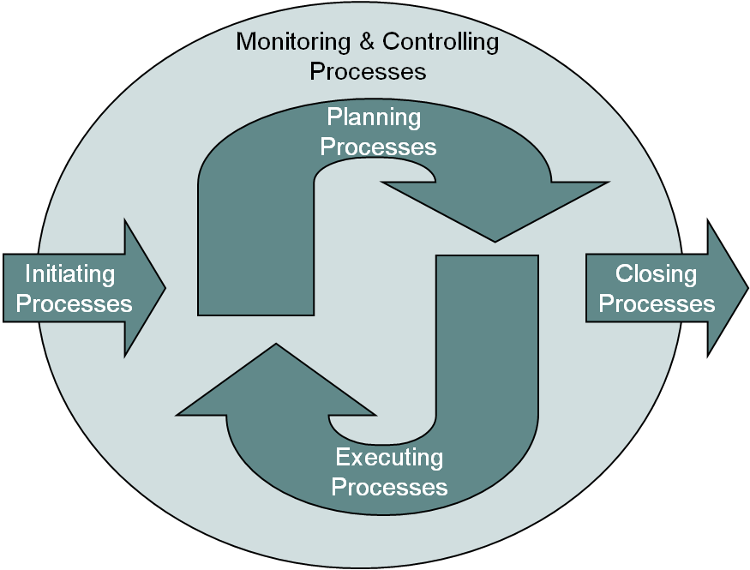
NDOT Commitments
NDOT will prepare a Program Level Management Plan per FHWA’s Major Projects requirements
NDOT will prepare a Project Level Management plan for each phase/package of the Major project following NDOT’s project management plan standards
Notes:
Using our Project Management Guidelines Manual, we plan to prepare both a program level management plan and a project level management plan.

Slide 18
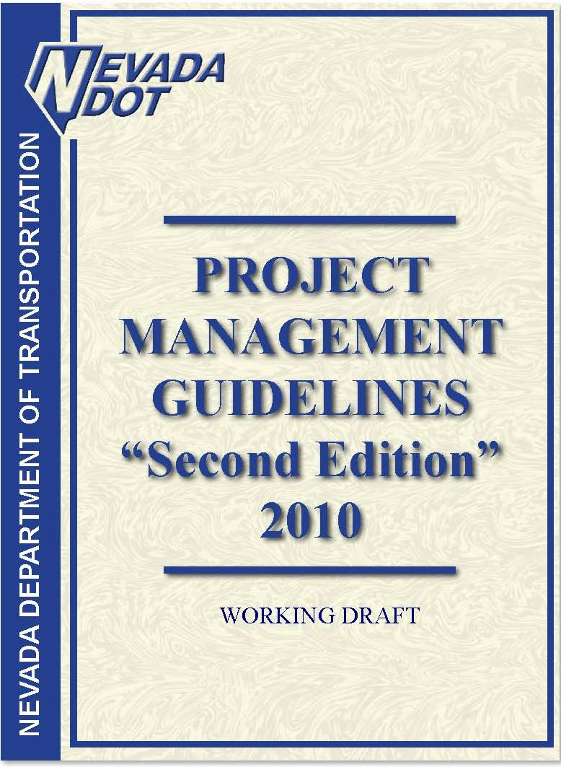
NDOT’s “Project Management Guidelines”
Project Management Institute –
“A Guide to the Project Management Body of Knowledge” (PMBOK)
Initiating
Planning
Executing
Monitoring & Controlling
Closing
Notes:
Project Management
The NDOT Project Management Guidelines (PMG) was developed based on the Project Management Institute – A Guide to the Project Management Body of Knowledge (PMBOK)
The NDOT Project Management Guidelines (PMG) was developed to :
improve project delivery,
improve team performance and
to satisfy legislative mandated reporting requirements. T

Slide 19
Deliverables Timeline
Cost Estimate Review (CER)
Finance Plan
Project Management Plan

Slide 20
Major Projects Deliverables Timeline
CER
FP
Management Plan
Notes:
In order for Federal funding to be authorized for the financing of Major Projects, the Project Owner must demonstrate to the FHWA that the project has been carefully planned out, i.e. costs have been estimated as accurately and meticulously as possible; risks have been carefully considered and mitigated; financing requirements and strategies have been clearly defined; and the implementation of the project delivery has been carefully planned.
Through the different phases of project delivery, Project Owners are required to submit financial and management plans and are subject to undergo various FHWA review processes before Federal funding can be released for the project. The FHWA Major Project requirements include:
Cost Estimating
Financial Plan
Project Management Plan
The timeline shown below identifies the major requirements and milestones for the three required processes, together with their relationship and other milestones in the overall program delivery process as it extends from planning to final design and right-of-way to construction.

Slide 21
NDOT Projects Status Report
I-15
14 Projects, $4.6 to $5.7 Billion
I-515/US-95
4 Projects, $3.3 to $4.5 Billion
US-95NW
5 Projects, $0.6 to $0.7 Billion
Northern Nevada
8 Projects, $2.5 to $3.2 Billion
Grand Total: $11 to $14.1 Billion
Notes:
I-15 North Phase 2
I-15 North Phase 3
I-15 / CC 215 Northern Beltway Interchange
I-15 NEON
I-15 Urban Resort Corridor Study
I-15 South Freeway Improvements Phase 1 Blue Diamond to Tropicana
I-15 South Bermuda Road Interchange
I-15 South Pebble Road Overpass
I-15 South Starr Avenue Interchange
I-15 South Cactus Avenue Interchange
I-15 South Las Vegas Boulevard
I-15 South Phase 1B From Blue Diamond to Tropicana
I-15 South Phase 2 Sloan Road to Blue Diamond
I-15 Sloan Road Interchange
I-15 Stateline to Sloan
I-515 Freeway Improvements – I-15 to Horizon Drive
I-515/US-95/US-93 Boulder City Bypass Phase 1
I-515/US-95/US-93 Boulder City Bypass Phase 2
US-93 Hoover Dam Bypass
US-95 Northwest Phase 1 Rainbow Blvd to Ann Rd
US-95 Northwest Phase 2 Ann Rd to Kyle Canyon Rd
US-95 Northwest Phase 3 CC-215 Beltway Interchange
US-95 Northwest Phase 4 Horse Ave Interchange
US-95 Northwest Phase 5 Kyle Canyon Rd Interchange
I-80 Robb to Vista
I-580 Freeway Extension
US-395 North McCarran Blvd to Stead Blvd
US-395 North Moana Lane to I-80
SR 445 Pyramid Highway Improvements
US-395 Carson City Freeway Phase 2B S. Carson St. to Fairview Dr.
US-395 Carson City Freeway Phase 2B Pkg 1 Clearview Dr to Fairview Dr
I-580 at Meadowood Mall Way

Slide 22
Project Status Report
I-15 Projects - $4.6 to $5.7 Billion
I-15 Urban Resort Corridor Study - Underway
I-15 North Phase 2 – Craig Rd. to Speedway Blvd. 2012
I-15 North Phase 3 – Speedway Blvd. to Apex 2014-2015
I-15 / CC 215 Northern Beltway Interchange - 2015-2016
I-15 NEON 2013 (several phases – Long Range)
I-15 South Design / Build - Blue Diamond to Tropicana
Under Construction – Complete 2012
I-15 South Bermuda Road Interchange – Long Range
I-15 South Pebble Road Overpass – Long Range
Notes:
I-15 North Phase 2
I-15 North Phase 3
I-15 / CC 215 Northern Beltway Interchange
I-15 NEON
I-15 Urban Resort Corridor Study
I-15 South Freeway Improvements Phase 1 Blue Diamond to Tropicana
I-15 South Bermuda Road Interchange
I-15 South Pebble Road Overpass
I-15 South Starr Avenue Interchange
I-15 South Cactus Avenue Interchange
I-15 South Las Vegas Boulevard
I-15 South Phase 1B From Blue Diamond to Tropicana
I-15 South Phase 2 Sloan Road to Blue Diamond
I-15 Sloan Road Interchange
I-15 Stateline to Sloan
I-515 Freeway Improvements – I-15 to Horizon Drive
I-515/US-95/US-93 Boulder City Bypass Phase 1
I-515/US-95/US-93 Boulder City Bypass Phase 2
US-93 Hoover Dam Bypass
US-95 Northwest Phase 1 Rainbow Blvd to Ann Rd
US-95 Northwest Phase 2 Ann Rd to Kyle Canyon Rd
US-95 Northwest Phase 3 CC-215 Beltway Interchange
US-95 Northwest Phase 4 Horse Ave Interchange
US-95 Northwest Phase 5 Kyle Canyon Rd Interchange
I-80 Robb to Vista
I-580 Freeway Extension
US-395 North McCarran Blvd to Stead Blvd
US-395 North Moana Lane to I-80
SR 445 Pyramid Highway Improvements
US-395 Carson City Freeway Phase 2B S. Carson St. to Fairview Dr.
US-395 Carson City Freeway Phase 2B Pkg 1 Clearview Dr to Fairview Dr
I-580 at Meadowood Mall Way

Slide 23
Project Status Report
I-15 Projects - $4.6 to $5.7 Billion (Cont’d)
I-15 South Starr Avenue Interchange – 2012-2013
I-15 South Cactus Avenue Interchange - 2012
I-15 South Las Vegas Boulevard - 2011-2012
I-15 South Phase 2 Sloan Road to Blue Diamond – Long Range
I-15 Sloan Road Interchange – Long Range
I-15 Stateline to Sloan – Long Range
Notes:
I-15 North Phase 2
I-15 North Phase 3
I-15 / CC 215 Northern Beltway Interchange
I-15 NEON
I-15 Urban Resort Corridor Study
I-15 South Freeway Improvements Phase 1 Blue Diamond to Tropicana
I-15 South Bermuda Road Interchange
I-15 South Pebble Road Overpass
I-15 South Starr Avenue Interchange
I-15 South Cactus Avenue Interchange
I-15 South Las Vegas Boulevard
I-15 South Phase 1B From Blue Diamond to Tropicana
I-15 South Phase 2 Sloan Road to Blue Diamond
I-15 Sloan Road Interchange
I-15 Stateline to Sloan
I-515 Freeway Improvements – I-15 to Horizon Drive
I-515/US-95/US-93 Boulder City Bypass Phase 1
I-515/US-95/US-93 Boulder City Bypass Phase 2
US-93 Hoover Dam Bypass
US-95 Northwest Phase 1 Rainbow Blvd to Ann Rd
US-95 Northwest Phase 2 Ann Rd to Kyle Canyon Rd
US-95 Northwest Phase 3 CC-215 Beltway Interchange
US-95 Northwest Phase 4 Horse Ave Interchange
US-95 Northwest Phase 5 Kyle Canyon Rd Interchange
I-80 Robb to Vista
I-580 Freeway Extension
US-395 North McCarran Blvd to Stead Blvd
US-395 North Moana Lane to I-80
SR 445 Pyramid Highway Improvements
US-395 Carson City Freeway Phase 2B S. Carson St. to Fairview Dr.
US-395 Carson City Freeway Phase 2B Pkg 1 Clearview Dr to Fairview Dr
I-580 at Meadowood Mall Way

Slide 24
Project Status Report
I-515/US-95 - 4 Projects, $3.3 to $4.5 Billion
US-93 Hoover Bypass –Capacity / Safety Improvements - 2011
I-515/US-95/US-93 - Boulder City Bypass Phase 1 – 2011
Package 1 – R/W Acquisitions 2011
Package 2 – Utility Relocation & Frontage Roads 2011
Packages 3 & 4 - Mainline - Foothill to US 95 / US 95 Interchange 2012
I-515/US-95/US-93 - Boulder City Bypass Phase 2 – Long Range
I-515 FWY Improvements – I-15 to Horizon Drive – Long Range
Notes:
I-15 North Phase 2
I-15 North Phase 3
I-15 / CC 215 Northern Beltway Interchange
I-15 NEON
I-15 Urban Resort Corridor Study
I-15 South Freeway Improvements Phase 1 Blue Diamond to Tropicana
I-15 South Bermuda Road Interchange
I-15 South Pebble Road Overpass
I-15 South Starr Avenue Interchange
I-15 South Cactus Avenue Interchange
I-15 South Las Vegas Boulevard
I-15 South Phase 1B From Blue Diamond to Tropicana
I-15 South Phase 2 Sloan Road to Blue Diamond
I-15 Sloan Road Interchange
I-15 Stateline to Sloan
I-515 Freeway Improvements – I-15 to Horizon Drive
I-515/US-95/US-93 Boulder City Bypass Phase 1
I-515/US-95/US-93 Boulder City Bypass Phase 2
US-93 Hoover Dam Bypass
US-95 Northwest Phase 1 Rainbow Blvd to Ann Rd
US-95 Northwest Phase 2 Ann Rd to Kyle Canyon Rd
US-95 Northwest Phase 3 CC-215 Beltway Interchange
US-95 Northwest Phase 4 Horse Ave Interchange
US-95 Northwest Phase 5 Kyle Canyon Rd Interchange
I-80 Robb to Vista
I-580 Freeway Extension
US-395 North McCarran Blvd to Stead Blvd
US-395 North Moana Lane to I-80
SR 445 Pyramid Highway Improvements
US-395 Carson City Freeway Phase 2B S. Carson St. to Fairview Dr.
US-395 Carson City Freeway Phase 2B Pkg 1 Clearview Dr to Fairview Dr
I-580 at Meadowood Mall Way

Slide 25
Project Status Report
US-95NW 5 Projects, $0.6 to $0.7 Billion
US-95 Northwest Phase 1 - Rainbow to Ann Rd
Under Construction – Complete 2012
US-95 Northwest Phase 2 - Ann Rd to Kyle Canyon Rd
2013
US-95 Northwest Phase 3 – US 95/215 Beltway Interchange
2013
US-95 Northwest Phase 4 - Horse Ave Interchange
Under Construction – Complete 2011
US-95 Northwest Phase 5 - Kyle Canyon Interchange
2016
Notes:
I-15 North Phase 2
I-15 North Phase 3
I-15 / CC 215 Northern Beltway Interchange
I-15 NEON
I-15 Urban Resort Corridor Study
I-15 South Freeway Improvements Phase 1 Blue Diamond to Tropicana
I-15 South Bermuda Road Interchange
I-15 South Pebble Road Overpass
I-15 South Starr Avenue Interchange
I-15 South Cactus Avenue Interchange
I-15 South Las Vegas Boulevard
I-15 South Phase 1B From Blue Diamond to Tropicana
I-15 South Phase 2 Sloan Road to Blue Diamond
I-15 Sloan Road Interchange
I-15 Stateline to Sloan
I-515 Freeway Improvements – I-15 to Horizon Drive
I-515/US-95/US-93 Boulder City Bypass Phase 1
I-515/US-95/US-93 Boulder City Bypass Phase 2
US-93 Hoover Dam Bypass
US-95 Northwest Phase 1 Rainbow Blvd to Ann Rd
US-95 Northwest Phase 2 Ann Rd to Kyle Canyon Rd
US-95 Northwest Phase 3 CC-215 Beltway Interchange
US-95 Northwest Phase 4 Horse Ave Interchange
US-95 Northwest Phase 5 Kyle Canyon Rd Interchange
I-80 Robb to Vista
I-580 Freeway Extension
US-395 North McCarran Blvd to Stead Blvd
US-395 North Moana Lane to I-80
SR 445 Pyramid Highway Improvements
US-395 Carson City Freeway Phase 2B S. Carson St. to Fairview Dr.
US-395 Carson City Freeway Phase 2B Pkg 1 Clearview Dr to Fairview Dr
I-580 at Meadowood Mall Way

Slide 26
Project Status Report
Northern Nevada - 8 Projects, $2.5 to $3.2 Billion
I-580 Freeway Extension – Under Const. / Compl. 2011
I-580 at Meadowood Mall Way – Under Const. / Complete 2012
US-395 North - Moana Lane to I-80 – Under Const. / Complete 2011
I-80 Robb Drive to Vista - Design Build - 2011
US-395 Carson City Freeway (2B Pkg 1) – Clearview to Fairview
Under Const. / Complete 2012
US-395 Carson City Freeway – S. Carson St. to Fairview Dr. - 2012
SR 445 Pyramid Highway Improvements – 2015
US-395 North - McCarran Blvd to Stead Blvd - 2014
Notes:
I-15 North Phase 2
I-15 North Phase 3
I-15 / CC 215 Northern Beltway Interchange
I-15 NEON
I-15 Urban Resort Corridor Study
I-15 South Freeway Improvements Phase 1 Blue Diamond to Tropicana
I-15 South Bermuda Road Interchange
I-15 South Pebble Road Overpass
I-15 South Starr Avenue Interchange
I-15 South Cactus Avenue Interchange
I-15 South Las Vegas Boulevard
I-15 South Phase 1B From Blue Diamond to Tropicana
I-15 South Phase 2 Sloan Road to Blue Diamond
I-15 Sloan Road Interchange
I-15 Stateline to Sloan
I-515 Freeway Improvements – I-15 to Horizon Drive
I-515/US-95/US-93 Boulder City Bypass Phase 1
I-515/US-95/US-93 Boulder City Bypass Phase 2
US-93 Hoover Dam Bypass
US-95 Northwest Phase 1 Rainbow Blvd to Ann Rd
US-95 Northwest Phase 2 Ann Rd to Kyle Canyon Rd
US-95 Northwest Phase 3 CC-215 Beltway Interchange
US-95 Northwest Phase 4 Horse Ave Interchange
US-95 Northwest Phase 5 Kyle Canyon Rd Interchange
I-80 Robb to Vista
I-580 Freeway Extension
US-395 North McCarran Blvd to Stead Blvd
US-395 North Moana Lane to I-80
SR 445 Pyramid Highway Improvements
US-395 Carson City Freeway Phase 2B S. Carson St. to Fairview Dr.
US-395 Carson City Freeway Phase 2B Pkg 1 Clearview Dr to Fairview Dr
I-580 at Meadowood Mall Way

Slide 27
Detailed Project Info
NDOT’s New Website
www.nevadadot.com
Notes:
The Project Management Plan is the guide for implementing the major project and documents assumptions and decisions regarding communication, management processes, execution and overall project control. The purpose of the Management Plan is to clearly define the roles, responsibilities, procedures and processes that will result in the project being managed such that it is completed on-time, within budget, with a high degree of quality, in a safe manner and in a way in which the public trust, confidence and support in the project will be maintained.
In accordance with Section 106(h)(2) of Title 23, as amended by SAFETEA-LU, a Project Management Plan shall "document the procedures and processes that are in effect to provide timely information to the project decision makers to effectively manage the scope, costs, schedules, and quality of, and the Federal requirements applicable to, the project. A Project Management Plan shall also document the role of the agency leadership and management team in the delivery of the project. It is essential that the Project Management Plan establishes the metrics by which success of the project is defined."
The FHWA has developed Project Management Plan guidance that describes topics that form the basic contents of a Project Management Plan that meet the SAFETEA-LU requirements. This guidance is intended to be a general framework for the Project Management Plan, but not a prescriptive format. View the Project Management Plan Guidance.

Slide 28
Thank you !
whoffman@dot.state.nv.us
Notes:
The Project Management Plan is the guide for implementing the major project and documents assumptions and decisions regarding communication, management processes, execution and overall project control. The purpose of the Management Plan is to clearly define the roles, responsibilities, procedures and processes that will result in the project being managed such that it is completed on-time, within budget, with a high degree of quality, in a safe manner and in a way in which the public trust, confidence and support in the project will be maintained.
In accordance with Section 106(h)(2) of Title 23, as amended by SAFETEA-LU, a Project Management Plan shall "document the procedures and processes that are in effect to provide timely information to the project decision makers to effectively manage the scope, costs, schedules, and quality of, and the Federal requirements applicable to, the project. A Project Management Plan shall also document the role of the agency leadership and management team in the delivery of the project. It is essential that the Project Management Plan establishes the metrics by which success of the project is defined."
The FHWA has developed Project Management Plan guidance that describes topics that form the basic contents of a Project Management Plan that meet the SAFETEA-LU requirements. This guidance is intended to be a general framework for the Project Management Plan, but not a prescriptive format. View the Project Management Plan Guidance.

Slide 29
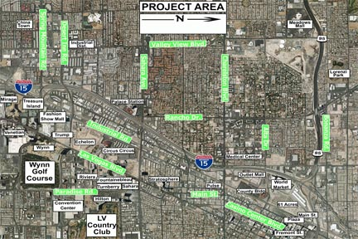
NEON
Notes:
Currently working on FHWA PMP and draft finance plan
The Record of Decision (ROD) has been released!
If approved and funding is available, construction could start as early as 2013, continuing through five or more phases into 2030.
More details on project phasing will be publicized as they are determined.

Slide 30
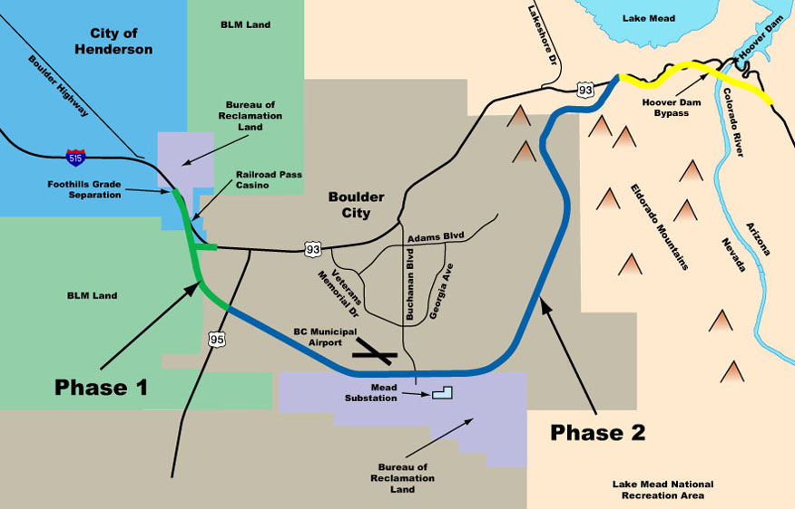
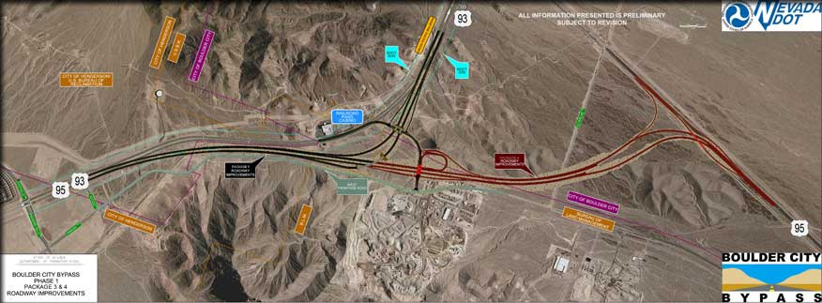
Boulder City Bypass
Package 3
Package 4
Notes:
FHWA PMP and Finance plan updates are due later this year.
2- phases
This is phase 1
Phase 1 extends from the Foothills grade separation to the US 95 interchange south of the existing US 93/US 95 interchange for a project length of approximately 2.75 miles. A visual simulation of the Railroad Pass interchange is shown below, depicting what it might look like when complete.
Development of Phase 1 is broken into 4 packages: Package 1: Right of Way setting for US 93/US 95 Freeway Improvements.
Package 2: Construct the frontage road and utility relocations. Package 3: Construct realigned US 93/ US 95 mainline to the intersection with the frontage road and the new interchange at Railroad Pass. Package 4: Complete the US 93/US 95 Interchange at Railroad Pass, and construct the new US 95 connection, bypassing the existing US 93/US 95 interchange. Click on the map below for larger view.

Slide 31
Accounting for Risks and Uncertainties

Slide 32
NDOT Risk Management Implementation
Complete risk management guidelines and tools
Finalize policies/guidelines for risk reserve and contingency usage.
Implement NDOT’s scoping guidelines to develop project baselines
Perform quantitative risk analysis on all PM Division projects and select other projects using consultants
≤ $100 million: NDOT Risk Tracking and Analysis Tool -Qualitative Risk Analysis
> $100 million: update analysis
Review project risks on annual basis and update cost/schedule
Track and report project baseline performance (scope, schedule and budget)
Notes:
Finalize policies or guidelines for risk reserve and contingency usage. For example:
The Project Team’s allowance: 60% confidence level.
The Project Manager’s allowance: 70% confidence level.
The Program Manager’s allowance (used for programming projects) : 85% confidence level.

Slide 33
Accounting for Risks & Uncertainties
Notes:
As the project is developed and project risks are reduced/retired, the confidence in project costs/schedule will increase.
PM #13 performance measurement is based on comparing the project’s total awarded costs to the project baseline range at the end of the environmental phase.

Slide 34
NDOT’s Approach to CER Requirements
Risk Management:
Probabilistic, risk based, integrated cost and schedule model
Currently working with FHWA to “certify” this process
Notes:
If certification received, FHWA HQ staff will not require CER be performed by them: we will perform our own risk analysis and they will review and approve our report to minimize duplication of effort.

