Slide 1
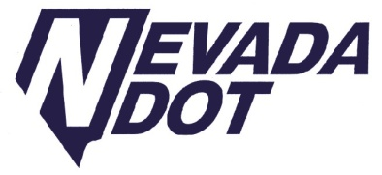
NEVADA
TRANSPORTATION CONFERENCE
March 22 -23, 2011
Reno, Nevada
Denise Inda
Nevada Department of Transportation

Slide 2
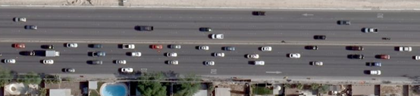
Intelligent Transportation Systems
Using Technology to Improve Mobility and Increase Reliability
Notes:
NDOT is using technology to improve reliability and mobility while reducing congestion. Intelligent Transportation Systems provide roadway users with information that allows the users to make educated decisions that can save time and money.

Slide 3
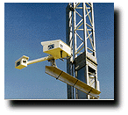
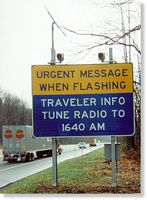
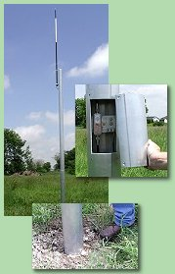
ITS is installed statewide for a variety of uses
Road Weather Information System (RWIS)
Wind Advisory Systems
Highway Advisory System (HAR)
Flashing Chain Control Signs
Dynamic Message Signs
Notes:
ITS is installed statewide for a variety of uses: Road Weather Information System, Wind Advisory Systems, Highway Advisory System, Flashing Chain Control Signs, Dynamic Message Signs, etc.

Slide 4
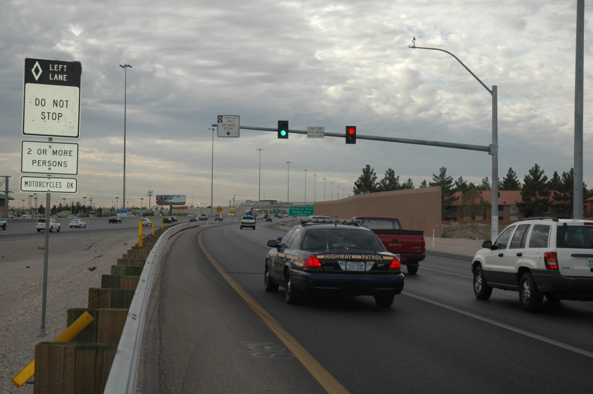
The largest concentration of ITS devices is in the Las Vegas Valley
Flow Meters
CCTV (Cameras)
DMS
Ramp Meters
Trail blazer Signs
Notes:
Over 50 DMS, 70 Cameras and several hundred flow meters provide coverage on US 95 and I 15. Live video from the cameras is available via the internet. Freeway data is gathered and recorded, and used in a variety of ways. First, travel times for specific roadway segments can be posted on the DMS and websites, providing travelers with real-time information.

Slide 5
NDOT is expanding the instrumented areas in Las Vegas through multiple projects:
I-15 ITS Design Build (FAST Package C & G – Silverado Ranch Rd. to California Stateline)
US-95 Package B2 Integration (Cheyenne to I-215)
I-15 Design Build South (Tropicana Blvd. to Blue Diamond Rd.)
US 93 – Boulder City Widening
FAST Package D (I-15 - Craig to Apex)
FAST Package F (US-93 – I-515 to Boulder City)
Notes:
NDOT is expanding the instrumented areas in Las Vegas through multiple projects under design & construction. Work zone ITS provides drivers with additional information that can improve travel through the work zone.

Slide 6
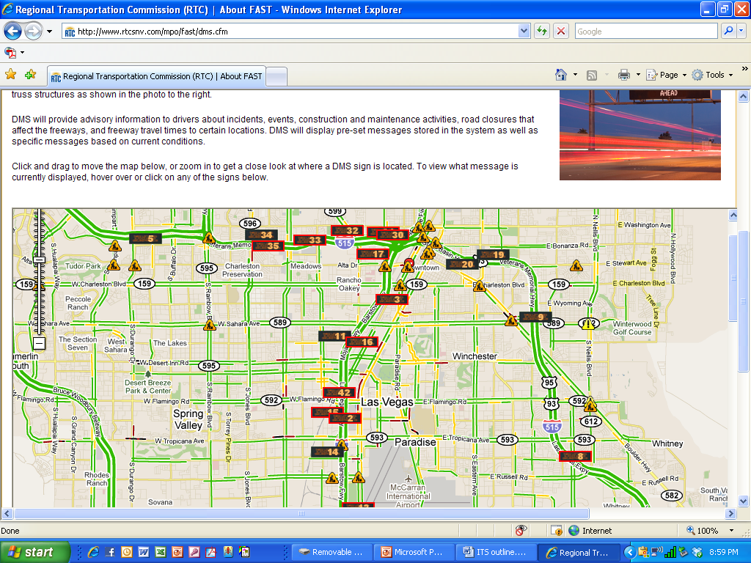
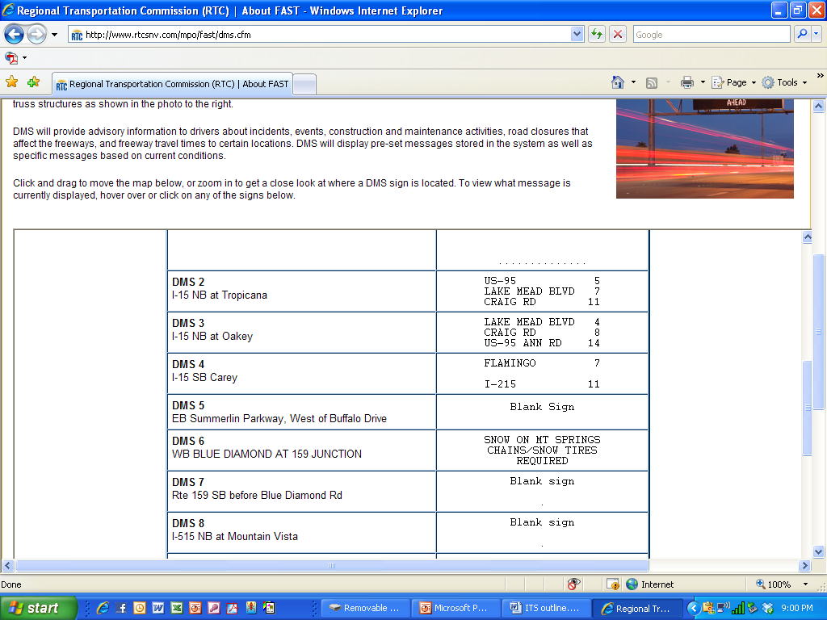
Freeway data is gathered, recorded and used many ways
Notes:
Travel times for specific roadway segments can be posted on the DMS and websites, providing travelers with real-time information that can be used for route decision making. Data is used for ramp meter timing, and in the future, this data may be used to determine variable speed limits.

Slide 7
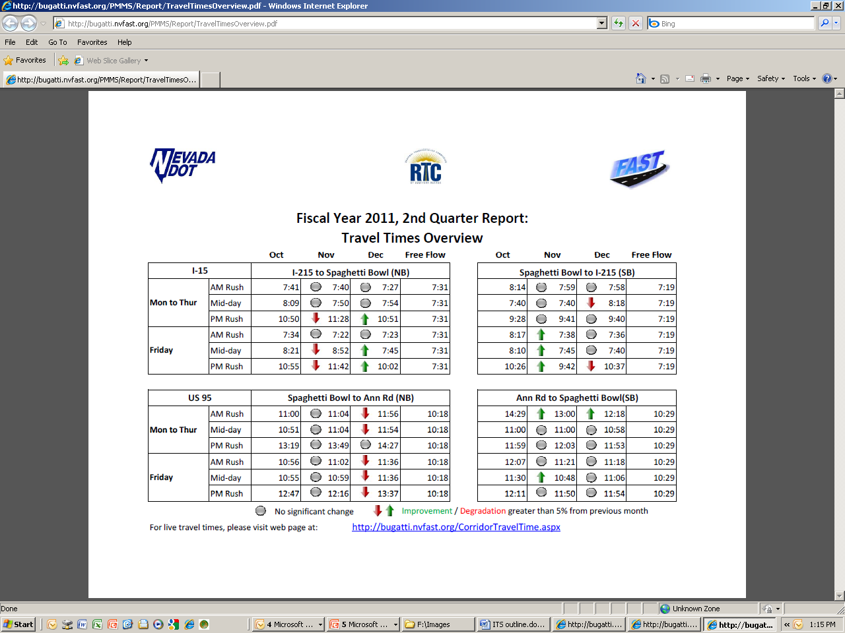
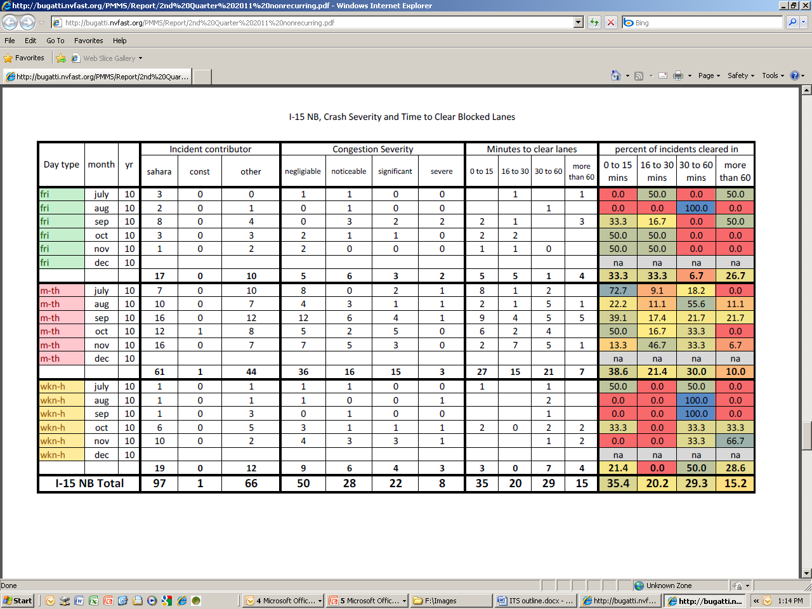
Data is used to determine freeway performance
Notes:
Data is being used to monitor performance of ITS systems, benefits and impacts of construction projects. Utilizing FAST’s performance monitoring system is the next phase of operations in Nevada. We now have the ability to evaluate roadway operations before and after construction projects and during construction and lane closures or special events. Planned ITS expansion will allow us to evaluate more roads throughout the state in this manner, and with this we can determine the performance of our roadways and the benefits of the improvements. As we move toward performance-based transportation funding at both the local and national levels, the ability to develop relevant outcome-based performance measures will contribute significantly to the success of the Department.

Slide 8
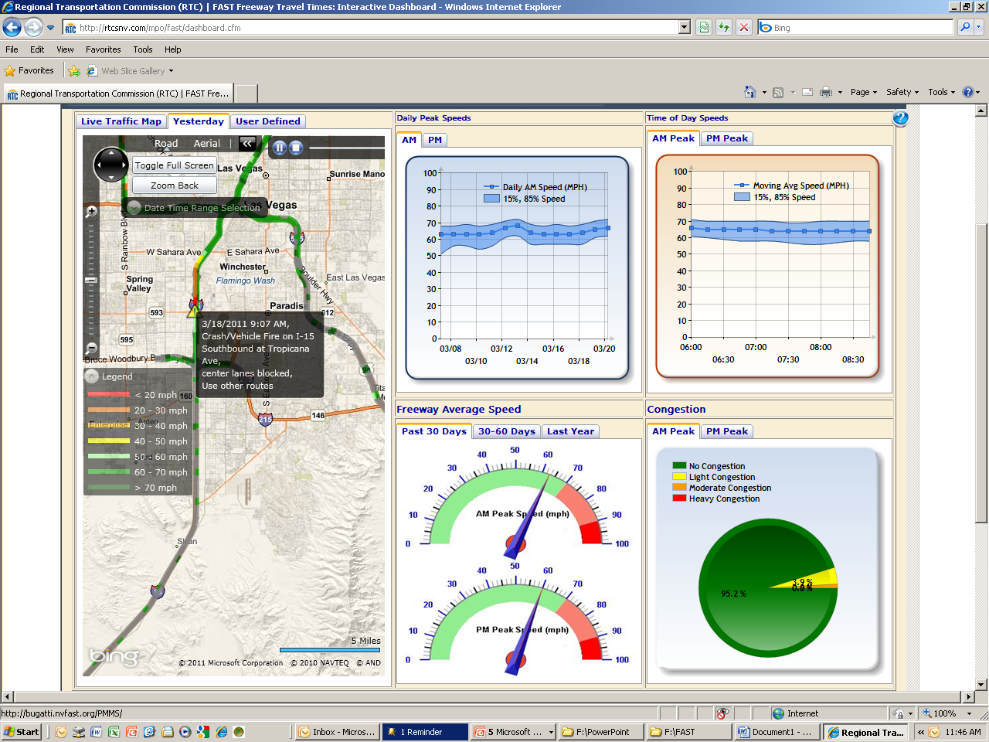
Freeway Travel Times Interactive Dashboard
http://www.rtcsnv.com/mpo/fast/dashboard.cfm
Notes:
FAST, NDOT and even the public can access the dashboard via the internet and review current and historical data. This detailed data can provide insight into trends, issues, and anomalies on the freeways and allows NDOT & FAST engineers to develop technical, data-based solutions.

Slide 9
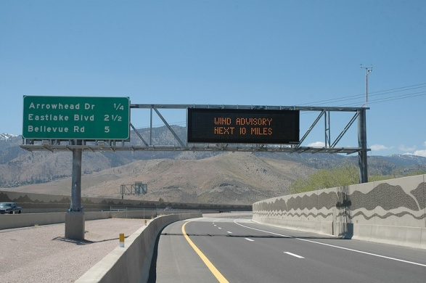
System Expansion – Statewide
Fiber-optic communications
Flow meters
Cameras
Work Zone ITS
DMS
Notes:
We are beginning to install add this type of roadside instrumentation in other parts of the state, in addition to the existing RWIS sites, DMS and cameras. Equipment spacing and communication methods vary meet the more rural nature of the state. We are expanding fiber-optic communications along I 80 to allow for additional ITS devices at intermittent locations.

Slide 10
Integrated Transportation Reliability Program (ITRP)
Goal: To identify regional and statewide strategies to improve the reliability of travel within Nevada in urban areas as well as along interregional rural corridors
Initial phase complete
Phase 2 just beginning
Projects are being developed to address near-term opportunities
Longer-term strategies will be integrated into state and local project planning and implementation.
Notes:
The goal of this project was to identify regional and statewide strategies to improve the reliability of travel within Nevada in urban areas as well as along interregional rural corridors
The initial phase of the project is complete and Phase 2 is just beginning. Projects that support the recommendations of this program are begin developed and the Phase 2 of the project will advance the recommendations from the first phase and begin addressing some of the near-term opportunities. We will also begin integrating the longer-term strategies into state and local project planning and implementation.

Slide 11
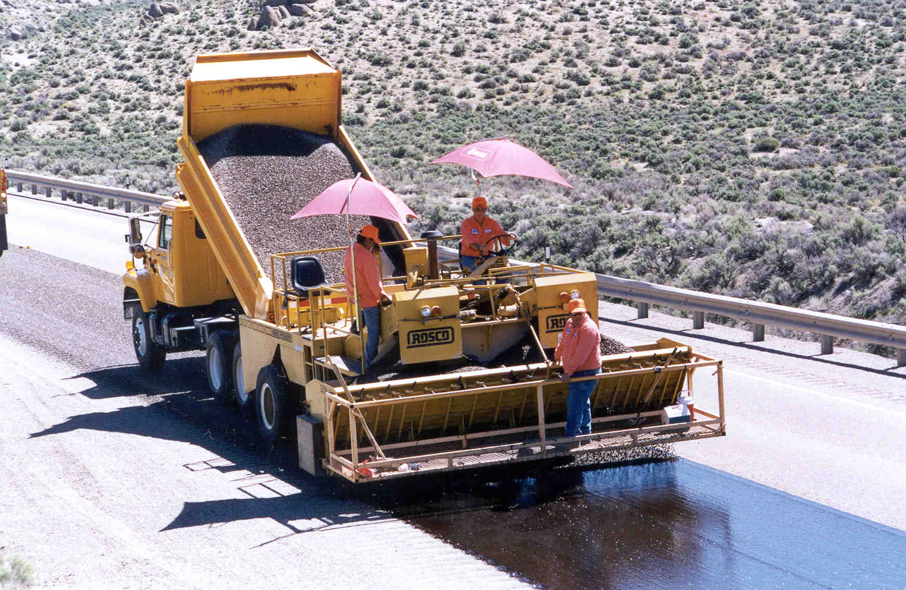
Integrated Mobile Observations (IMO)
Pilot project gathers maintenance vehicle data
Part of a national initiative for connecting vehicles
Mobile data can be used for other processes & decision making
Improve internal processes by automatically populating maintenance management databases.
Notes:
Nevada has been selected as one of two states in the nation for this program which is a pilot project to gather maintenance vehicle (snow plow and other) data that can be used for other processes & decision making. This program is part of a national initiative for connecting vehicles. One of the bigger benefits for the Department is that it has the potential to improve internal processes by automatically populating maintenance management databases.

Slide 12
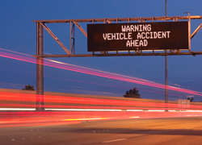
Innovative solutions
Haz Mat Response
ITS Knockdown
ITS Maintenance/Repair
Notes:
ITS and Operations are growing at a very quick pace, and we’ve come up with a few innovative solutions to allow the Department to respond quickly to the issue at hand. We have agreements in place that allow for the contractor to quickly respond when called out to address a hazardous material clean up that is the result of and incident. The quicker the hazardous material can be removed from the roadway, the less delay. Another agreement allows for a contractor to quickly repair and replace ITS equipment that is damaged in a crash. ITS systems such as DMS and ramp meters are critical to the safety and operations of our highways, so we’ve developed a process to get these systems running as quickly as possible. These two agreements reduce the costs to the Department because the contractors work to be reimbursed through the responsible party’s insurance. NDOT is only responsible for payment when costs cannot be recovered by the responsible party. In addition to these two agreements, we also have an agreement with a contractor to provide preventative maintenance and repairs to our increasing numbers of ITS equipment. This contract is used to augment District forces responsible for ITS and communications equipment.

Slide 13
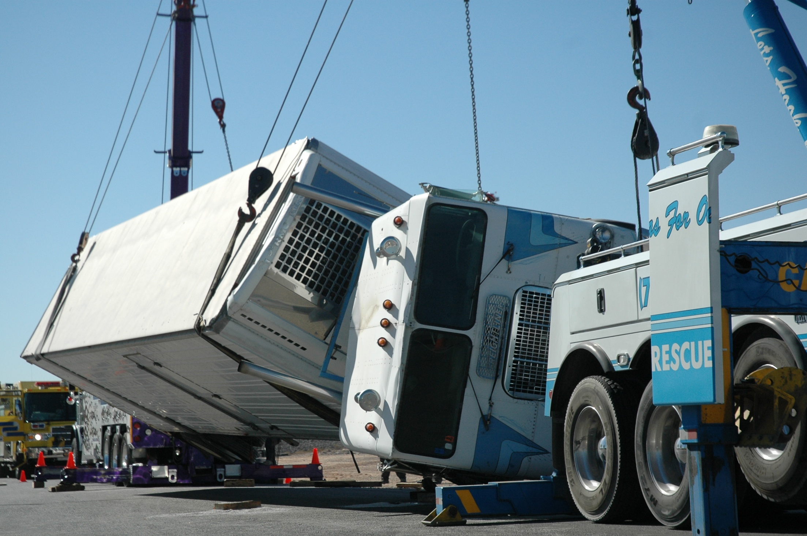
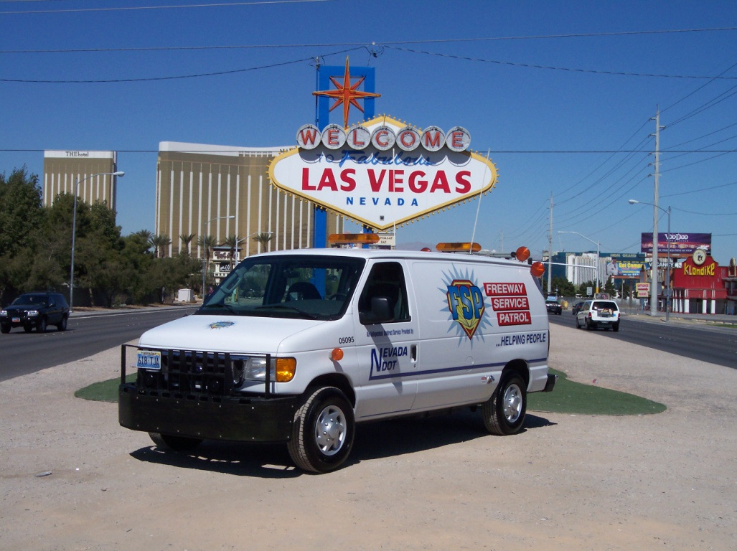
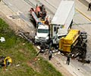
Implementing other programs in the area to reduce congestion:
Traffic Incident Management (TIM) Coalition
Freeway Service Patrol (FSP)
Incident Response Vehicles (IRV)
Notes:
Non-recurring congestion (due to incidents, weather, etc.) makes up almost ½ of all congestion. NDOT has developed many programs that reduce the impacts of non-recurring congestion. The TIM Coalition has been in place for several years in the Las Vegas area, and we’re just beginning to expand it to other regions of the state. Its primary goal is to bring emergency responders together to develop open communications that will allow for quick clearance of the road during incidents, reducing delay while increasing the safety of all those on the roads. Freeway Service Patrol responds to stalled or stranded vehicles in the roadway and quickly addresses the situation at hand and makes minor repairs, minimizing the impact to the roadway and reducing congestion. We are developing a pilot Incident Response Vehicle program which will provide quick response to large incidents that will impact the road for longer periods of time. The role of the IRV is to quickly set up traffic control for the incident, increasing the safety of responders and drivers as well as reducing the potential for secondary collisions.

Slide 14
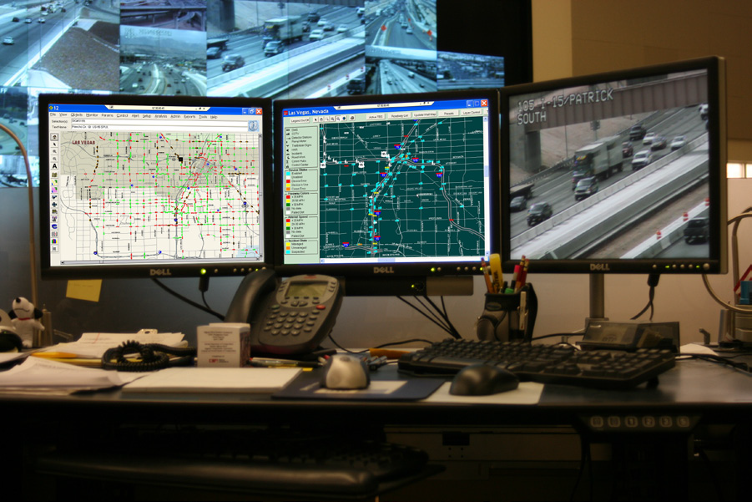
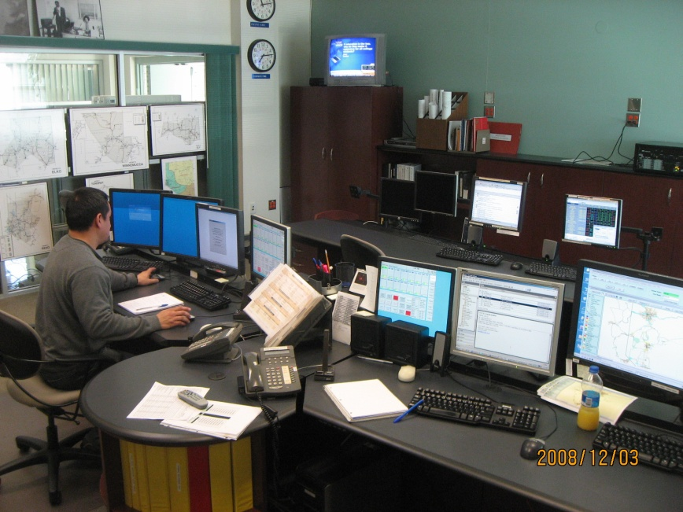
Additional ITS/Operations Programs:
Op center Training & Guidelines
I-80 Corridor Coalition
Wi-Fi At Rest Areas
Weather Forecasting Service
511 Traveler Information
Notes:
We also support ongoing programs that contribute to operations and improve reliability for travelers statewide. Some of those programs include the ones listed here.

Slide 15
Contact Info:
Denise M. Inda, PE, PTOE
Asst. Chief Operations Engineer
Nevada Department of Transportation
1263 So Stewart Street
Carson City, NV 89712
775-888-7867
dinda@dot.state.nv.us

