Slide 1
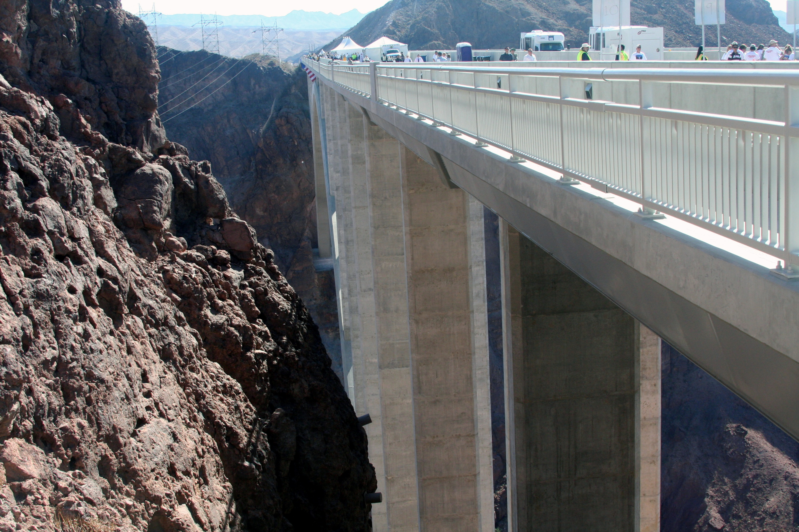

Interstate 11 AND FREIGHT OPPORTUNITIES
Nevada Transportation Conference
March 23, 2011

Slide 2
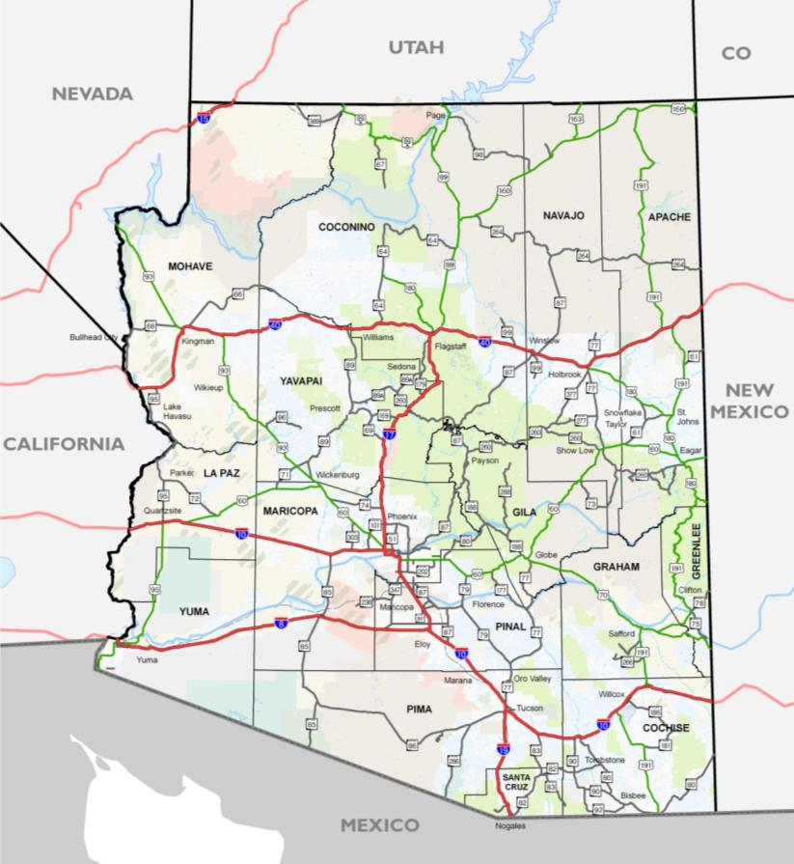
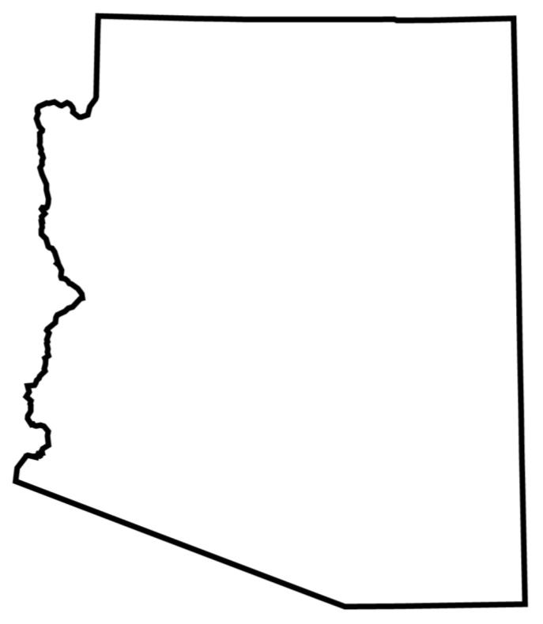

Bordering States
COG/MPO DISCUSSIONS
ST. GEORGE:
Scottsdale of Utah?
Tourism and Recreation
California Population:
60 M by 2050!
#1 in growth
Las
Vegas
Navajo Nation relates more to New Mexico
Grand Canyon TOURISM
17
Tourism and Freight Corridor
I-17 Extension?
25
High-tech
industry along
I-25
People
Businesses
Second homes
Tourists
Commercial Vehicles
Eager/ Springerville provide shopping/ services to Western New Mexico
LAND BRIDGE
agriculture
ECONOMIC DEVELOPMENT
Mexico’s fastest growing states are in the north (Sonora, Chihuahua, and Nuevo Leon)
Transportation infrastructure
Key CONNECTIONS to Guaymas, Hermosillo,
Punta Colonet
maquiladoras

Slide 3


Arizona
COG/MPO DISCUSSIONS
Commercial Trucking
  Distribution throughout Southwest USA
  Elevation in Central Arizona (SR-89/SR-69)
  US-95/SR-95 Corridor
  CANAMEX
Natural Resources
  Copper in Safford Area
Emerging Industries
  Welton Oil Refinery
  Warehousing
Sun Corridor Megaregion
  Prescott
  Phoenix
  Tucson
Recreation and Tourism
R e c r e a t i o n
Pearce
Ferry
Growth Limitations
In-migration
Western CANAMEX?
R e c r e a t i o n
SUN CORRIDOR
Copper mining
Agrarian → Industrial
Incoming Commerce!
Informal Truck Bypasses
Warehousing/Distribution Hub

Slide 4
Metropolitan Growth
Phoenix-Mesa, AZ MSA
Las Vegas, NV-AZ MSA

Slide 5
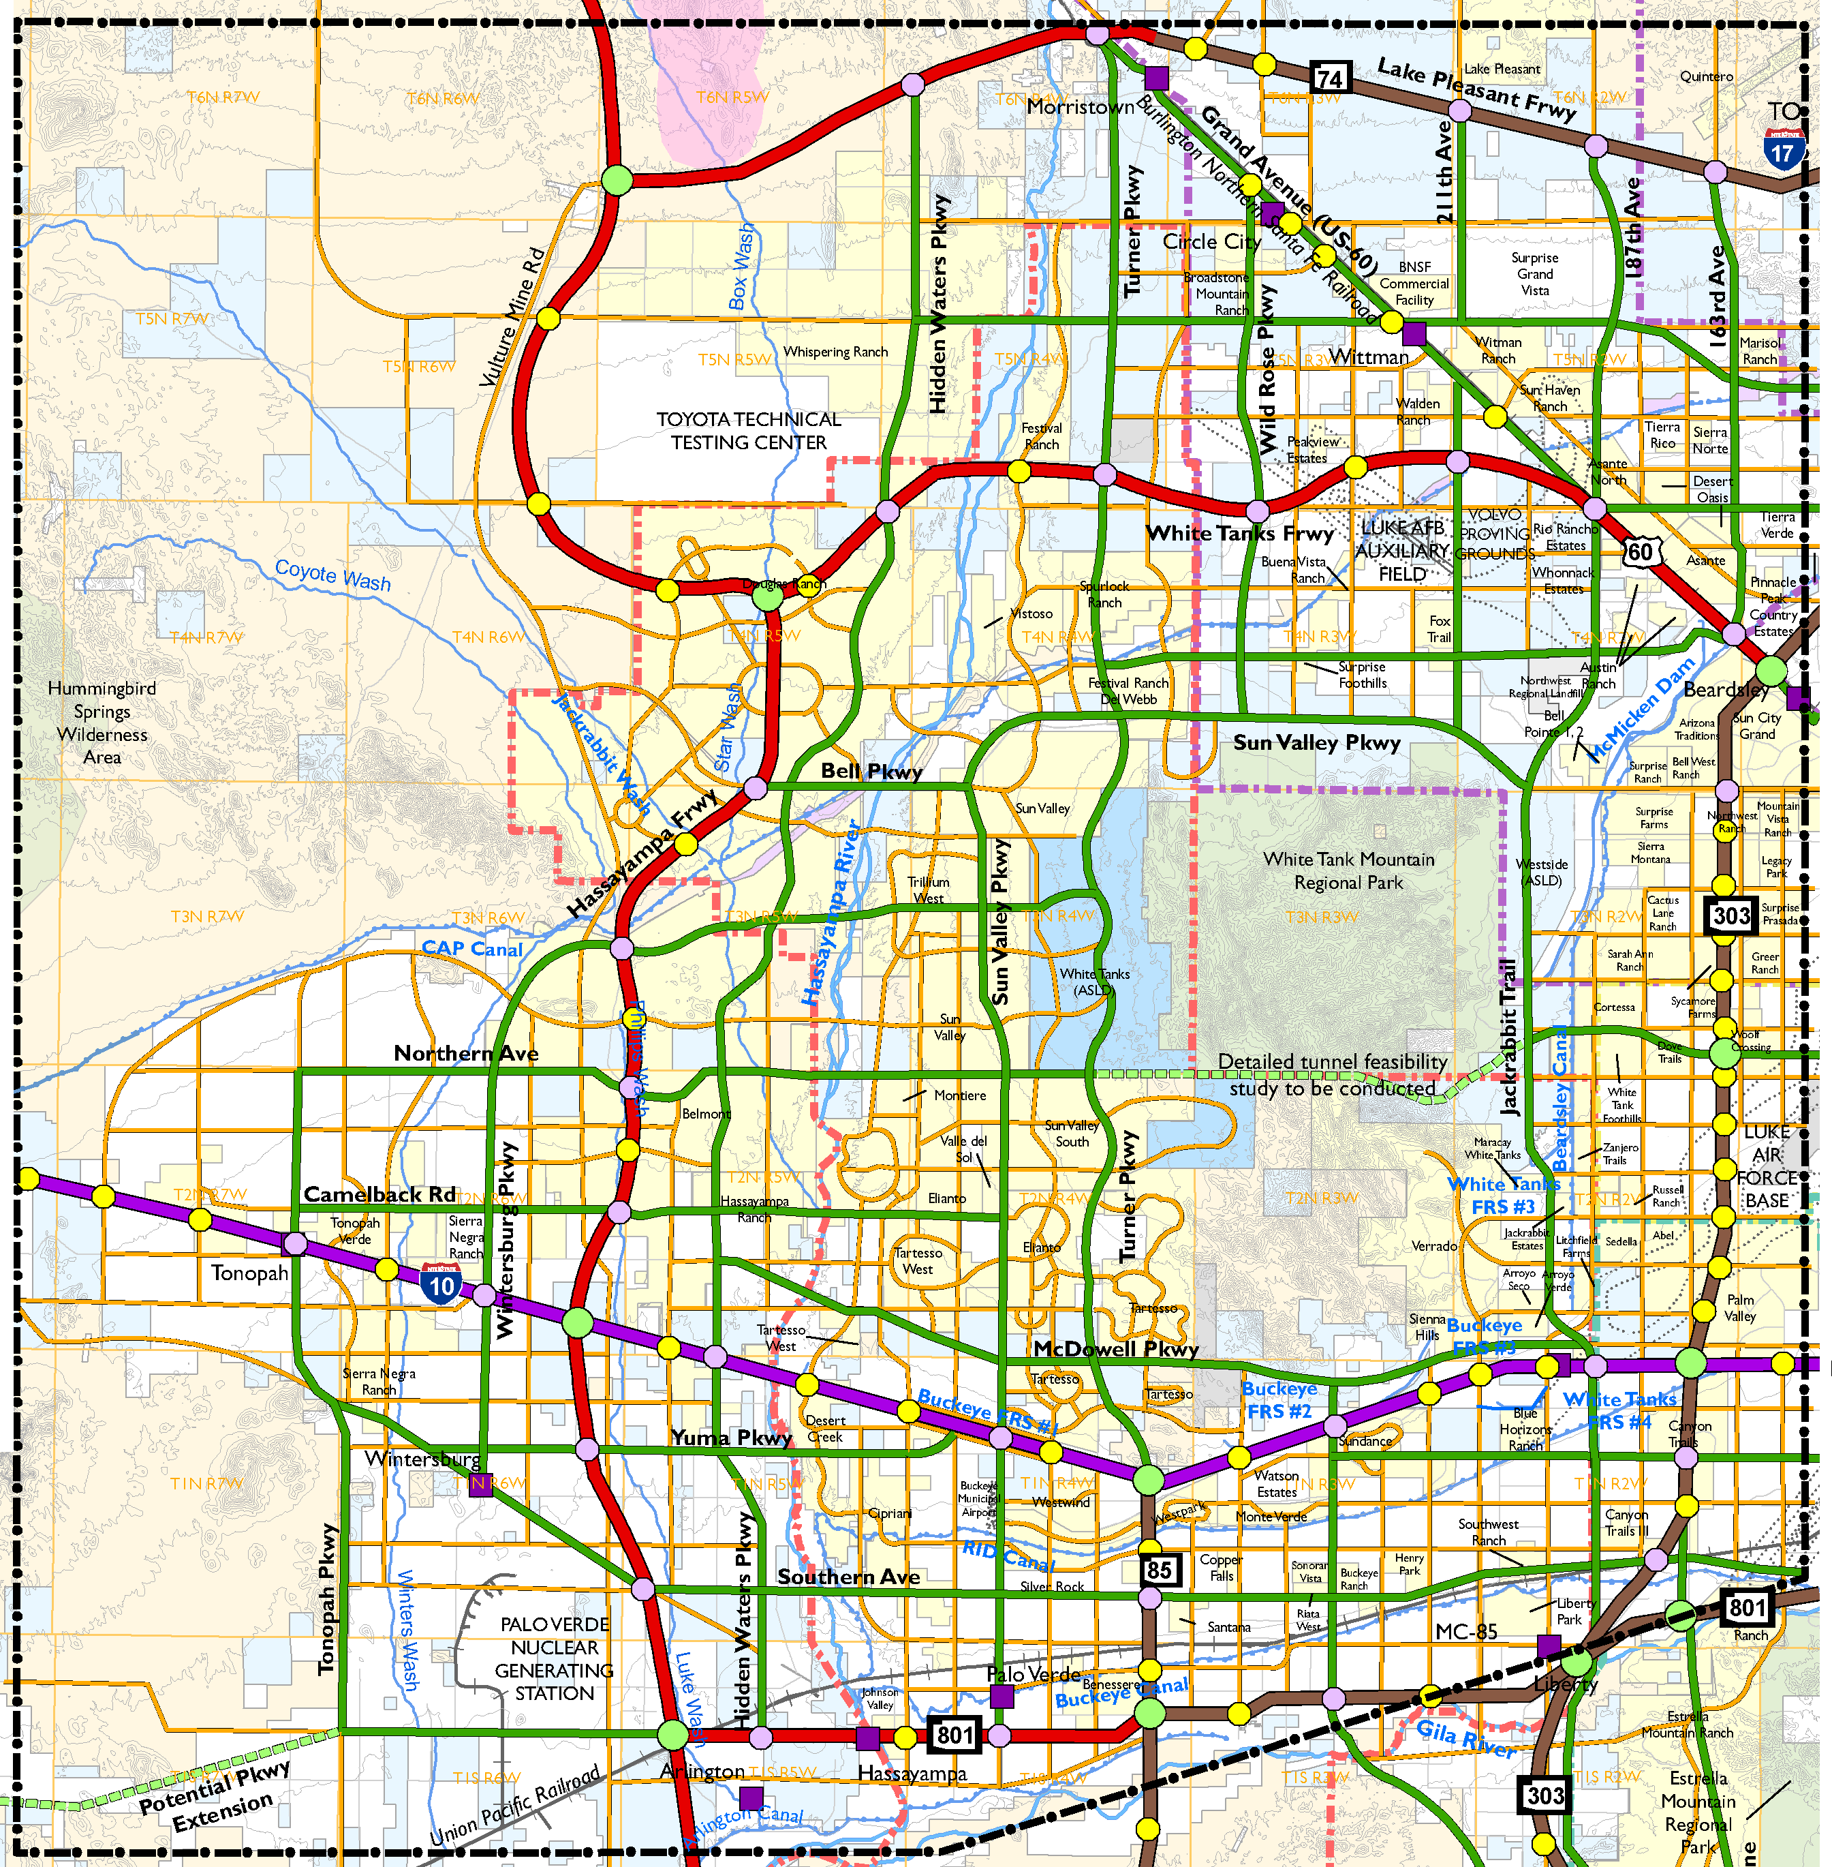
Roadway Framework
INTERSTATE 10-HASSAYAMPA VALLEY TRANSPORTATION FRAMEWORK STUDY
Freeways
Parkways
Major Arterials
Existing Freeway Improvements
Future RTP Freeways
New Freeway Proposals
New Parkway Alternatives
New Parkway Proposals
Future Major Arterial Network
 | Population | Employment
2005 | 138,000 | 48,000
2030 | 948,000 | 379,000
Build-Out | 2,862,000 | 836,000
.

Slide 6
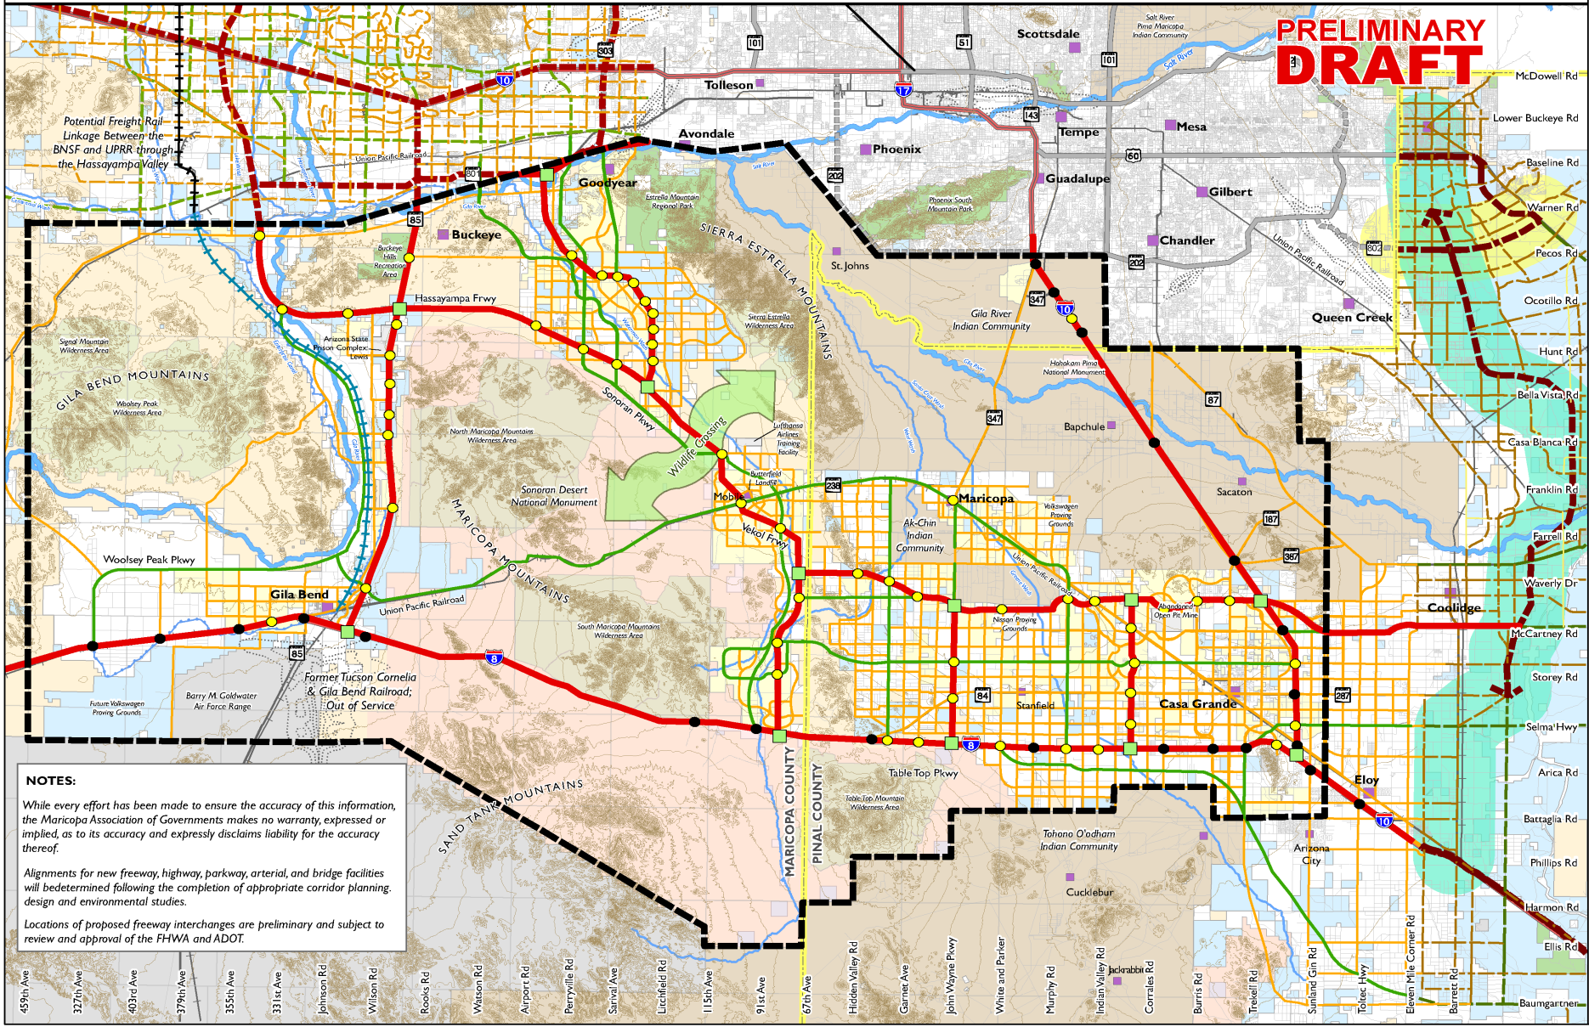
Roadway Framework
INTERSTATES 8 AND 10 – HIDDEN VALLEY

Slide 7
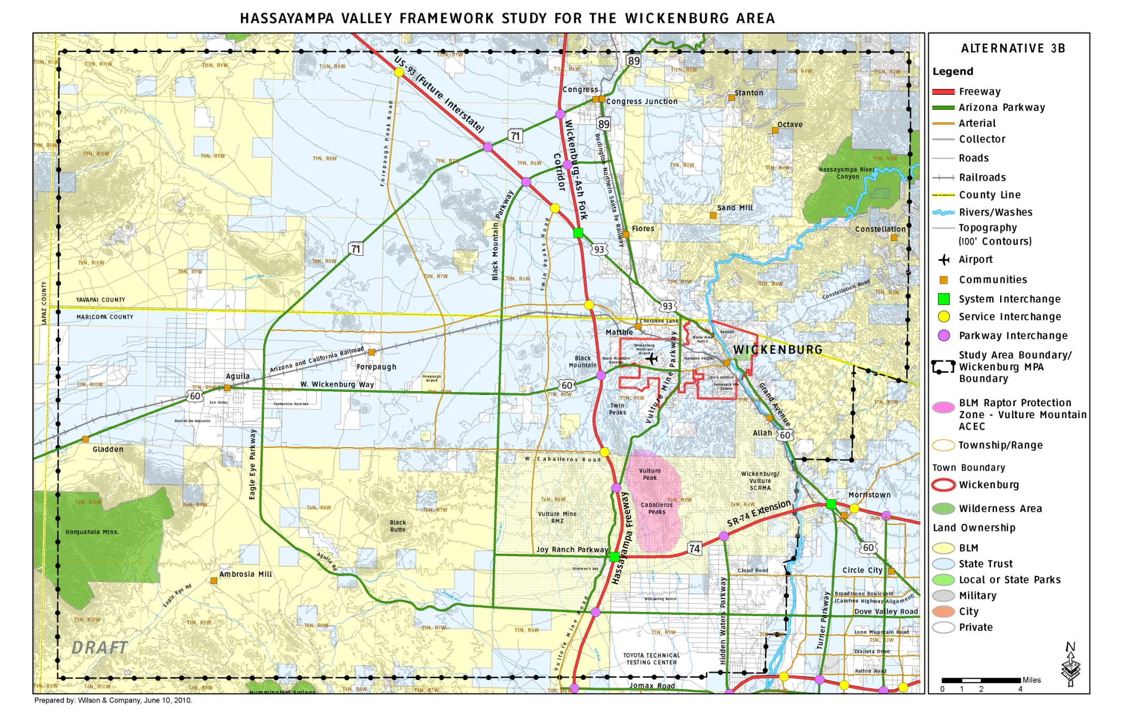
Roadway Framework
Hassayampa Valley Framework Study for the Wickenburg Area.

Slide 8
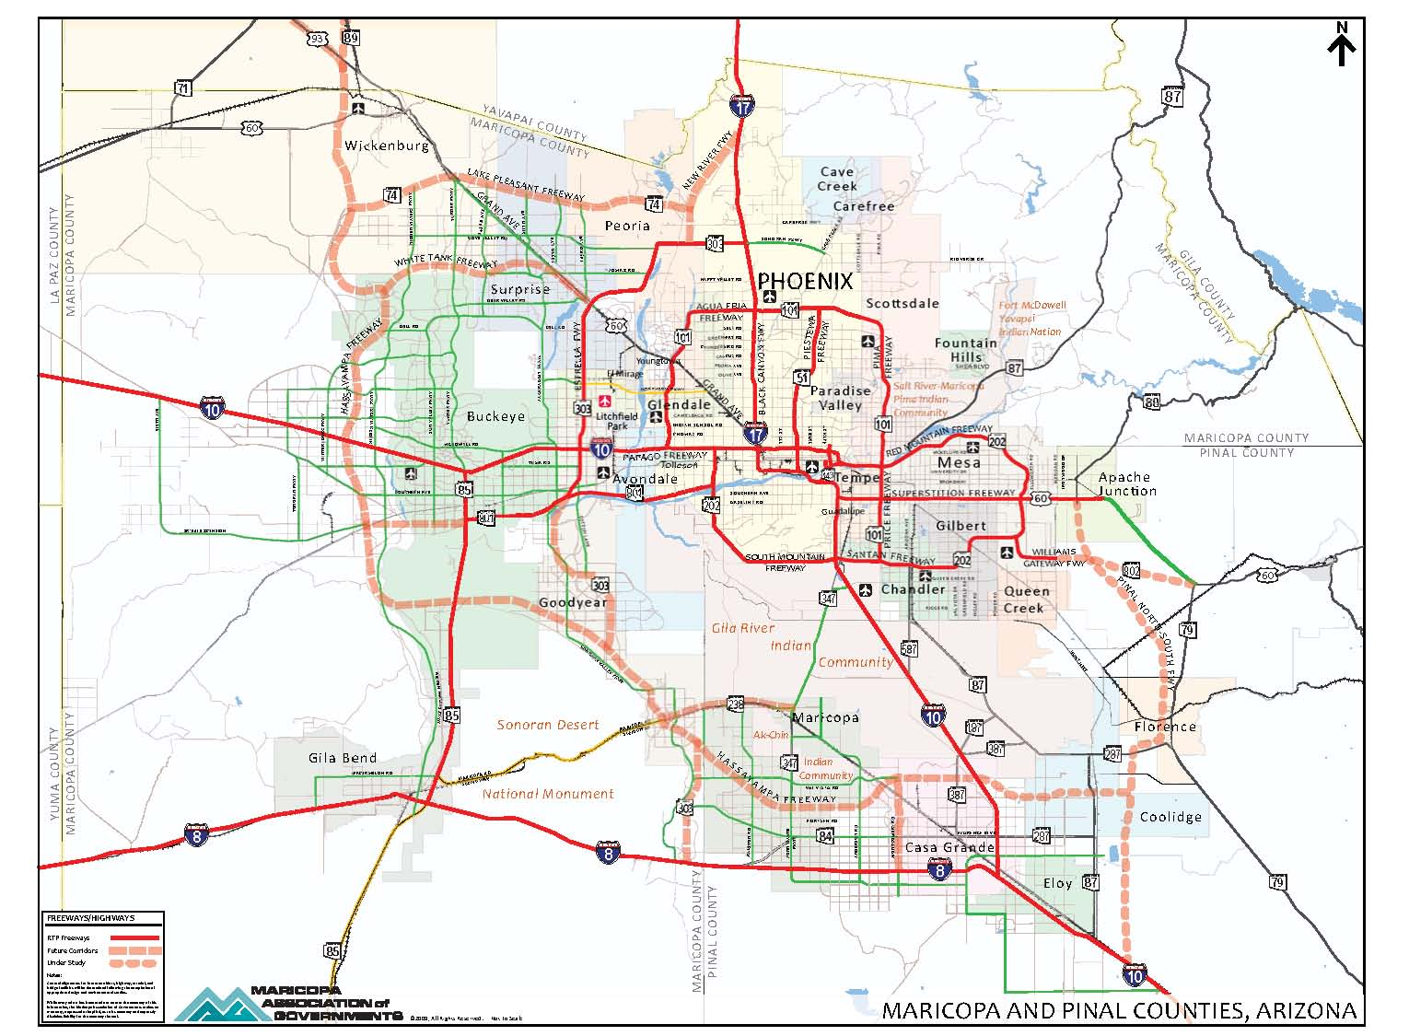

Slide 9
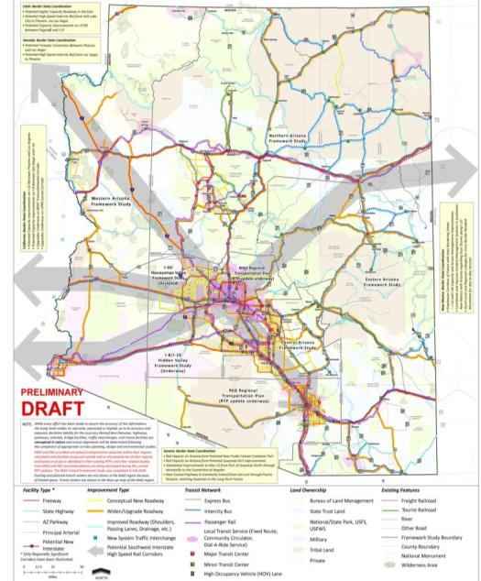

Statewide Framework
Accepted by the State Transportation Board, January 2010.

Slide 10
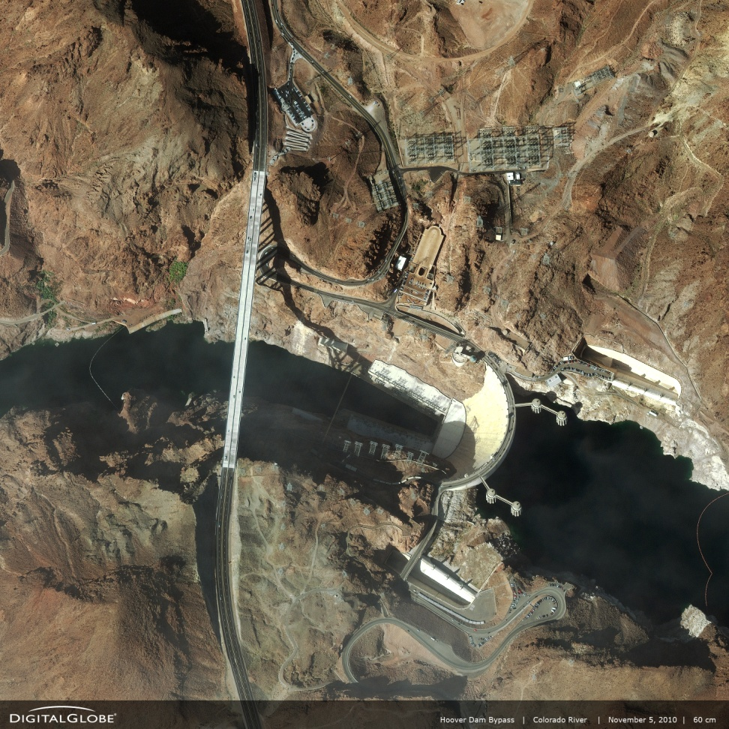
Gaps and Issues
Boulder City Bypass
Bridging the Colorado River at Hoover Dam
US-93 widening
Extension into Phoenix
  Along Grand Avenue?
  Bypass Phoenix?

Slide 11
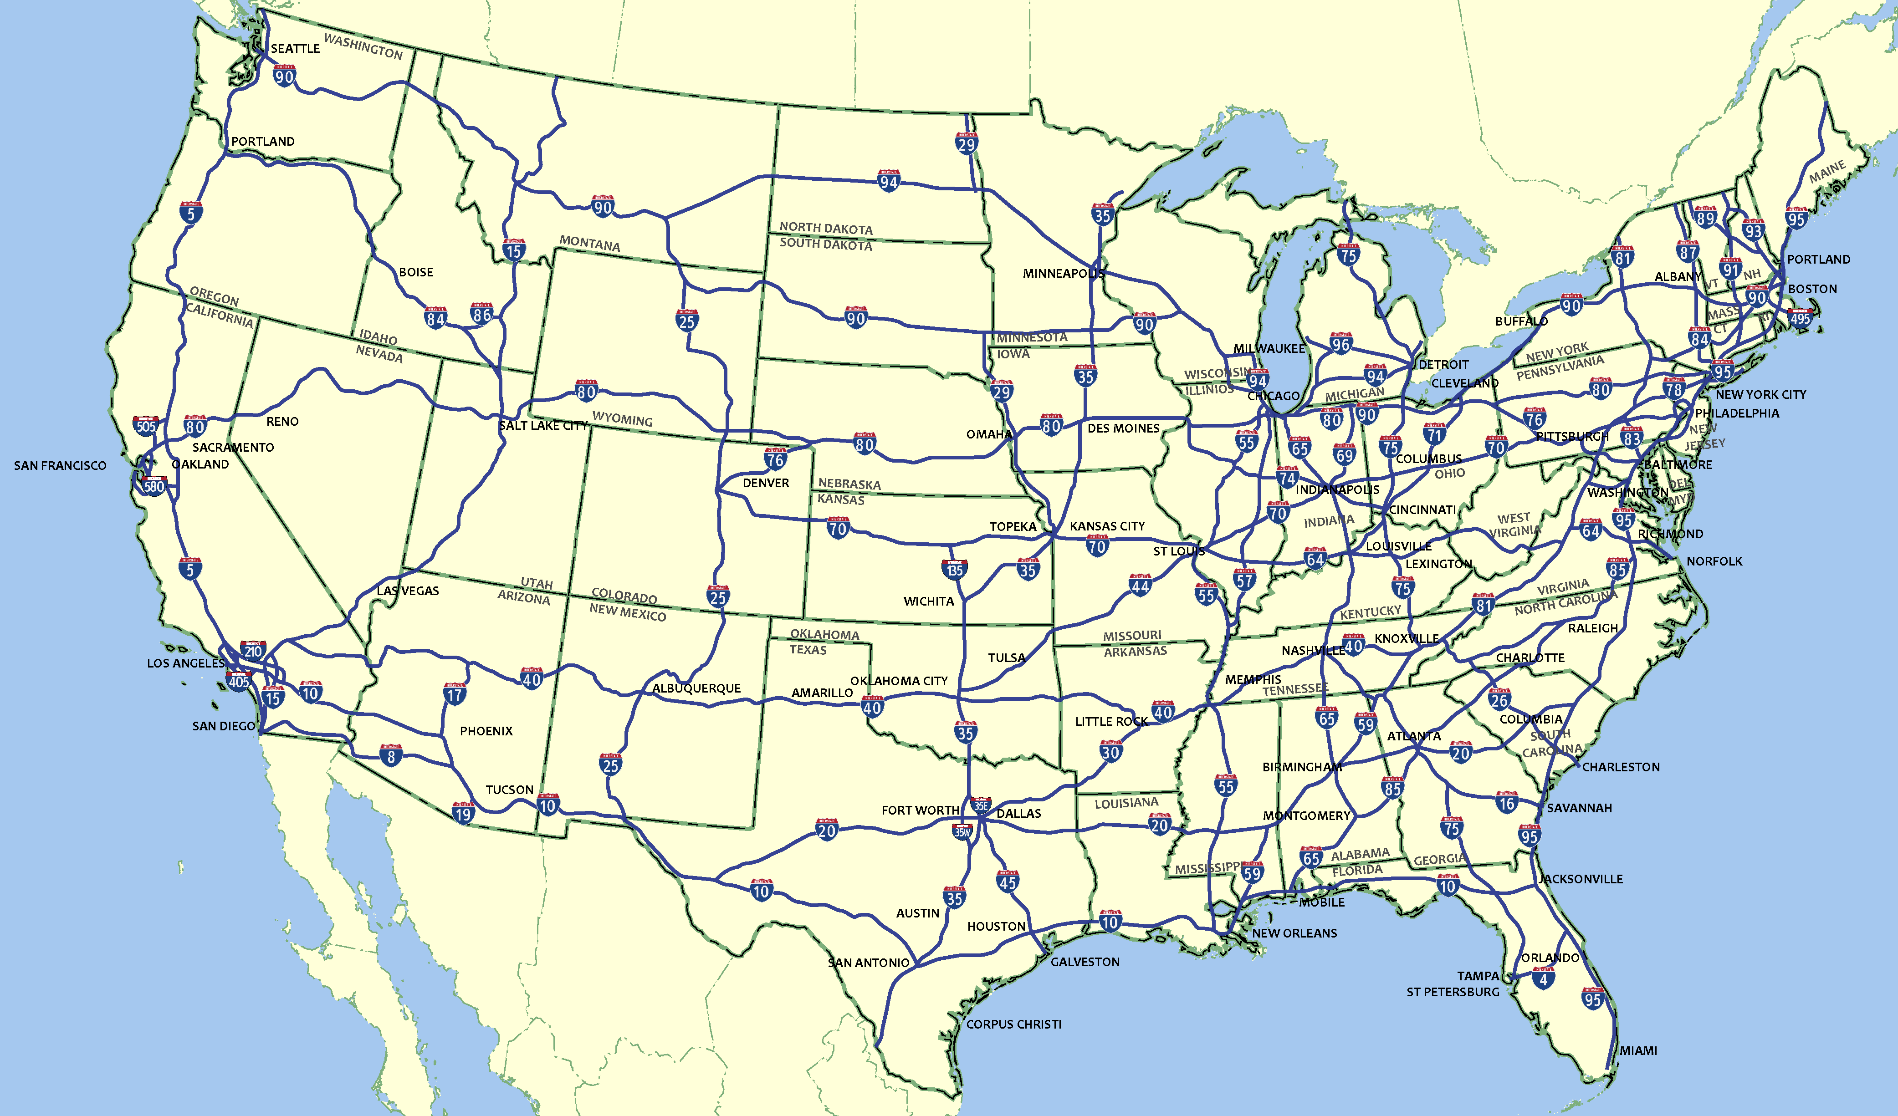
Interstate Highway System
1956 Federal-Aid Authorization

Slide 12
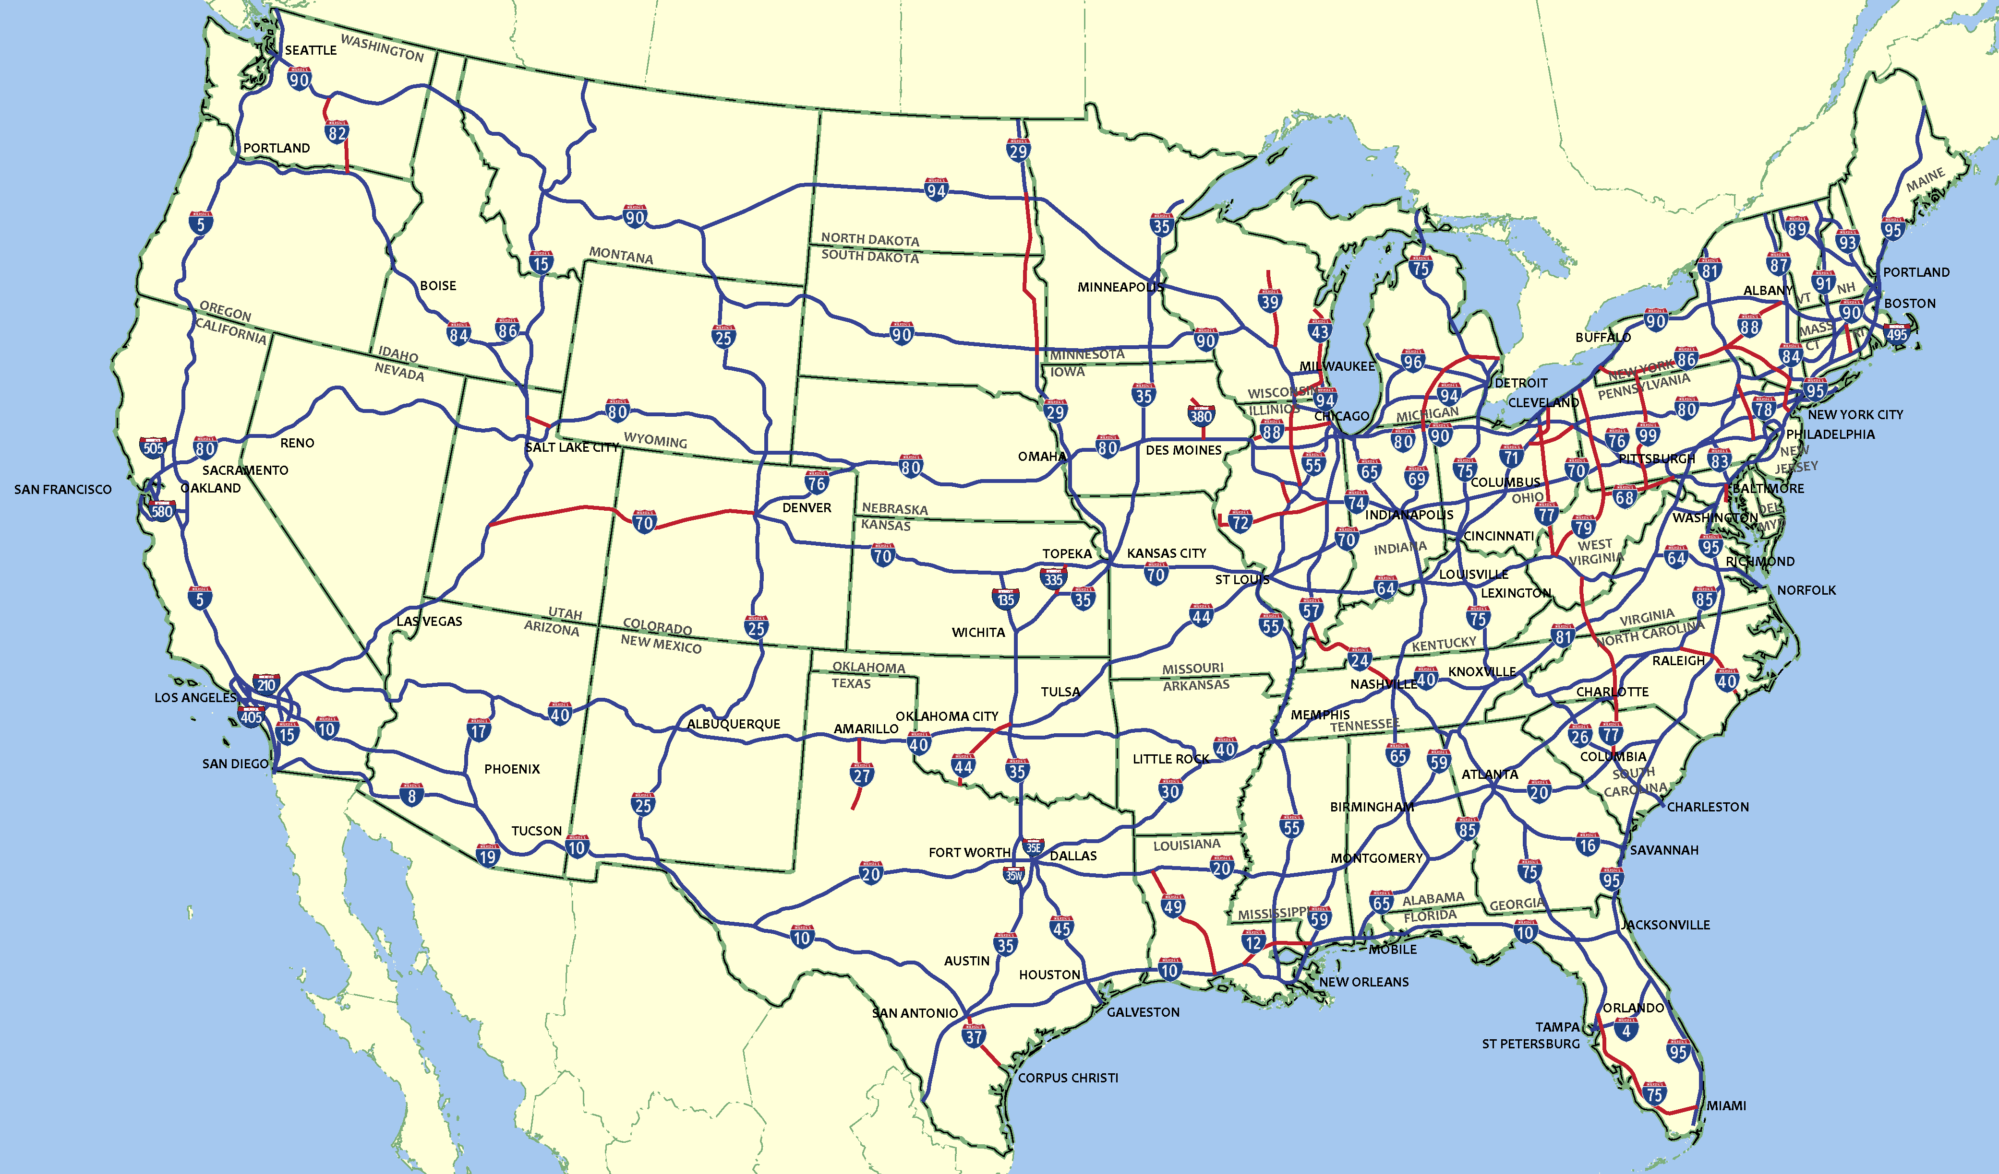
Interstate Highway System
1957-1992 Additions

Slide 13

Interstate Highway System
ISTEA and TEA21 High Priority Corridor Additions

Slide 14

Interstate Highway System
Interstate 11 Corridor
Intermountain West Opportunities

Slide 15
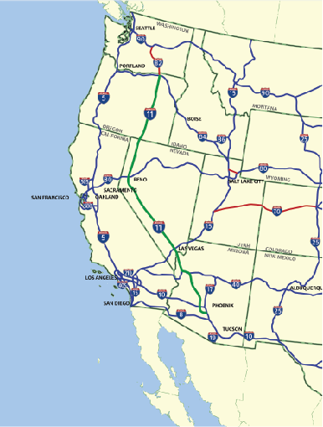
Interstate 11
FACTS:
Accepted as an illustrative project in MAG RTP 2008.
Business communities in Phoenix and Las Vegas have championed the Interstate 11 corridor with a private sector/public sector coalition seeking interstate designation.
Hoover Dam Bypass Bridge opened to traffic in 2010.
Environmental Studies proposed for the Hassayampa Valley Segment.
BENEFITS:
Improve travel reliability for the Intermountain West.
Enhance economic benefit by linking trade between Mexico, Canada and the Intermountain West.

Slide 16
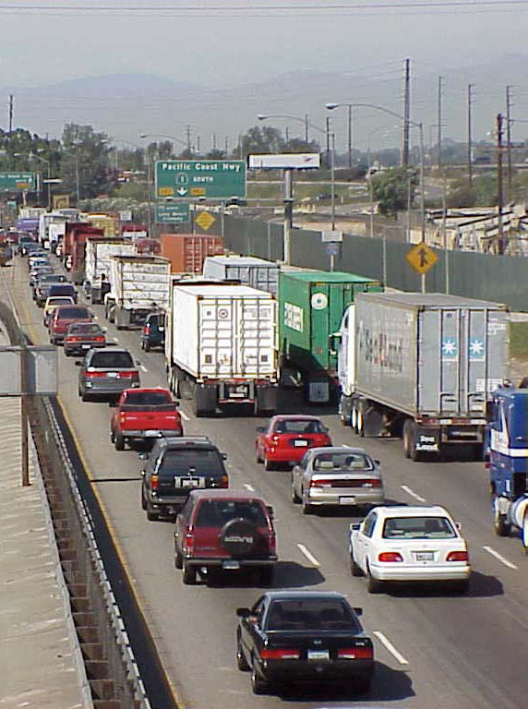
MAG Freight Framework Study
Evaluate existing freight operations.
Commodity flow analysis.
  Cargo and trade forecasts.
National and regional freight profile
  Shipper perspectives.
  Carrier perspectives.
Inland port market assessment.
Consult project stakeholders.
Policy and regulatory issues.
Identify funding opportunities and strategies.

Slide 17
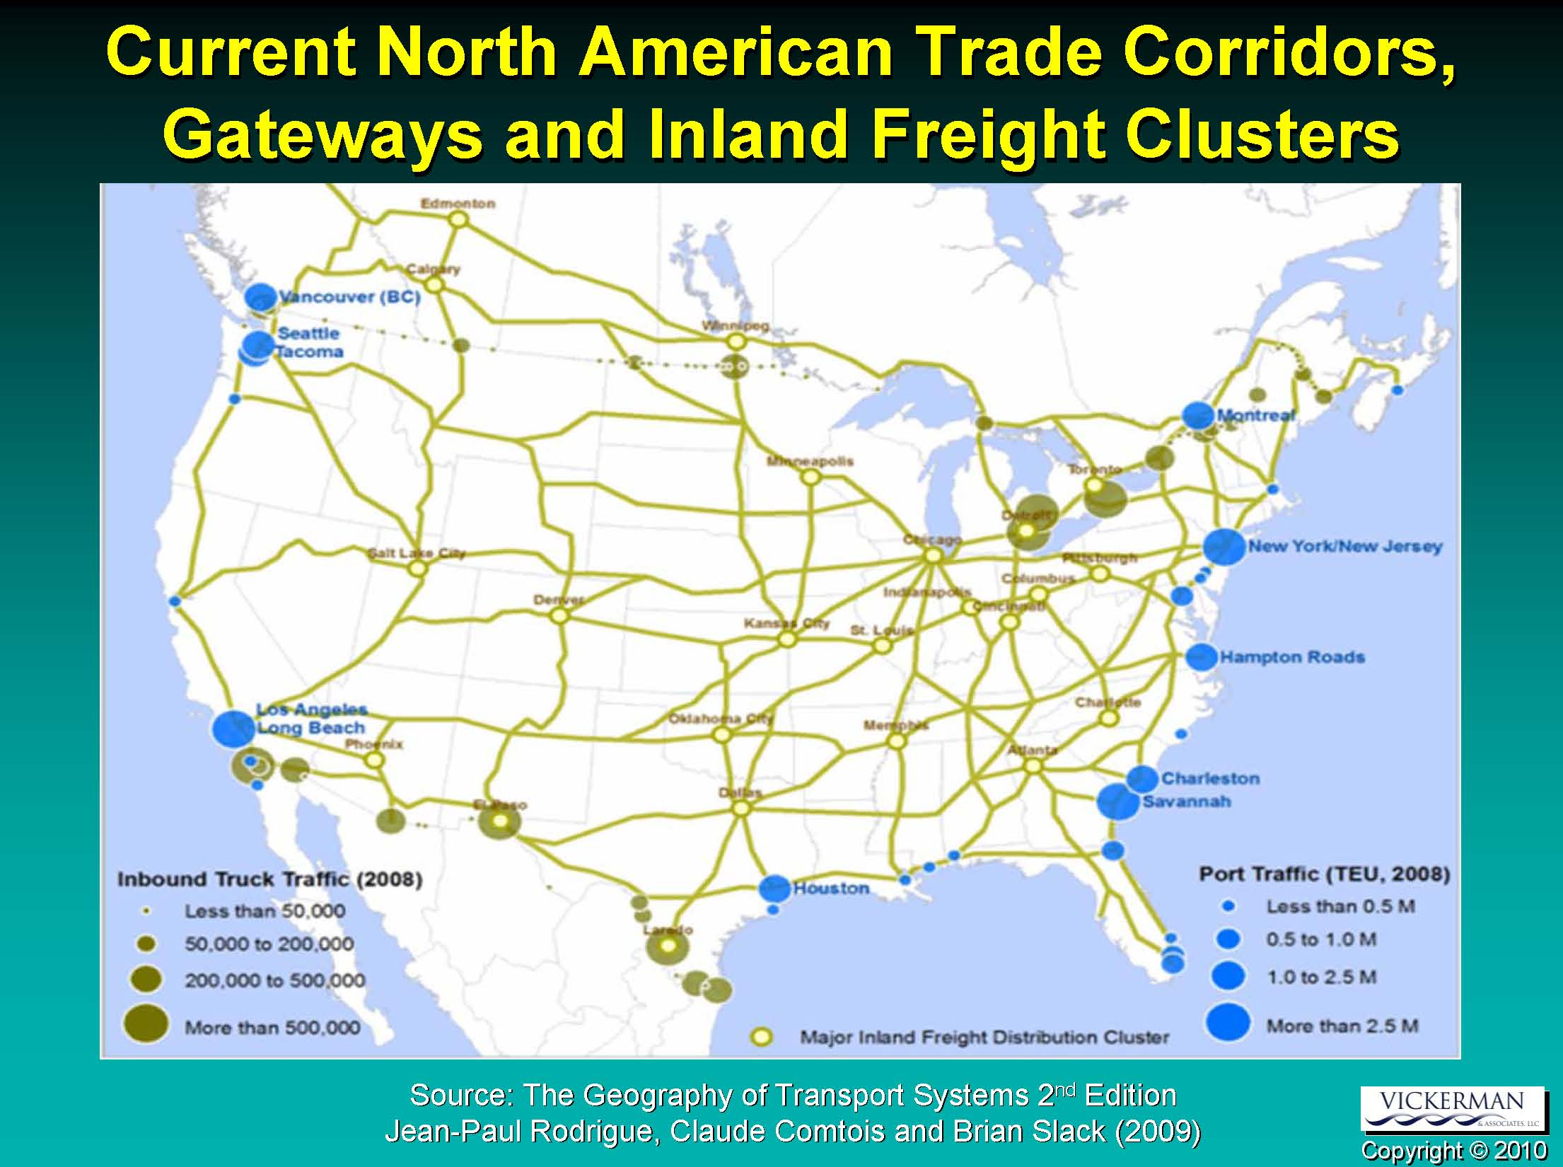
North American Gateways
Source: Coalition for America's Gateways and Trade Corridors

Slide 18
Ton-Miles of Truck Shipment

Slide 19
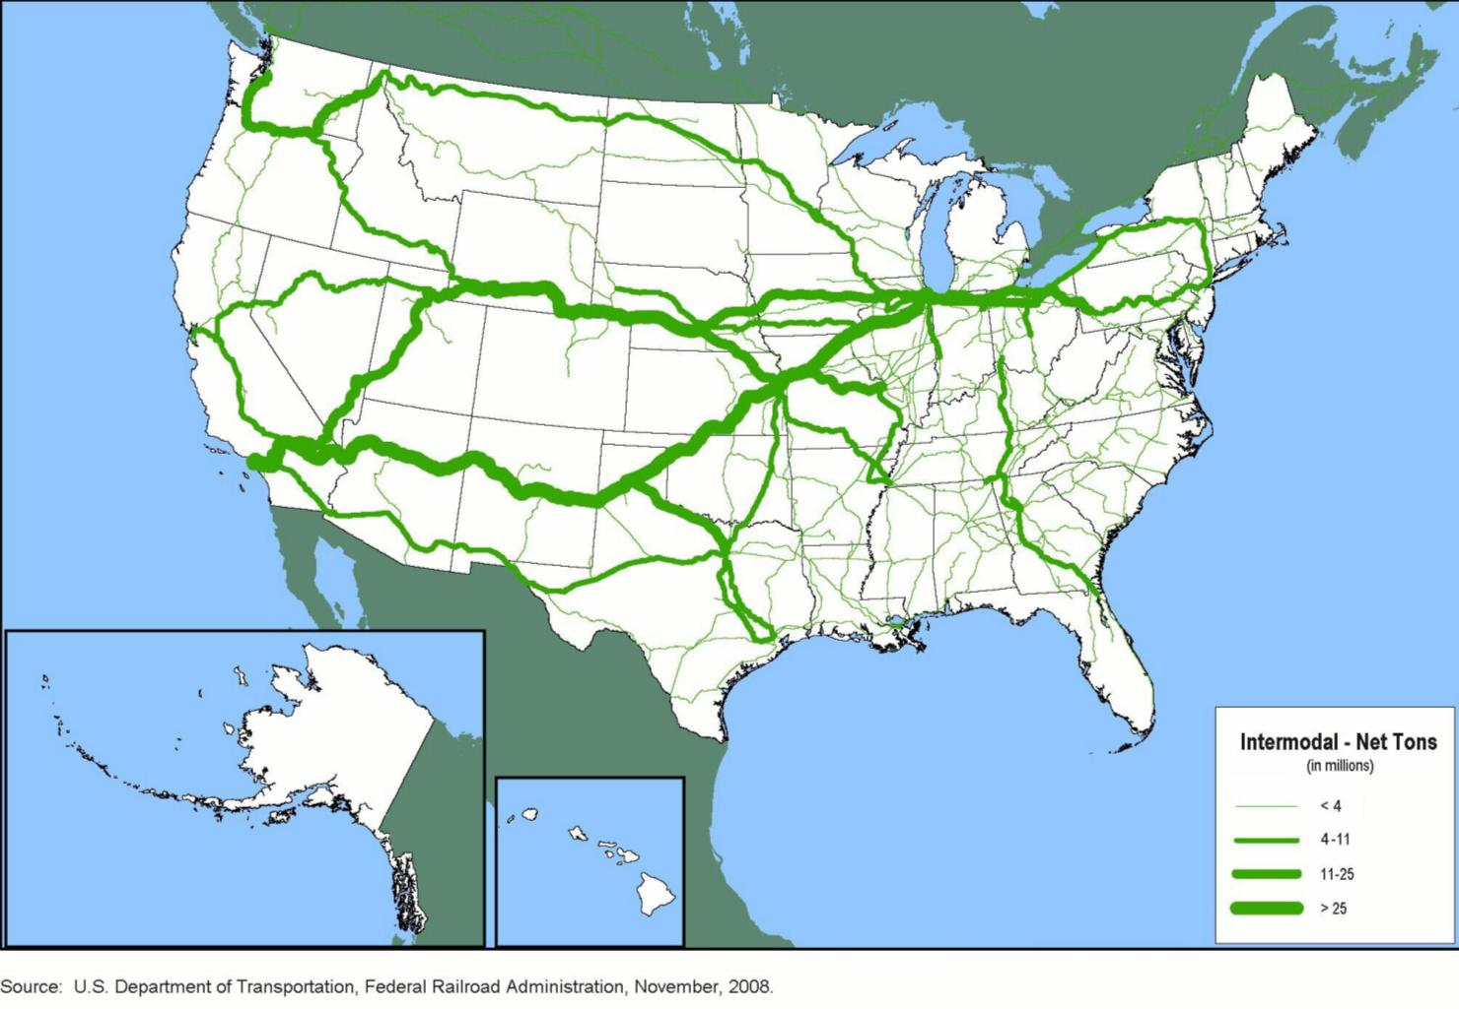
Tonnage of Trailer-on-Flatcar and Container-on-Flatcar Intermodal Moves

Slide 20
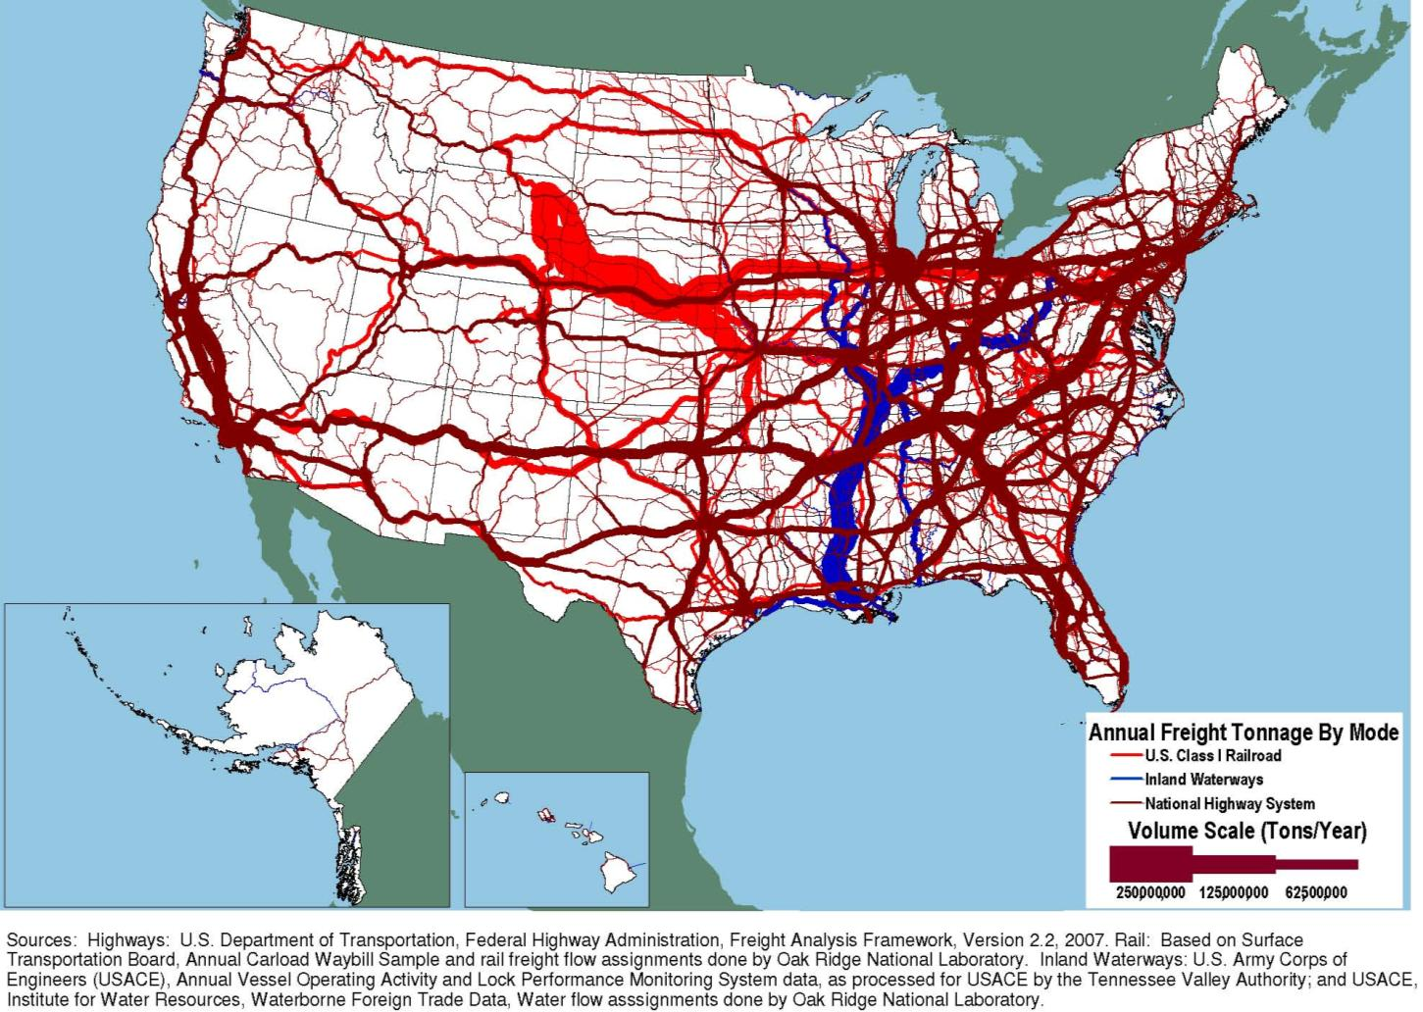
Tonnage on Highways, Railroads and Inland Waterways

Slide 21
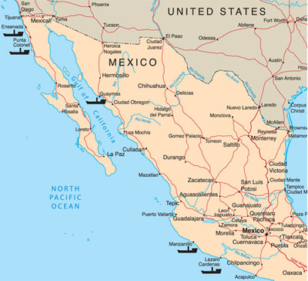
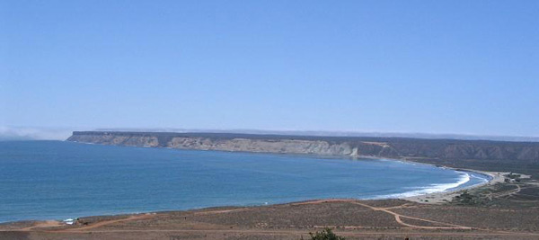
Proposed Deep Sea Port of Punta Colonet
PORT FACTS:
Located 150 miles south of Tijuana, Mexico.
Border Crossing Feasibility Study underway.
Infrastructure Issues.
Economic feasibility.
1 million TEUs by opening year.
5 million TEUs by 2030.

Slide 22
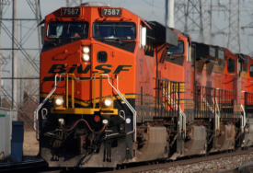
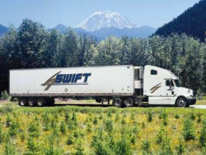
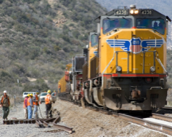

2007 Port Activities
World Ports
(Thousands of full and empty TEUs)
U.S.A. Ports
(Thousands of full and empty TEUs)
Punta Colonet
6 million TEU
By 2030
Punta Colonet
1 million TEU
Opening

Slide 23
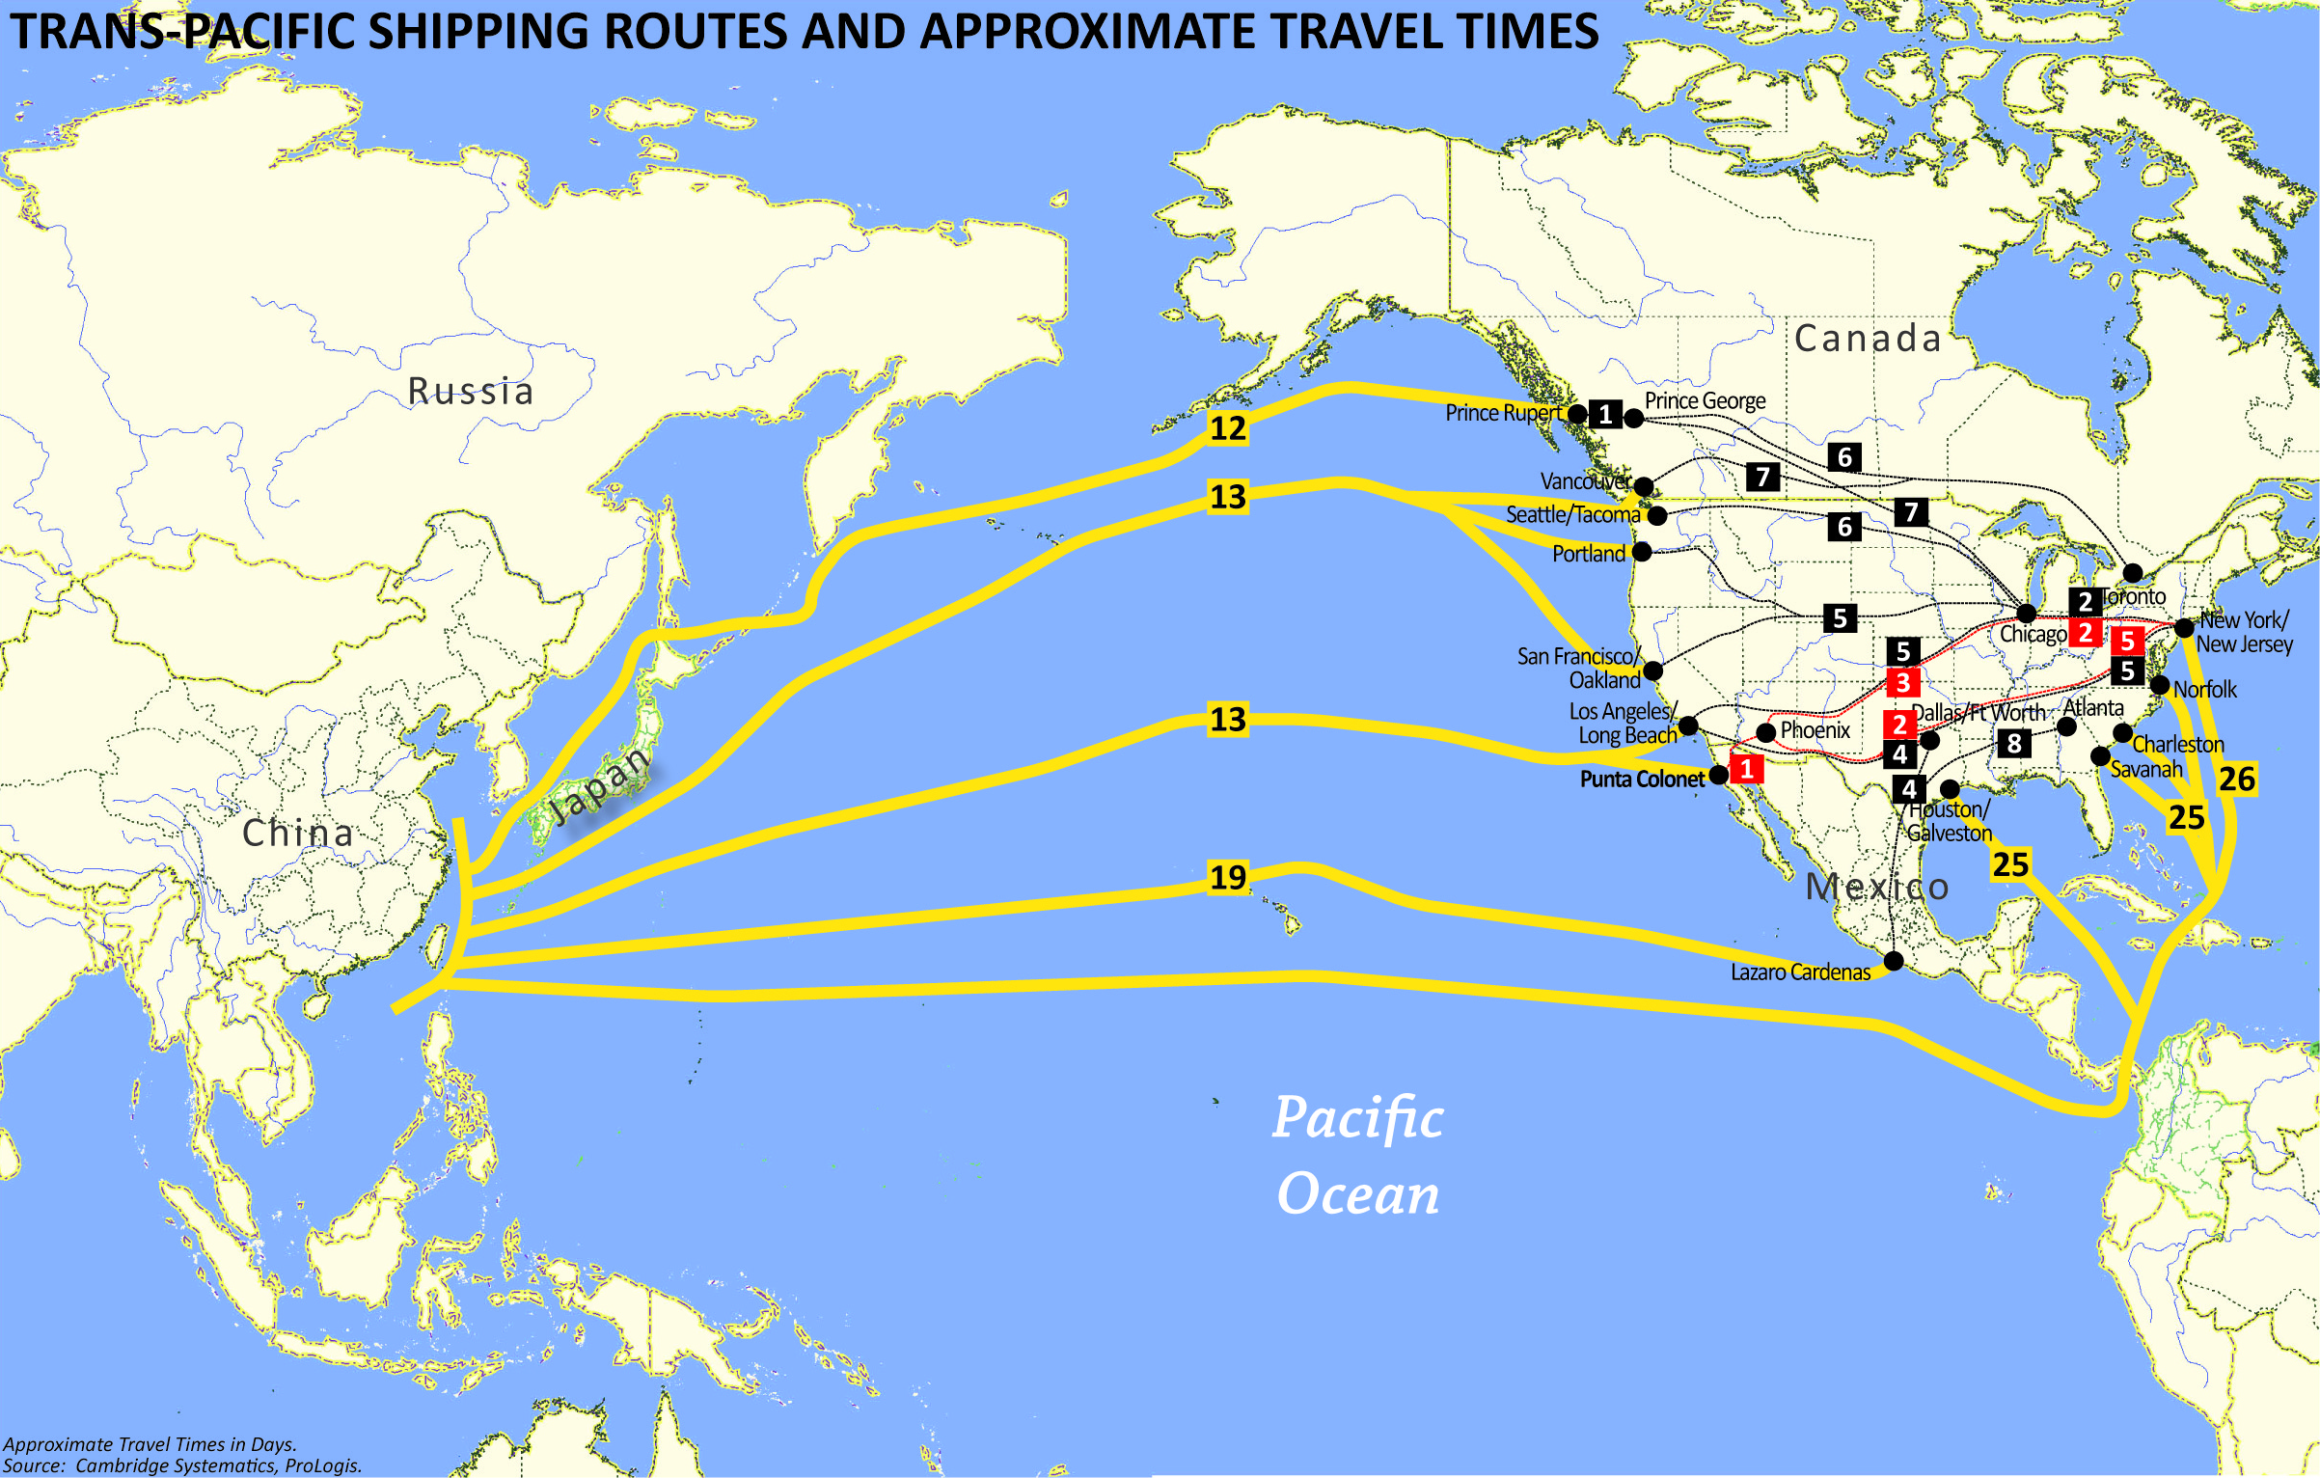

Slide 24
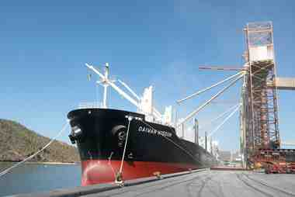
Port of Guaymas
PORT FACTS:
Rail Capacity to handle 14 trains per day – each direction.
4-Lane Highway No. 15 located 1-mile from port.
Located 240 miles from Nogales and 420 miles from Phoenix.
Port Activity: Grains, Minerals, Autos.
Grain storage Capacity of 68K tons.
Moved approximately 2-million tons last year.
Indefinite waiver of Mexico’s 16% value-added tax.

Slide 25
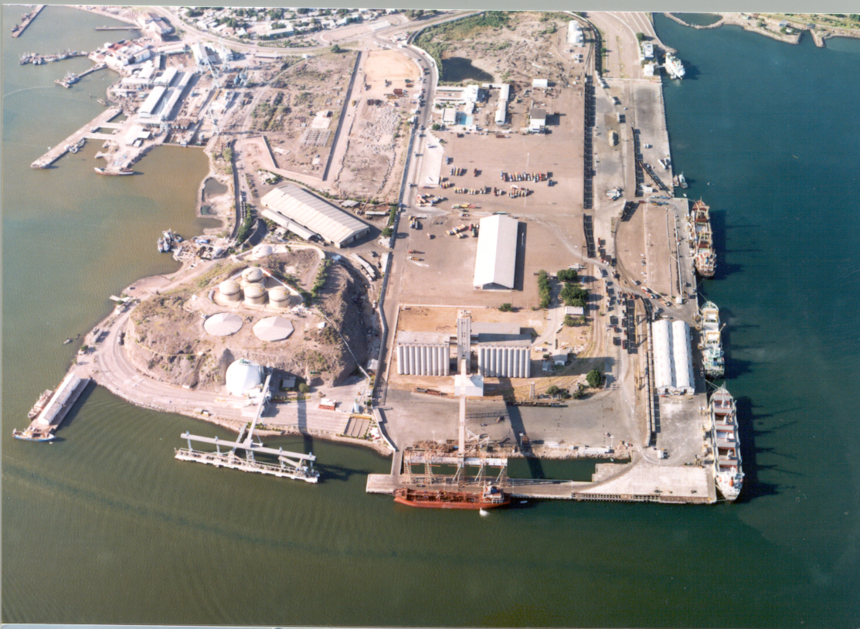

Slide 26
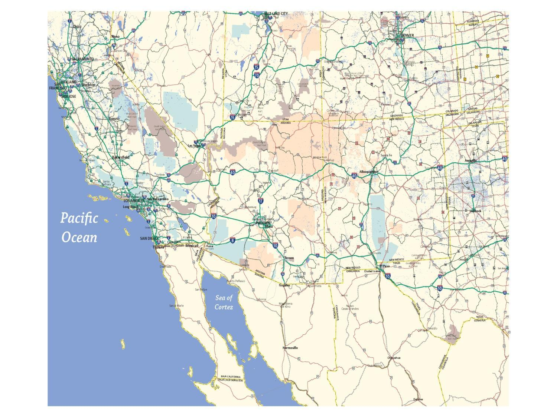
Inland Port Opportunities
Union Pacific
BNSF Railway
BNSF Railway
KINGMAN
Hassayampa Corridor
PHOENIX
YUMA
TUCSON
Punta Colonet
Union Pacific
Guaymas

Slide 27
Interstate Highway System
Interstate 11 Corridor
Freight Opportunities
Notes:
But also for the intermountain west…..
A few of the transportation agencies in California are even excited about the possibilities of Interstate -11 ***Next slide…

Slide 28
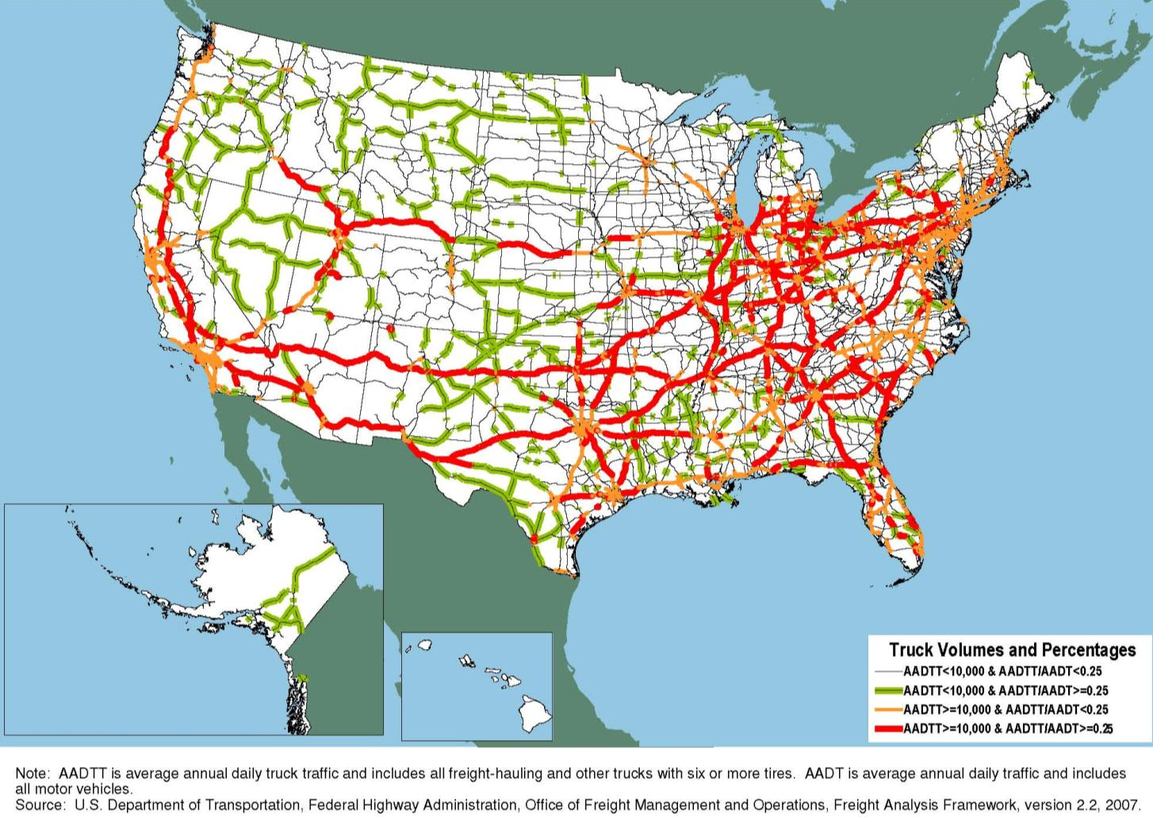
2035 Major Truck Routes on the National Highway System

Slide 29
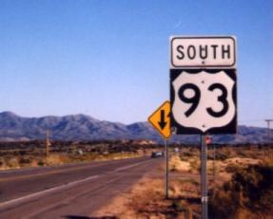
CAN-DO: The Interstate 11 Coalition
Connecting Arizona and Nevada – Delivery Opportunities
Town of Buckeye, AZ
City of Kingman, AZ
Maricopa County, AZ
Town of Wickenburg, AZ
Yavapai County, AZ
Boulder City, NV
City of Las Vegas, NV
Regional Transportation Commission of Southern Nevada
America Nevada Company
AREA Property Partners
Arizona Builder’s Alliance
Associated General Contractors Arizona
Belmont
Buckeye Valley Chamber of Commerce
Buckeye Valley Development, Inc.
Douglas Ranch
The Greenspun Company
JDM Partners
Langley Properties
Las Vegas Convention and Visitors Authority
NAIOP Southern Nevada Chapter
The Nevada Development Authority
Pulte Homes Corporation
The Sundt Companies
Swift Transportation, Inc.
Wickenburg Chamber of Commerce

Slide 30
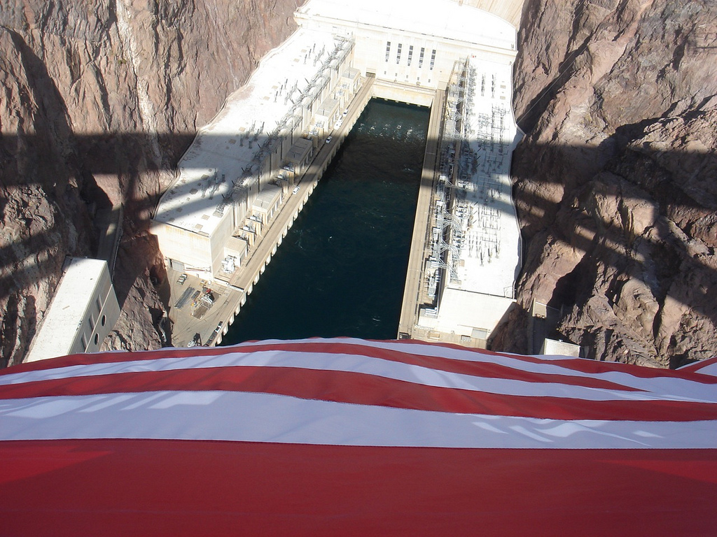
For more information . . .
Tim Strow
Maricopa Association of Governments
tstrow@azmag.gov
(602) 254-6300

Slide 31
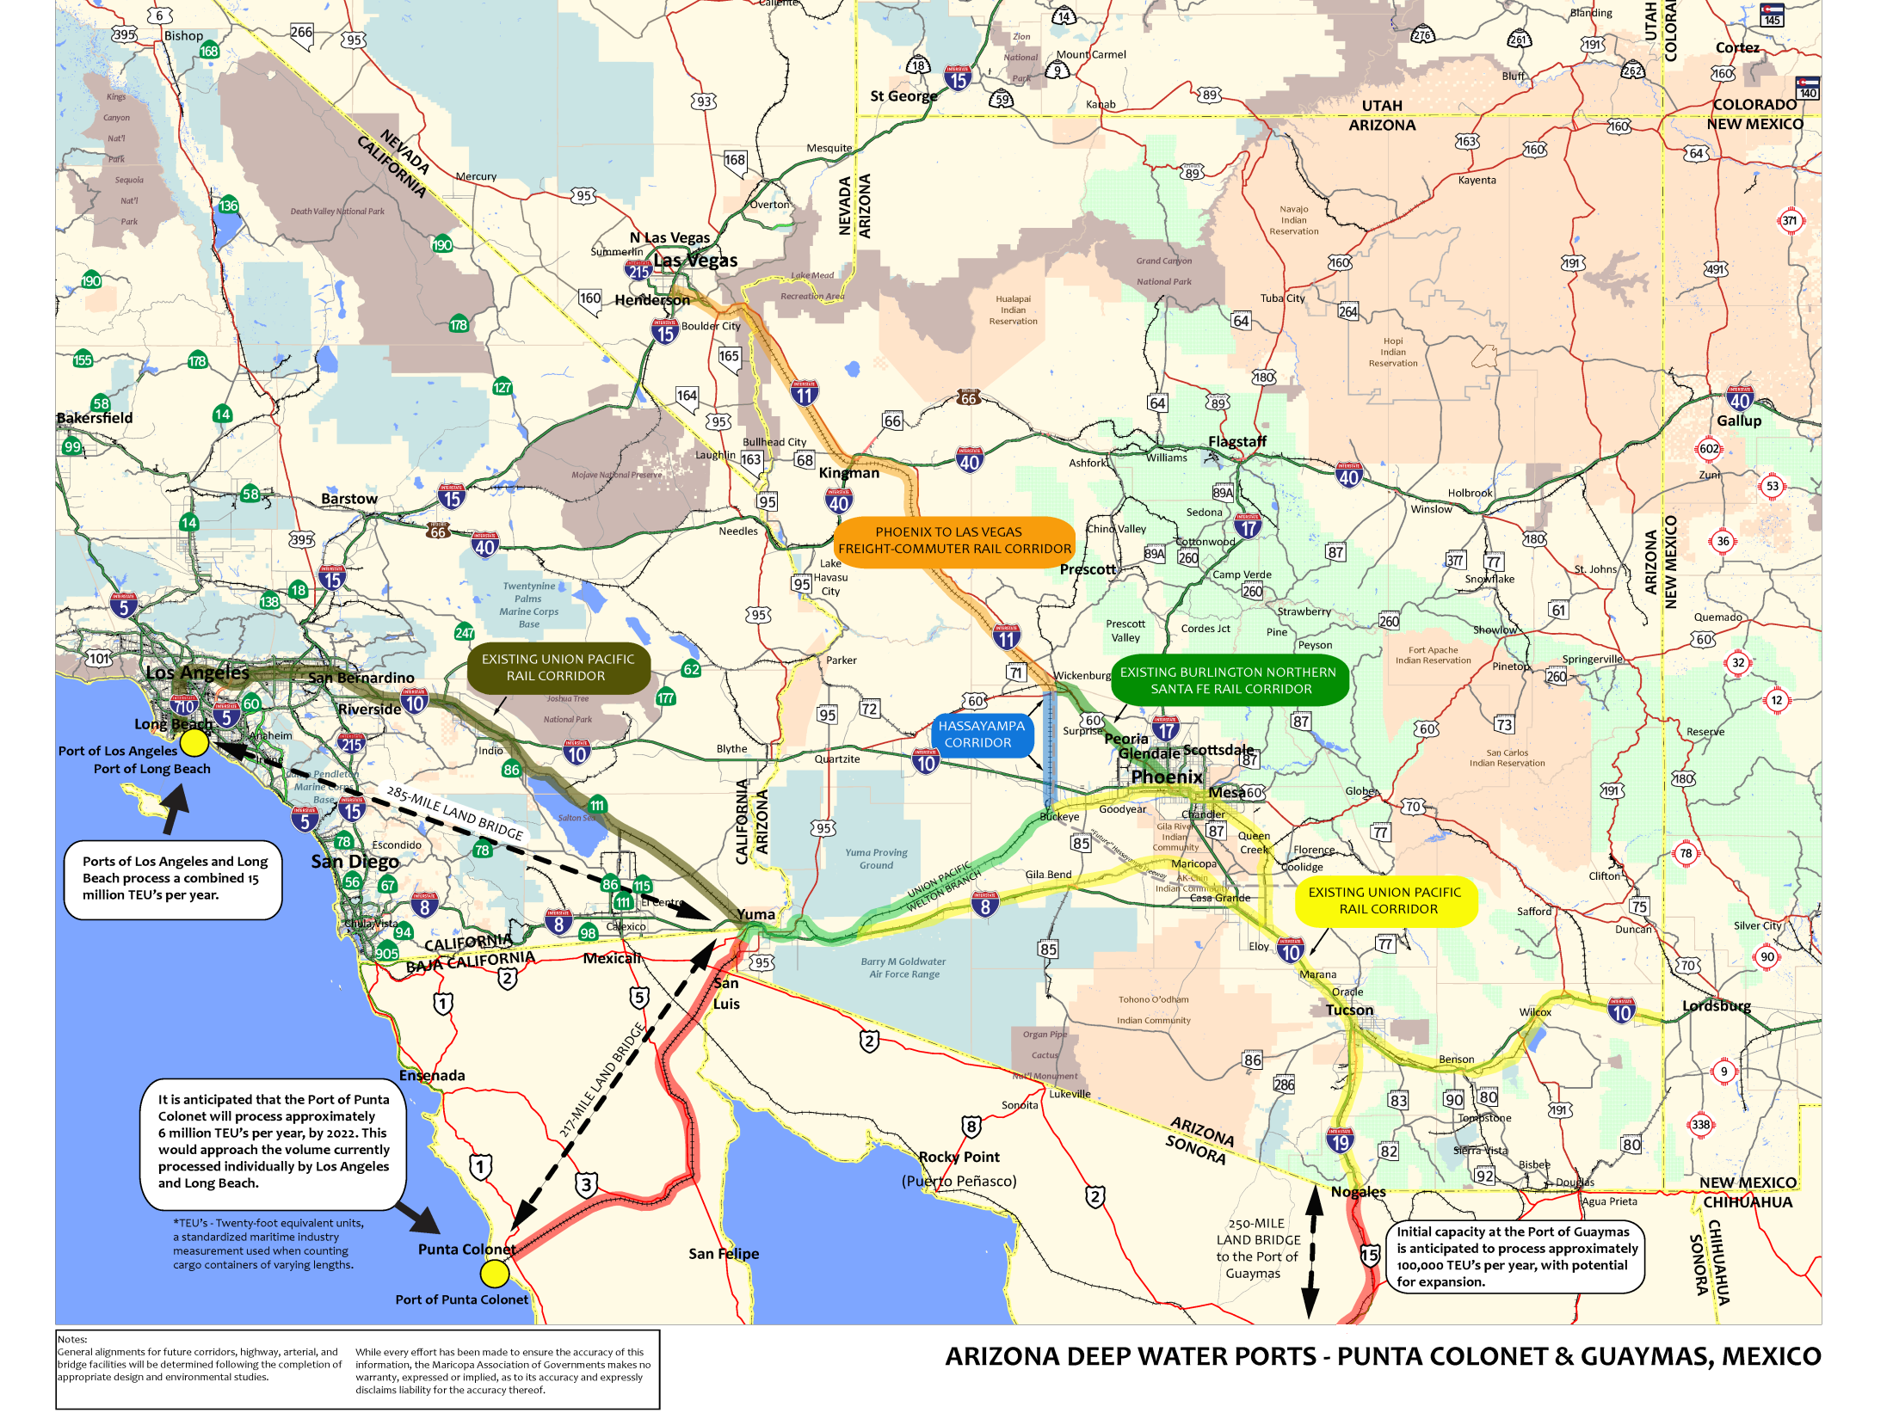

Slide 32
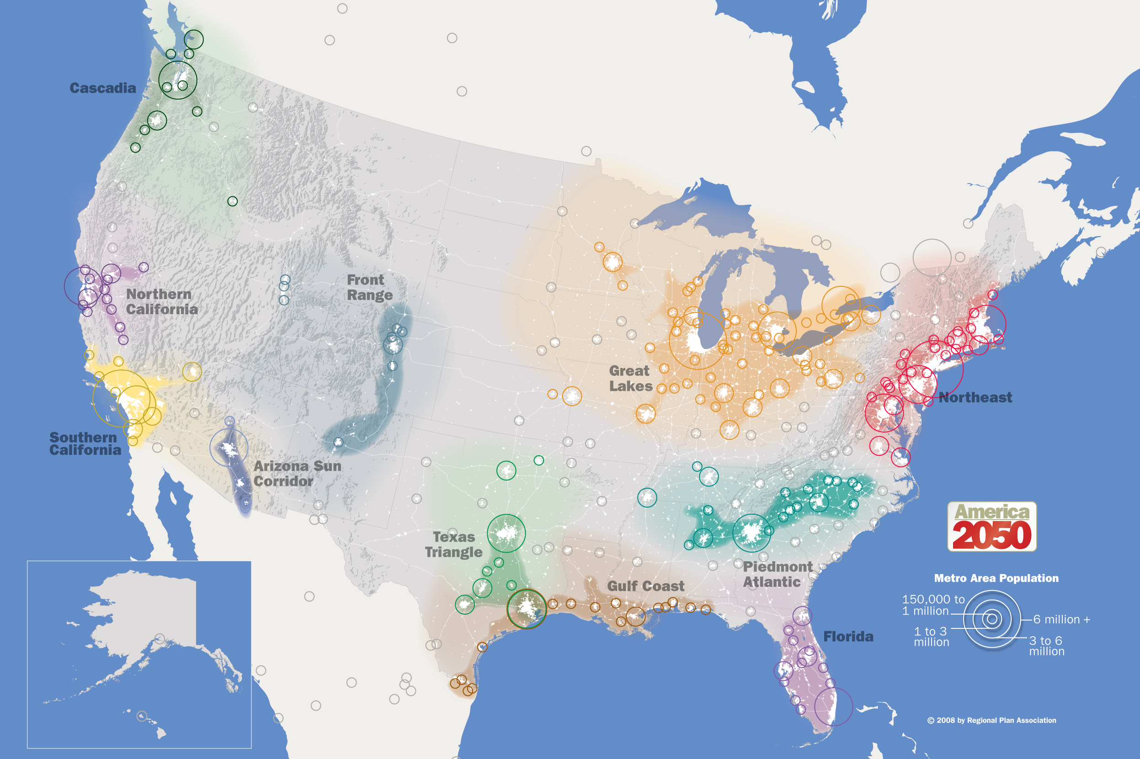
Megaregions

Slide 33
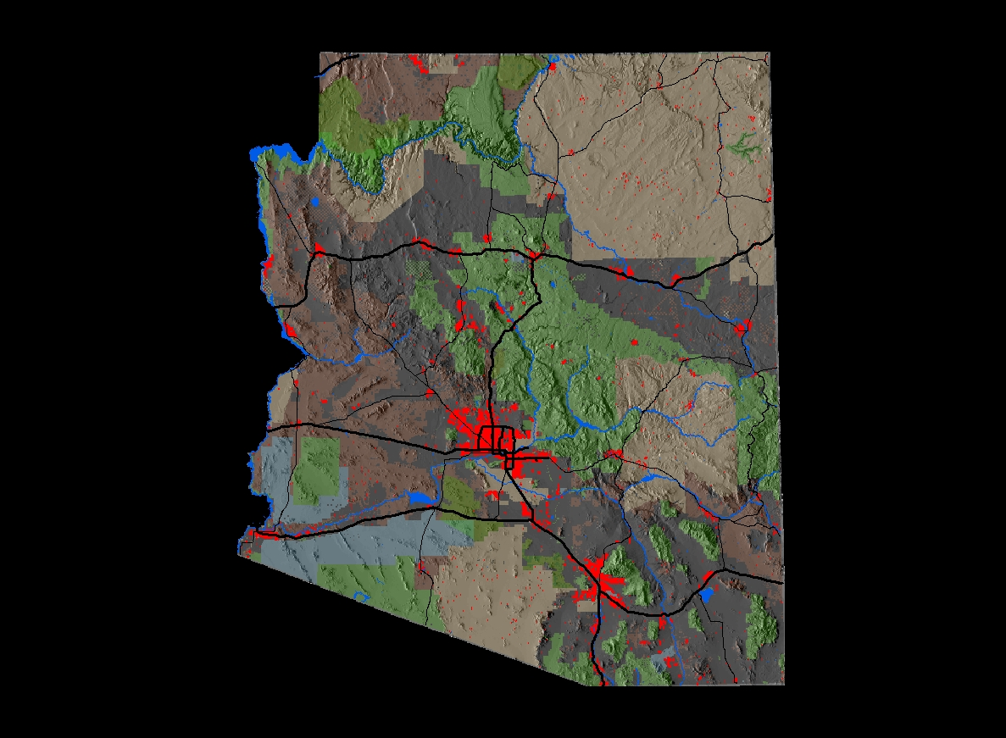
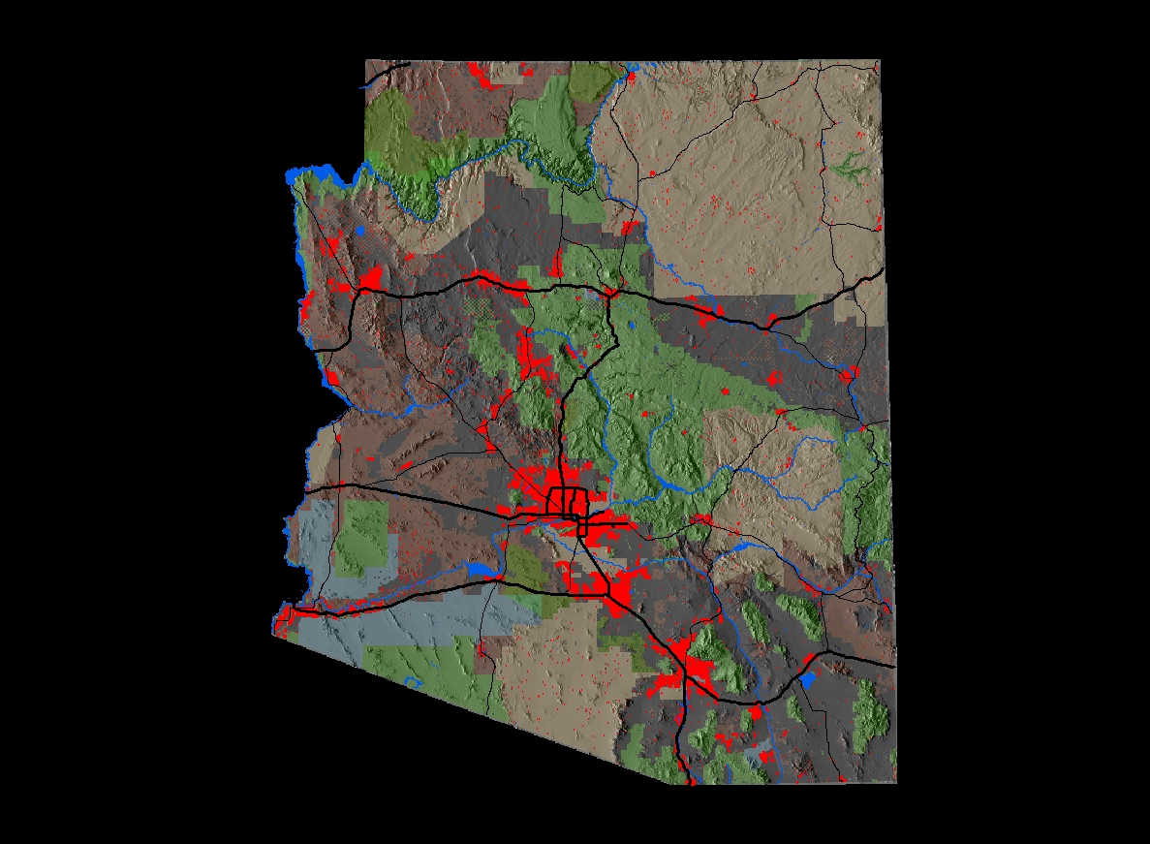
Sun Corridor
2010
2030
5.5 Million
7.5 Million
Interlocking Economic Systems
Common Transportation Systems
Shared Natural Resources and Ecosystems

