Slide 1
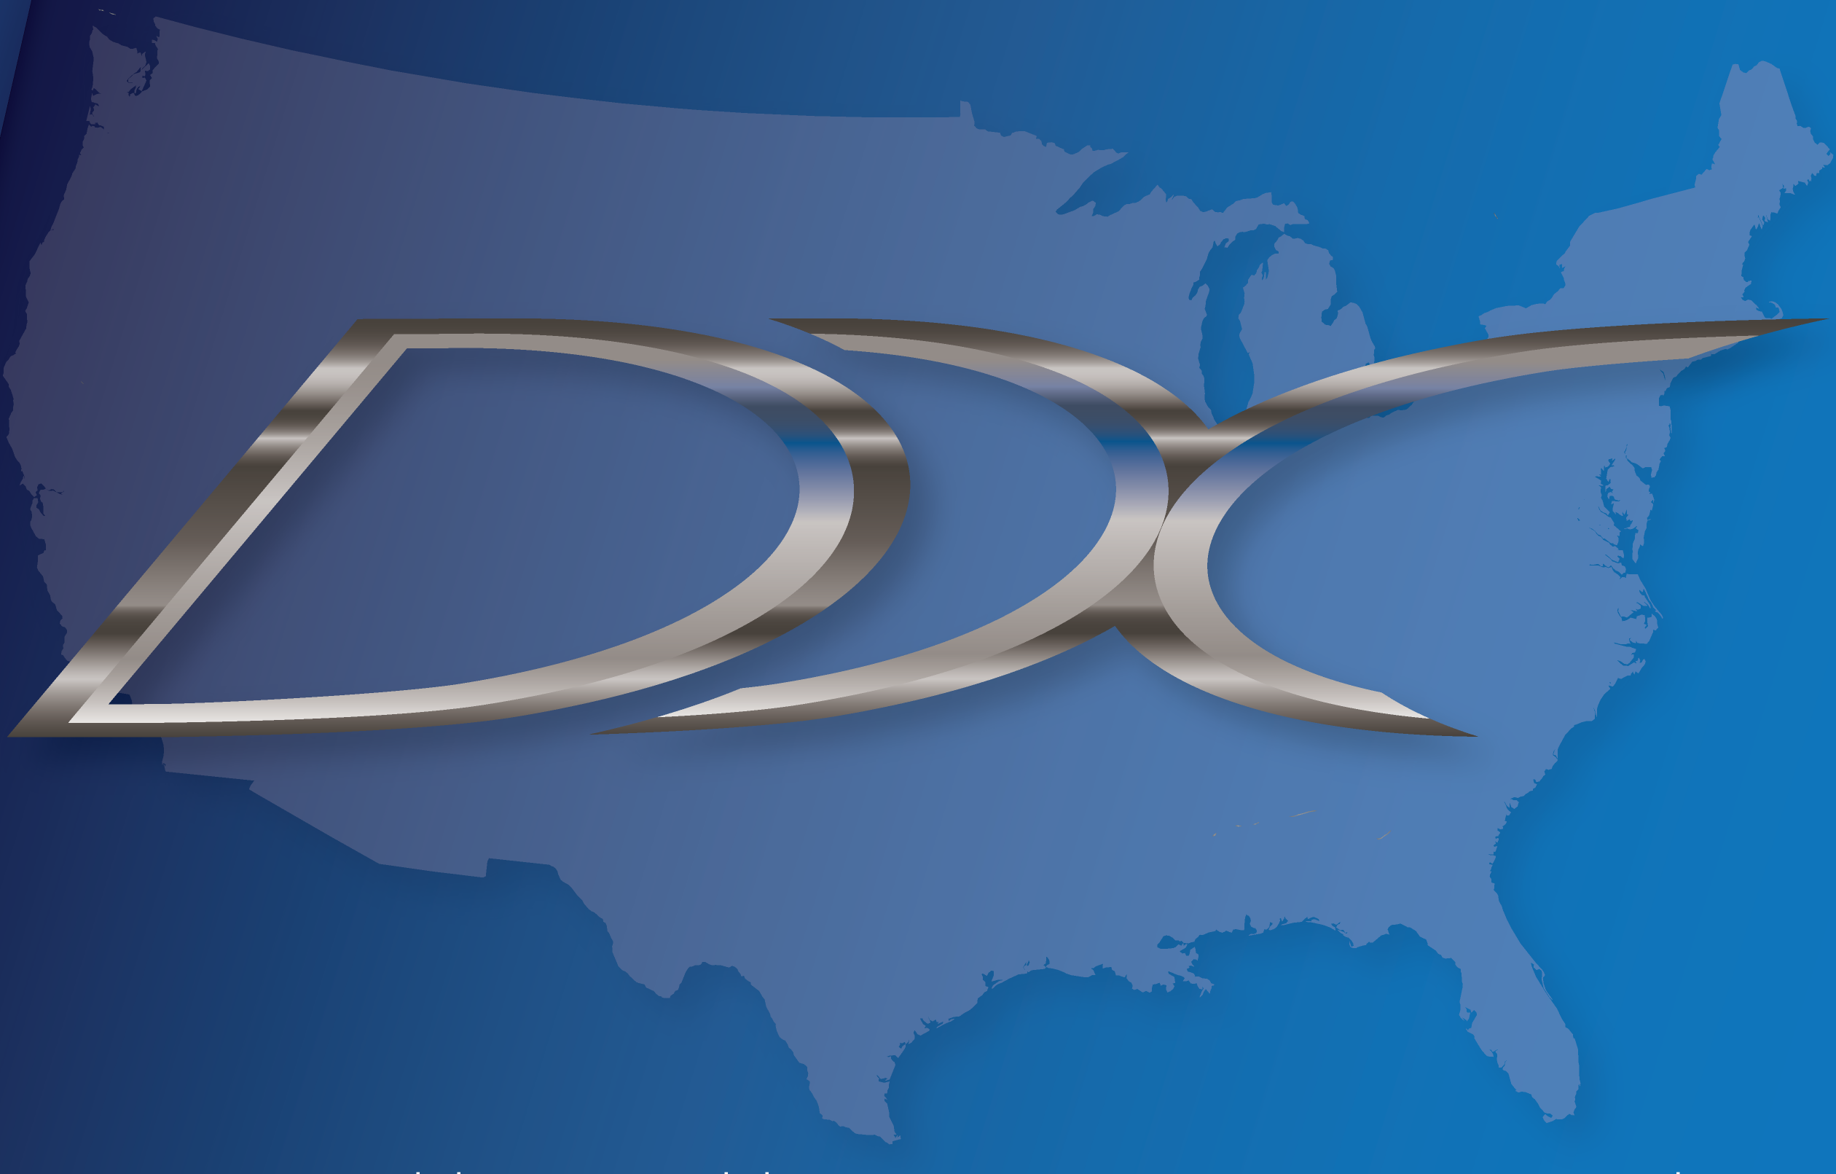

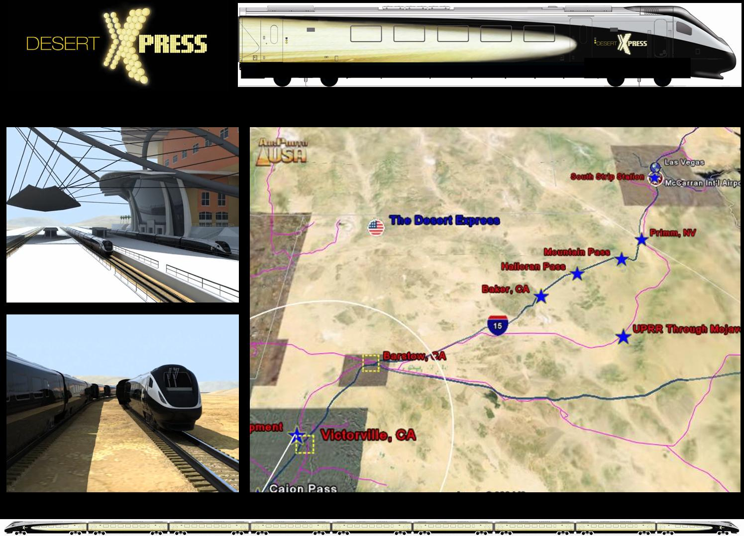
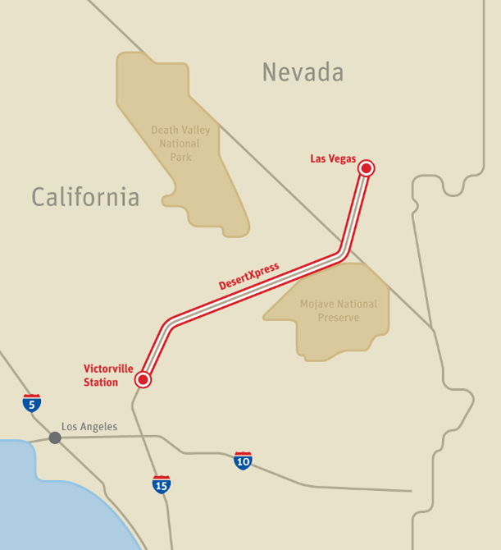
DesertXpress
Information contained in this presentation is confidential and proprietary to DesertXpress Enterprises, LLC
© 2011 DesertXpress Enterprises, all rights reserved

Slide 2
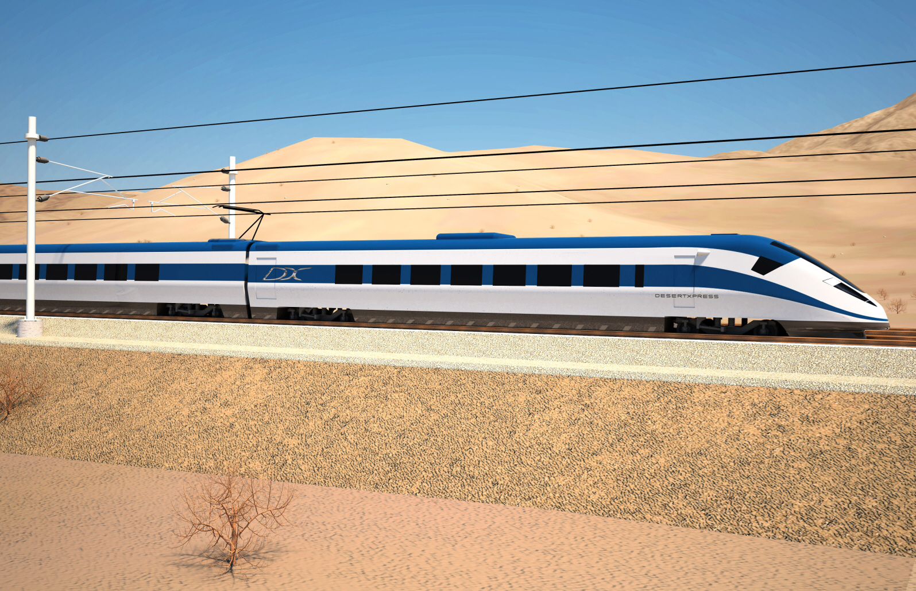
DesertXpress: The First Dedicated Interstate
High Speed Passenger Railroad in the US
Notes:
DesertXpress addresses a pressing transportation need while offering passengers an unparalleled rail experience between Victorville, CA and Las Vegas.
Tuesday, March 22, 2011
2
Transmax Group. Private and Confidential
Victorville to Vegas | Speaking notes

Slide 3
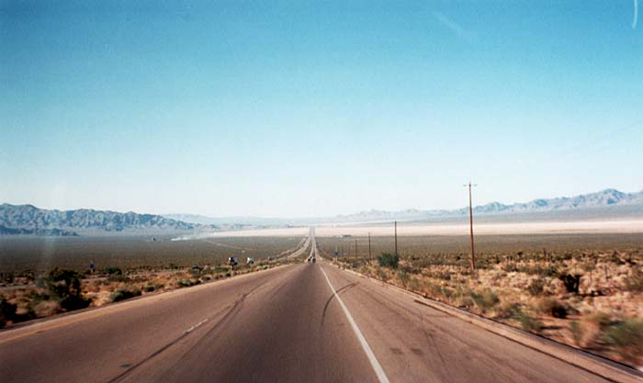
The Challenge
The need for HSR in the Southern California – Las Vegas corridor is universally accepted
Nevada leadership has been searching for 30 years for a solution to this pressing transportation need
Prior initiatives:
  Too short to serve a true transportation need
  Too large to advance beyond the study phase with multiple interests and technical challenges
  Non-exclusive right-of-way
Reduced Congestion at McCarran Airport
Reduced Congestion on I-15

Slide 4
Three critical success factors
DesertXpress satisfies three critical success factors – unlike prior attempts in this corridor
The Need Exists
  Unprecedented high-level of demand that is captive and growing
  Only one road connecting major travel destinations
Supportive Leadership is in Place
  Private and public sector support exists to establish true high speed rail in America and in this corridor using steel wheel on rail trains (EMU)
A Financeable Project
  Ridership studies forecast that the system as designed serves a robust market with sufficient revenue to support project costs

Slide 5
DesertXpress: A Strategic Approach
  Define a system that avoids the congestion of the Los Angeles basin, minimizes environmental impacts, and serves the transportation needs of the corridor
  Build a first phase that gets to the population collection center of Southern California to attract the ridership necessary to support the project’s costs
  Use next generation standard gauge, steel wheel on rail high speed train technology with a proven safety case incorporating capability to interoperate with the California High Speed Rail system

Slide 6
DesertXpress: A Strategic Approach
  Deliver on the promise of the Las Vegas experience starting in Southern California, with ease of use, baggage handling direct to your room, and hotel check-in
  Deliver on the convenience of a multi-modal Las Vegas terminal with taxis, hotel shuttle service, rental cars and a future direct connection with the Las Vegas Monorail
  Coordinate with CA to connect 50 miles west in Palmdale to interface with the North-South California High Speed system – connecting Las Vegas to all of California

Slide 7
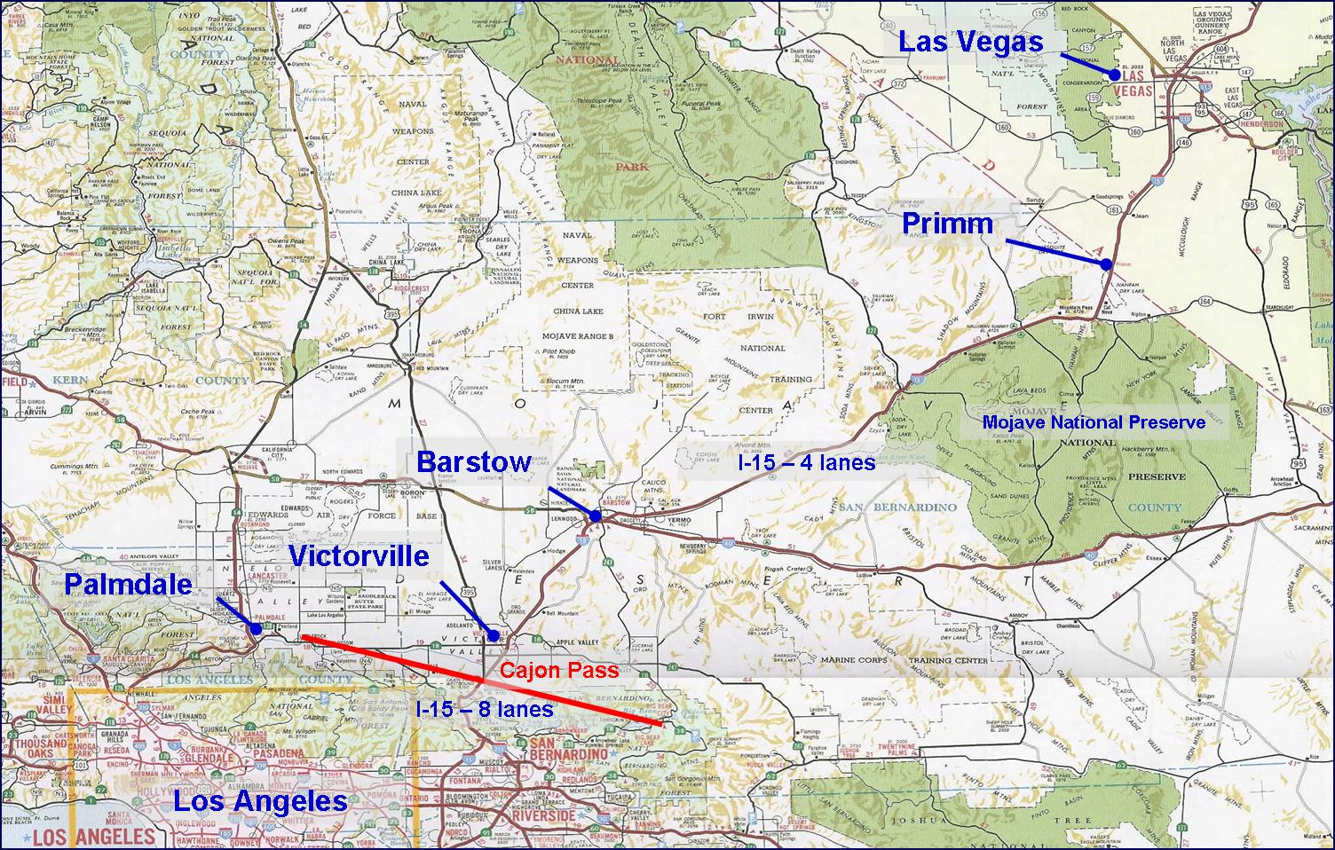
Corridor Orientation

Slide 8
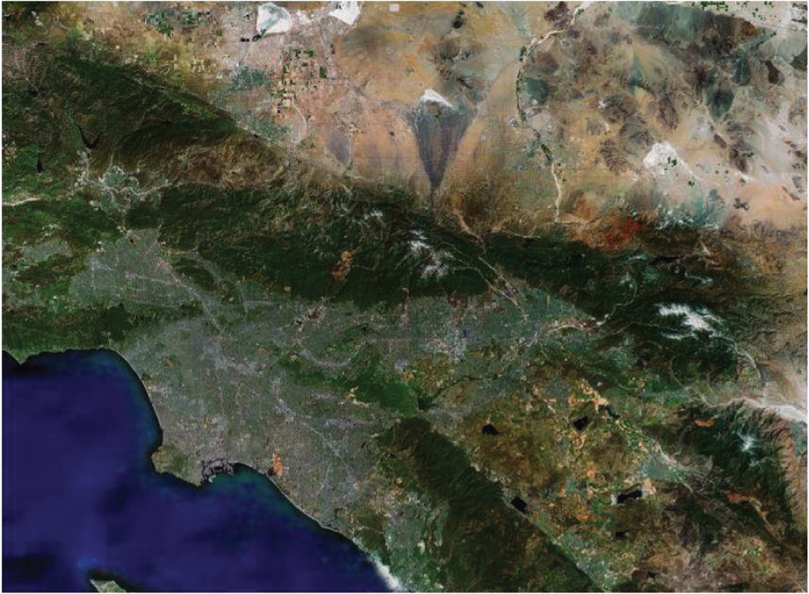
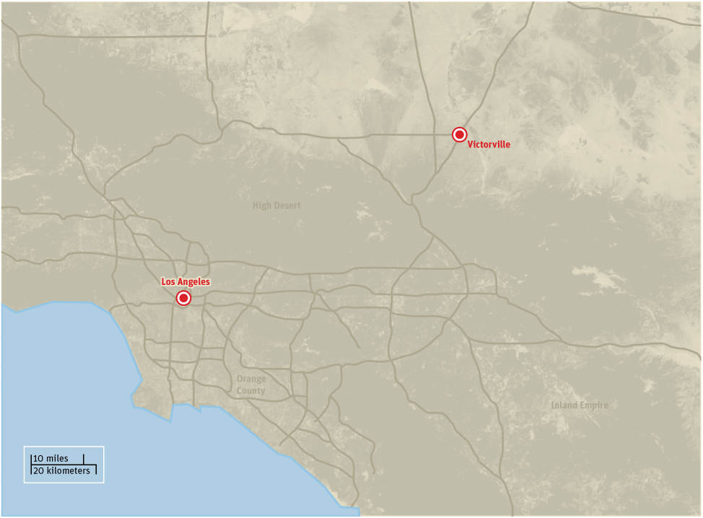
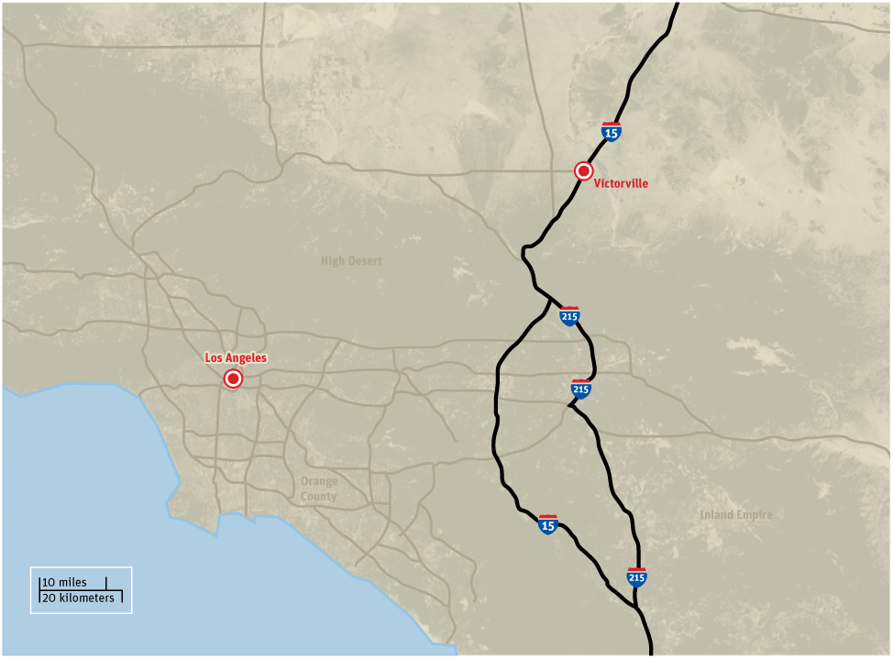
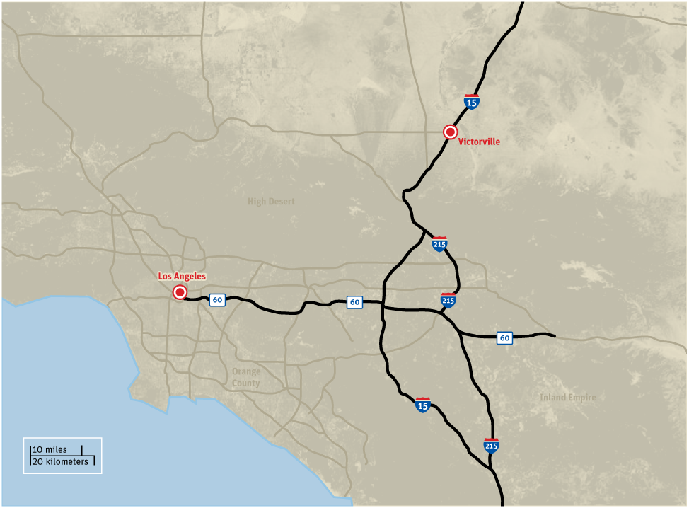
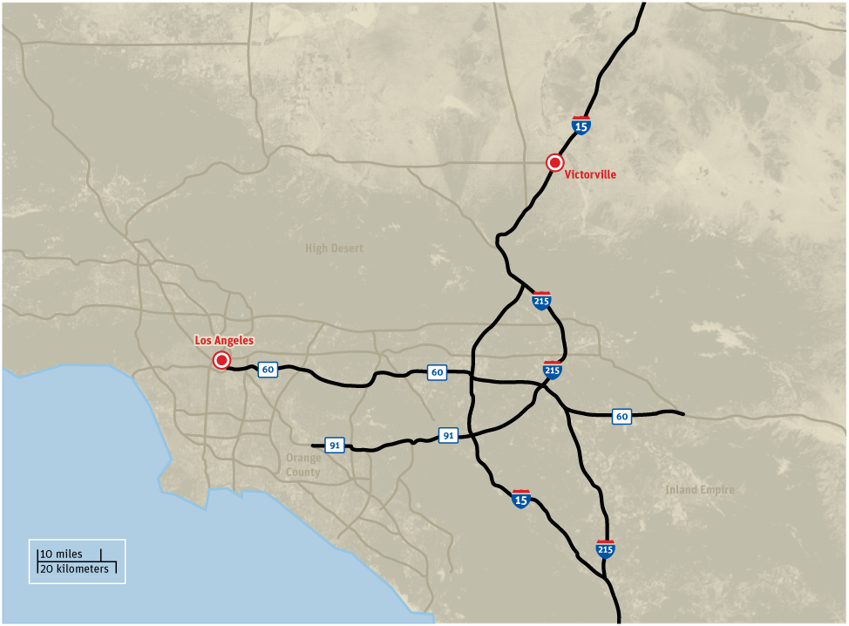
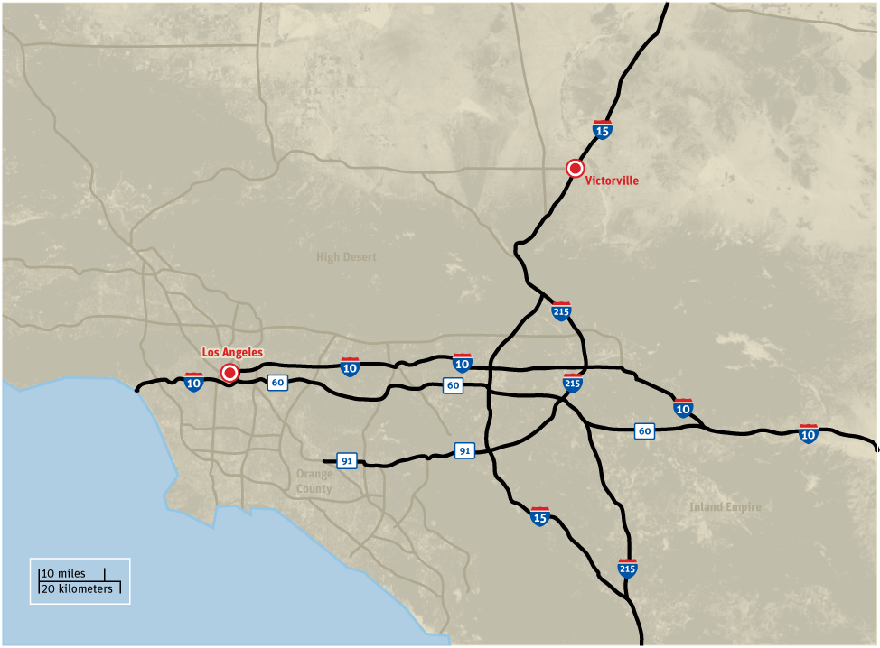
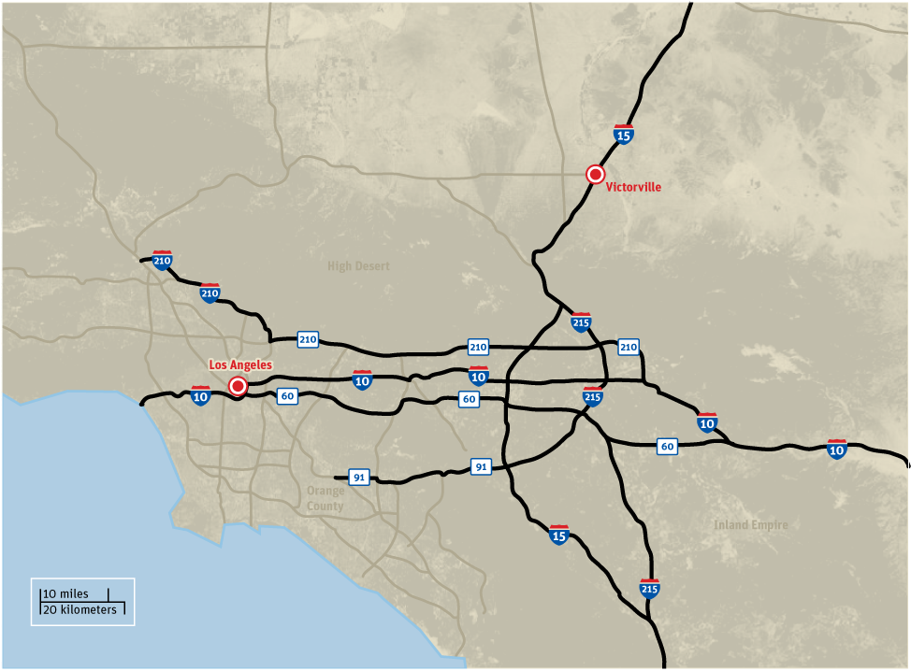
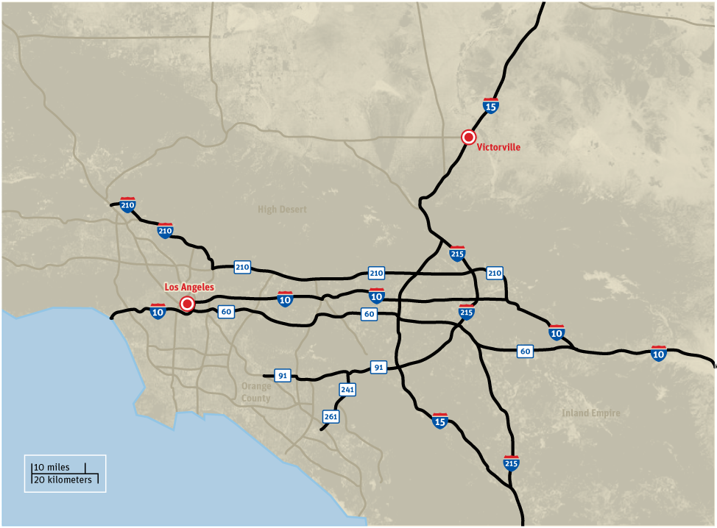
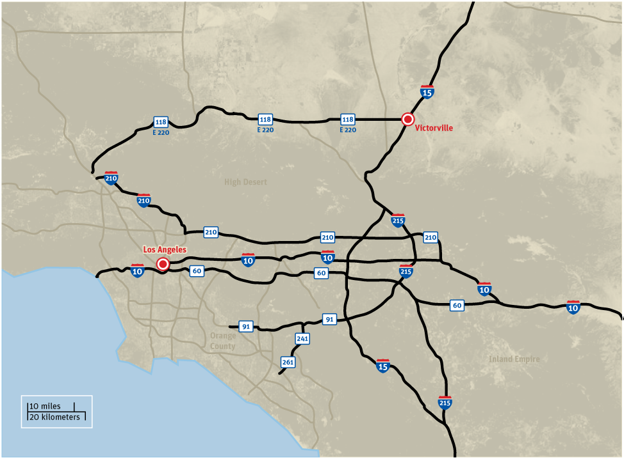
All roads lead to Victorville
8
Notes:
It’s a short drive to Victorville from Los Angeles and environs—and a long drive beyond that to Vegas.
Tuesday, March 22, 2011
8
Transmax Group. Private and Confidential
Victorville to Vegas | Speaking notes

Slide 9
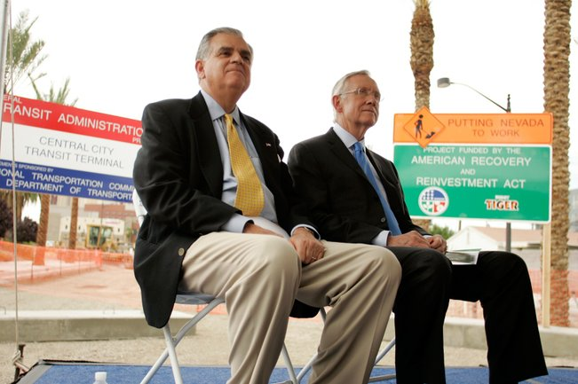
DesertXpress as Part of a Federally Designated HSR Corridor
Las Vegas Sun July 2, 2009
A boost for DesertXpress
Reid uses corridor designation to show backing for private project
Senator Harry Reid, with Transportation Secretary Ray LaHood, holds a press conference about a proposed high-speed train that would go from Las Vegas to Southern California in downtown Las Vegas Thursday, July 2, 2009.

Slide 10
California – Nevada High Speed Rail System

Slide 11
DesertXpress Project Overview
  302 km (188 miles) from Victorville, CA to Las Vegas, NV
  All new exclusive double track with no at-grade vehicle or pedestrian crossings
  Dedicated passenger - only service - no mixing with freight trains
  Two stations with no intermediate stops - express service
  Primarily within or adjacent to the existing I-15 freeway right-of-way
  Maximum vertical grade of 4.5% and minimum radius curves of 2500 meters (8000 feet) deliver a trip time of 84 minutes

Slide 12
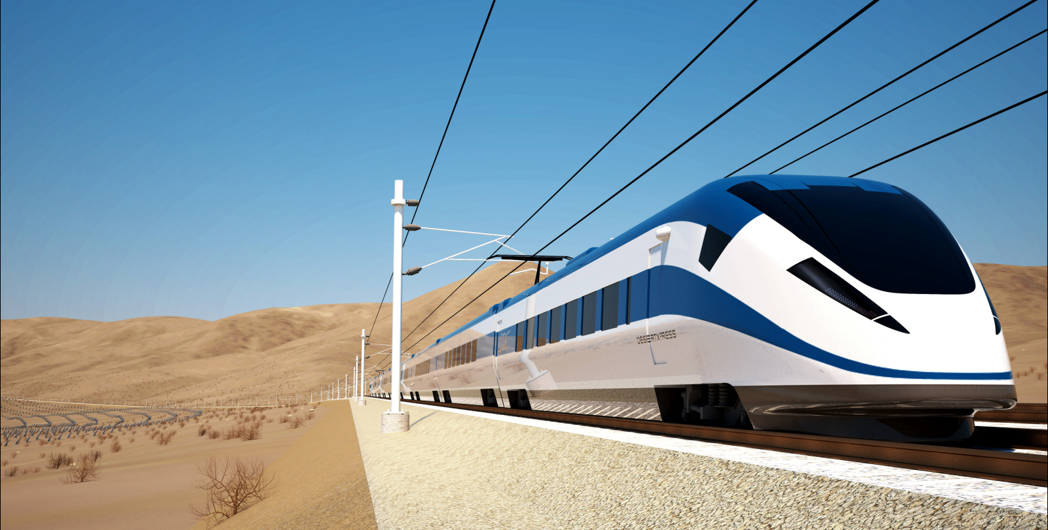
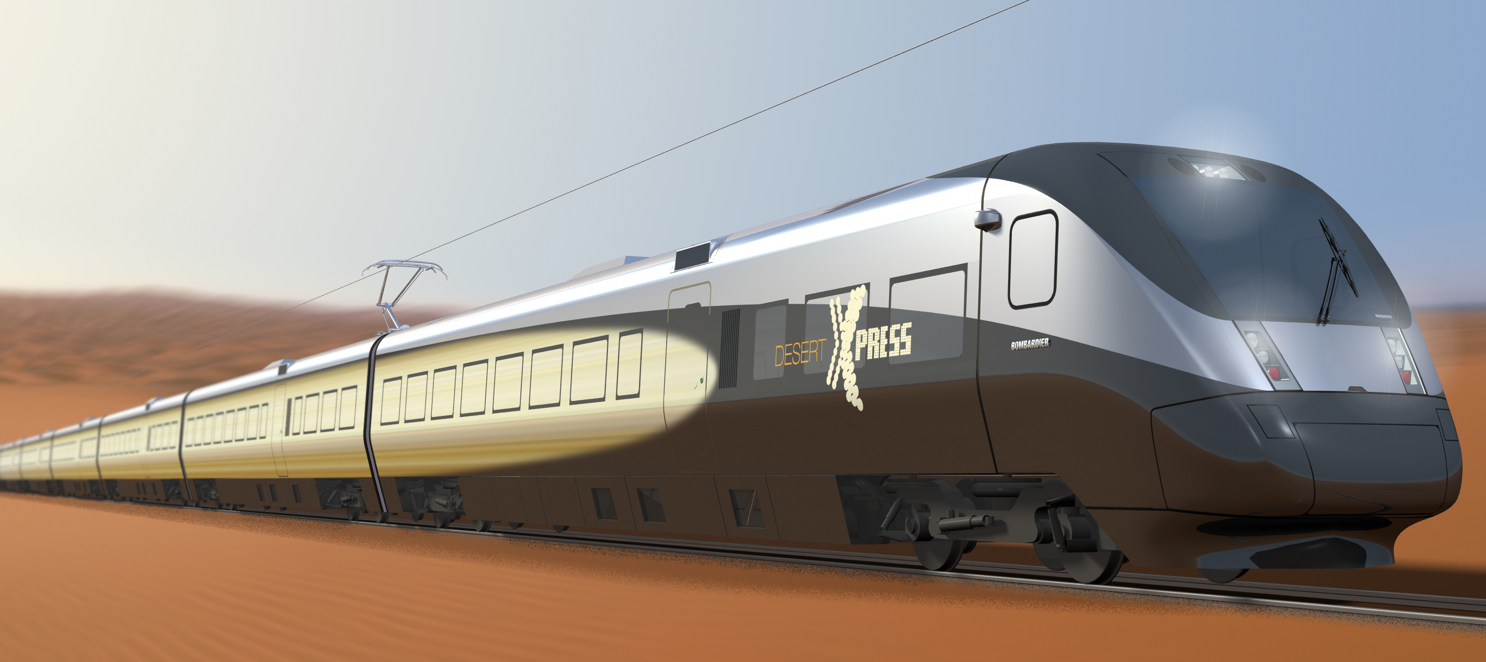
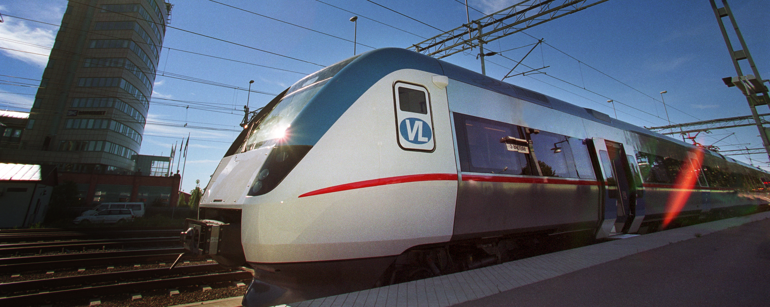
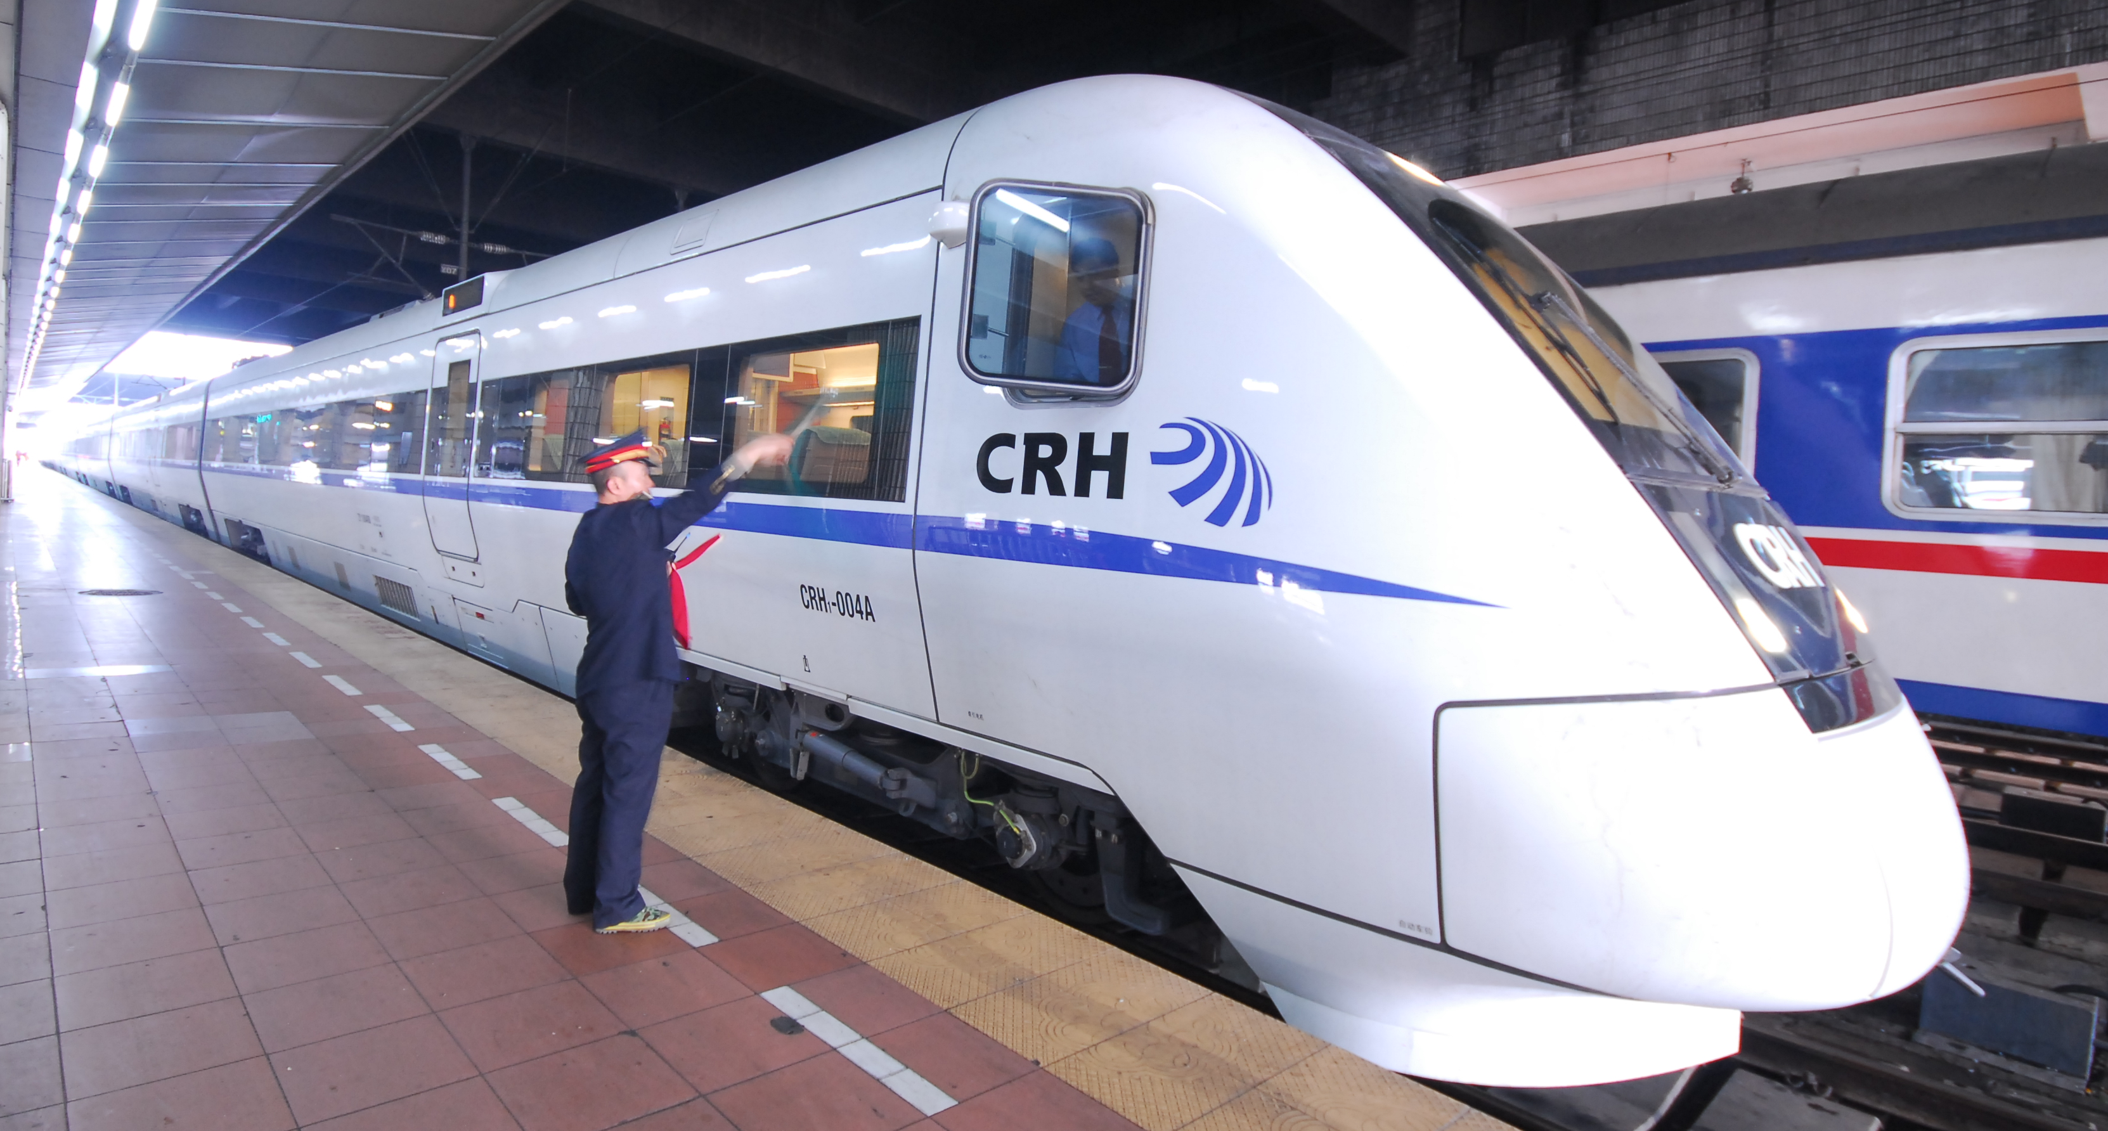
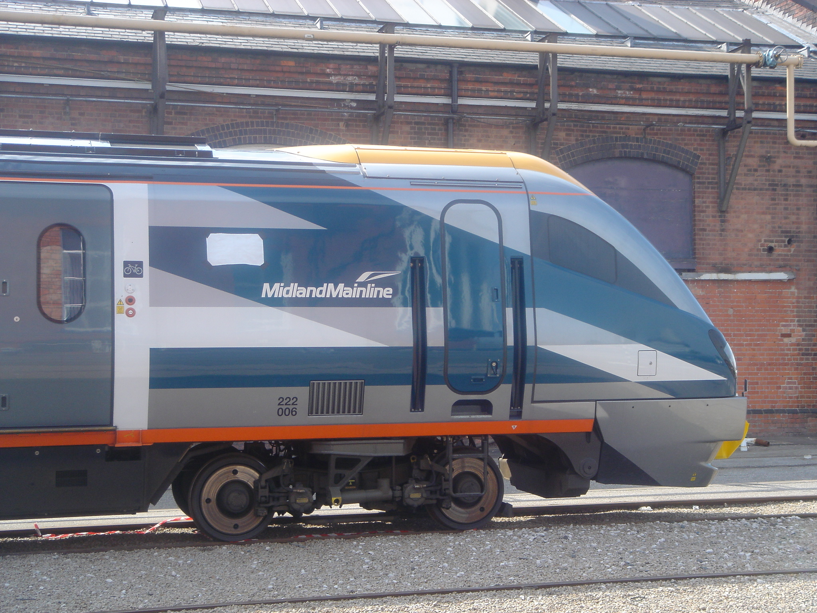
The Trains

Slide 13
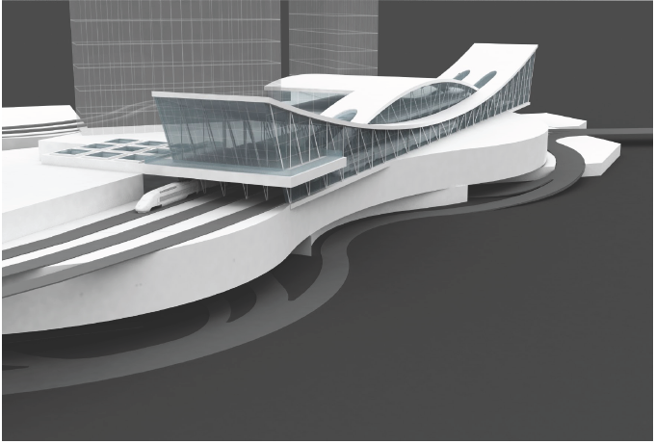
Central Station West – Las Vegas

Slide 14
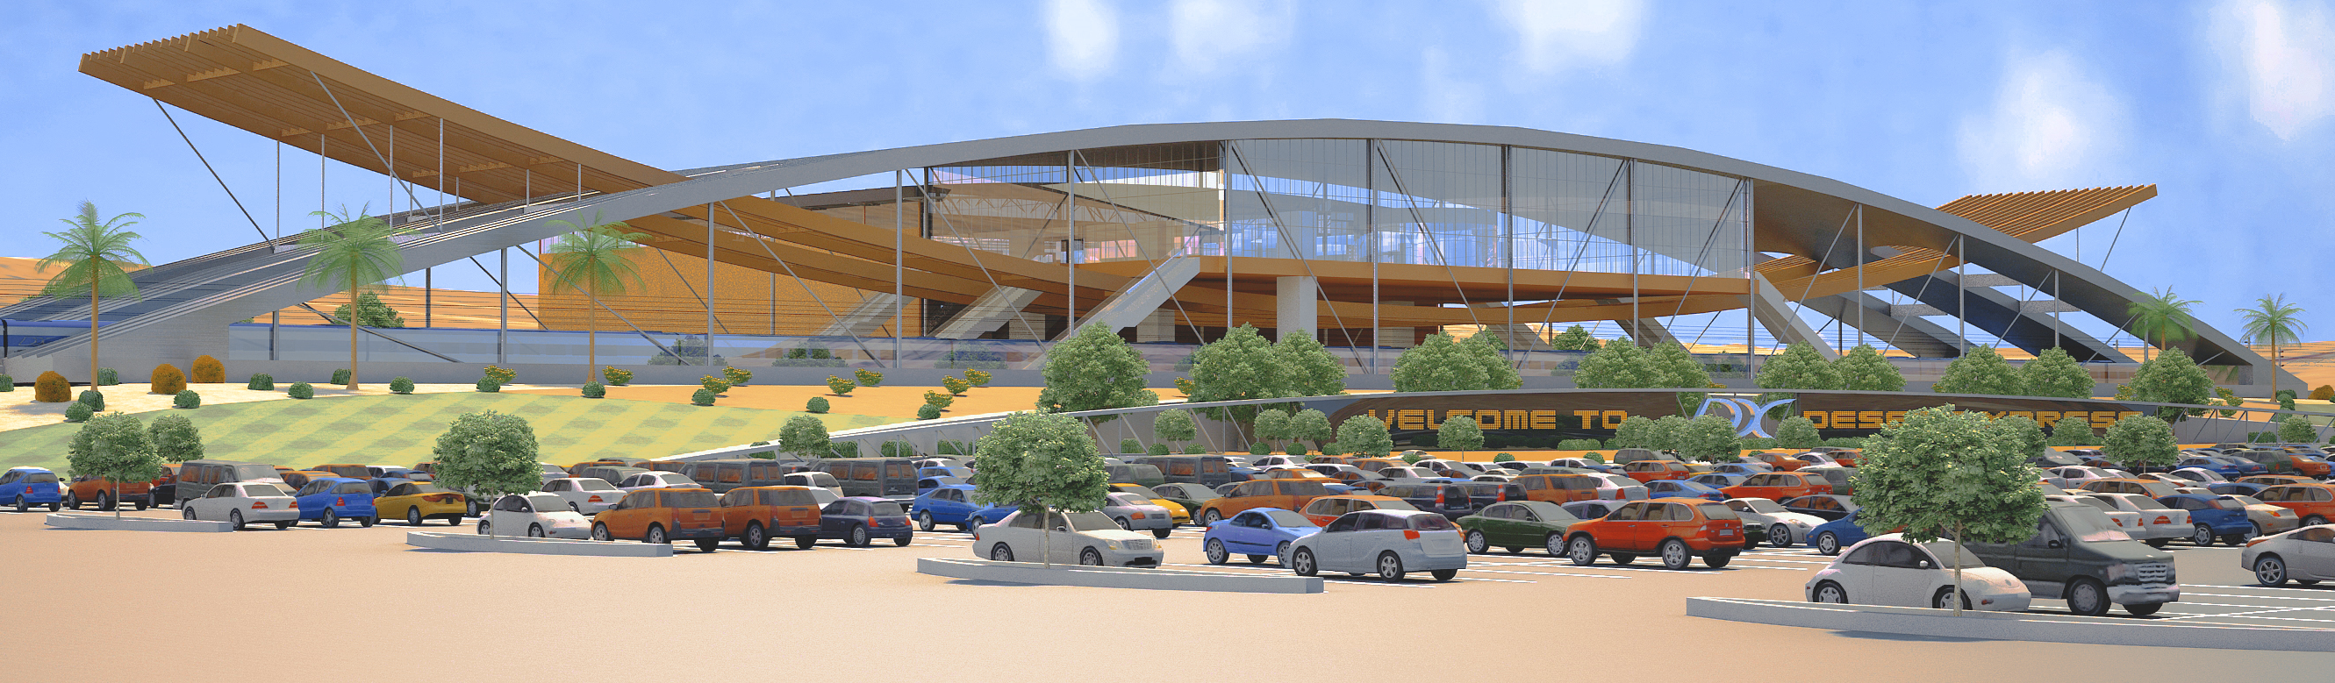
Southern California Terminus

Slide 15
Ridership/Market Share
  Up to 39 million visitors come to Las Vegas from around the world, an estimated 25% come from Southern California
  An estimated 11 million of those visitors drive on I-15
  Traffic studies performed for the Environmental Impact Statement forecast an approximate 25% shift of private automobiles from I-15 to the train reducing emissions and fuel consumption while facilitating goods movement in the corridor
  To satisfy the travel demand, the current operating plan calls for departures every 20 minutes on peak days

Slide 16
Cooperation with Federal and State Agencies
The Federal Railroad Administration is the Lead Agency for the Environmental Impact Statement with the following cooperating agencies:
    Surface Transportation Board
    Bureau of Land Management
    Federal Highway Administration
    National Park Service
Interagency Working Groups were established with NDOT, Caltrans, FRA and FHWA focused on the EIS, Right of Way, and Design that resulted in an agreed design manual for the Railroad-Highway Interface
The Notice of Intent to prepare the EIS was published in July 14, 2006
The Draft EIS was issued on March 18, 2009
A supplemental Draft EIS was issued on August 27, 2010
The Final EIS is currently under review by the FRA
The first privately funded high speed passenger rail EIS in US history

Slide 17
Project Benefits
DesertXpress will provide a safe, reliable and energy efficient alternative to auto travel on the I-15 plus:
Deliver the Nation’s first dedicated high speed rail project
Create over 80,000 direct and indirect jobs in Nevada and California during the 4-year construction period
Provide significant long-term environmental benefits including:
  Reduce major pollutants in the corridor by an estimated average of 40%
  Reduce consumption of oil by an estimated 450,000 barrels per year (18 million gallons of petroleum)

Slide 18
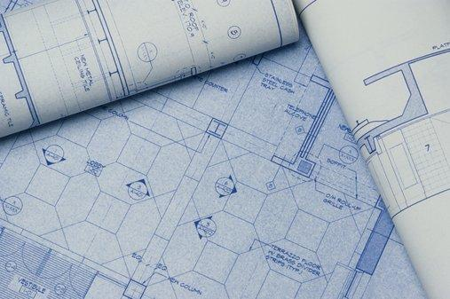
DesertXpress, LLC
Notes:
Tuesday, March 22, 2011
18
Transmax Group. Private and Confidential
Victorville to Vegas | Speaking notes

