Slide 1

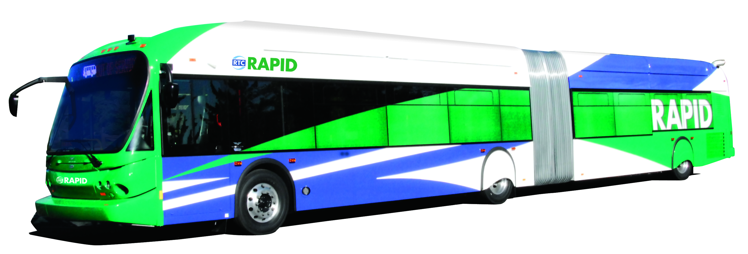
RTC RAPID and Beyond
A BRT Demonstration Project in the Virginia Street Corridor
David Jickling
Director of Public Transportation and Operations
Regional Transportation Commission, Washoe County

Slide 2
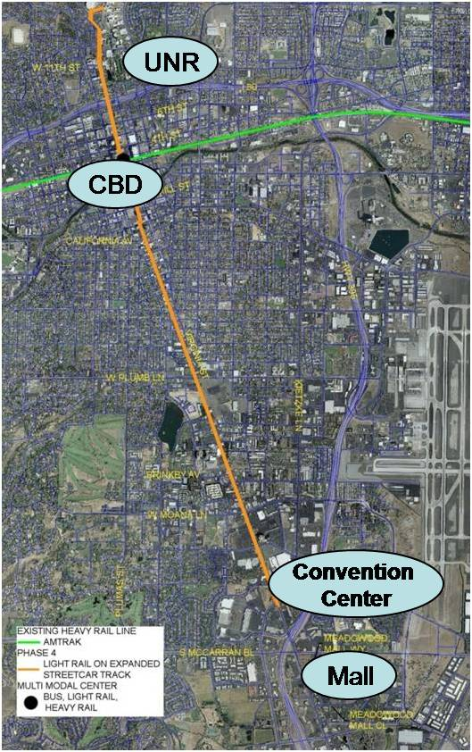
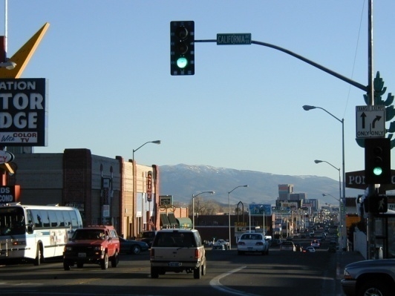
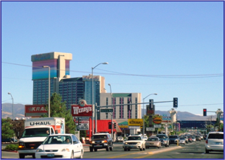
Virginia Street
Resort corridor connecting
  University of Nevada, Reno
  Downtown
  Truckee River
  Strip Casinos
  Convention Center
  Meadowood Mall
Major transportation corridor
  30,000 ADT
Strong transit ridership
  5,000/day
  (14% Mode Split)

Slide 3
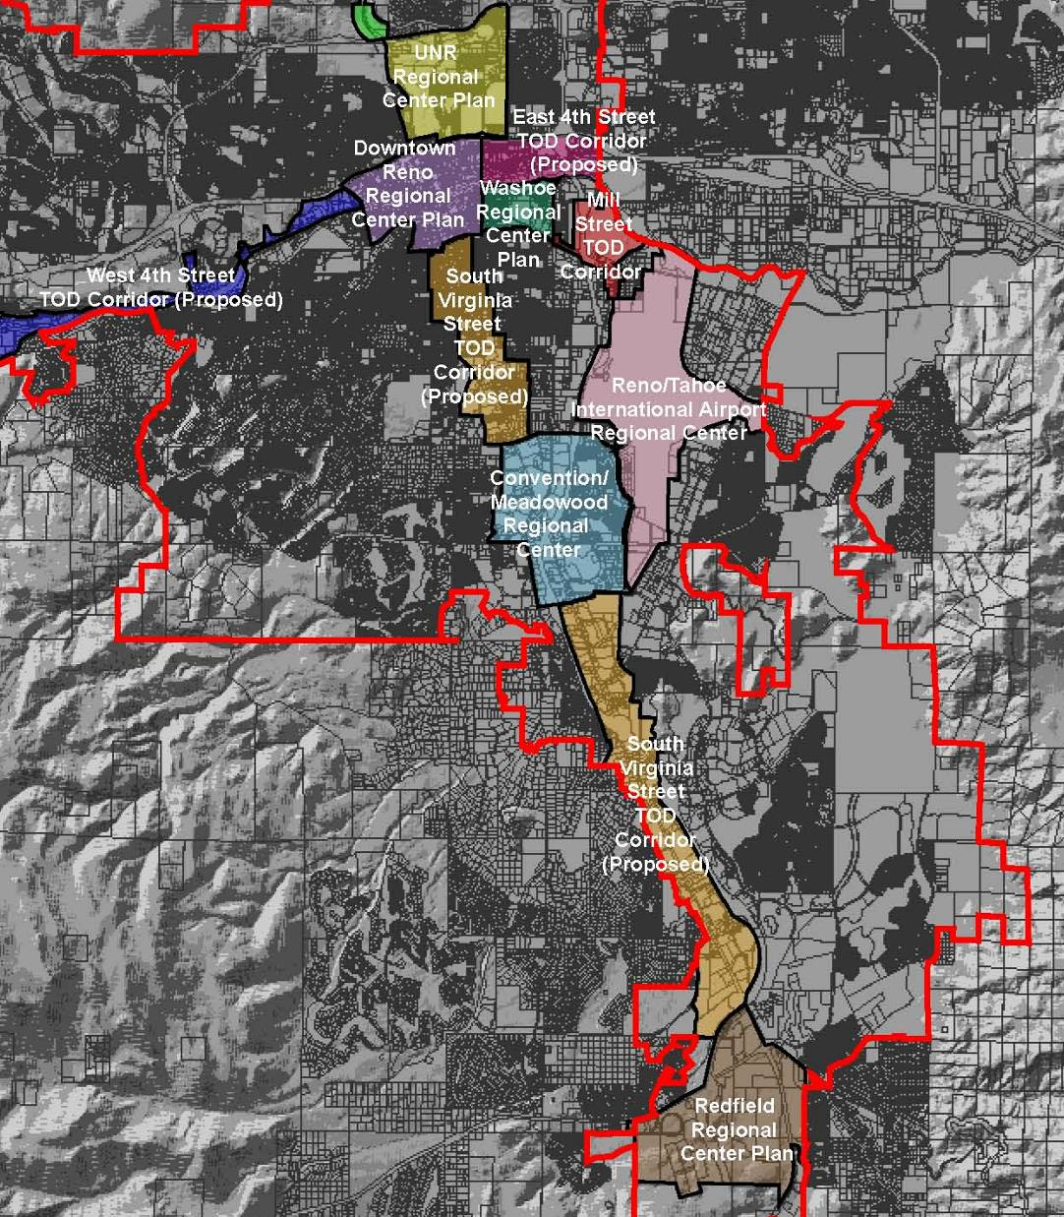
UNR Regional Center Plan
Downtown Reno
Regional Center Plan
South Virginia Street TOD
Convention Center/Meadowood
Regional Center Plan
Reno City Limits
Virginia Street
City of Reno Master Plan Elements
Transit Oriented Developments / Regional Centers

Slide 4
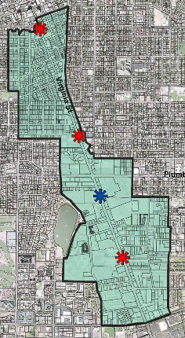
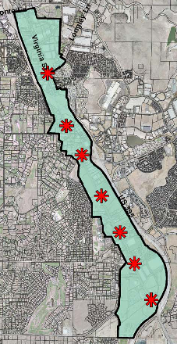
Virginia Street Initiatives
RTC proposed Bus Rapid Transit in 2001 as part of the 2030 RTP
Truckee Meadows Regional Planning Agency adopted regional TOD initiative
City of Reno adopted TOD street design standards
2003 RTC Bus Rapid Transit Feasibility Study
2005 RTC Environmental Analysis and Preliminary Design Services
Virginia Street TOD Planning Area

Slide 5
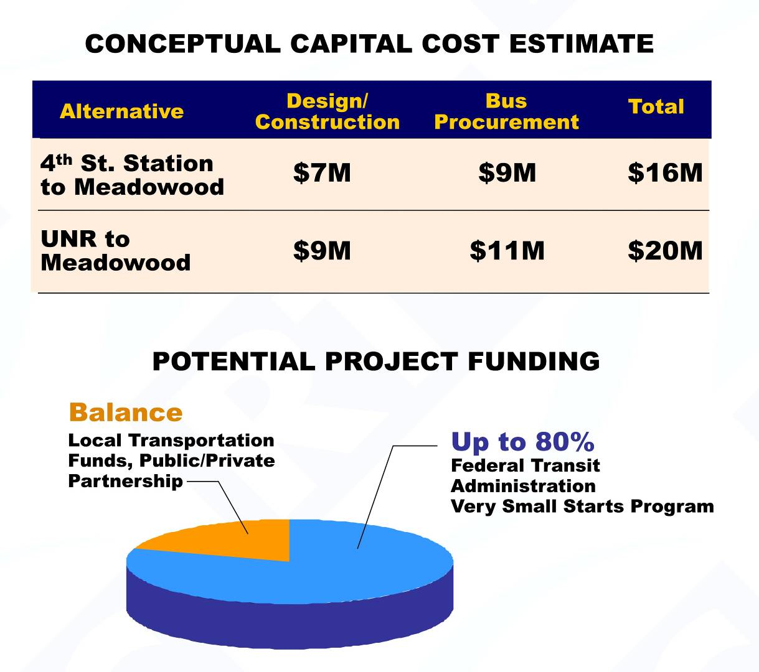
South Virginia Street BRT Project Cost and Funding
Project viewed favorably by FTA for Very Small Starts funding
Local match tied to success of RTC-2 ballot measure on November 4, 2008
Ballot measure failed
FTA application withdrawn
Beginning of the Great Recession

Slide 6
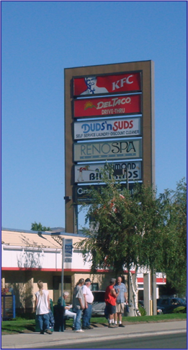
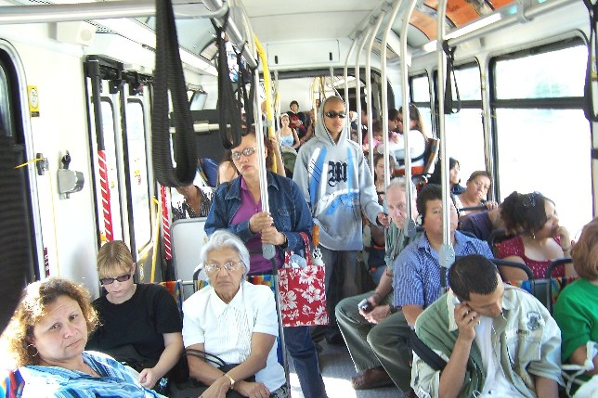
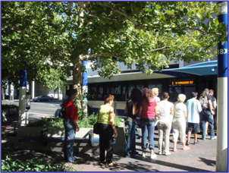
Having lost at the ballot box in November 2008 . . . .
RTC was projecting 30% service cuts
What if we . . . .
  Replaced Route 1 with new BRT service
  Used CMAQ funds to operate the first three years
This would . . . .
  Free up nearly $5.0M annually in local funds to offset remaining service cuts
  Provide a higher level of service in our primary transit corridor
Crowded Bus
Waiting for the bus
Long queue to board the bus

Slide 7
Why Bus Rapid Transit (BRT)?
Low-cost, high-capacity alternative to Light Rail
Meets the needs of the majority of riders
  40% of ridership travels between downtown and Meadowood
  60% of riders want only a few stops
Better service/Better travel time
  Fewer stops = faster travel time for the majority of riders
  More consistent travel time leads to better spacing, improving dependability
Attract more riders
  As service becomes more convenient, more people will consider transit
Easy to implement incrementally
  BRT can progress/adapt from mixed flow to dedicated travel lane operation

Slide 8
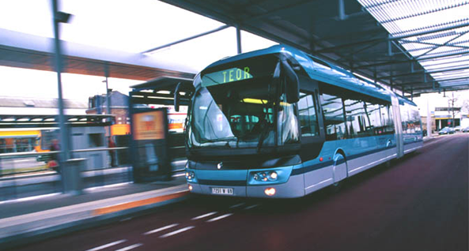
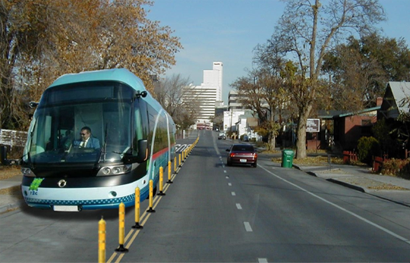
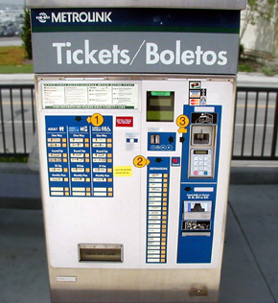
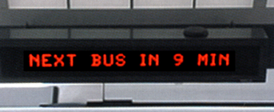
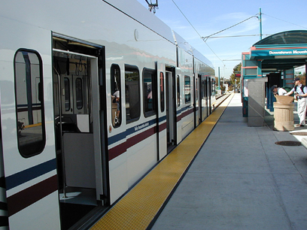
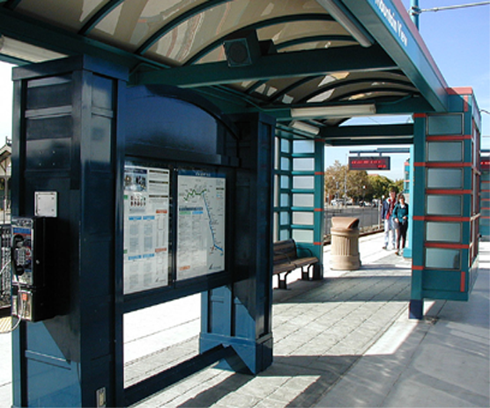
Bus Rapid Transit – It can look and operate like light rail
Modern, easily accessible vehicles
Real-time arrival information
Easy access, quick boarding and alighting at multiple doors
Comfortable waiting areas
Efficient service results from fewer stops, prepaid fares, quick boarding and alighting, and priority roadway treatments

Slide 9
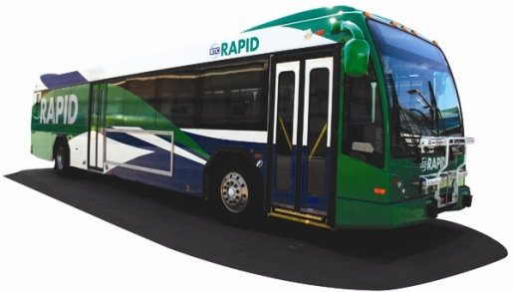
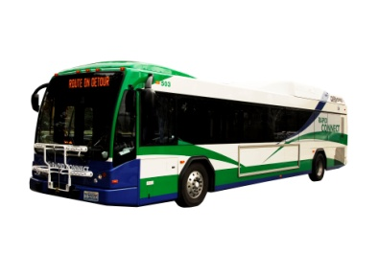
Introducing RTC RAPID
RTC RAPID
  Expanded hours and
  improved frequencies
  A higher level of service than Route 1
  10-minute headways between 5:30 AM and 8:00 PM
  Rebranded existing vehicles
RTC CONNECT,
  Augment RTC RAPID
  30 minute headways
  Local service
  24-hours a day

Slide 10
RTC RAPID Ridership
Compared to Route 1 & all other RIDE service

Slide 12
RTC RIDE ROUTE PRODUCTIVITY: MARCH 2007

Slide 14
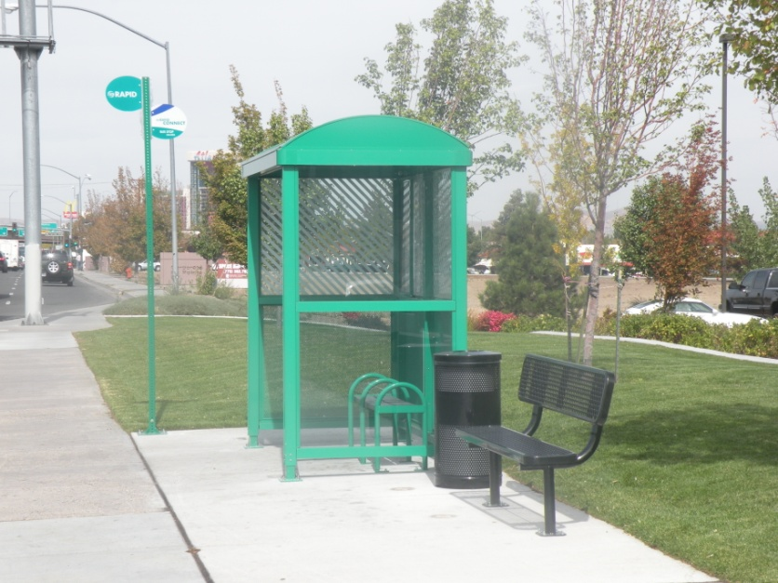
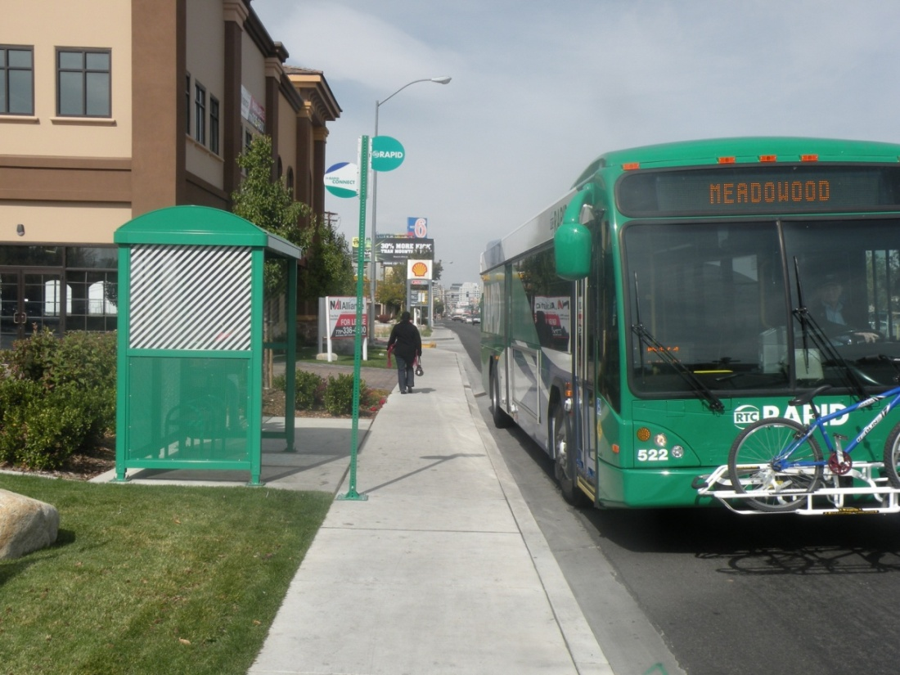
Year 1: Shelters
Shelters and signs branded to match the green RAPID color scheme.
Exterior bike racks on rebranded buses. New buses will have interior racks.

Slide 15
Year 2: The RAPID Vehicle
New Flyer DE60LFA 60-ft. diesel-electric hybrid articulated bus
Piggy-back procurement through Albuquerque, NM, Sun Tran
Eight Vehicles
$1 M each
CMAQ and TIGGER funding
Notes:
RAPID Y2S project is on part the overall RAPID/RAPID CONNECT Service

Slide 18
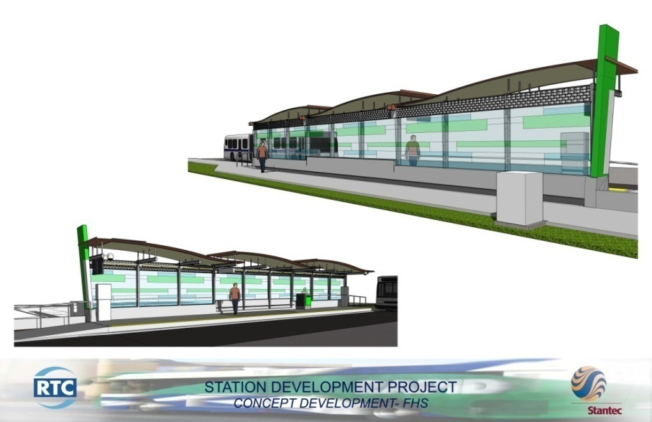
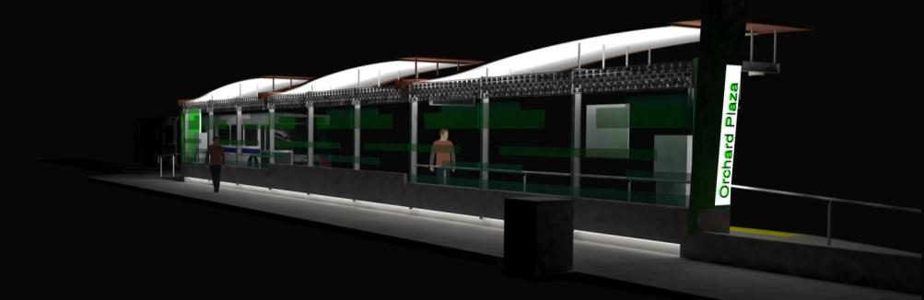
Year 2: Stations
Build in existing public right of way; accepting easements
Full Stations
  Raised platforms
  Pre-board fare purchase machines
  Next bus display
  Security cameras
  Sidewalk by-pass desirable
  Art Component
Construction Summer 2011

Slide 19
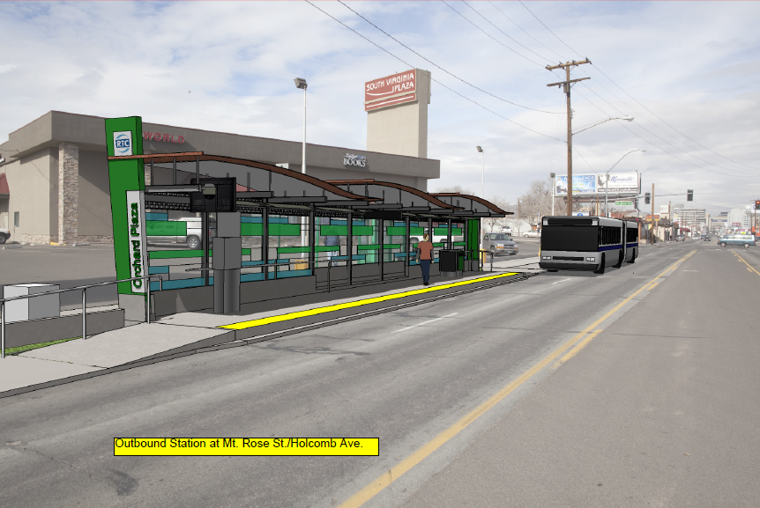
Southbound Mt. Rose

Slide 20
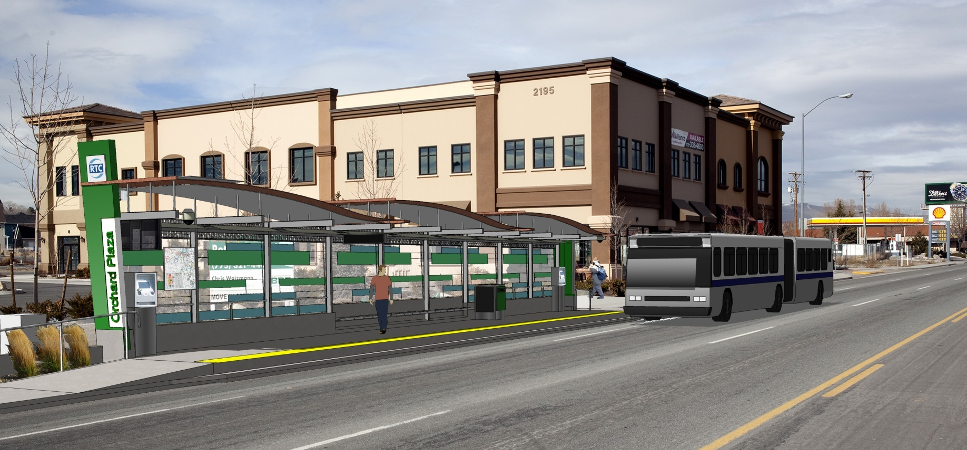
Southbound Orchard Plaza

Slide 21
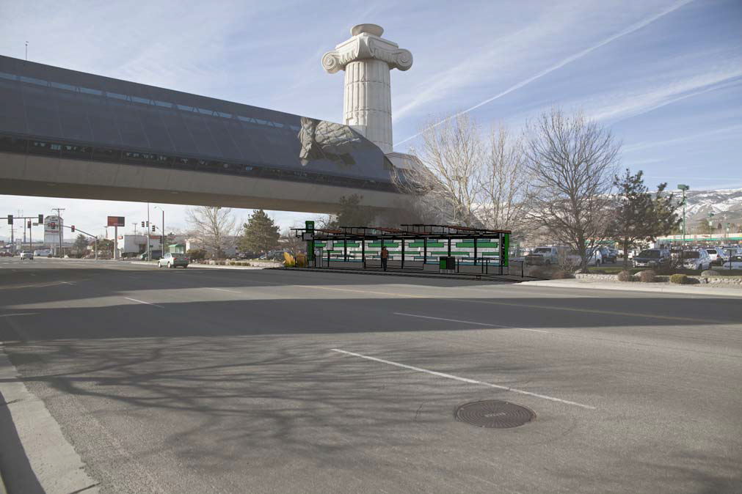
Peckham Southbound

Slide 22
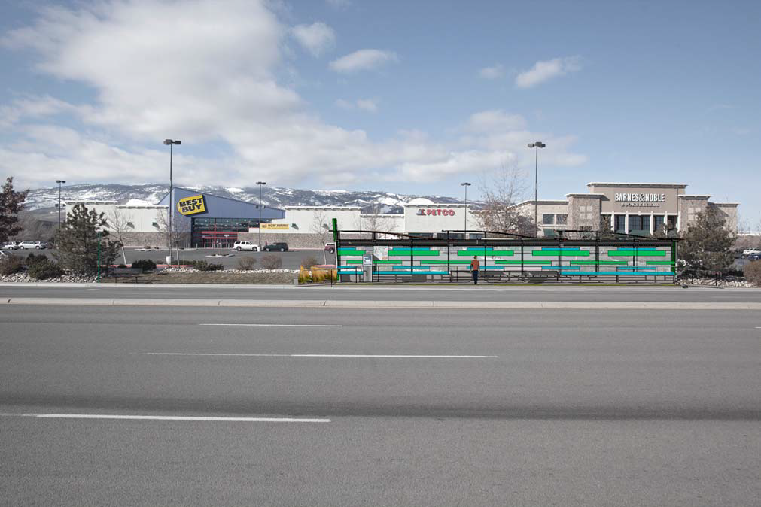
Meadowood Circle Southbound

Slide 23
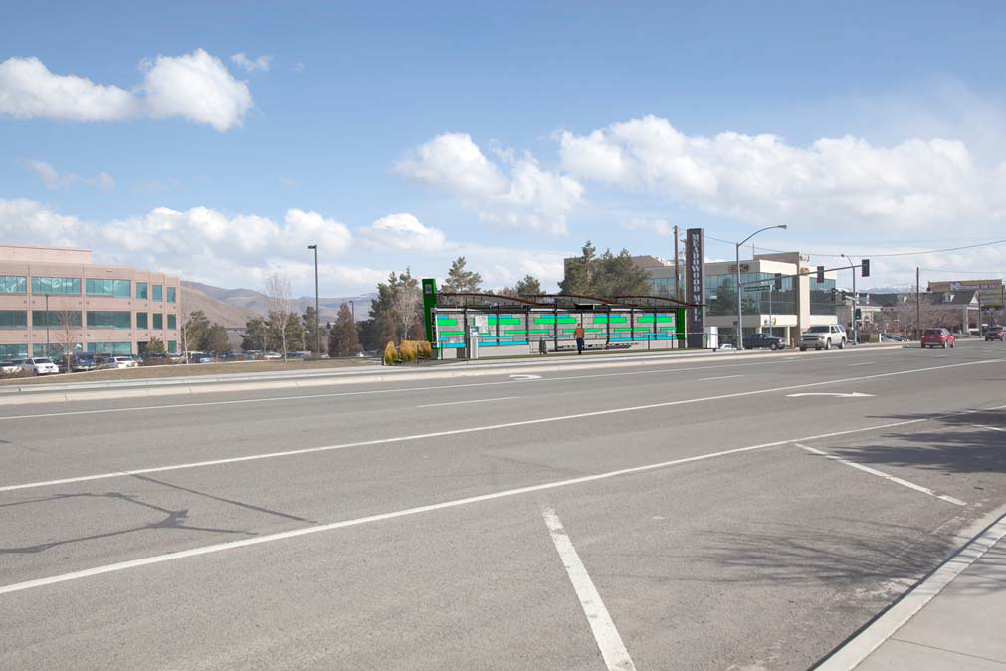
South McCarran Northbound

Slide 24
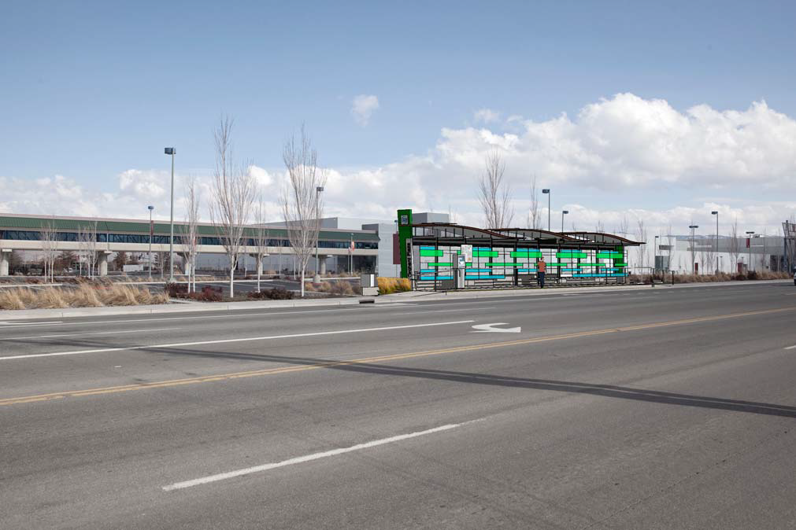
Peckham Northbound
Convention Center

Slide 25
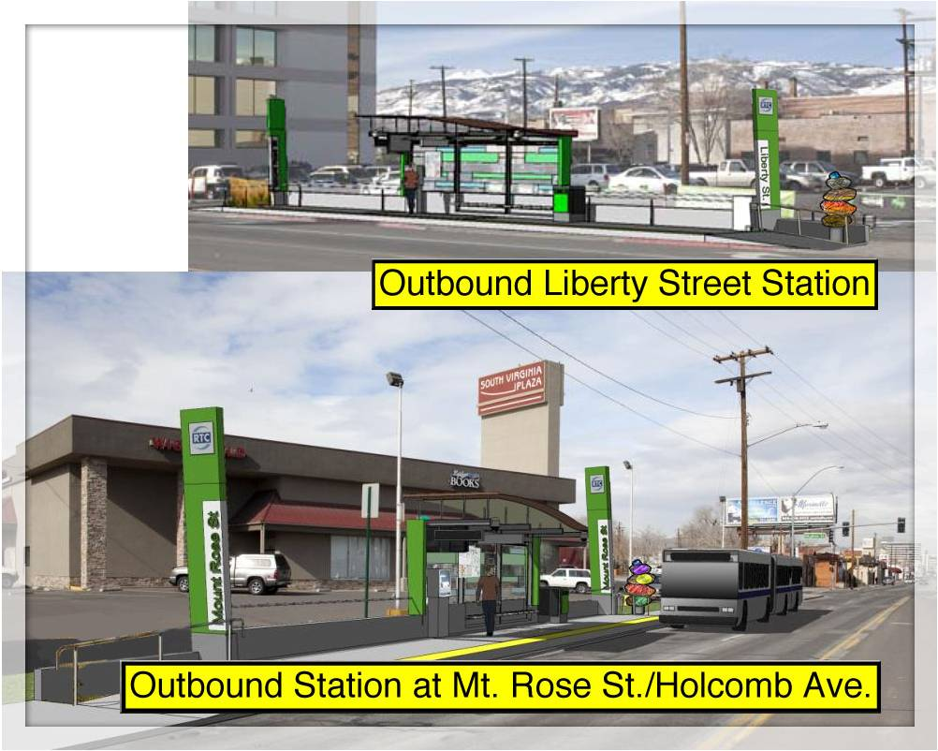
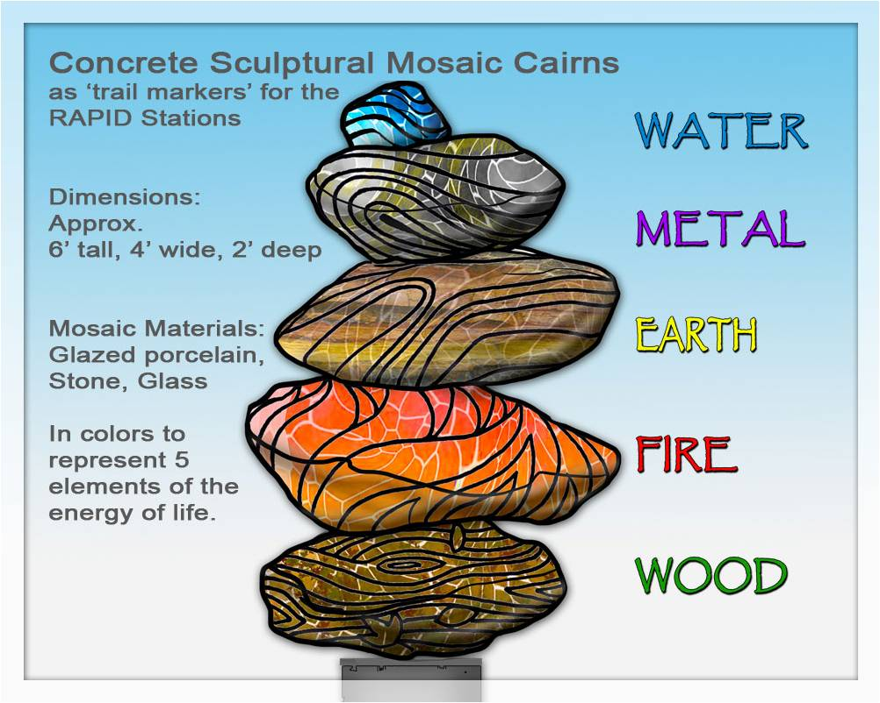
Art Concept:
Concrete Sculptural Mosaic Cairns

Slide 26
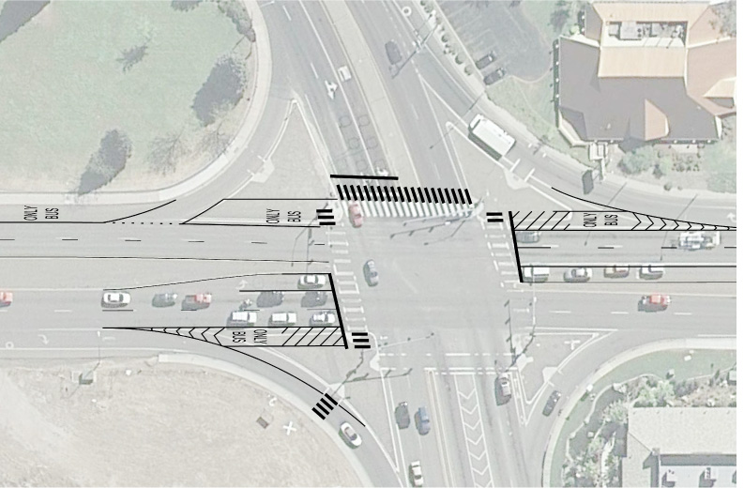
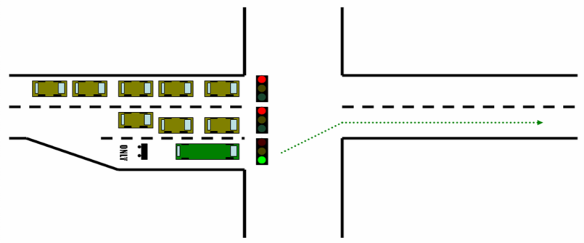
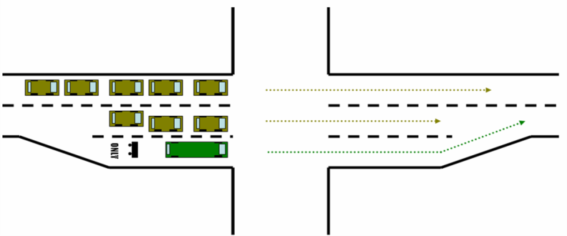
Year 2: Spring 2011
Transit Queue Jump
Queue-jump and queue-bypass at key intersections
Virginia Street & Kietzke Lane

Slide 27
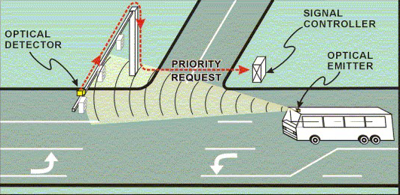
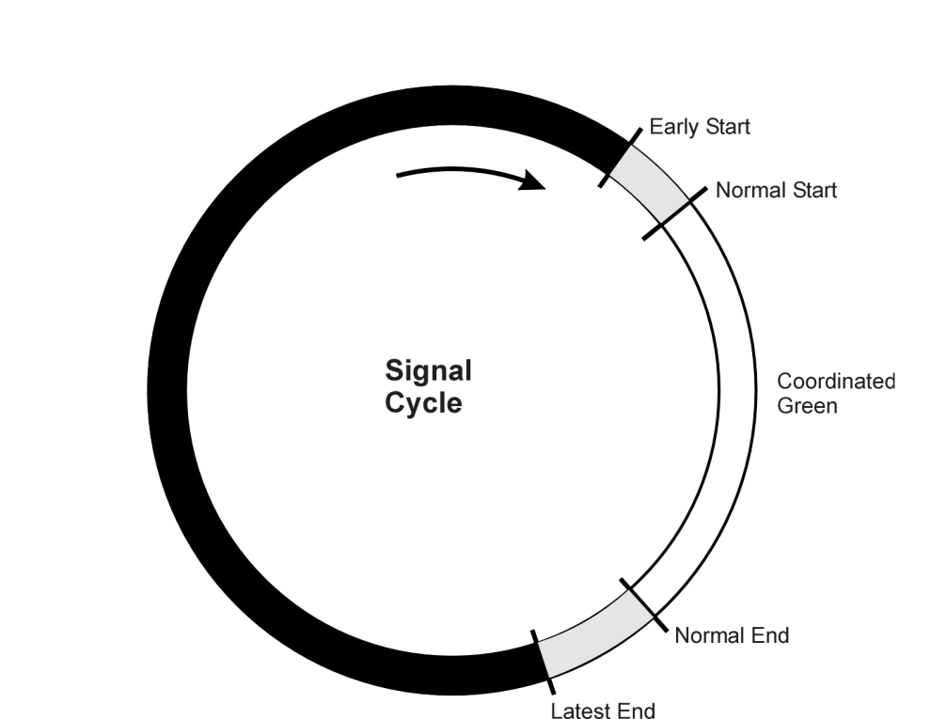
Year 2: Spring 2011
Transit Signal Priority
Transit Signal Priority at key intersections

Slide 28
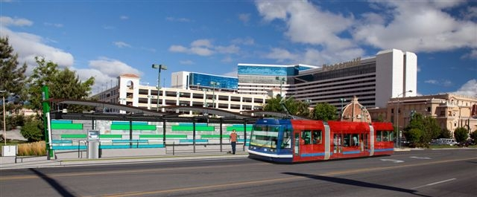
Beyond RTC RAPID?
Virginia Street Streetcar
Project in partnership with City of Reno
Feasibility Analysis
Prepare for federal funding
Build local support

Slide 29
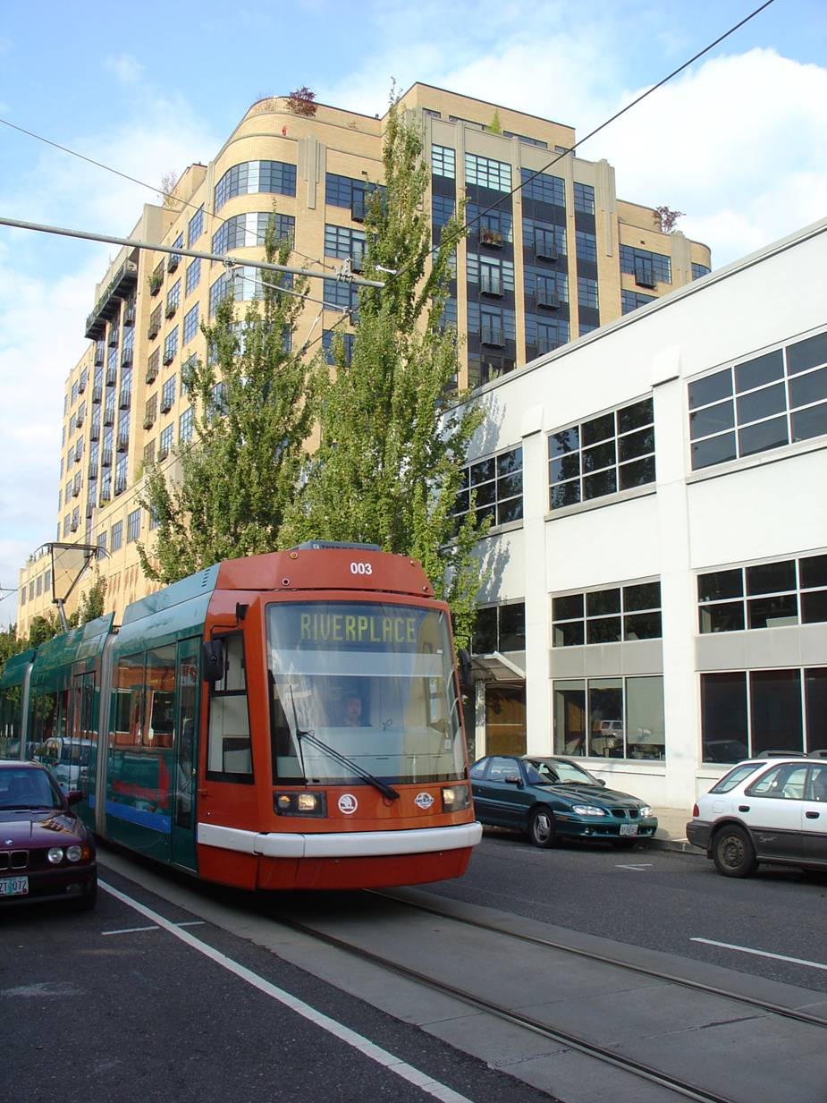
HIGH QUALITY TRANSIT
Streetcars:
Operate in right of way
Clean, quiet electric power
Easy to understand routes
Reflect a permanent public investment

Slide 30
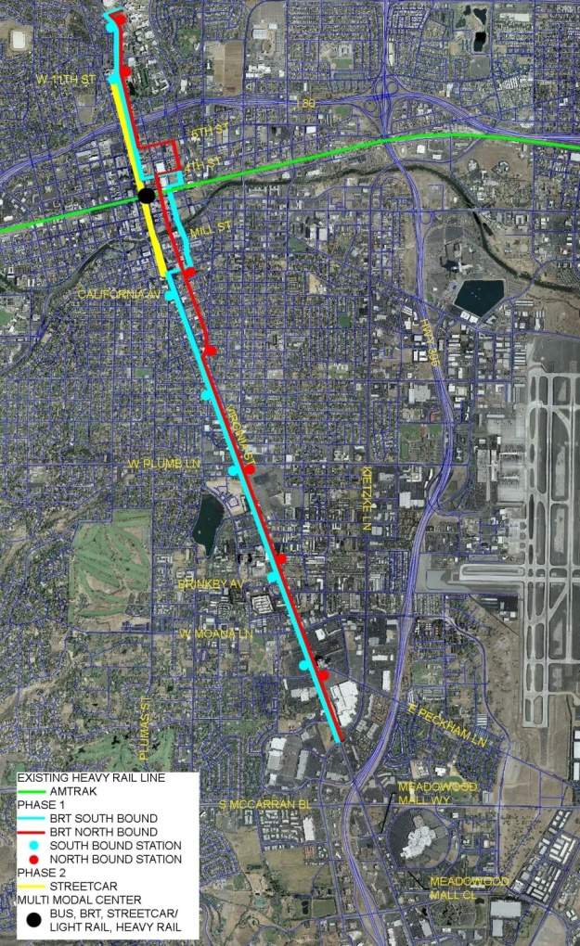
Street Car Concept
Result of BRT and land use policies
Promote walkability
Transit supportive land uses
Encourage redevelopment
Attract high quality, high density growth
  Promote economic vitality
High quality transit to serve attractions:
Gaming, tourism, government, retail and education
Phase I

Slide 31
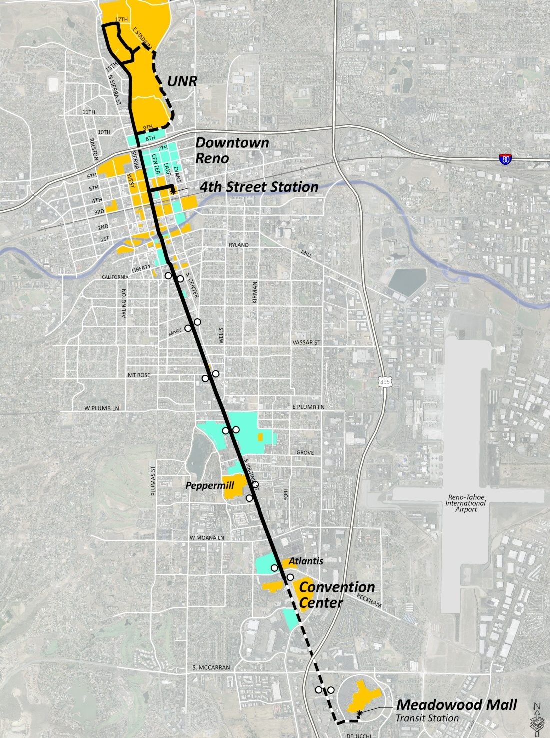
Virginia Street well positioned for Streetcar
Linear corridor
Significant existing ridership
  15% (4,685) of AADT (30,000)
Connects:
  8,850 hotel rooms
  500,000 SF of convention space
Substantial development potential
City commitment to mixed use, higher density corridor

Slide 32
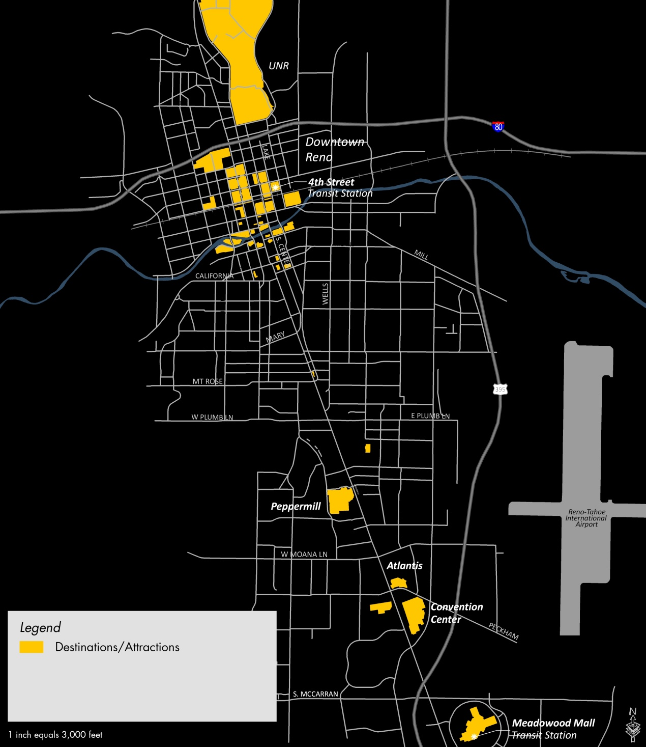
CORRIDOR ATTRACTIONS

Slide 33
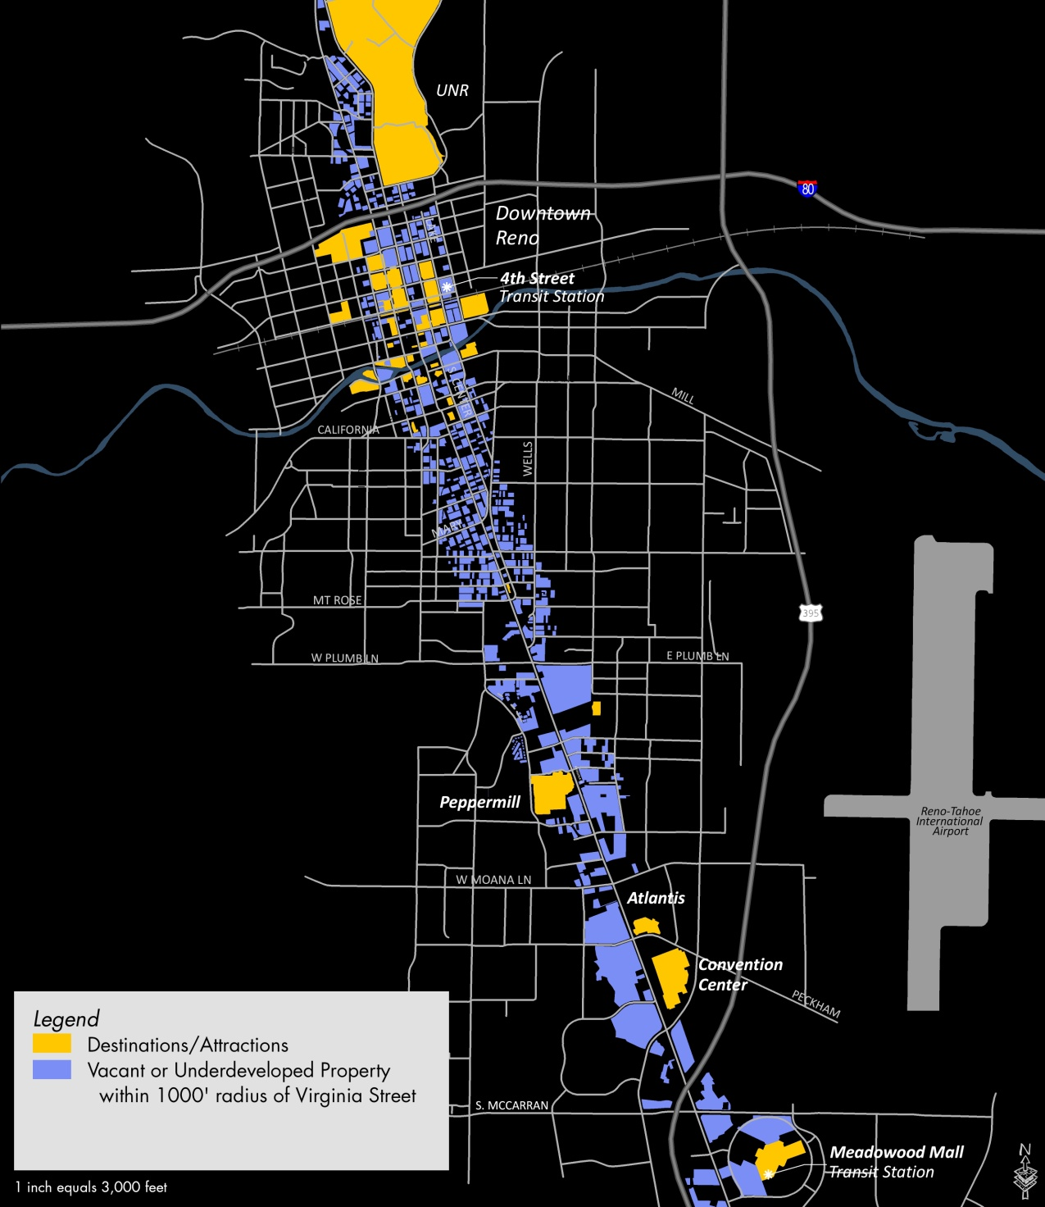
POTENTIAL DEVELOPMENT

Slide 34
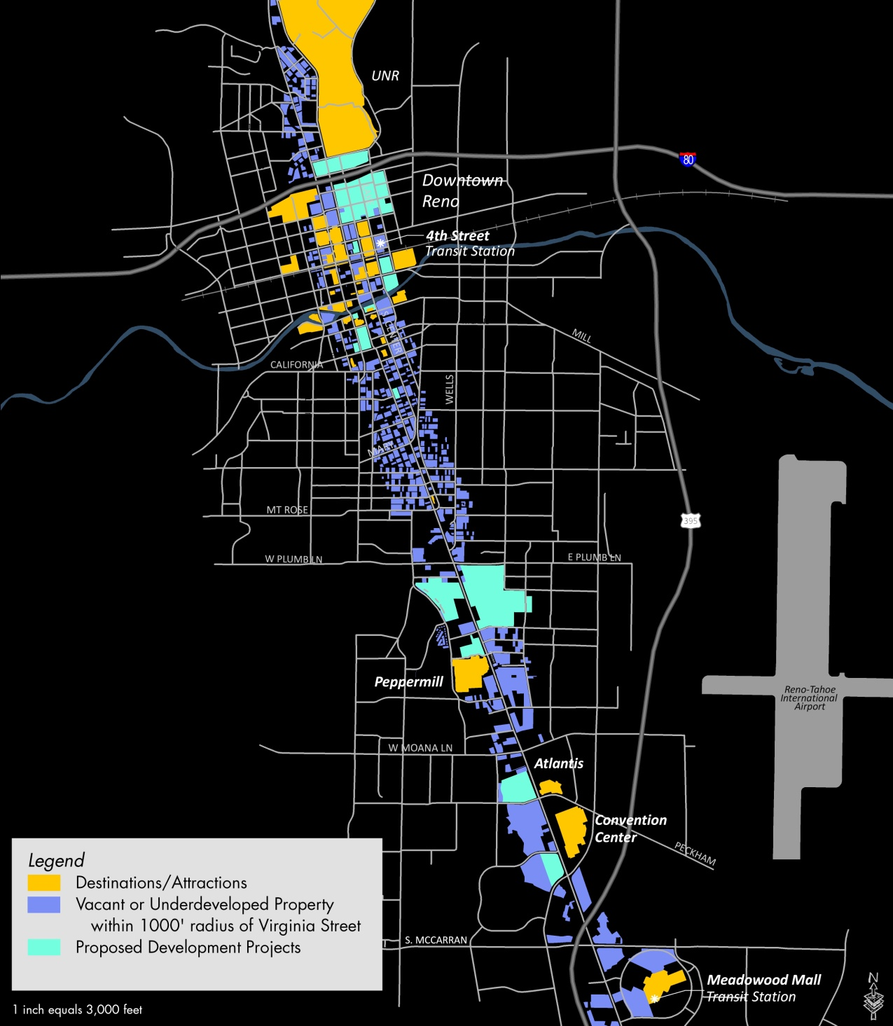
PROPOSED DEVELOPMENT

Slide 35
PROJECTED DEVELOPMENT (20 YEARS)
Without Streetcar:
  $500 million
With Streetcar:
  $1.5 billion
Streetcar Premium:
  $1 Billion
  4,100 residential units
  7.4 million square feet
  $60M – $240 million property tax revenue ($125M average)
Notes:
Regarding property tax revenue, the $60M figure is the net present value of the stream of property tax revenue over 20 years associated with the mid-case scenario of the nodal development/RAPID station development projection. This is the projection that revealed the $1billion bump. The better figure to use here is $128 million in additional property tax revenues from the ‘with streetcar’ development projection. This is the total additional property tax revenue associated with the bump in development. The actual total property tax revenue collected over that period is projected at $170M. This also points out that without a streetcar, projected development (based on pas development, existing land uses and future population projection) would yield property tax revenues of only $42M over 20 years in the corridor.

Slide 36
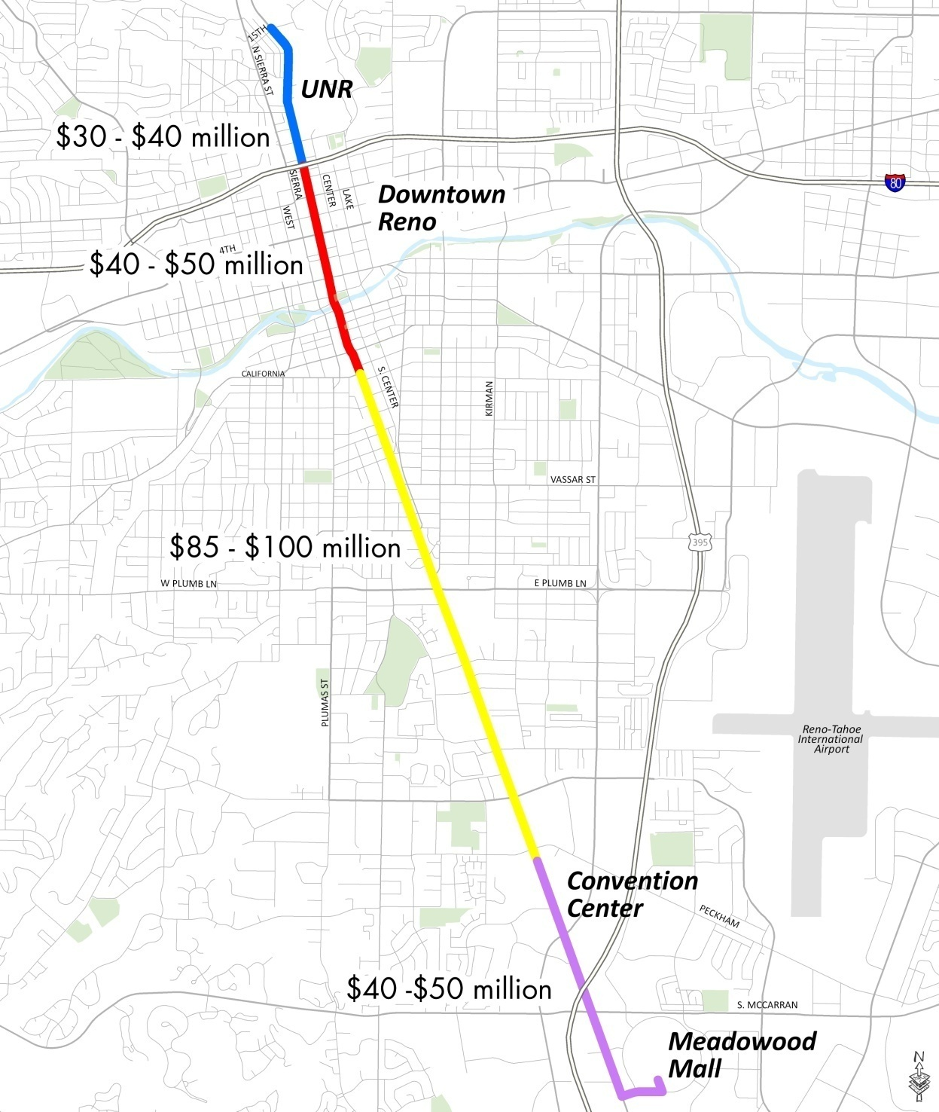
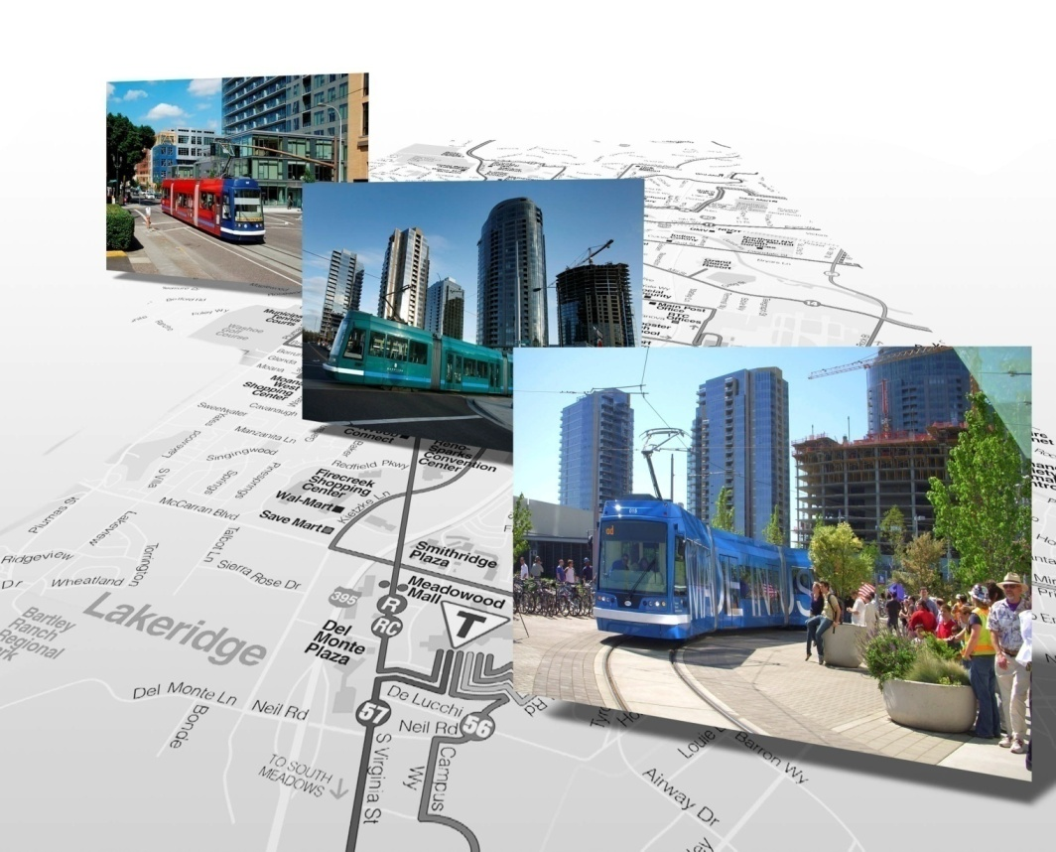
Capital Estimate:
  Approximately $37 million per mile
Operating Estimate:
  $1.2-1.4 million per mile per year

Slide 37
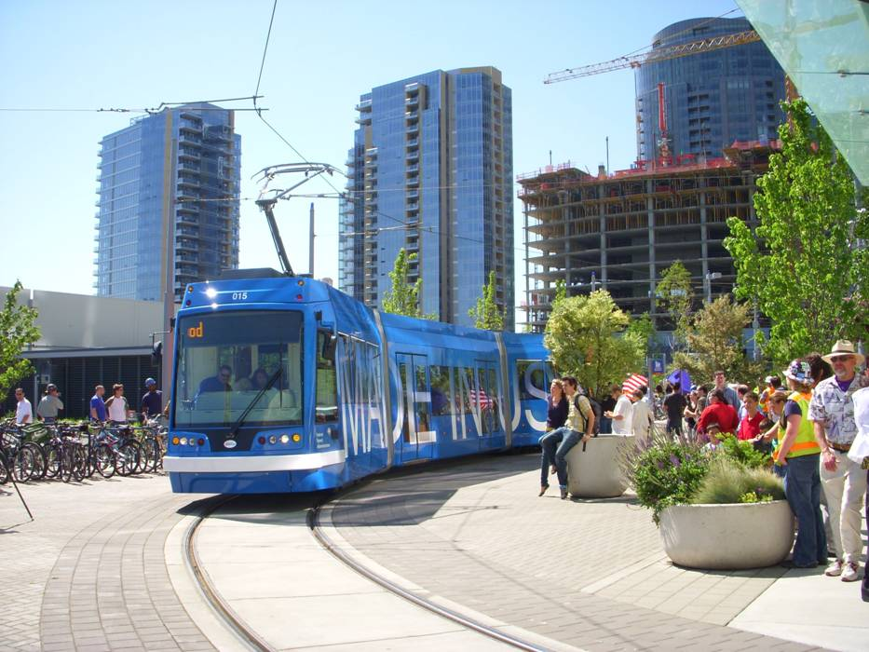
Local Finance Options
Special Assessment District
Redevelopment Districts
Fuel Tax
Regional Road Impact Fee
CMAQ funds
Hotel Room Tax, Car Rental Tax, STAR bonds
Sales Tax
Only three appear to be viable at this time: Special Assessment District, Fuel Tax, Sales Tax

Slide 38
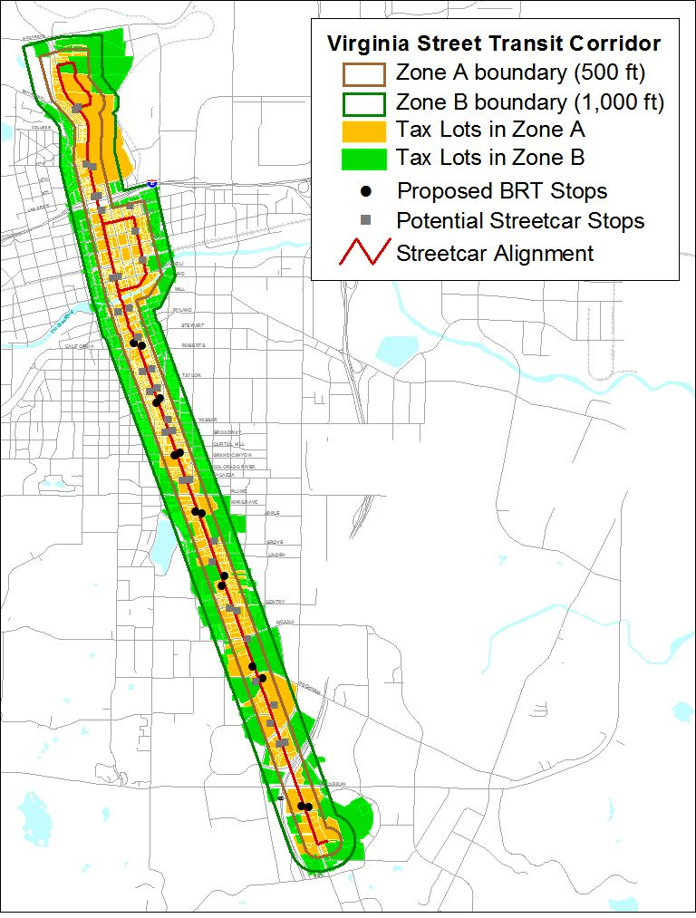
Streetcar Special Assessment District
Zone A: 0-500 ft. from streetcar – 4.5X baseline development
Zone B: 500-1,000 ft. from streetcar – 1.5X baseline development
Estimated revenue: $20M

Slide 39
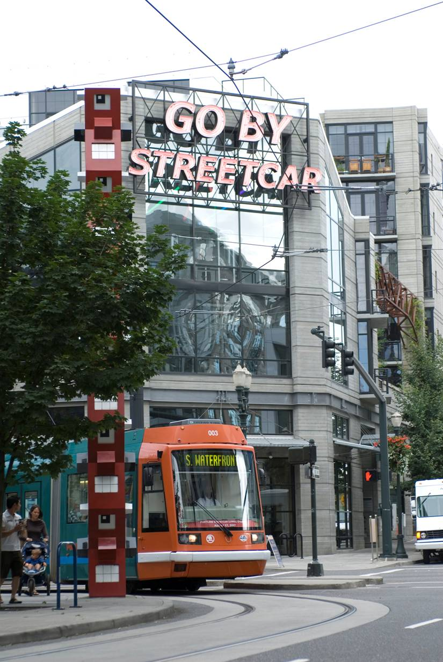
Portland Streetcar Actual Development Density
Increase in Property Values
Increase in Kind and Quality of Development

Slide 40
DEVELOPMENT IN OTHER CITIES
Reno’s Projected Return on Total Investment: 6x
Projected Return on Local Investment: 12x

Slide 41
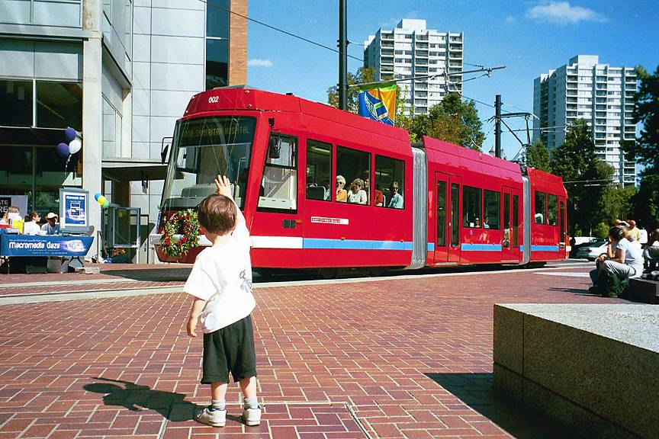
Next Steps
  Finalize Service and Phasing
  Finalize local Finance Plan
    Continue to build stakeholder support
  Meet with FTA to discuss small starts process
  Begin preliminary engineering and environmental

Slide 42
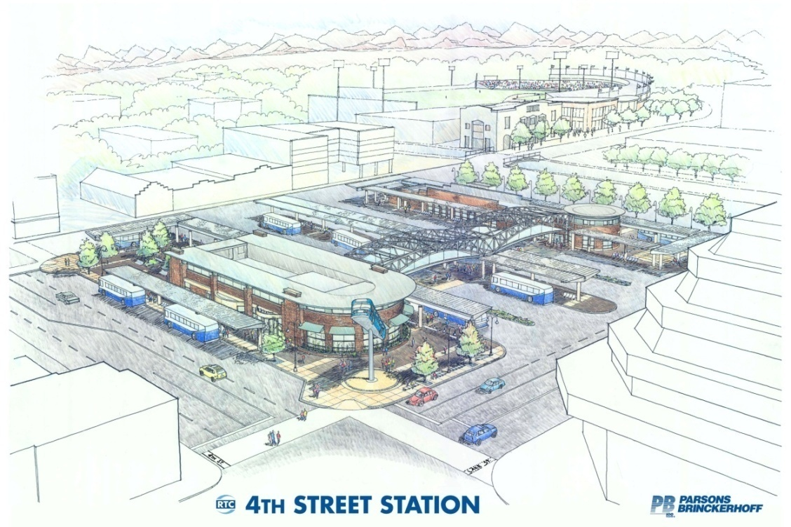
Questions or Comments?
775.335.1902
djickling@rtcwashoe.com
Thank You!

