Slide 1
2011 Nevada Transportation Conference THE BIG PICTURE Reno, Nevada March 22, 2011
Greg Novak, P.E.
Major Projects Manager
FHWA Nevada Division

Slide 2


Slide 3


Our Visit Today
What is Every Day Counts?
Shortening Project Delivery Toolkit
Accelerating Technology & Innovation
Thunderous Applause!
Part 1:
Part
2:
Part
3:
Part
4:

Slide 4
What is Every Day counts?
Home
Part
1:

Slide 5

Why?
How long does it take to deploy innovation in the transportation industry?
Change a business practice
Replace a design system
Replace a construction process…
2 years?
10 years?
5 years?
20+ years?

Slide 6


Why?
“We are continuously looking for new ideas, working with stakeholders to bring new products and innovative processes to market.” – V. Mendez
Challenge… to make Every Day Count!
Victor Mendez
FHWA Administrator
Greg Nadeau
Deputy Administrator

Slide 7


Why?
“Currently the NEPA process alone takes 72 months… We need to change the mindset and challenge this State driven process.” – at 1st EDC Summit 2010 in VA
John Horsley
Executive Director
AASHTO

Slide 8
Shortening Project Delivery Toolkit…
Home
Part
1:
Part
2:

Slide 9

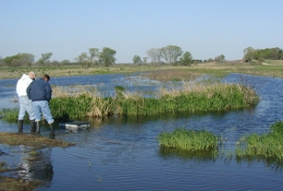

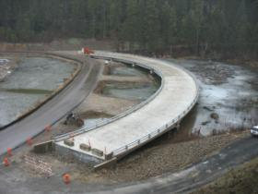
Shortening Project Delivery Toolkit
The toolkit is developed to guide and support State and local agencies in the use of underutilized flexibilities in the existing law and in the development of processes and agreements that minimize duplication of effort and reduce delays in project implementation.
Planning
NEPA
ROW/Utilities
Design/Construction

Slide 10
Accelerating Technology & Innovation…
Home
Part
1:
Part
2:
Part
3:

Slide 11

Accelerating Technology and Innovation
Every Day Counts is NOT about inventing the next "big thing". It's about taking effective, proven and market-ready technologies and getting them into widespread use. By advancing 21st century solutions, we can improve safety, reduce congestion and keep America moving and competitive.

Slide 12





A COLLABORATIVE PROCESS
Input from stakeholders
Input from FHWA field staff and SHAs
Technology Rating Panel Recommendations
January 26th 2010
Select Final Technologies
Innovation Deployment Teams established for each technology
Implementation roadmaps, marketing plans, and performance measures drafted
Provide training to FHWA field offices
Meet with stakeholders during Summits
Notes:
We presented a pared down list of potential technologies and innovations to a Panel consisting of State, industry (including NACE ARTBA, and ACG), and FHWA representatives.
In January, the Panel met and identified 5 topic areas; some topics contained more than one technology for that area.
With additional input from FHWA Leadership, including Division Administrators, we settled on the 5 specific technologies in the Every Day Counts Initiative.
Deployment teams were established for each technology; they have established implementation roadmaps covering the next 2-3 years.
We also provided training on the technologies to the FHWA field offices, so they would be in a position to work with the States, locals, and industry on implementation.

Slide 13
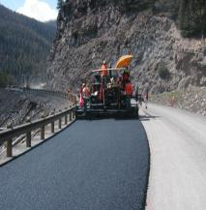
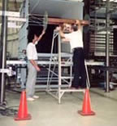




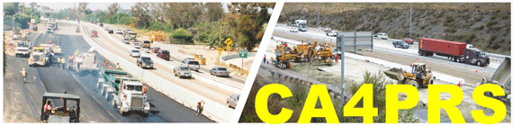


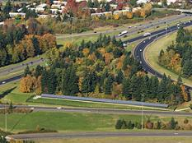
Phase 1 – TECHNOLOGIES CONSIDERED
Green Pavement
ABC (PBES, GRS, etc.)
Bridge Inspections NDE Showcase
Precast Pavement
ACS Lite
Roadway Departure Prevention
Alternative Intersection Designs
Intelligent Construction Technologies
Mechanistic Empirical Pavement Design
CA4PRS Tools
Smart Roadside
Asset Management Tools
Advanced Hydraulics Technologies
Oregon Solar Highway project
Notes:
This visual contains the technologies that were considered for the Every Day Counts Initiative.
We started with a broad list of technologies and innovations from past and current efforts, such as FHWA’s Market Ready Technologies, AASHTO TIG, and other sources.
We were looking for innovations that have been sufficiently deployed and tested, but there has been slow deployment.
We were also looking for areas that would help reduce construction costs for States and locals;
Accelerate construction so to reduce impacts on drivers and all highway users; and
Of course to improve safety, where possible.

Slide 14





What are the Innovations?
Warm Mix Asphalt (WMA)
Prefab. Bridge Elements & Systems
Geosynthetic Reinforced Soil
Safety Edge
Adaptive Traffic Control Technology

Slide 15

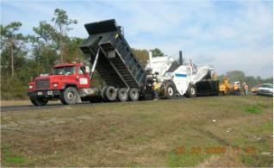

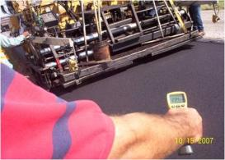
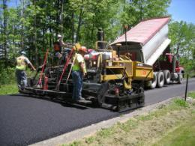

Warm Mix Asphalt
WMA encompasses a wide range of enabling technologies that enhance asphalt production and/or lay-down properties…

Slide 16

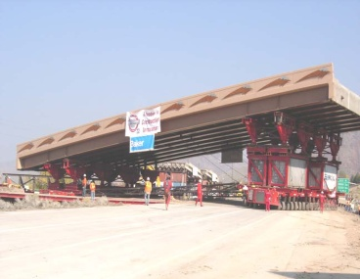
Prefabricated Bridge Elements & Systems
Prefabricated bridge elements and systems manufactured on-site or off-site, under controlled conditions, and brought to the job location ready to install
Benefits:
Reduces onsite construction time
Minimizes traffic disruption – months to days
Improves construction zone safety
Improved product quality – controlled environment, cure times, easier access, etc. constructability of bridge designs
Reduces environmental impact

Slide 17
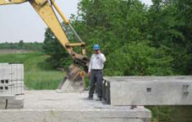
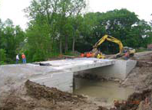

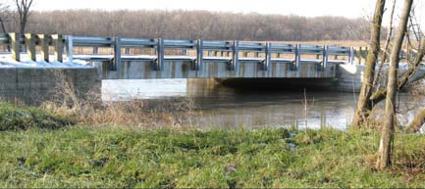
Geosynthetic Reinforced Soil
Fast, cost-effective bridge support method using alternating layers of compacted fill and layers of geosynthetic reinforcement to provide bridge support.
Lots of Benefits:
Eliminates approach slab or construction
Joint at the bridge-to-road interface
Reduced construction time (Complete in days!)
Less dependent on weather conditions
Flexible design – easily modified for unforeseen site conditions
Built with common equipment and materials
Notes:
Deliverables:
* Decision Making Framework for use during planning stage
* Training, Showcases, Webinars, Specifications for PBES elements, ABC manual, Conference Attendance, Awards Program, Demonstration Projects, Process for engaging public in Decision Making process
* Research to quantify environmental impacts reduce by using PBES
* Model Specification/Contract Language, Details - Standard Plans

Slide 18
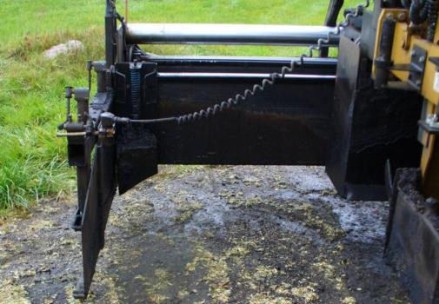
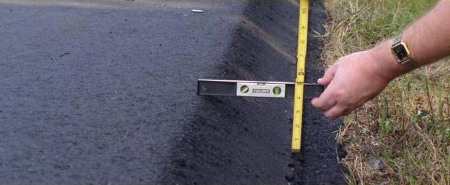
Safety Edge
Sloped pavement edge at a 30º angle which allows drivers a more controlled re-entry back onto the roadway after tire drop-off
Benefits:
Reduces crashes due to edge
Drop-off and uncontrolled recovery
Minimal cost (less than 1% on
2-lane highway)
Consolidated edge reduces edge raveling, increases durability
Notes:
Deliverables:
Implementation of a standard specification
T raining, Showcases, Webinars, Conference Attendance
Demonstration Projects

Slide 19

Key Message
Saves Lives
Drop-offs are a safety challenge
Low Cost
Safety Edge can mitigate shoulder drop-off
Improves Durability
Safety Edge can increase pavement edge durability
Notes:
The Safety Edge
The purpose of this overview is to introduce the purpose and need for the Safety Edge; the practical solution the Safety Edge provides; and the features and benefits. This presentation also is an opportunity to answer questions and discuss the advantages of the Safety Edge.
Three messages are key to communicating the benefits of the Safety Edge. The Safety Edge—
Saves lives.
Is low cost.
Improves durability.
This Safety Edge Technical Overview contains the following:
Purpose and Need
A Practical Solution
Conclusion
This is your elevator speech to all your partners. The Safety Edge- · Reduces crashes and saves lives by mitigating pavement edge drop-off · Is a low cost, systematic improvement applied during paving · Improves durability by reducing edge raveling Communicate that the Safety Edge is a simple but extremely effective solution that can help save lives by allowing drivers who drift off highways to return to the road safely. The FHWA's goal is to accelerate the use of the Safety Edge technology, working with States to develop specifications and adopt this pavement edge treatment as a standard practice on all new and resurfacing pavement projects.

Slide 20
In Greg’s Words…
“If you run of the road and there is a drop-off, the odds it will be a fatal crash just doubled!”
ROR + Drop Off = 2 x
+
+

Slide 21
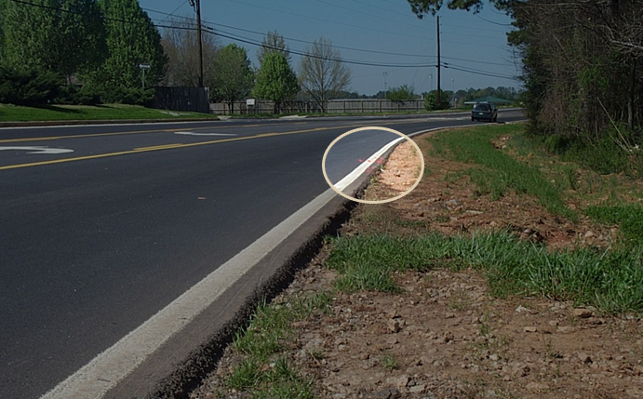
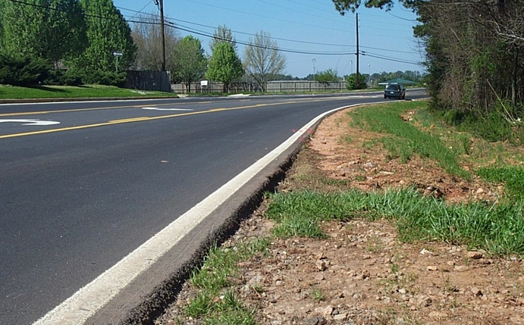

Are Drop-Offs a Problem?
Vehicle Re-entry
Notes:
This section of pavement was the site of a terrible crash. As you can see in the far background, there are sports field lights from a local High School. As reported in the Atlanta Journal Constitution, the morning of March 2003 a group of four high school students were on their way to school, their vehicle left the roadway at this horizontal curve. On re-entry the vehicle went into the opposing lane, colliding with a school bus.
Three teens died in a crash where this drop-off may have been a contributing factor. The decision on whether the drop-off was a contributing factor is a case for the courts to decide. What we do know is that crashes associated with edge drop-offs are some of the most severe (i.e., head on collisions, roll over, opposite-direction sideswipe or the driver may run off the road again and crash into a roadside object).
County road with speed limit of 45 mph. School bus driver reported to police the drop off location.
Background: Excerpt from article, The Low-Cost Dropoff Solution, published in Public Roads magazine, September/October 2007.
Four teenage boys from a high
school in Clayton County, GA,
were driving to school on a
rural two-lane highway on a March
morning in 2003 when something
went terribly wrong.
About a quarter-mile from campus,
the car's right tires slipped off
the pavement and dropped onto
the sandy shoulder. While attempting
to return to the pavement, the
16 year-old driver overcorrected
and lost control. The compact sedan
crossed the centerline and
slammed head-on into a school bus
coming in the opposite direction.
The driver and one passenger were
pronounced dead at the scene; another
passenger died later at the
hospital. The fourth teenager was
seriously injured but eventually recovered.
The driver of the school
bus, which was carrying no passengers,
suffered only minor injuries.
One cause of the crash, according
to the police report, involved a condition
known as pavement edge dropoff
(PEDO), the uneven edge or vertical
dropoff between the paved travel lane
and the unpaved shoulder. Highway
safety experts consider a dropoff of
12.7 centimeters (5 inches) or more
to be unsafe, especially if the edge is
at a 90-degree angle to the shoulder
surface. A dropoff of 5.1 centimeters
(2 inches) or more is considered a
potential driving hazard. The dropoff
along the stretch of highway where
the teens' car slipped off the pavement
ranged from about 5.1 to 10.2
centimeters (2 to 4 inches), according
to two safety engineers from
the Federal Highway Administration
(FHWA) who visited the site the day
after the crash.
When a vehicle slips off the pavement
and onto an unpaved shoulder,
the steep edge can make it difficult
"This is likely what happened in
the Lovejoy High School crash," says
FHWA Safety Engineer Frank Julian,
who visited and took photographs
of the crash site and learned that
there was evidence of scrubbing on
the inside edge of the vehicle's right
tires. According to the police report,
skid marks were found coming
back onto the roadway, leading the
inspectors to believe that "overcorrection
played a role in the [crash] ."

Slide 22
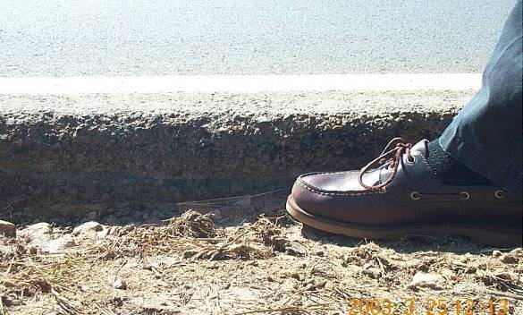
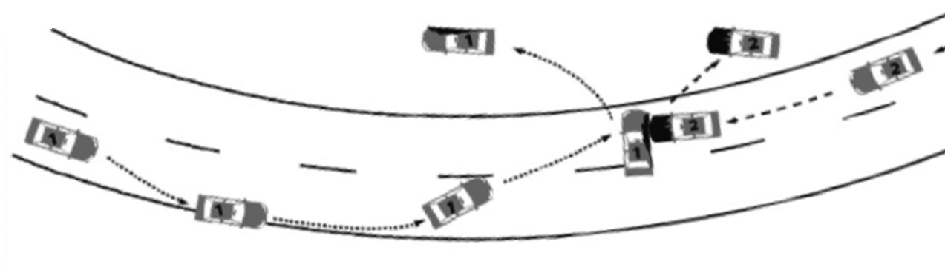
Typical Drop-Off Crash
with Tire Scrubbing
Notes:
22
This is a diagram of a typical overcorrection and what happened at this site. The picture shows a drop-off at the location of 4-6 inches.
Drop-offs of 3 or more inches can be considered dangerous. This is due to the tire scrubbing effect of an errant vehicle trying to re-enter the travel lane.
AASHTO Goal #16: Minimize the Consequences of Leaving the Road
FHWA Goal: Reduce fatalities involving roadway departure [run-off-the-road (ROR) and head-on] crashes by 10% by the year 2007. Assuming 22,920 fatalities in 2002 (16,000 single-vehicle run-off-road crashes and 6,920 head-on & opposite direction sideswipe crashes), this would reduce such fatalities to 20,628 (14,400 + 6,228) in 2007.
In 2002, ROR crashes will contribute to 16,000 fatalities, representing approximately 38% of all highway fatalities. The majority, about 70%, is expected to occur on rural highways, with about 90% on 2-lane roads (24% on local roads or streets; 9% on minor collectors; and 23% on major collectors). Head-on and opposite direction sideswipe crashes also represent a significant safety problem, contributing to an estimated 6,920 fatalities on all classes of highways in 2002.

Slide 23
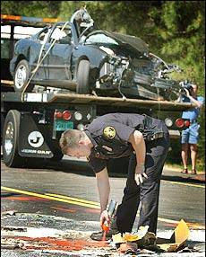
Edge Drop-Off Crash Types
Roll Over
Head-on
Opposing Sideswipe
Roadside Object
From The Atlanta Journal Constitution, 3-25-03
Notes:
Photo Credit: From The Atlanta Journal-Constitution, © March 25, 2003 Cox Newspapers. All rights reserved. Used by permission and protected by the Copyright Laws of the United States. The printing, copying, redistribution, or retransmission of the Material without express written permission is prohibited.
________________________________________________________________________________________________________________________________
Three teens died in a crash where this drop-off may have been a contributing factor. The decision on whether the drop-off was a contributing factor is a case for the courts to decide. What we do know is that crashes associated with edge drop-offs are some of the most severe (i.e., head on collisions, roll over, opposite-direction sideswipe or the driver may run off the road again and crash into a roadside object).
Background: Excerpt from article, The Low-Cost Dropoff Solution, published in Public Roads magazine, September/October 2007.
Four teenage boys from a high
school in Clayton County, GA,
were driving to school on a
rural two-lane highway on a March
morning in 2003 when something
went terribly wrong.
About a quarter-mile from campus,
the car's right tires slipped off
the pavement and dropped onto
the sandy shoulder. While attempting
to return to the pavement, the
16 year-old driver overcorrected
and lost control. The compact sedan
crossed the centerline and
slammed head-on into a school bus
coming in the opposite direction.
The driver and one passenger were
pronounced dead at the scene; another
passenger died later at the
hospital. The fourth teenager was
seriously injured but eventually recovered.
The driver of the school
bus, which was carrying no passengers,
suffered only minor injuries.
One cause of the crash, according
to the police report, involved a condition
known as pavement edge dropoff
(PEDO), the uneven edge or vertical
dropoff between the paved travel lane
and the unpaved shoulder. Highway
safety experts consider a dropoff of
12.7 centimeters (5 inches) or more
to be unsafe, especially if the edge is
at a 90-degree angle to the shoulder
surface. A dropoff of 5.1 centimeters
(2 inches) or more is considered a
potential driving hazard. The dropoff
along the stretch of highway where
the teens' car slipped off the pavement
ranged from about 5.1 to 10.2
centimeters (2 to 4 inches), according
to two safety engineers from
the Federal Highway Administration
(FHWA) who visited the site the day
after the crash.
When a vehicle slips off the pavement
and onto an unpaved shoulder,
the steep edge can make it difficult
"This is likely what happened in
the Lovejoy High School crash," says
FHWA Safety Engineer Frank Julian,
who visited and took photographs
of the crash site and learned that
there was evidence of scrubbing on
the inside edge of the vehicle's right
tires. According to the police report,
skid marks were found coming
back onto the roadway, leading the
inspectors to believe that "overcorrection
played a role in the [crash] ."

Slide 24

Adaptive Signal Control
ACS measures traffic flow and adjusts signal timing to promote smooth flow of traffic along arterial streets
Benefits:
ACS improves travel time
Reliability, reduces congestion, and smoothes traffic flow
Increases long-term viability of traffic signal operations
Widely deployable & uses existing control equipment
Notes:
Deliverables:
Strategic deployment sites
Develop ACSLite Implementation Guide
Develop Technology Innovation Award for ACSLite deployment sites
Regional ACSLite Product Demonstration Showcases
Incorporate ACSLite in to Microscopic Simulation Models
Develop & pilot training focused on the implementation of adaptive control technology
Incorporate ACSLite in to State DOT signal control mode selection criteria
Initiate and facilitate Adaptive Technology User Group
ACSLite Pooled Fund Study – On going maintenance and support for ACSLite
Conference Attendance

Slide 25
10 Regional EDC Summits - 2010
AK
9
WA
VT
MT
ME
ND
7
OR
MN
1
NH
WI
NY
MA
ID
SD
RI
10
WY
6
MI
2
NE
IA
PA
CT
NJ
DE
MD
DC
NV
8
IL
IN
OH
3
UT
CO
WV
CA
KS
MO
KY
VA
5
TN
NC
AZ
OK
AR
Guam
NM
4
SC
MS
AL
GA
VI
TX
LA
HI
FL
PR

Slide 26

Keep Moving Forward
Q. What will it take to make Every Day Counts a success in Nevada?
Notes:
This is your opportunity to ask any questions that you have regarding the technologies. The technology experts are available to help you and address your questions. Feel free to ask them about technical support, resources and assistance with your state implementation efforts.
We need your help to validate our understanding of where the technologies have been tried and implemented. Share both positive and not so positive experiences. There may be reasons behind negative perceptions that can be addressed.
Let us know if you think the technologies are applicable to the needs in your state or community.
Discuss the next steps and think about your implementation plan. The FHWA program offices have developed implementation plans that can be used as models for your state plans.

Slide 27


Home
http://www.fhwa.dot.gov/everydaycounts/

